Slide 1
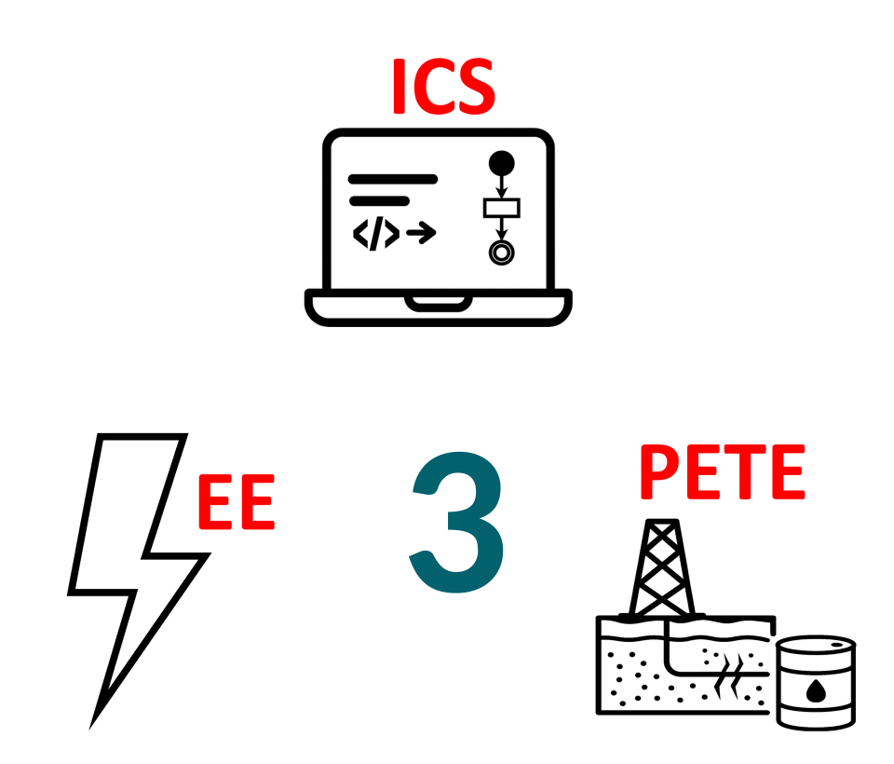
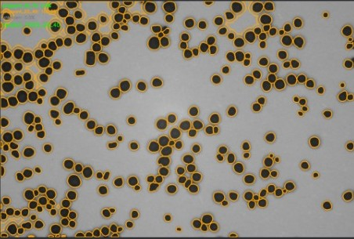
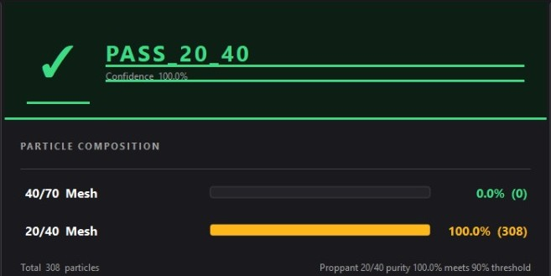
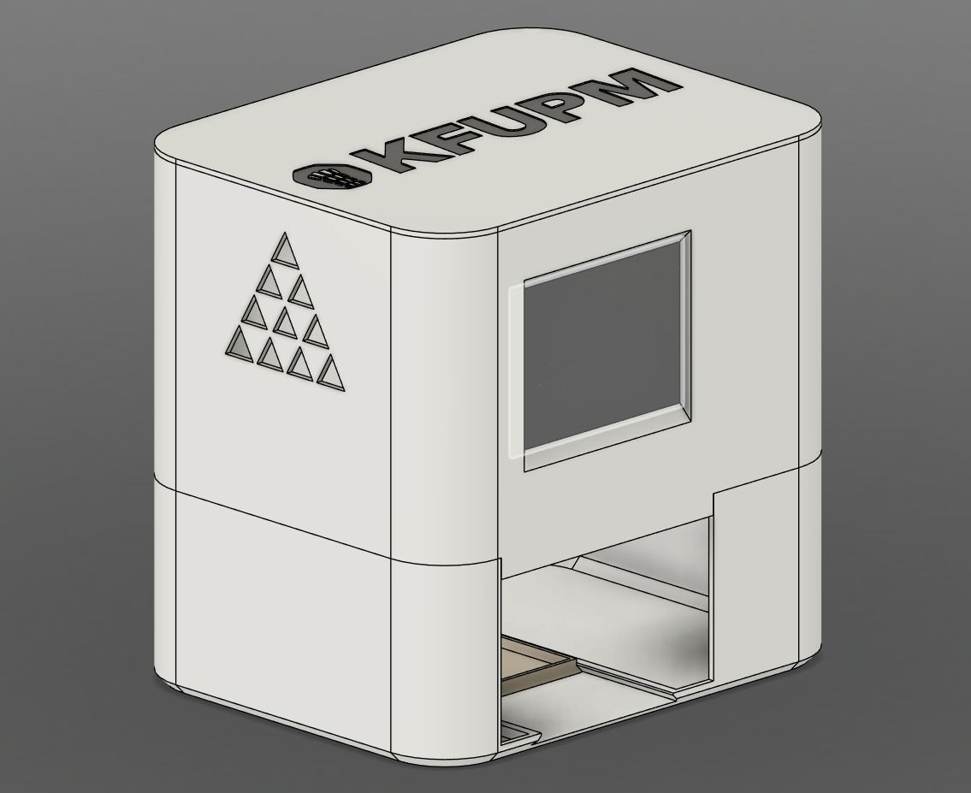
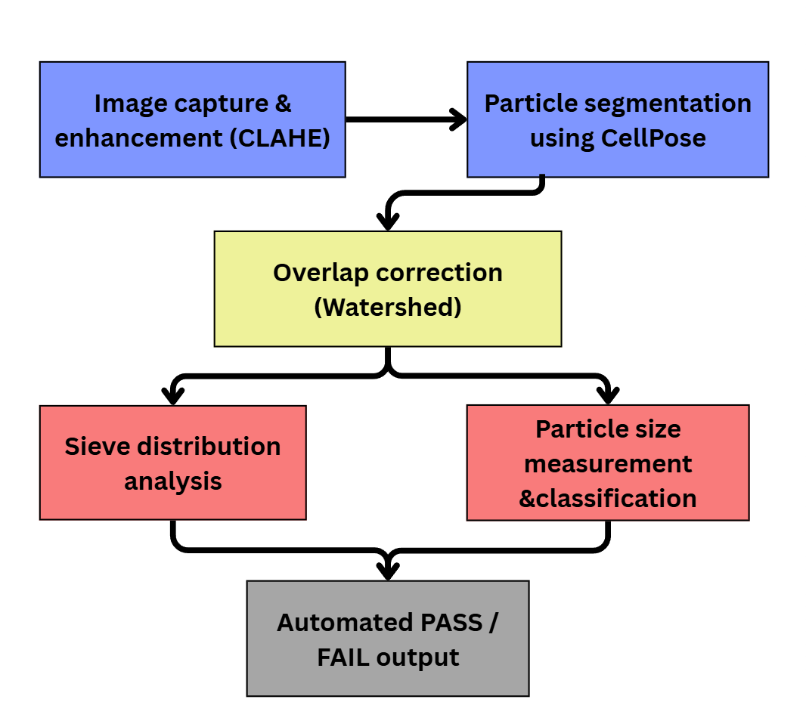
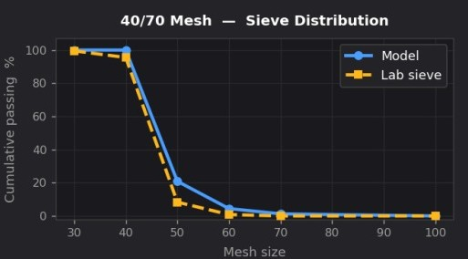
Automatic Classification of Proppant Using
Computer Vision
TEAM
M037
Abdullah Alsheddi, Malik Alharbi, Zyad Alyahya, Mohammed Alghamdi, Ahmed Areshi, Faisal Alshalan
Coach: Dr. Naveed Iqbal
Problem & Solution:
Constraints & Specs
S1 | Total power <150 W
S2 | ≤±5% deviation from sieve analysis
S3 | 110–220 VAC input
S4 | API RP 56/60/19C standard output
S5 | ≥90% pass/fail decision repeatability
S6 | Pass/fail issued only when ≥90% particles classified
S7 | ±10 wt% accuracy vs. lab sieve mass fractions
IS1 | Operating temperature <70°C
IS2 | Maintenance <2 actions/month
IS3 | End-to-end cycle time ≤20 s
IS4 | Auto-logging with ≥32 GB storage
Validation
Problem Statement
Manual sieve analysis takes at least 10 minutes per sample and cannot support real-time field decisions, risking injection of off-spec proppant that degrades fracture conductivity.
C1 | Classify ≥90% of particles with ≤10% mean size error
C2 | IEC-safe insulated enclosure
C3 | Daily energy usage ≤3.6 kWh
C4 | IEEE electrical compliance
C5 | Weight ≤20 kg (portable)
C6 | IP54-equivalent dust protection
C7 | Footprint ≤50×40×40 cm
C8 | API RP 56/19C compliant size classification
Solution:
The project implements a classification device that combines:
•Controlled imaging (camera + LED)
•CV algorithms for segmentation
•Diameter calculation and API classification logic
•Embedded processing for real-time analysis
The system captures a sample, processes particle data, and outputs a PASS/FAIL decision within seconds.
Prototype Design
Model Pipeline
Conclusion
Successfully classifies proppant according to
API RP 19C.
Provides results in less than 20 seconds.
Consumes only 16 W and weighs 2.6 kg.
Achieves ≥90% particle classification accuracy.
Maintains ≤10% size error, validated against sieve analysis.
Replaces a 10-step manual process with real-time and objective field QC.
Total system cost is under 7,000 SAR.

