Slide 1
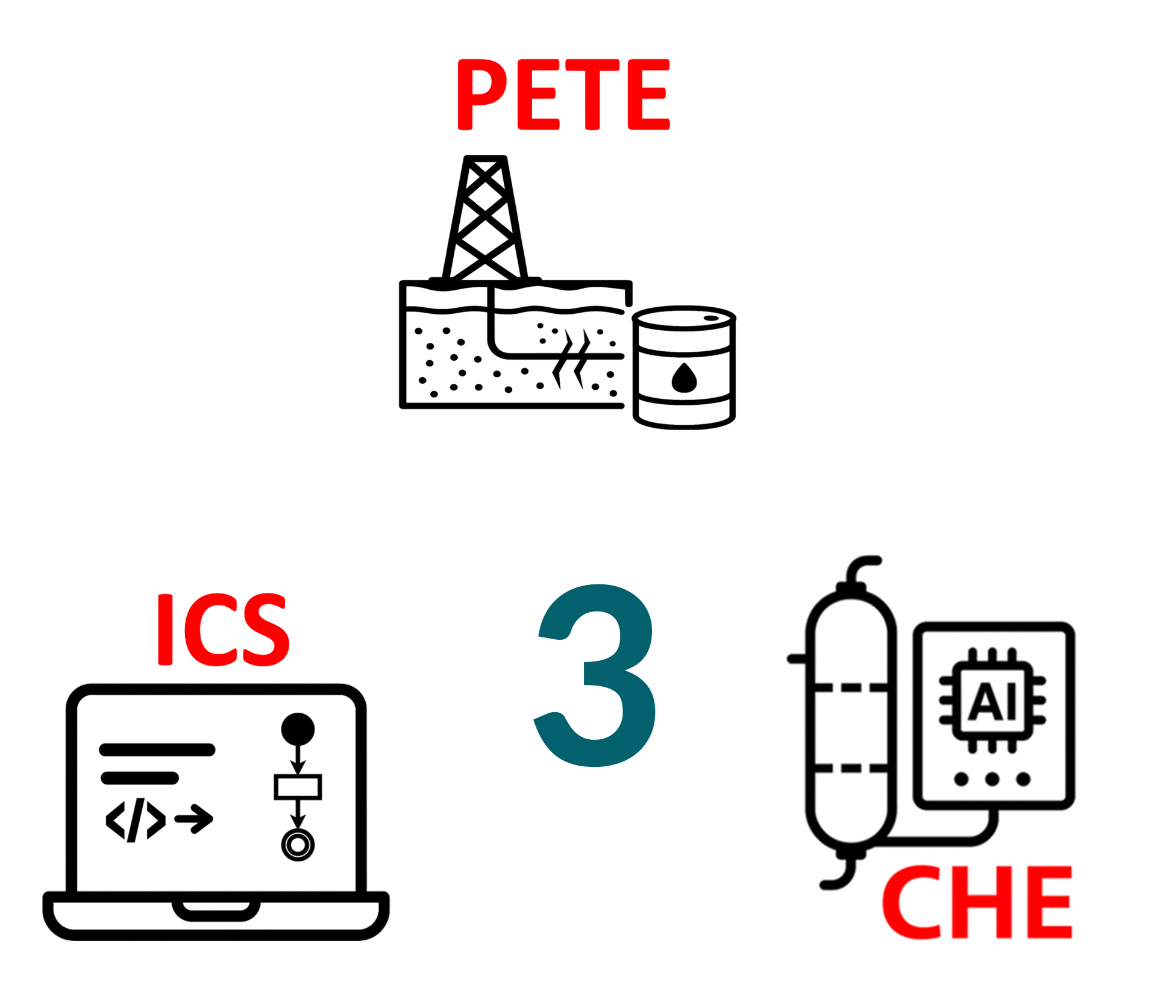
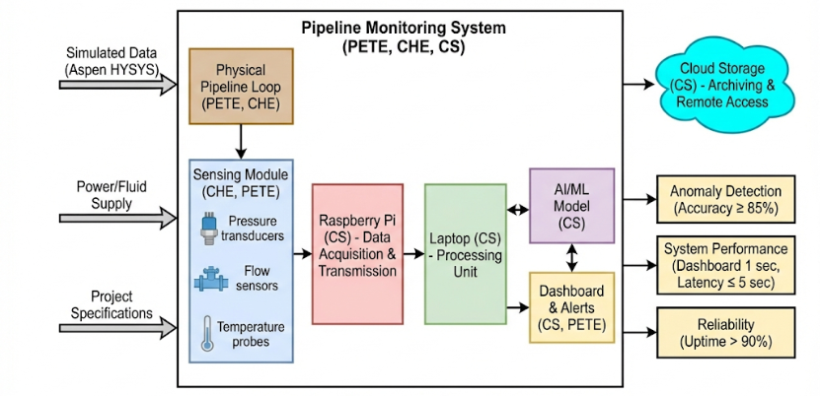
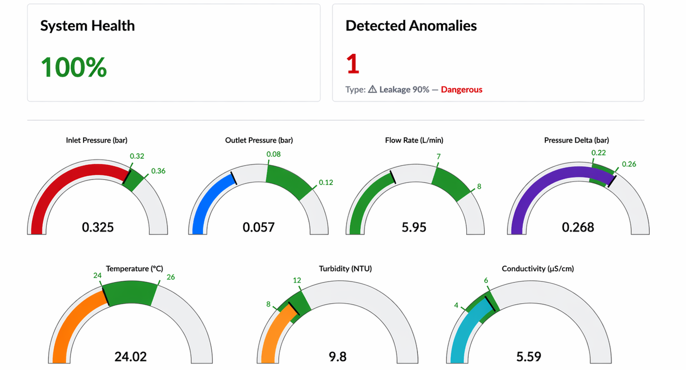
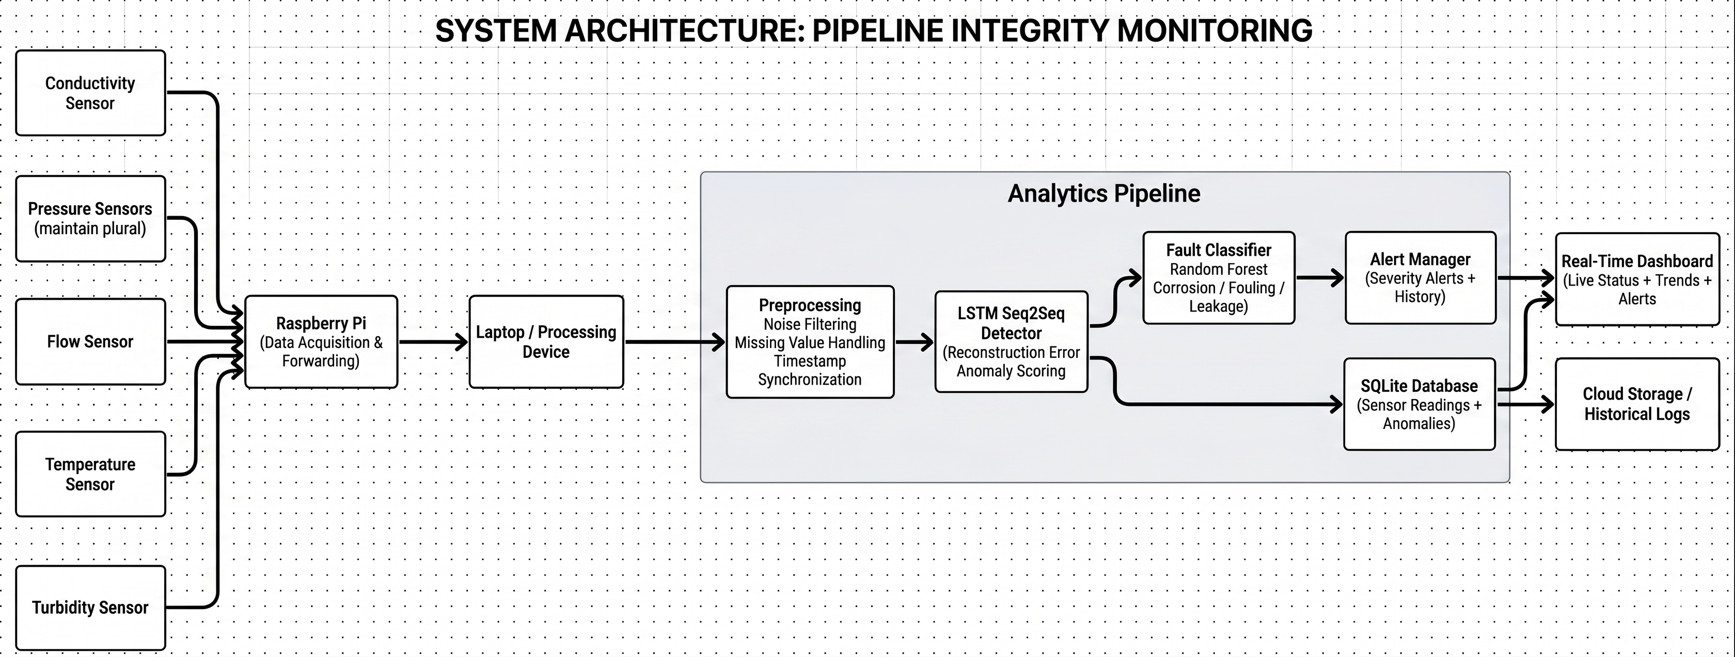
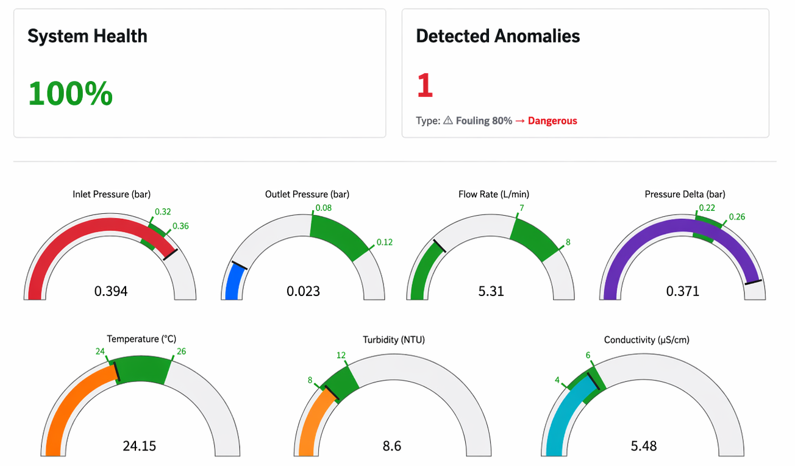
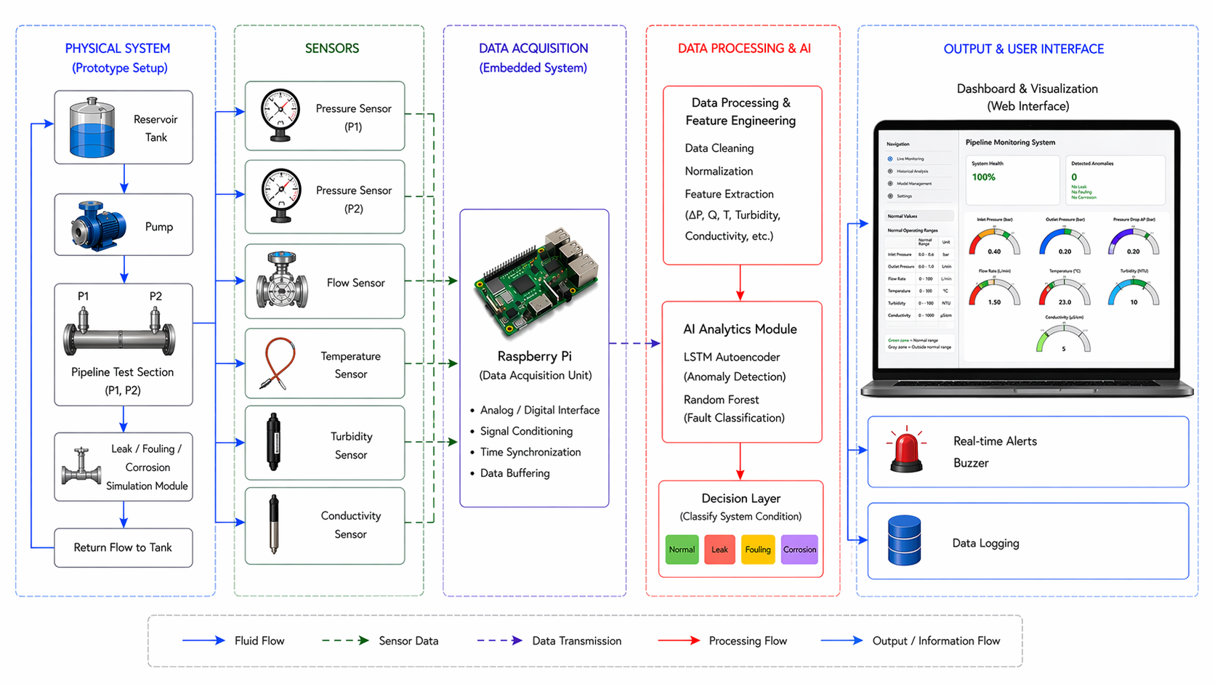
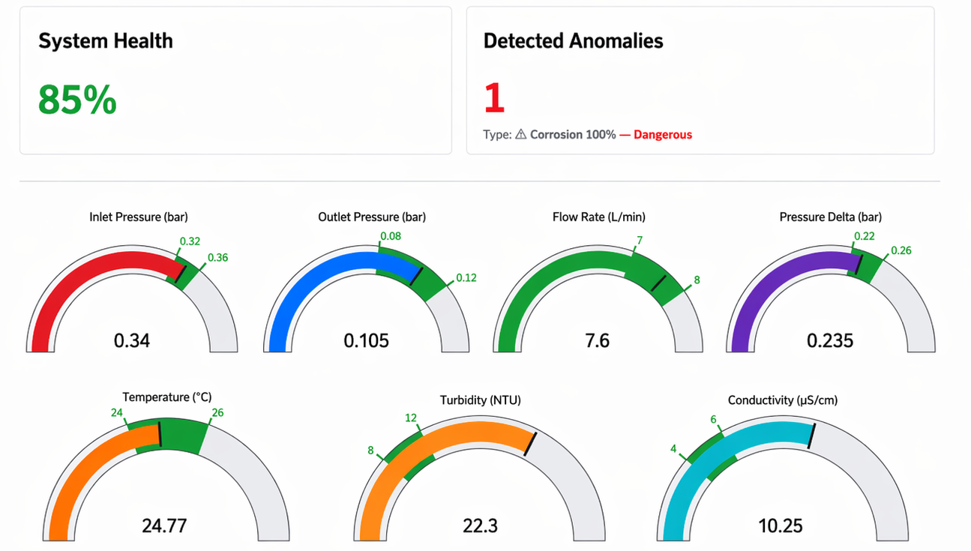

Pipeline AI Anomaly Detection system
TEAM
M035
Talal Alotaibi, Naif Alotaibi, Aseel Harbi, Wathiq Theyab, Abdualaziz Alarifi, Rakan Alulyan
Coach: Mansour Alharthi
Background
Prototype Design
Testing & Validation
Conclusions
Problem Statement
Block Diagram
Leak Simulation:
Simulated using three-way valve (flow diversion)
Summary
Pipelines are critical for transporting energy and chemical resources, but leaks, corrosion, and fouling can lead to environmental disasters, significant financial losses, and safety hazards. Current detection methods are often reactive or lack precision.
Team M35 successfully designed, built, and tested a prototype of the Pipeline AI Anomaly Detection System. The integrated hardware and machine learning model accurately detected and categorized common pipeline anomalies like leaks and blockages in real-time.
Constraints
System Architecture
Flow Restriction (Blockage/Fouling):
Controlled via flow control unit
Impact
Simulated data only due to lack of access to real pipelines
This low-cost system demonstrates a scalable approach for enhancing pipeline safety, reducing risks, and minimizing operational downtime in the energy and water transportation sectors.
Laboratory safety limits on pressure, temperature, and electrical systems
Limited dataset diversity across crude compositions and fault scenarios
Specifications
Final Form
Future Work
Corrosion Simulation:
Simulated via sensor data (conductivity & turbidity)
Integration of solar power and independent communication for true remote field deployment.
Testing on a larger, pressurized pipeline system with a wider range of fluids.
Refining the AI model with larger datasets for even higher accuracy across diverse conditions.
Anomaly detection accuracy ≥ 85%
Data acquisition interval ≤ 15 seconds
Dashboard update interval ≤ 1 second
Operational cost reduction ≥ 20%
Sensor accuracy ≥ 80%
Cloud data storage capacity up to 250 GB
ML model latency ≤ 5 seconds
Corrosion early detection accuracy ≥ 85%
System uptime ≥ 90%

