Slide 1
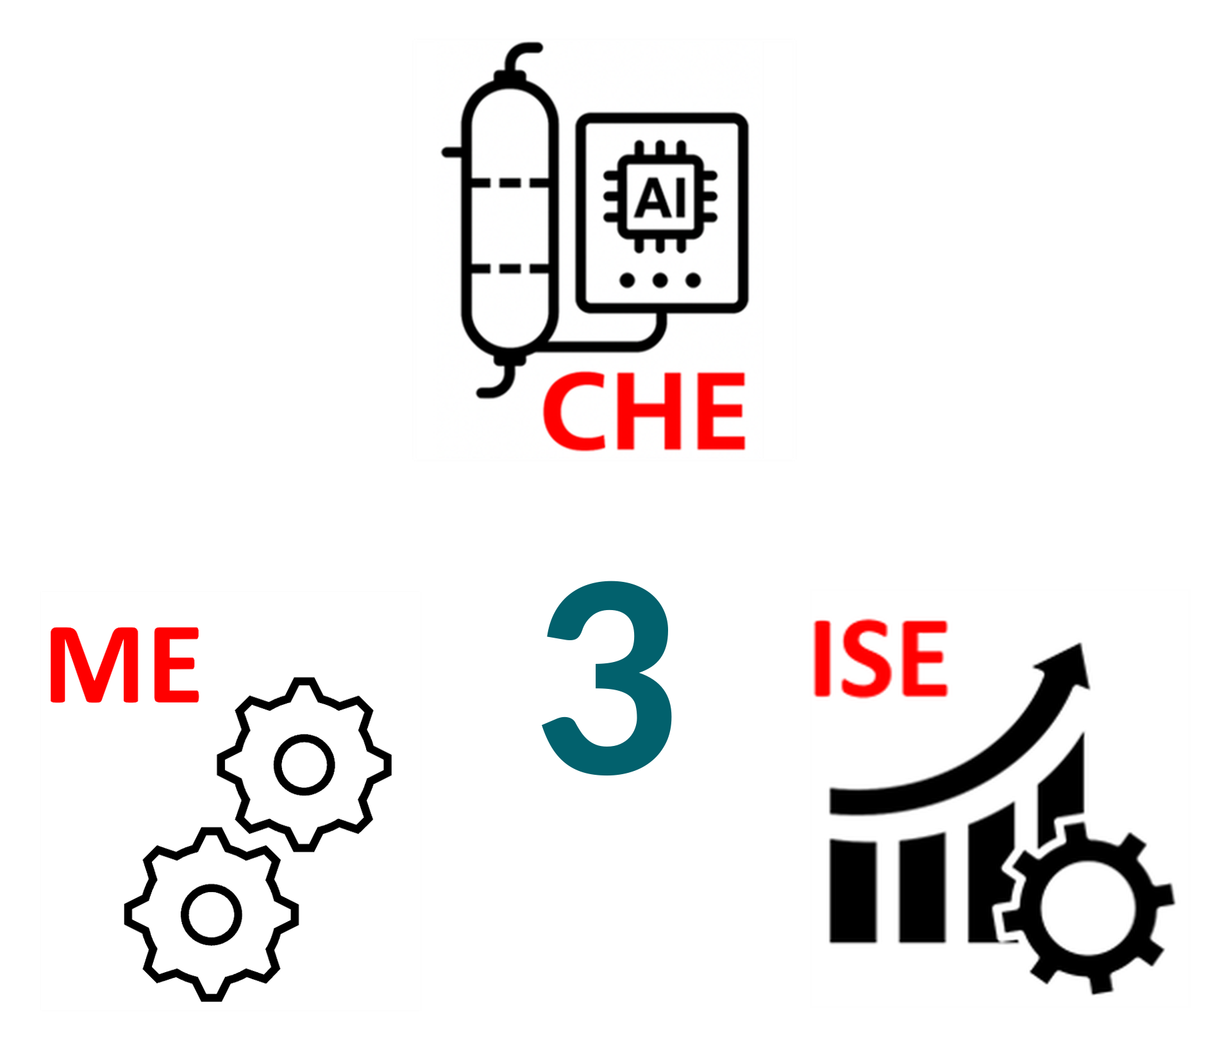
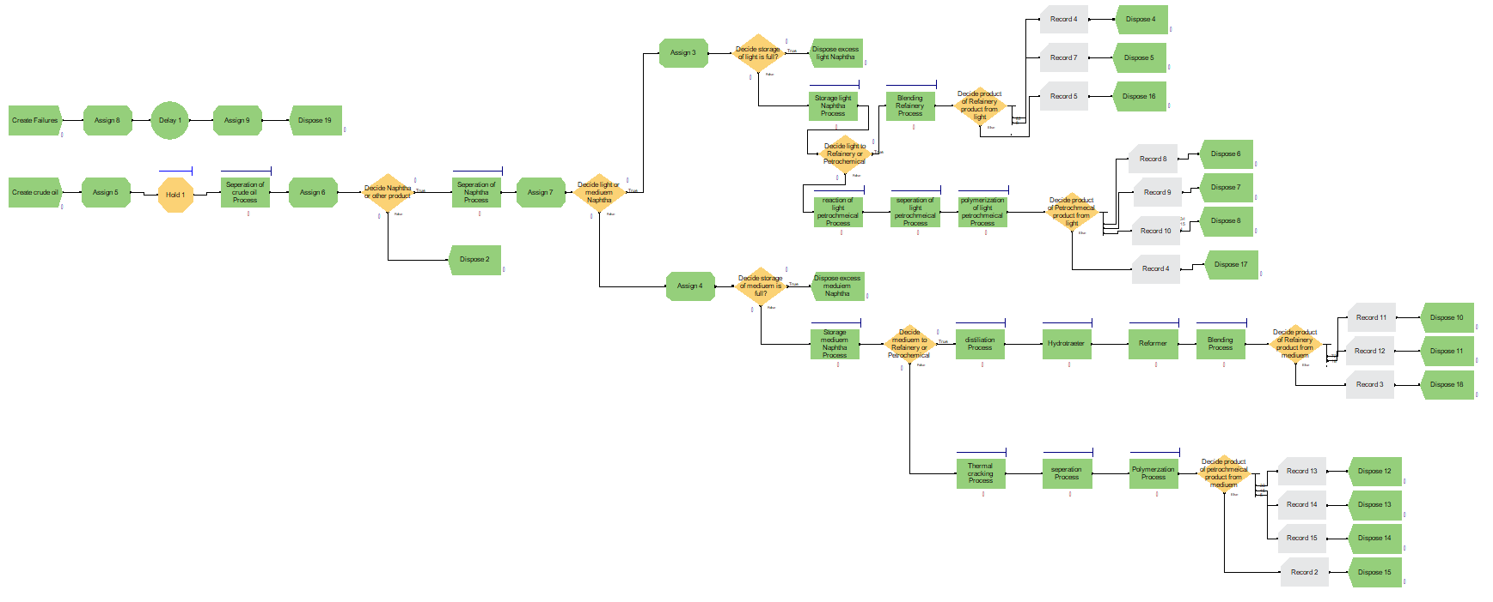
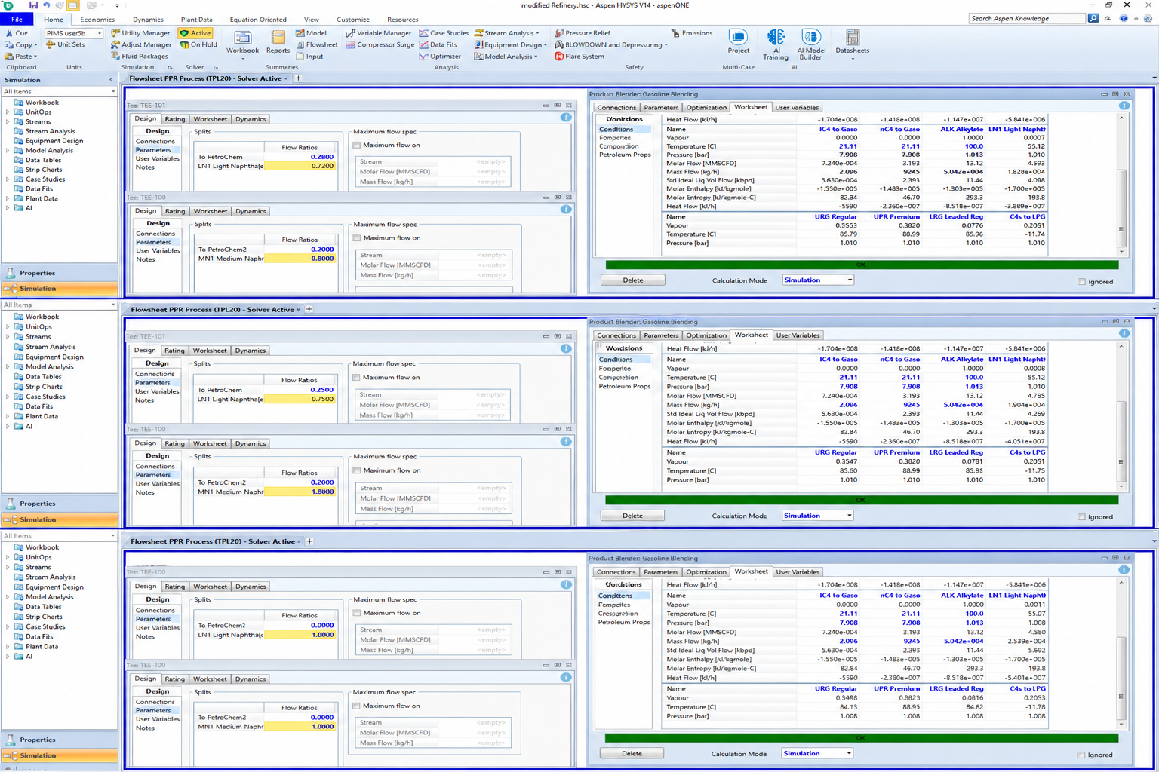
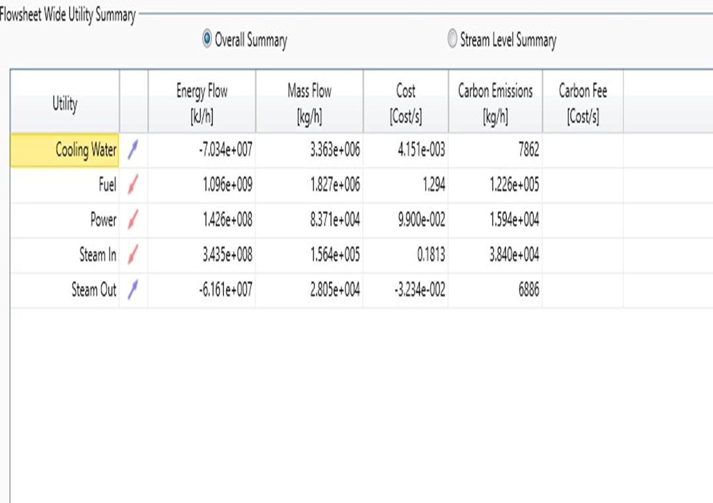
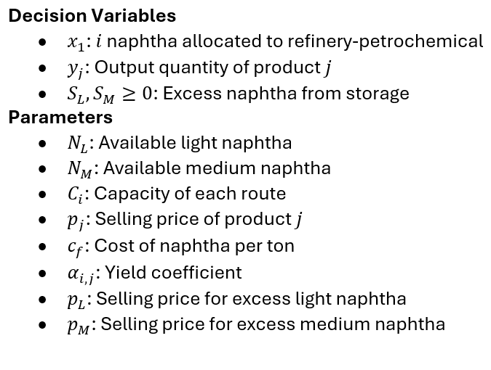
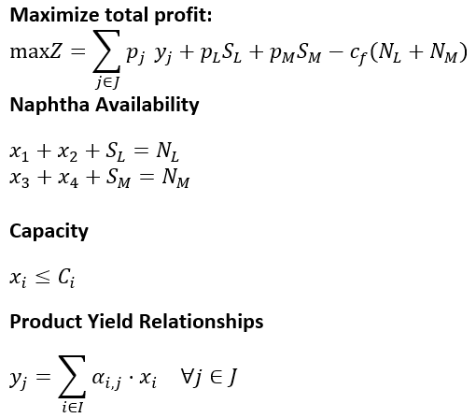
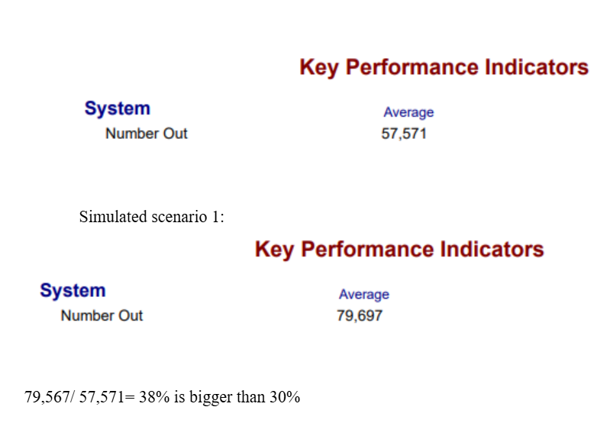
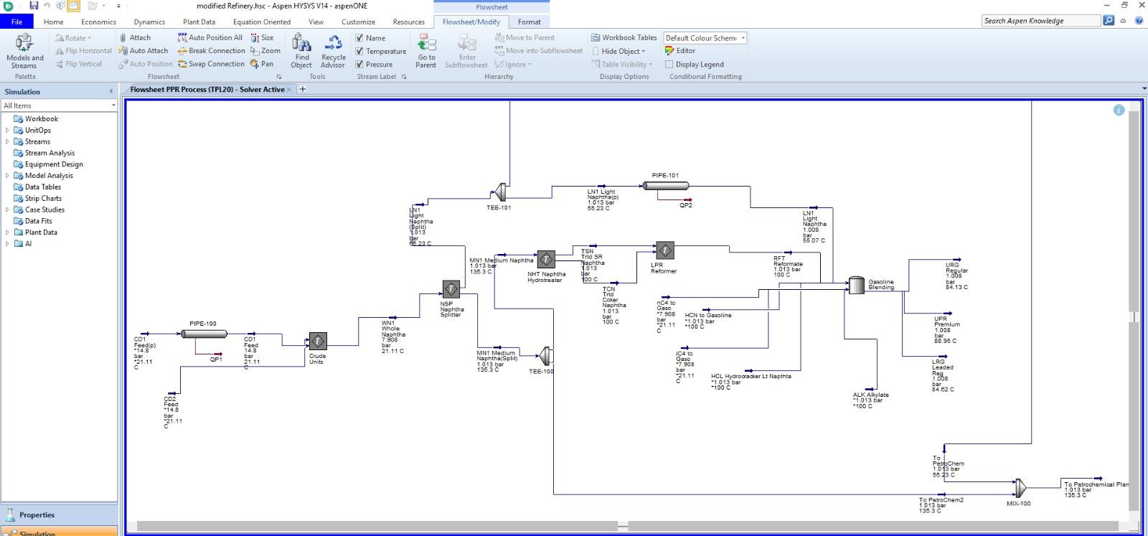
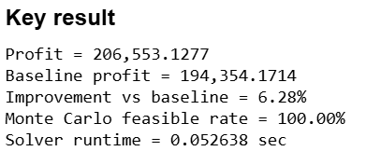
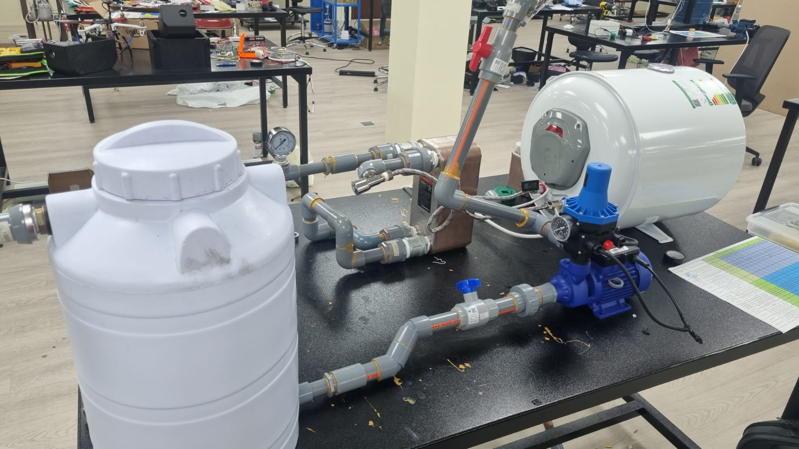
Optimizing Naphtha Allocation Between Refinery and Petrochemical Units
TEAM
M031
INSERT HERE The Multi-Disciplinary Strength logo
Redha Helal, Basam Al-Ahmed, Sohaib Al-Ghamdi , Faisal Al-Sarrar, Sajad Al-Habib, Mohammed Al-khazal
Coach: Dr.Ali Elkhazraji
Introduction / Background
Specifications
ARENA:
Testing / Validation
Integrated refinery–petrochemical systems share feedstocks like naphtha, where allocation decisions strongly affect profitability, energy efficiency, and operations. These systems also operate in dynamic environments with fluctuating market prices and changing process conditions.
Product yield variation: ≤ ±3%
CO₂ emissions: ≤ 0.25 t/ton feedstock
Heat exchanger capacity: 155,000 BTU
Furnace outlet temperature: 70°C
Pipe diameter: 1-inch PVC
Material: Stainless Steel
Profit improvement: ≥ 3%
Arena : 30% performance improvement
Optimization runtime: ≤ 5 min
System availability: ≥ 98%, throughput fluctuation: ≤ 2%
Energy cost reduction: ≥ 7% per ton feedstock
Model prediction accuracy: ≤ ±5%
Problem Statement
Static feedstock allocation methods cannot adapt to market changes or fully consider process and capacity constraints, leading to inefficient energy use, lower profitability, and suboptimal decisions.
Optimization Model:
Objectives
Prototype Design
Maximize overall profitability
Improved Energy efficiency
Enhanced operational feasibility
Develop simulation for making decision
Aspen HYSYS
Physical Prototype:
Constraints
T 20-450°C, P 1-30 bar
Sensor accuracy: ≤ 5% error
Piping efficiency: ≤ 5% loss across pipes
Heat exchanger effectiveness: ≥ 85%
Optimization model feasibility: ≥ 98% across all scenarios
Conclusions
An integrated optimization–simulation framework was developed, improving economic performance, energy efficiency, and operational feasibility under dynamic conditions.

