Slide 1

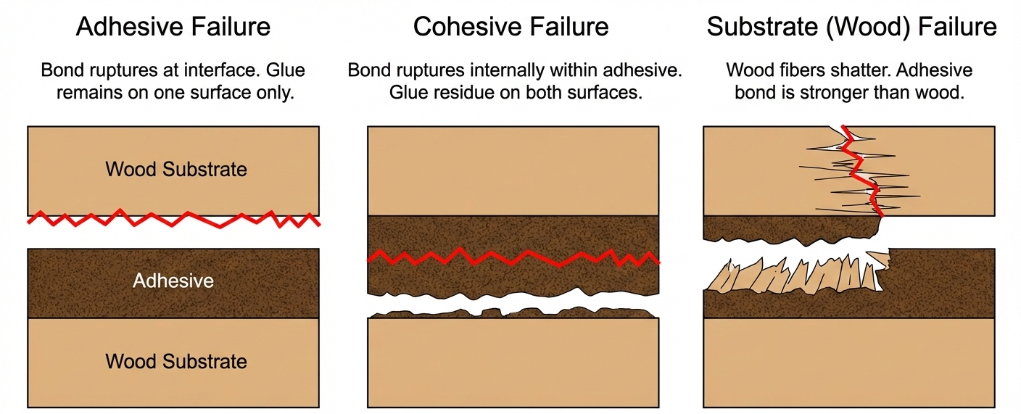
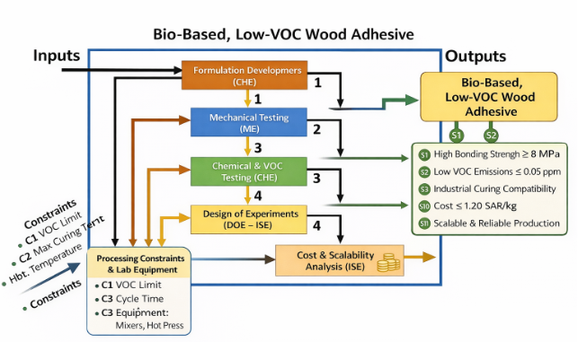
Low-VOC Bio-Based Wood Adhesives Using Natural Polymers
TEAM
M030
INSERT HERE The Multi-Disciplinary Strength logo
Anas AlSulaim (ME), Abdullah AlShammary (ME), Abdullah Althunayyan (ISE), Hamad Alabdulhadi (ISE), Yousef Mahrous (CHE), Abdulrahman AlQahtani (CHE)
Coach: Dr. Ali Elkhazraji
Introduction
Constraints & Specifications
Multidisciplinary Design
Validation & Results
Elevator Pitch
Formaldehyde-based wood adhesives are cheap and strong, but they are highly toxic and derived from depleting fossil fuels. We engineered a 100% bio-based alternative using a synergistic blend of Lignin, Tannin, and Casein. Our design acts as a "drop-in“ replacement for existing factory lines, delivering industrial-grade strength with zero toxic emissions.
Problem Statement
Health & Environment: Conventional Urea-Formaldehyde (UF) resins emit carcinogenic VOCs, endangering factory workers and failing strict indoor air quality standards (E0/E1).
The Gap: Current "green" adhesive alternatives suffer from poor water resistance, weak structural integrity, or slow curing times, making them unviable for mass industrial manufacturing.
Project Objectives
Develop a renewable wood adhesive matrix (Lignin-Tannin-Casein).
Eliminate toxic VOC emissions while maintaining structural integrity.
Ensure drop-in compatibility with existing hot-press machinery.
Hard Constraints (Must Pass):
Safety: VOC Emissions ≤ 0.05 ppm (EPA / E0 compliance).
Process: Maximum Curing Temp ≤ 150°C.
Compatibility: Must use existing roll-spreaders and hot-presses (no CAPEX required).
Target Specifications
(CHE): Formulation & Safety
Formulated the biopolymer matrix.
Verified VOC emissions inside a sealed environmental chamber.
(ME): Curing & Structural Mechanics
Optimized thermal curing kinetics using 1-D transient heat transfer to ensure the core reached 120°C activation without scorching the wood.
Conducted destructive shear testing utilizing a Universal Testing Machine (UTM) per ASTM D905 standards.
(ISE): Optimization & Scalability
Applied Design of Experiments (DOE) to optimize mixing parameters.
Calculated batch cycle times (≤ 45 min) and industrial cost feasibility.
Performance vs. Specifications
Bond Strength: Achieved 8.03 MPa (± 0.21) — MET
VOC Emissions: < 0.01 ppm (Undetectable) — MET
Viscosity: 3933 cP (Perfect spreadability) — MET
Curing Cycle: 9.5 minutes at 150°C — MET
Cost: $1.14 / kg — MET
Failure Modes
Metric | Target Value
Bond Strength | ≥ 8.0 MPa
Water Resistance | ≥ 70% Retention
Curing Time | ≤ 10 min
Viscosity | 3000 – 5000 cP
Production Cost | ≤ $1.20 / kg
Conclusions
This project successfully balances mechanical performance, economic feasibility, and public safety. By eliminating formaldehyde, we protect workers and end-users while providing the wood panel industry with a scalable, sustainable material.

