Slide 1
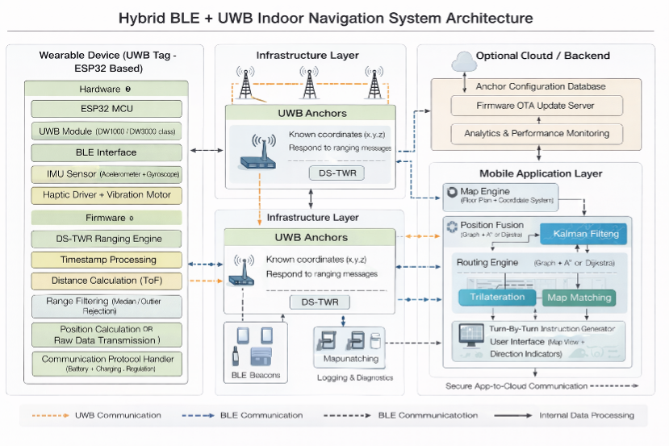
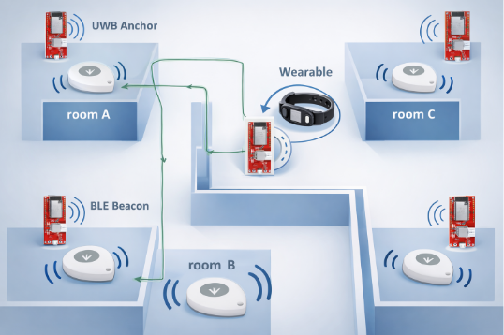
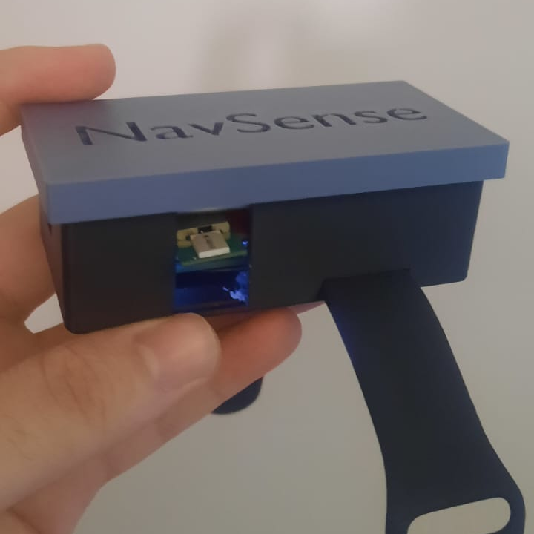
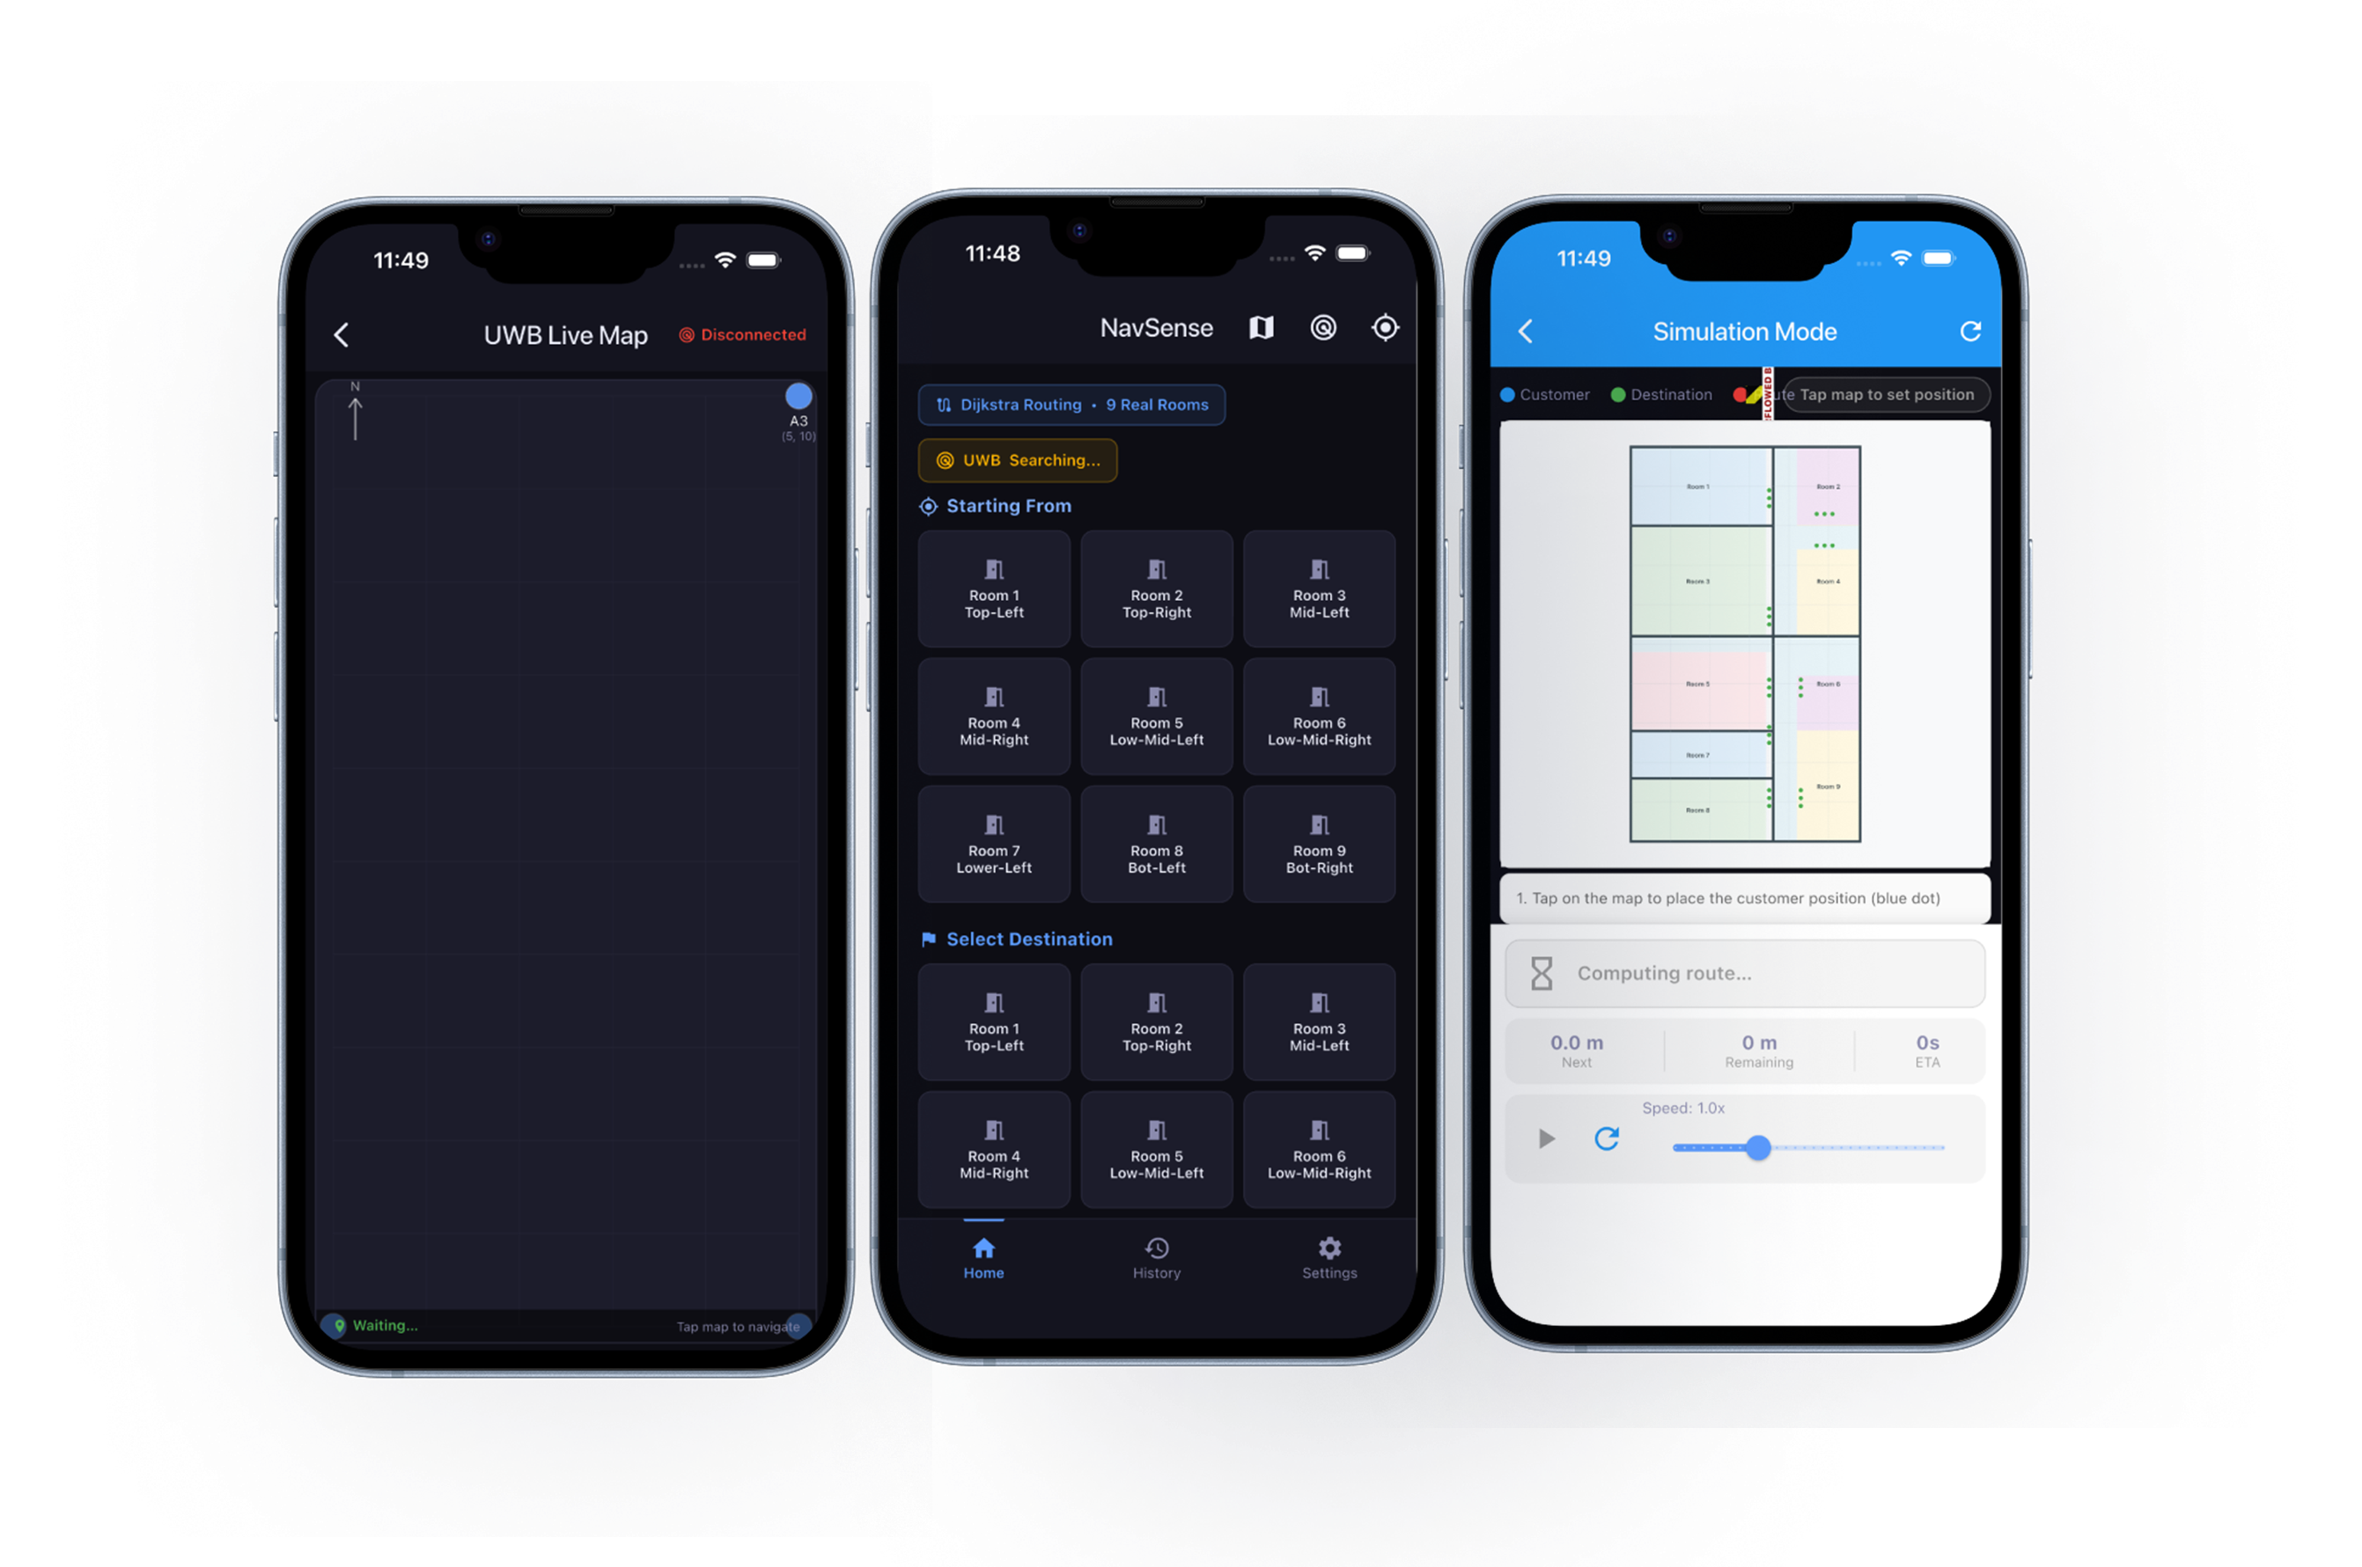
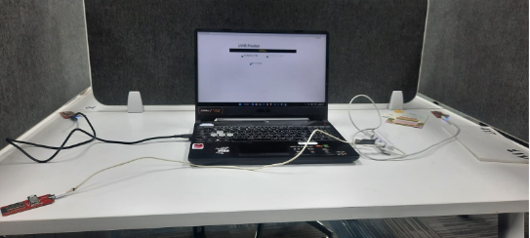
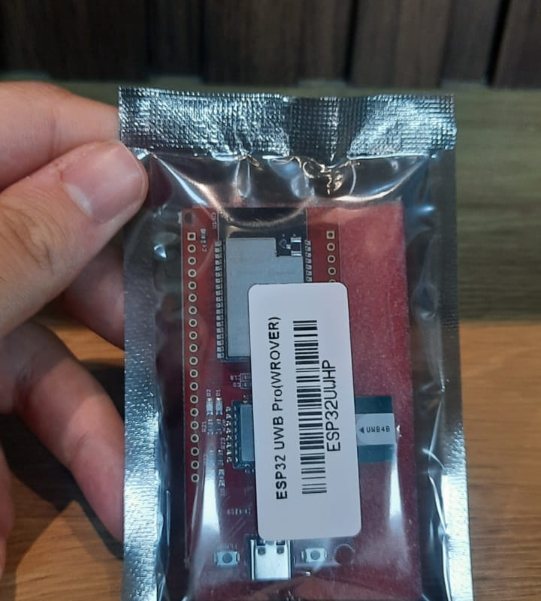
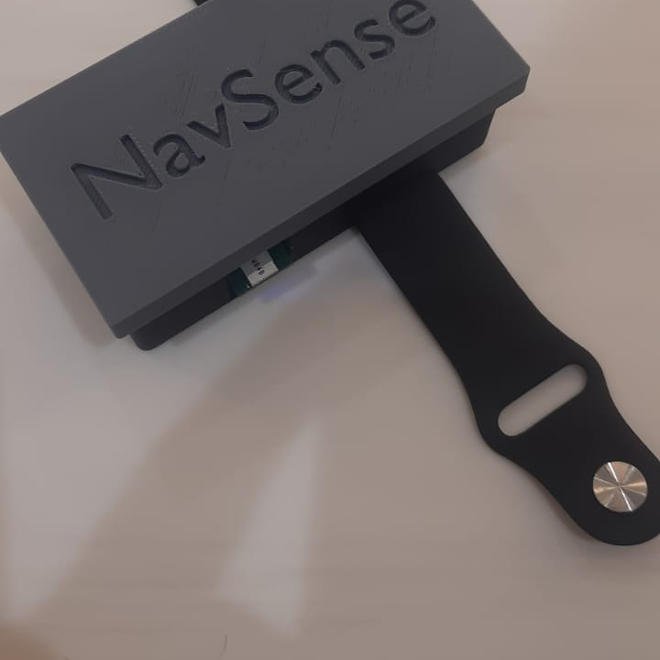
TEAM
NavSense: Indoor Navigation System with Haptic Wearable
4
029
Nawaf Alharthi (SWE) · Mohammed Alsheqaih (SWE) · Omar Ben Mansour (COE) · Mohammad Al Hareky (ISE) · Anas Alqahtani (ISE) · Muwaffaq Alwusaybie (EE)
2× SWE · 2× ISE
1× COE · 1× EE
Coach: Dr. Naveed Iqbal
Introduction & Problem
Solution — Hybrid BLE + UWB System Architecture
Key Design Features
Indoor navigation in GPS-denied buildings is a critical accessibility gap. Per GASTAT 2023, 21.8% of severely disabled individuals in Saudi Arabia have visual impairments and spend 80–90% of their time indoors.
Existing Wi-Fi/BLE-only systems give meter-level accuracy (2–15 m) with >500 ms latency — too coarse for safe step-by-step guidance. Visually impaired users need a low-latency wearable that delivers directional indoor guidance without visual or auditory attention.
INPUTS: BLE Beacons + UWB Anchors + IMU
▼
Hierarchical Localization
BLE narrows the zone → UWB delivers ≤ 0.5 m precision via two-way time-of-flight ranging
Safety Logic
Confidence gating, automatic re-routing, and deterministic decisions for identical inputs
▼
Directional Haptics
Four motors at 90° offsets — sequential vibration delivers Left, Right, Forward, Stop & Alert cues
▼
Figure 2: BLE beacons identify zones; UWB anchors deliver sub-half-meter ranging; mobile app fuses data and streams haptic commands to the wearable.
OUTPUT: Eyes-free, ears-free guidance
Figure 1: GPS-denied multi-room indoor environment.
Constraints & Specifications
Validation & Verification
Conclusions
ID | Requirement | Target
Constraints
C-1 | Wireless updates to wearable | BLE only
C-2 | Single-floor test area | ≤ 1,000 m²
C-3 | ESP32 firmware memory | ≤ 4 MB flash
C-4 | Mobile UI accessibility | WCAG 2.1 AA
Specifications
S-1 | Localization update rate | ≥ 2 Hz
S-2 | Wearable mass | ≤ 200 g
S-3 | Shortest-path routing | No revisits
S-4 | Bilingual UI | EN + AR (RTL)
S-5 | Battery life | ≥ 4 hours
S-6 | Signal re-acquisition | ≤ 10 s
S-7 | Haptic command latency | ≤ 500 ms
Integrated Specifications
I-1 | E2E haptic latency at 200 users | ≤ 200 ms
I-2 | System availability | ≥ 95%
I-3 | Pedestrian counting accuracy | ≥ 85%
Specification | Required | Measured | Status
Battery life | ≥ 4 h | 4.17 h | PASS
Haptic latency | ≤ 500 ms | 42.57 ms | PASS
Signal re-acquisition | ≤ 10 s | 5.2 s | PASS
Localization rate | ≥ 2 Hz | 10 Hz (UWB) | PASS
Wearable mass | ≤ 200 g | 99.0 g | PASS
WCAG 2.1 AA | All criteria | 18/18 (100%) | PASS
End-to-end latency | ≤ 200 ms | 142 ms (P99) | PASS
Sub-meter accuracy with sub-200 ms latency
Hybrid BLE + UWB achieved 0.27 m mean error and 142 ms P99 latency, exceeding the ≤ 0.5 m and ≤ 200 ms targets.
Practical, all-day usability
Wearable mass measured at 76.3 g (vs. ≤ 200 g target) with 4.17 h battery life — non-visual, low cognitive-load directional haptics.
UWB live test
ESP32 + DW1000
Wearable prototype
Verified across all four disciplines
18/18 WCAG 2.1 AA criteria met and all EE specifications passed verification — a layered, scalable, energy-efficient architecture.

