Slide 1
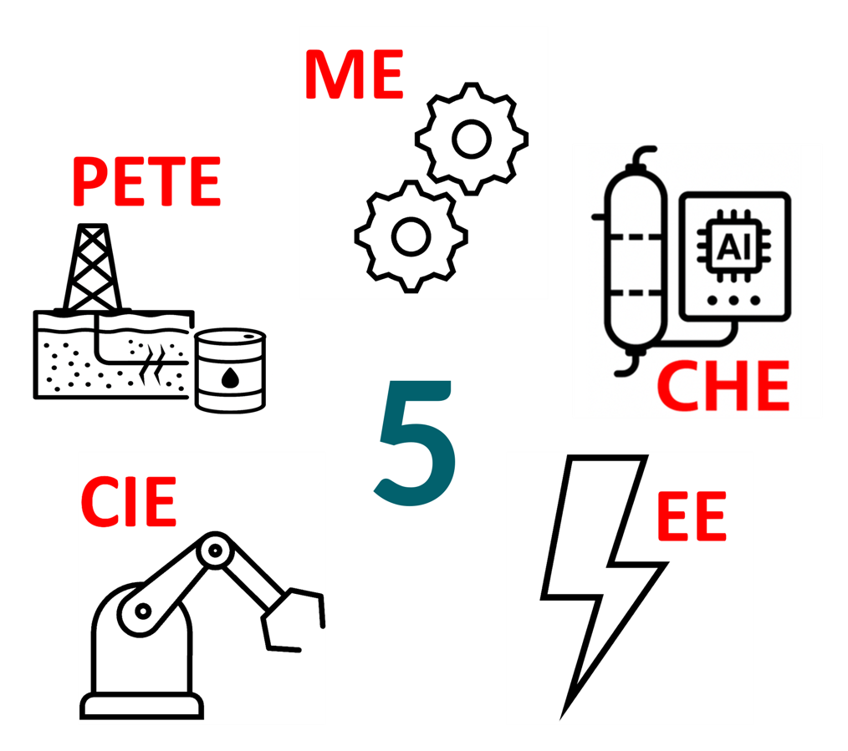
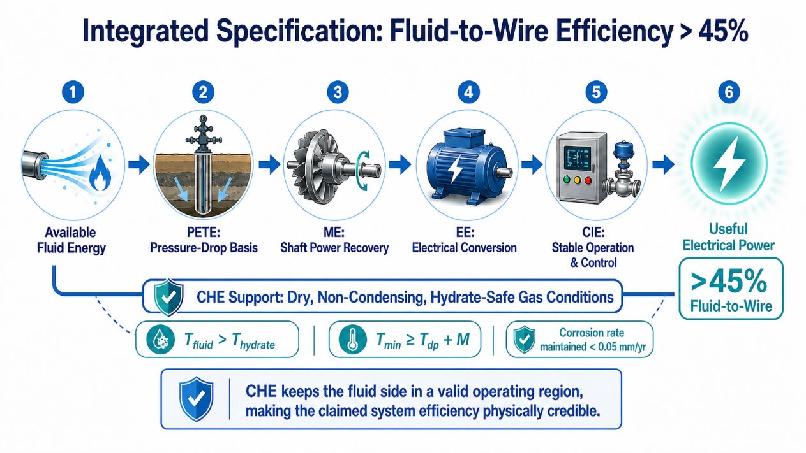
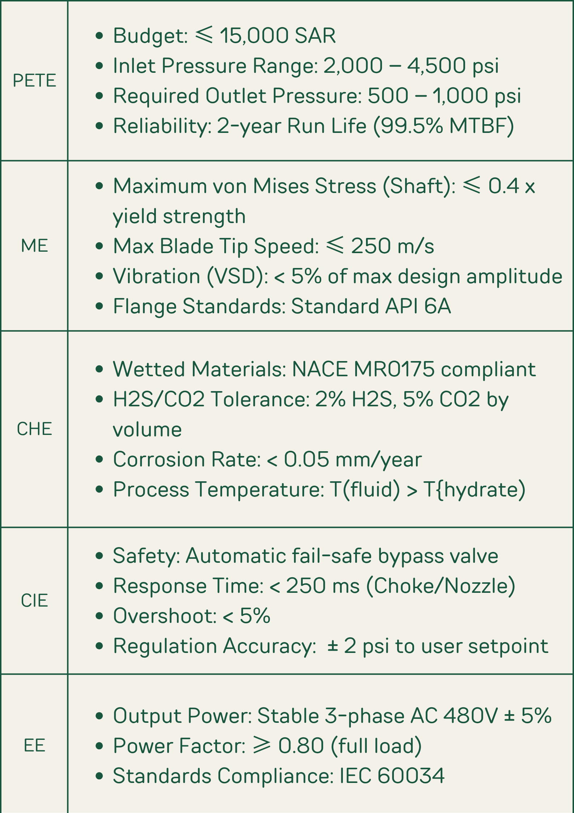
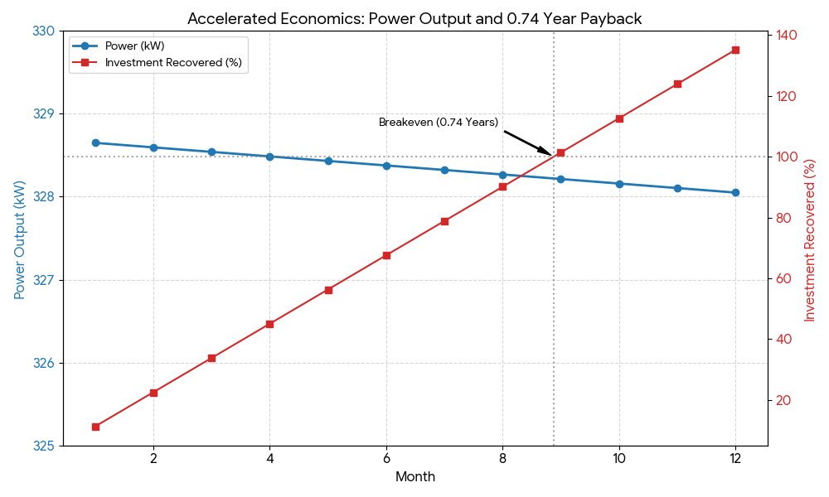
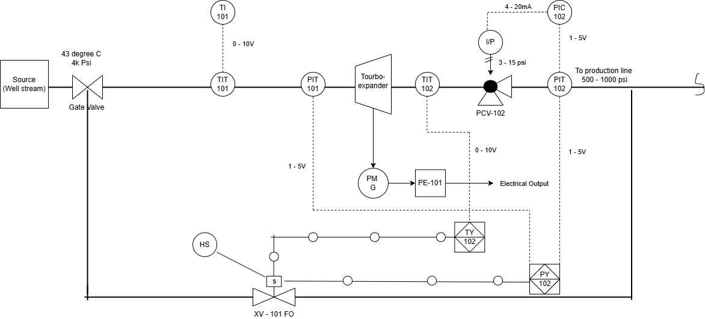


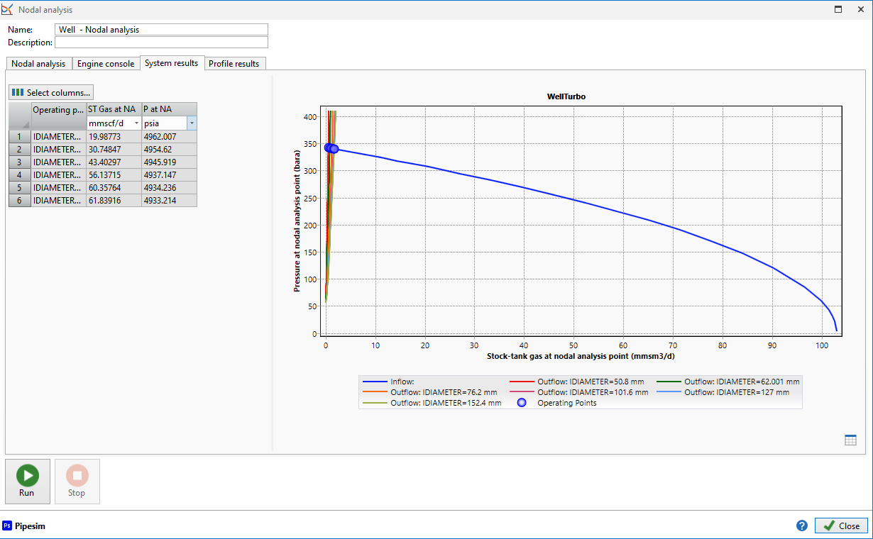
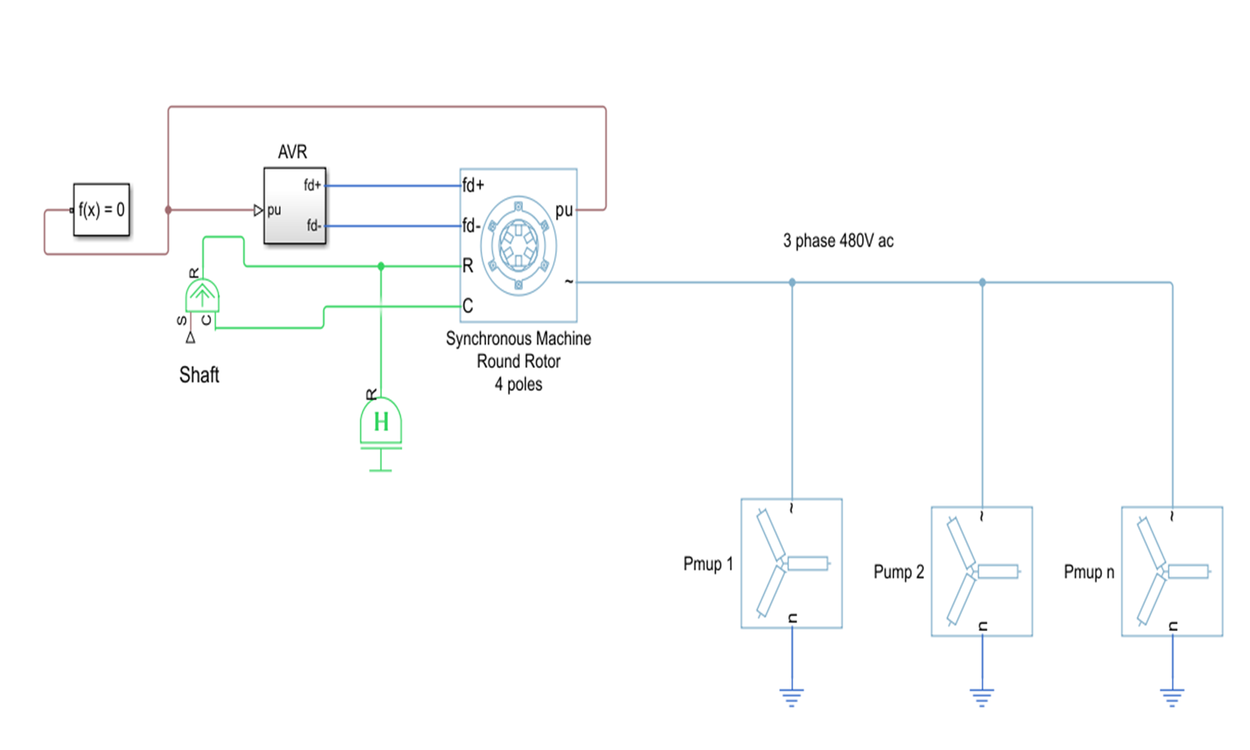
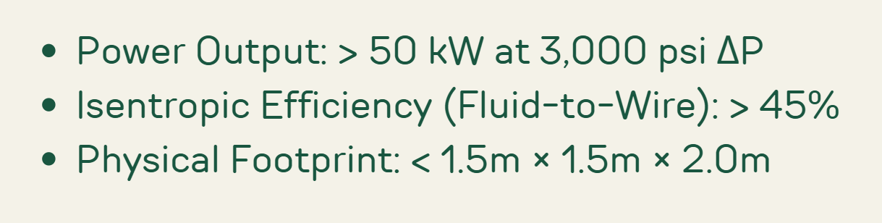
Development of a Regenerative Turbochoke System for Autonomous Wellsite Power Generation in High-Pressure Gas Wells
TEAM
M023
MUATH ZENNI, ABDULAZIZ MUNTHIRI, AHMED ALGHOMLAS, RAIAN ALAMRANI, MOHSEN ALMALKI, SAJJAD ALMAHMOUD
Coach: Dr. AHMED MAHMOUD
Introduction
Prototype Design
Constraints and Specifications
Testing and Validation
This project develops a Regenerative Turbochoke System that converts the pressure drop in high-pressure natural gas wells into autonomous electrical power, reducing the reliance on external power grids and making a sustainable, self-powered solution for remote wellsites.
The designed prototype was tested using gas production data for one year
The Overall Design
Problem Statement
Traditional natural gas wells have choke valves that dissipates high pressure as wasted heat and noise, while requiring external power for site instrumentation.
Power vs Time
The most striking result of EFA is the Payback Period of 0.74 years.
The Control System
Conclusion
The Regenerative Turbochoke System successfully met its goals, and it demonstrates that wasted pressure at the wellhead can be transformed into a reliable, autonomous power source, reducing the operational costs and carbon footprint of remote high-pressure gas wells.
Integrated Specifications
The Nodal Analysis Including RTS
The Power Generation System

Slide 2
Development of a Regenerative Turbochoke System for Autonomous Wellsite Power Generation in High-Pressure Gas Wells
TEAM
M023
MUATH ZENNI, ABDULAZIZ MUNTHIRI, AHMED ALGHOMLAS, RAIAN ALAMRANI, MOHSEN ALMALKI, SAJJAD ALMAHMOUD
Coach: Dr. AHMED MAHMOUD
Introduction
Prototype Design
Constraints and Specifications
Testing and Validation
This project develops a Regenerative Turbochoke System that converts the pressure drop in high-pressure natural gas wells into autonomous electrical power, reducing the reliance on external power grids and making a sustainable, self-powered solution for remote wellsites.
The designed prototype was tested using gas production data for one year
The Overall Design
Problem Statement
Traditional natural gas wells have choke valves that dissipates high pressure as wasted heat and noise, while requiring external power for site instrumentation.
Power vs Time
The most striking result of EFA is the Payback Period of 0.74 years.
The Control System
Conclusion
The Regenerative Turbochoke System successfully met its goals, and it demonstrates that wasted pressure at the wellhead can be transformed into a reliable, autonomous power source, reducing the operational costs and carbon footprint of remote high-pressure gas wells.
Integrated Specifications
The Nodal Analysis with RTS
The Power Generation System

Slide 3
Development of a Regenerative Turbochoke System for Autonomous Wellsite Power Generation in High-Pressure Gas Wells
TEAM
M023
MUATH ZENNI, ABDULAZIZ MUNTHIRI, AHMED ALGHOMLAS, RAIAN ALAMRANI, MOHSEN ALMALKI, SAJJAD ALMAHMOUD
Coach: Dr. AHMED MAHMOUD
Introduction
Prototype Design
Constraints and Specifications
Testing and Validation
This project develops a Regenerative Turbochoke System that converts the pressure drop in high-pressure natural gas wells into autonomous electrical power, reducing the reliance on external power grids and making a sustainable, self-powered solution for remote wellsites.
The designed prototype was tested using gas production data for one year
The Overall Design
Problem Statement
Traditional natural gas wells have choke valves that dissipates high pressure as wasted heat and noise, while requiring external power for site instrumentation.
Power vs Time
The most striking result of EFA is the Payback Period of 0.74 years.
The Control System
Conclusion
The Regenerative Turbochoke System successfully met its goals, and it demonstrates that wasted pressure at the wellhead can be transformed into a reliable, autonomous power source, reducing the operational costs and carbon footprint of remote high-pressure gas wells.
Integrated Specifications
The Nodal Analysis with RTS
The Power Generation System

