Slide 1




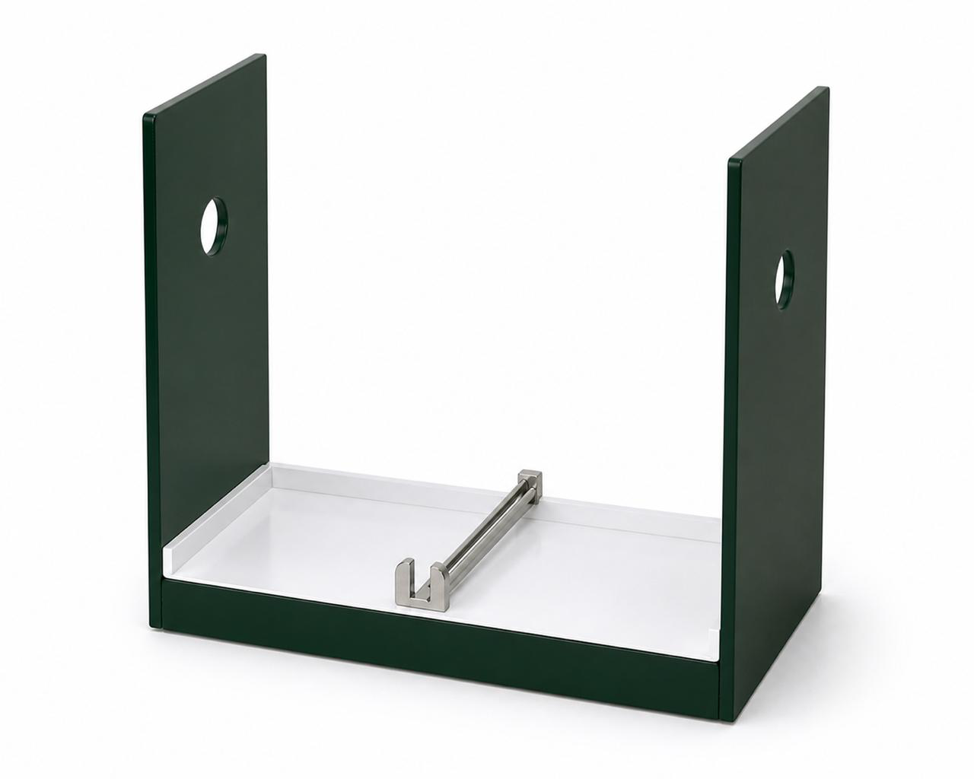
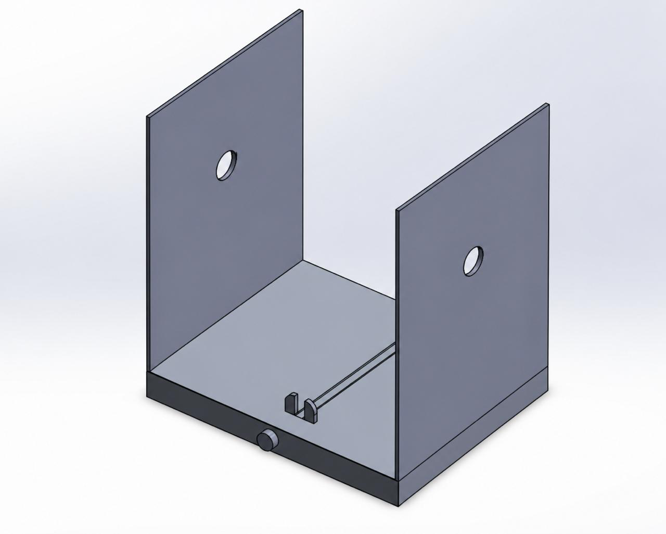

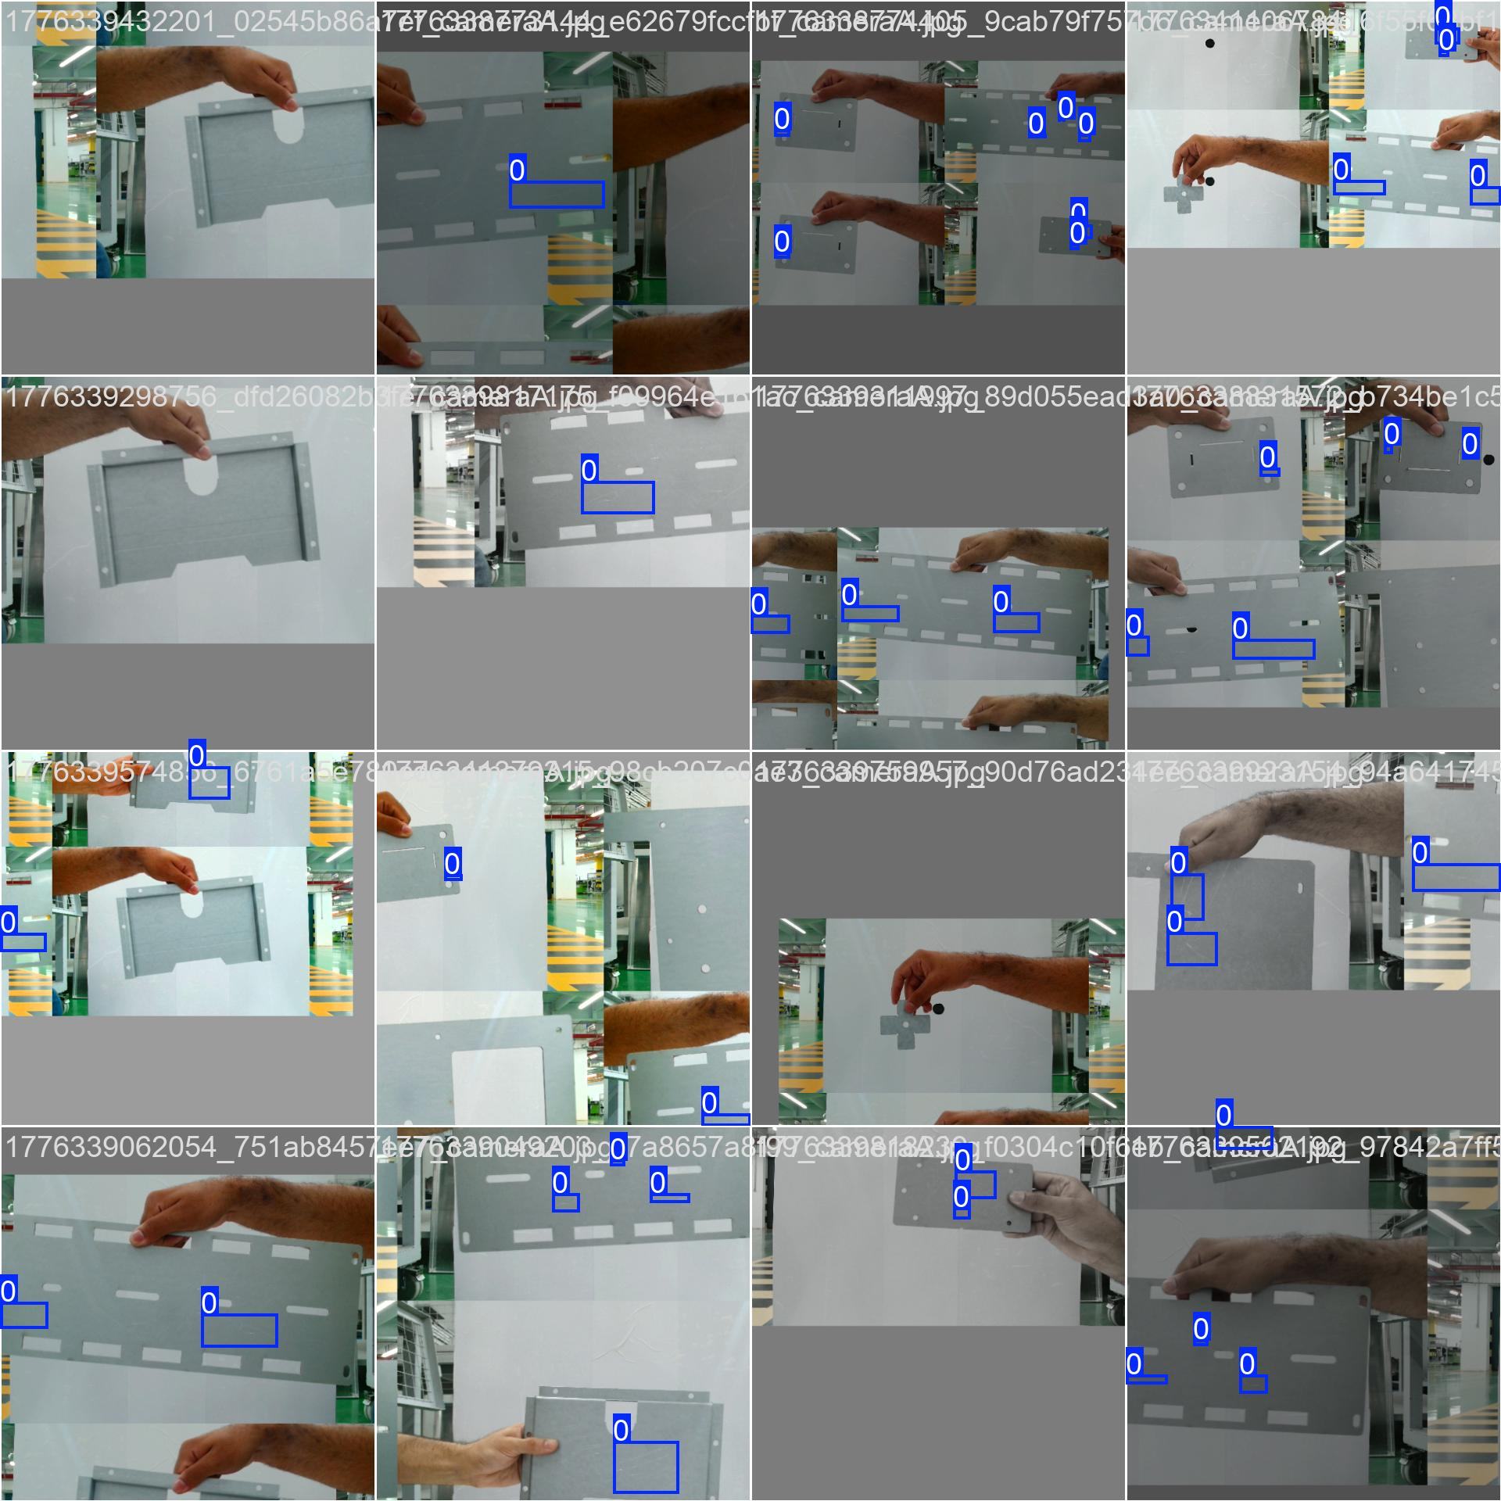
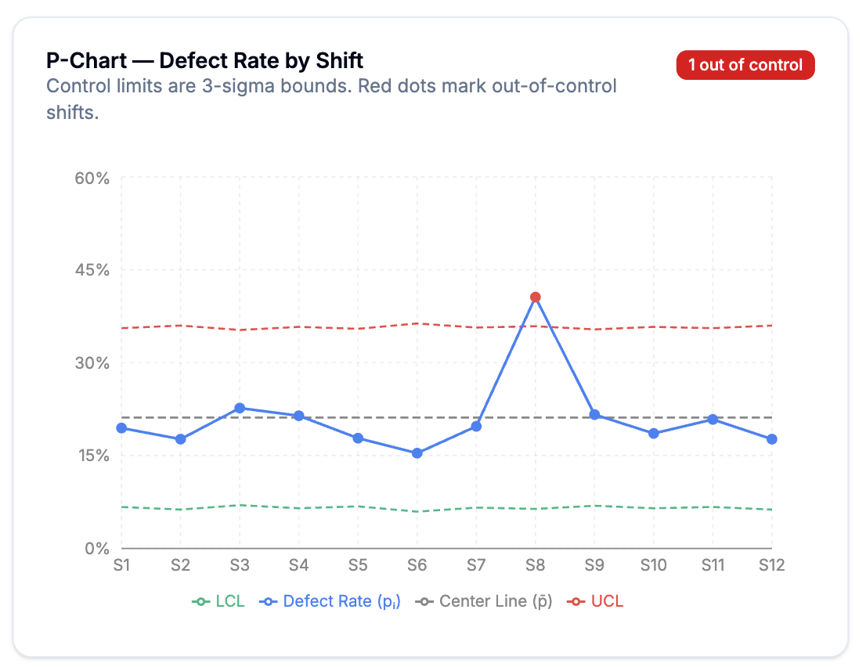
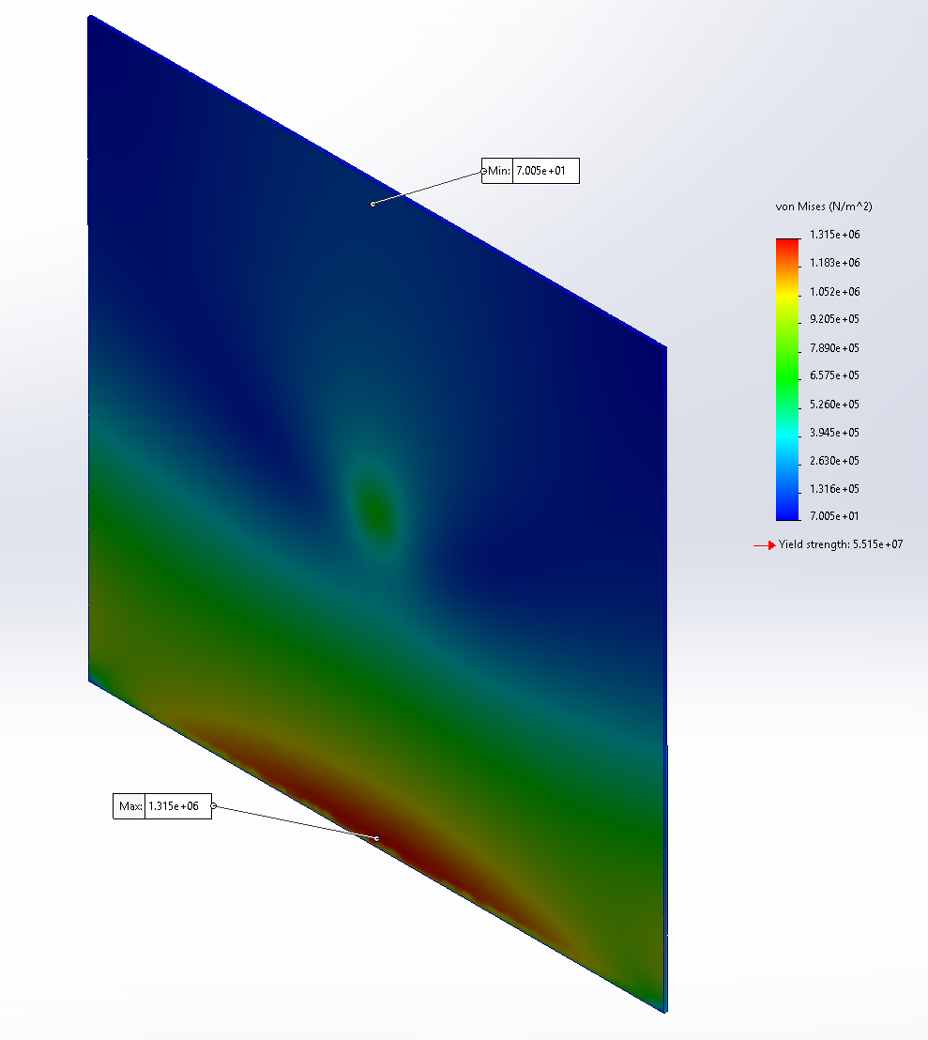
Smart Quality Control System for Fabrication
Production Line
TEAM
M022
4
Haidar Al Zaindeen | Abdullah Al Abbas |Mohammed Almohsen
Ali Alyousef | Ali Kazim | Moammal Almahfoudh
Coach: Essam Alhomaidi
Background
Prototype Design
Constraints
Problem:
Manual inspection in sheet-metal fabrication is inconsistent and often misses small surface defects.
Solution:
A compact dual-camera system automatically inspects both sides of the sheet in real time to provide accurate pass/fail decisions.
Cost | ≤ 20,000 SAR
Accuracy | ≥ 70%
Size | ≤ 0.343 m³
Temp/Humidity | 0–45°C, <70%
Backup Time | ≥ 20 min
Weight | ≤ 70 kg
Specifications
Inspection Cov. | 100%
Processing Time | ≤ 1.5 s
Dash Update | ≤ 1.5 s
DB Reliability | ≥ 99.9%
Power Cons. | ≤ 150 W
Decision Output | Pass/Fail
False Reject Rate | ≤ 5%
Inspection Time | ≤ 1.5 s
Live Demo
Testing & Validation
Defect Detection Results:
Defect Rate
Analysis (SPC):
Structural Stress
Analysis:
Conclusion
The system enables fast, accurate, and automated inspection, reducing errors and improving quality control in production lines.
Scan to see our dashboard!

