Slide 1
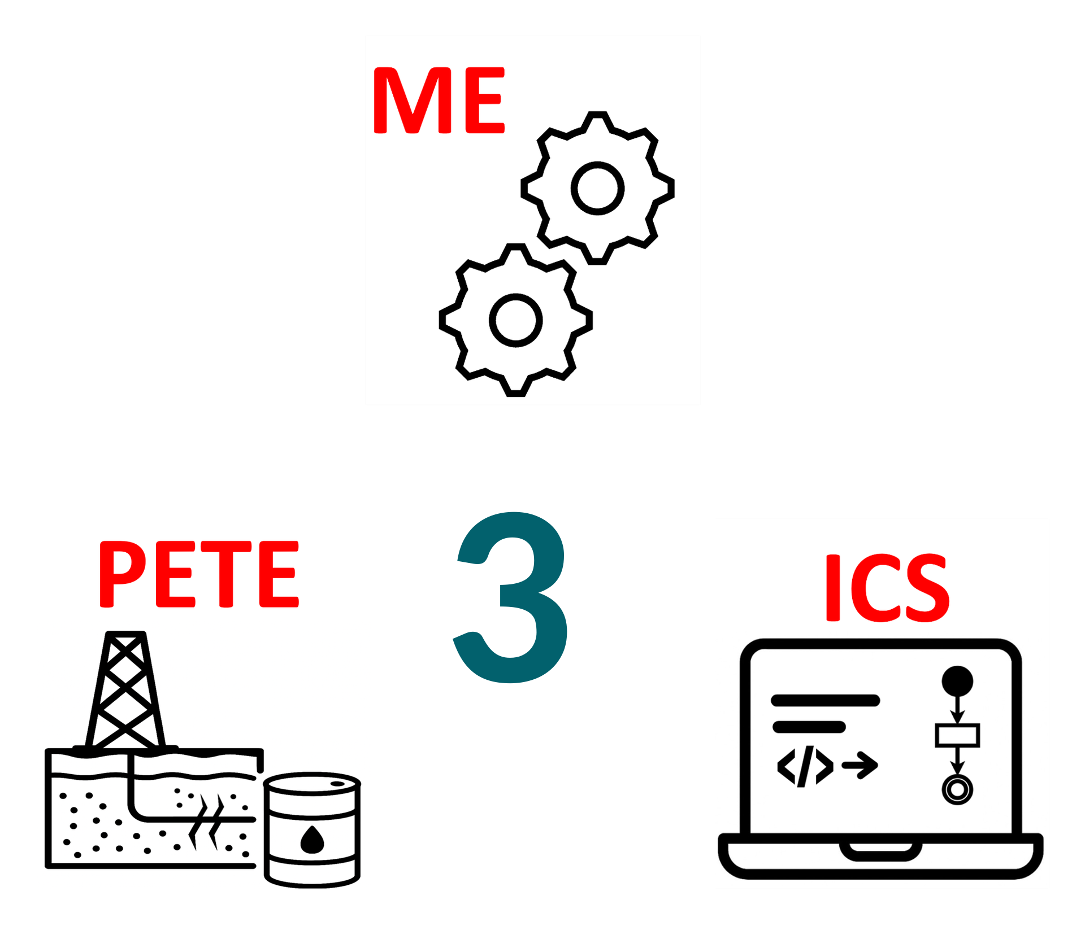
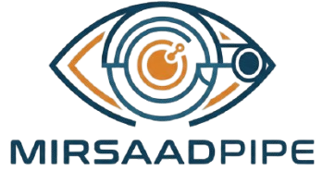
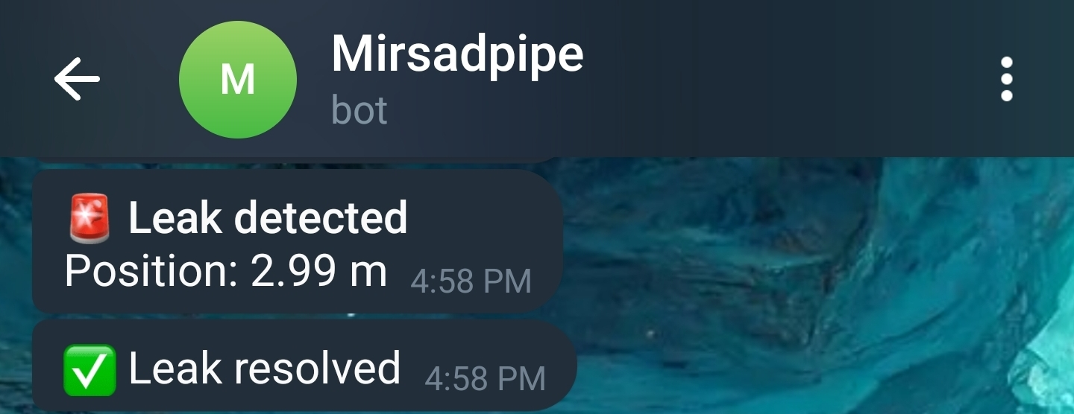
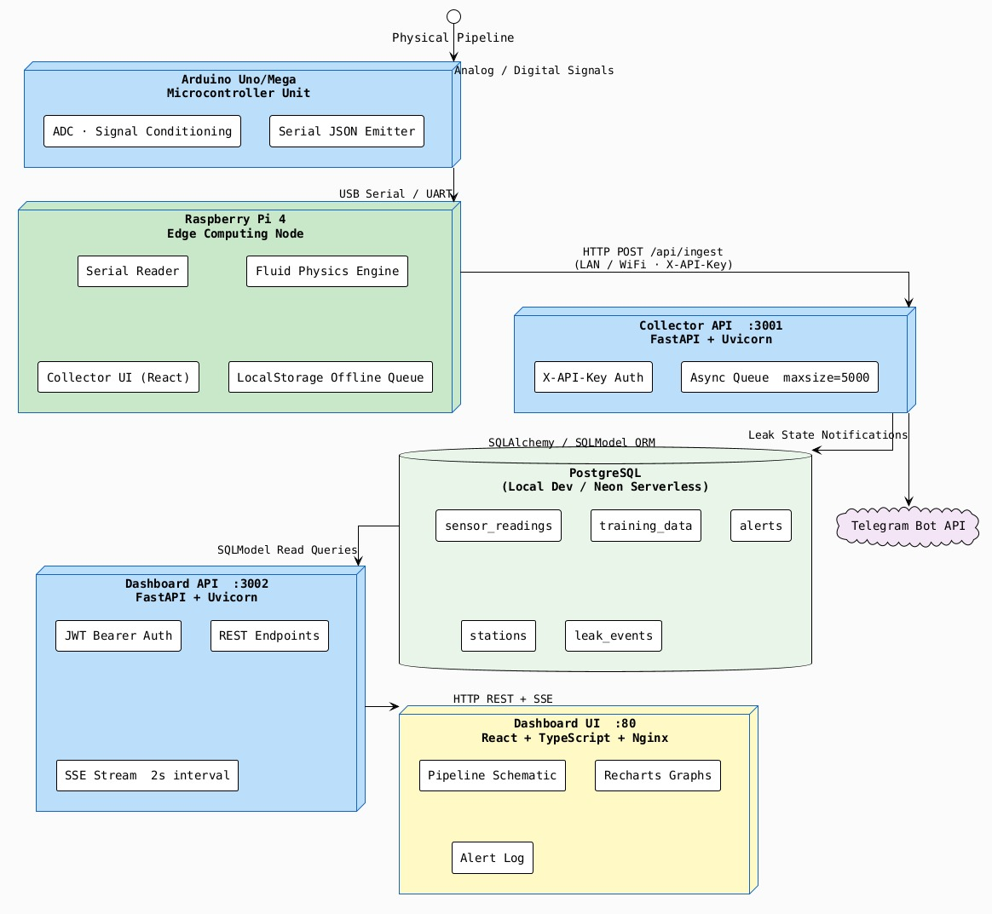
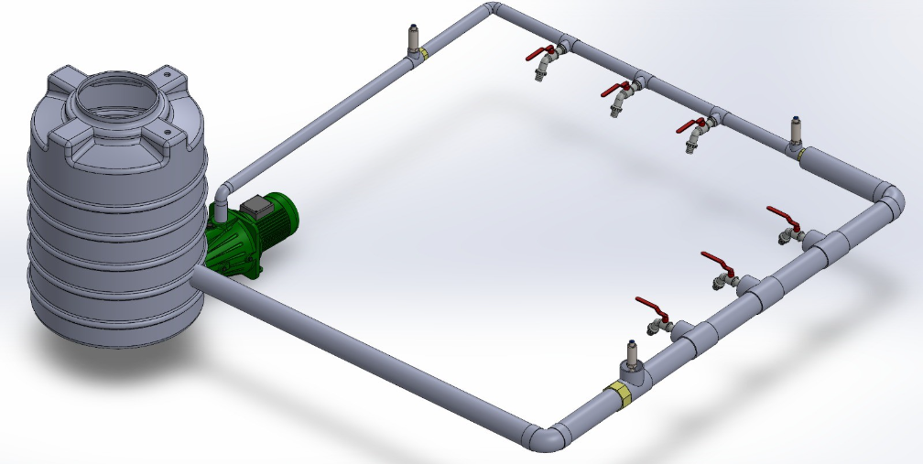
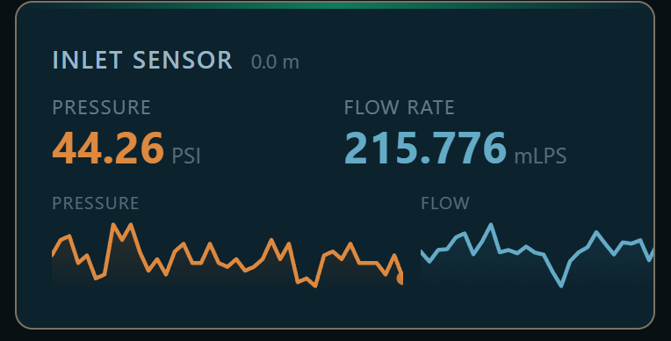
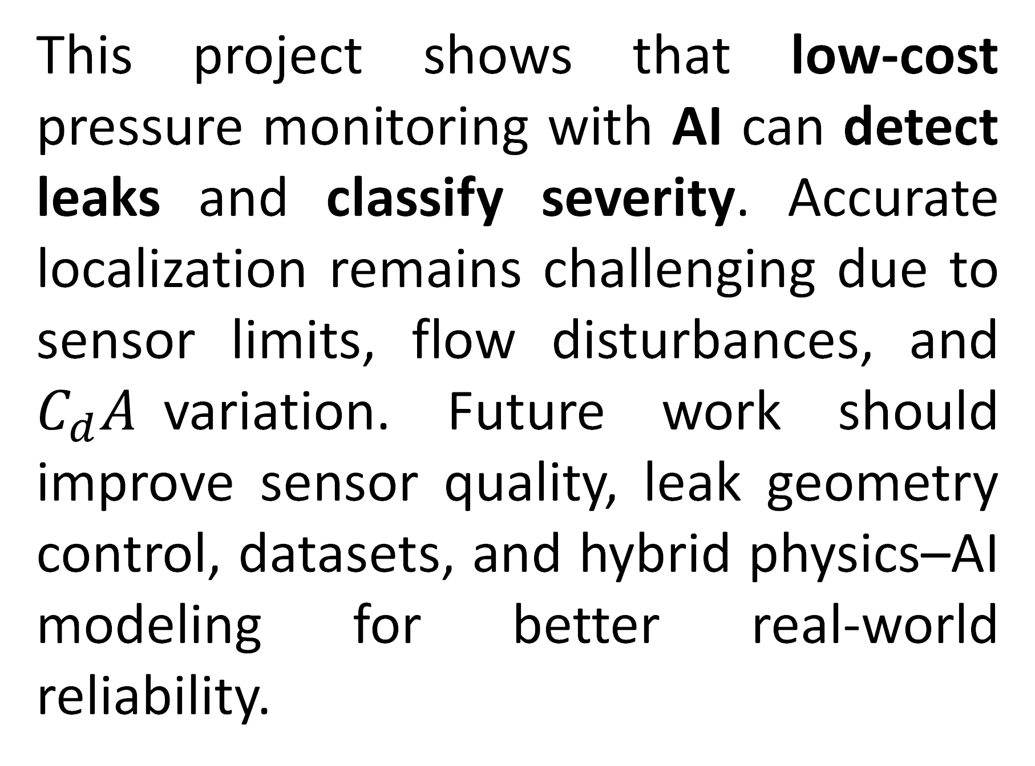
TEAM
M021
Project AI-Powered Oil Pipeline Leak Detection and Monitoring System
INSERT HERE The Multi-Disciplinary Strength logo
Mahdi Alamayad, Ali Al Marrar, Mohammed Alkubaish, Muhamad Almarhoon, Hassan Aljunabi, Mahdi Alyousif
Coach: Dr. Mansour Alharthi
Background/Basis
Testing And Validation
Prototype Design
Oil pipeline leaks must be detected quickly and accurately, even in remote locations with limited power and unstable connectivity. Current monitoring methods do not reliably meet the needed performance for early detection, leak localization, real time alerting, 99% availability, and low false alarm rates. A compact AI based monitoring system is needed to detect pressure drops, classify leak severity, and continue operating locally when network access is lost.
Stations
Conclusions
This project shows that AI could be used to greatly improve the performance of leak detection methods. It can classify the leak severity while also sending quick notifications about the leak to different devices.
Key Constraints and Specs
Impact and Future Work
Oil-only testing
Low power (15W per station)
Low-cost sensors
System availability of ≥ 99%
Leak severity classification based on flow rate
Leak location accuracy within 0.5 m
Baseline pressure profile with R² ≥ 0.9 (no-leak condition)
This project shows that low-cost pressure monitoring with AI can detect leaks and classify severity. Accurate localization remains challenging due to sensor limits, flow disturbances, and $C_{d}A$variation. Future work should improve sensor quality, leak geometry control, datasets, and hybrid physics–AI modeling for better real-world reliability.

