Slide 1
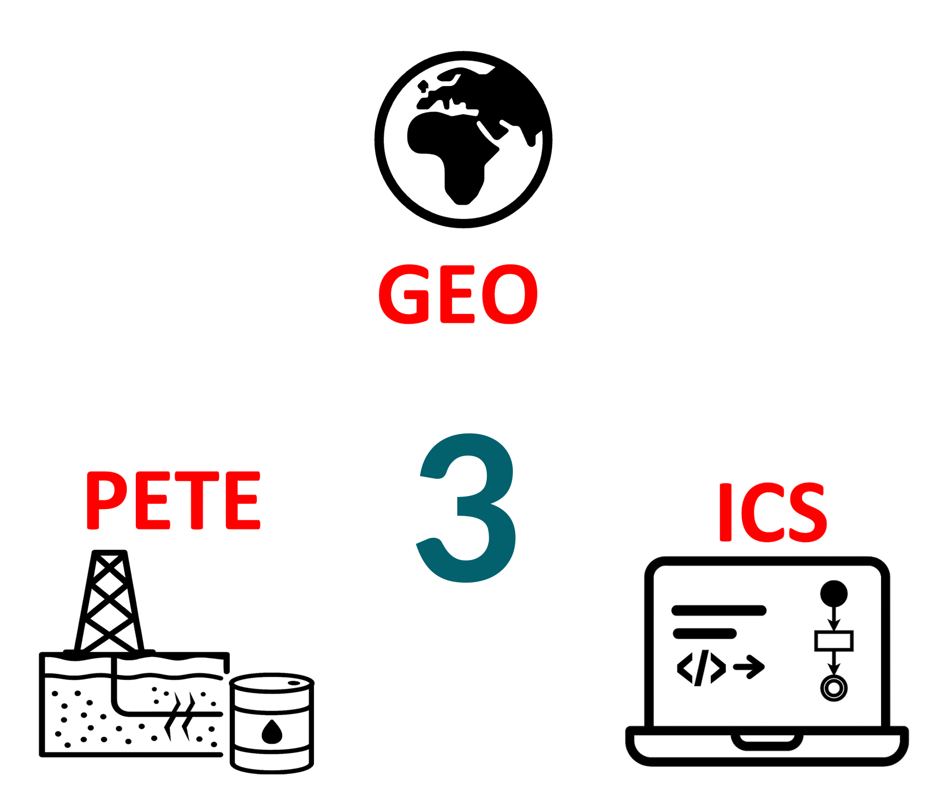
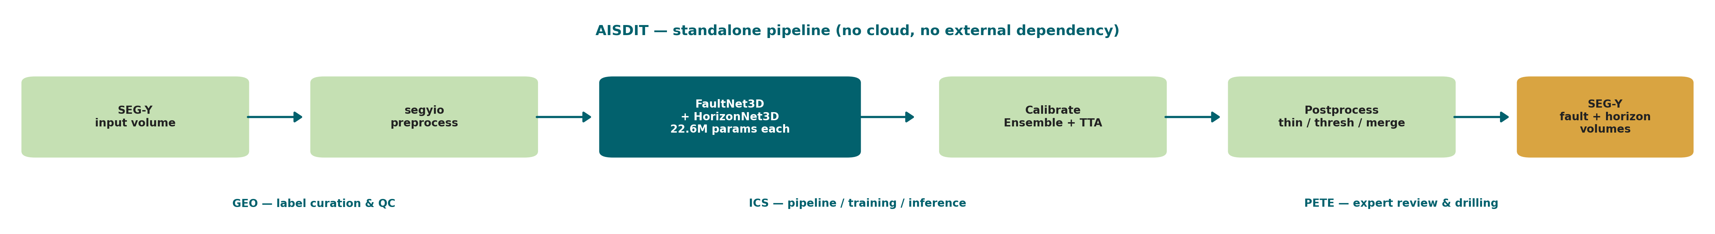
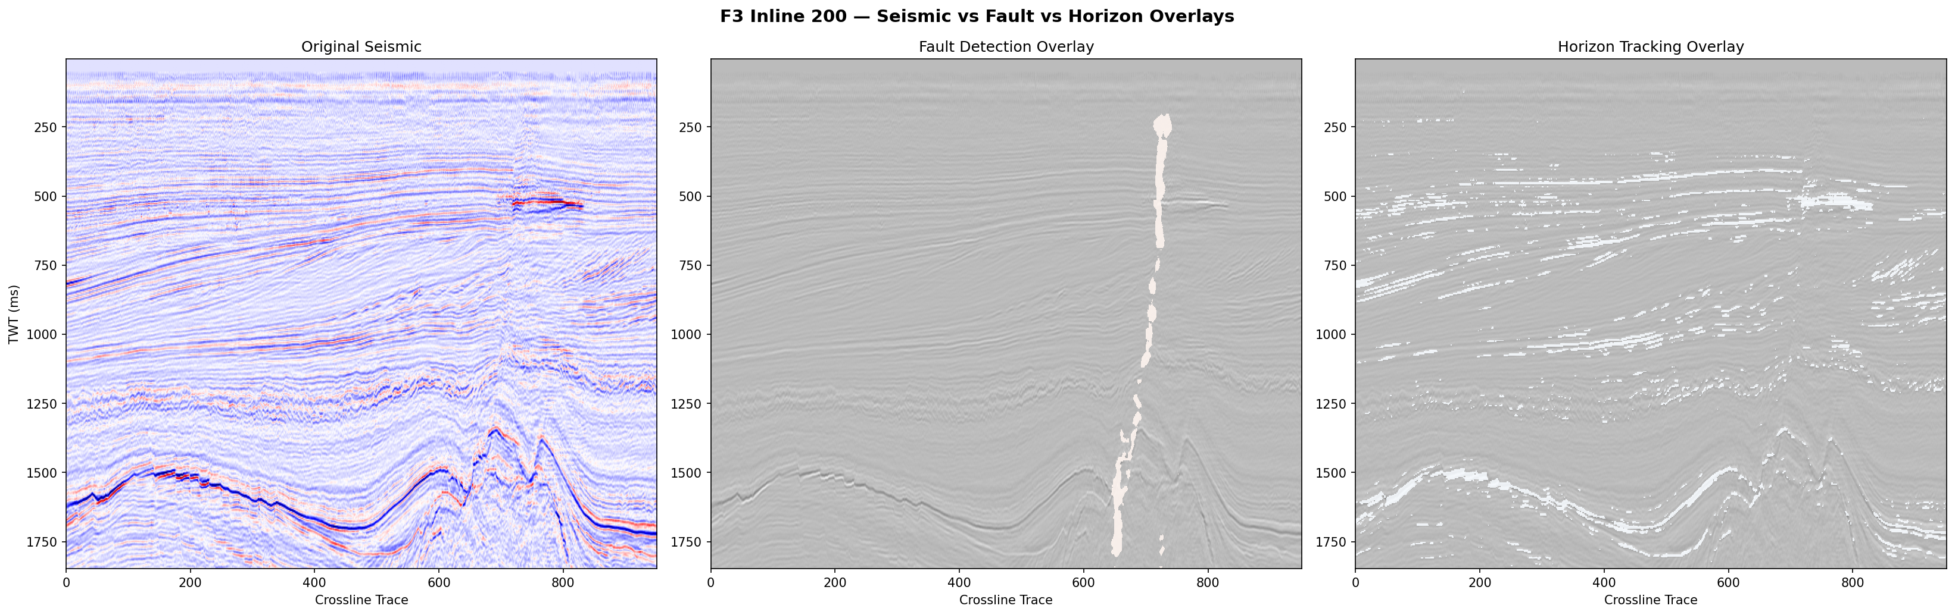
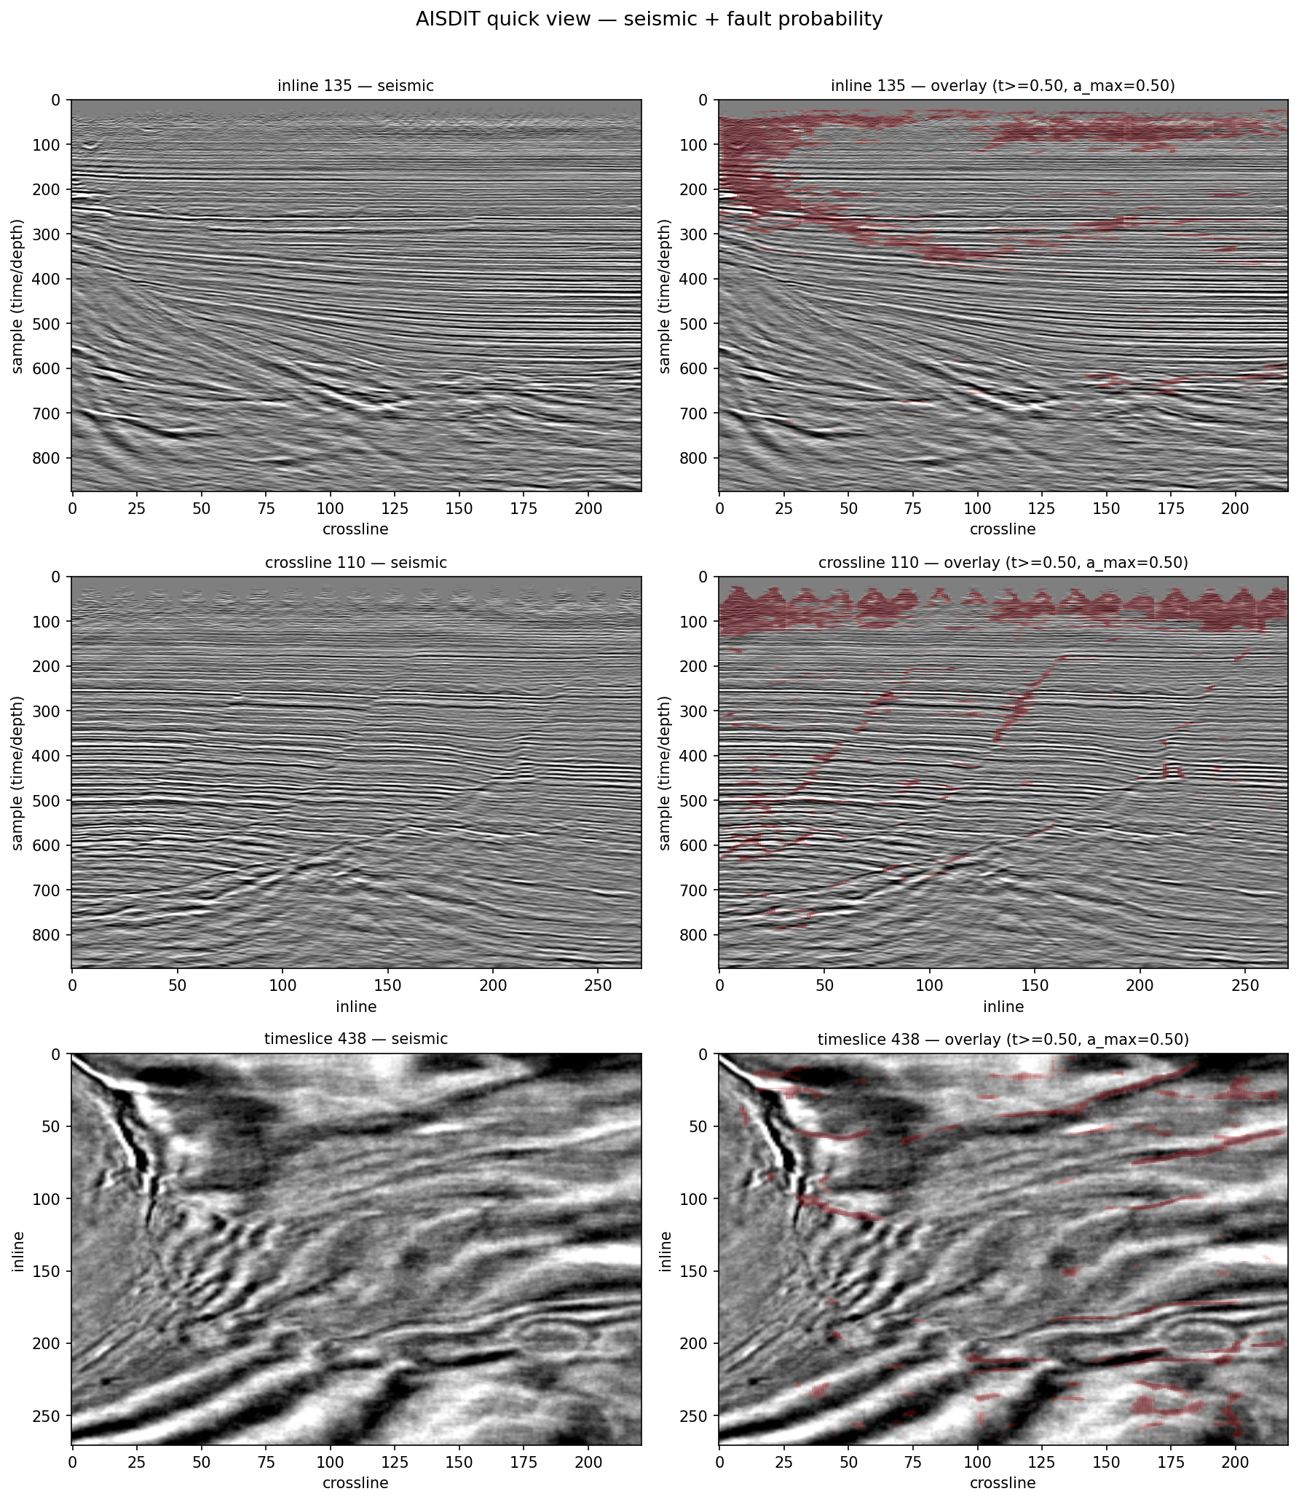
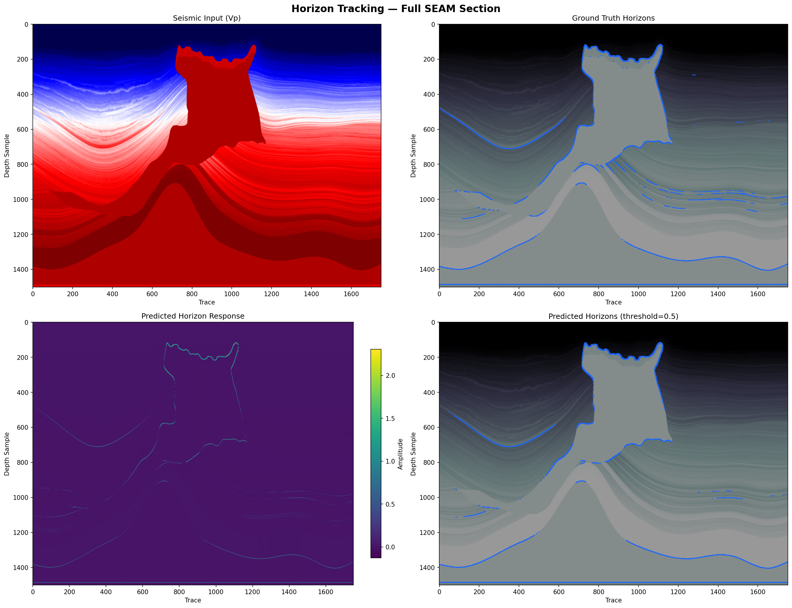
AI-Powered Seismic Data Interpretation Tool
TEAM
M017
Alhussain Yamani (ICS), Abdullah Alaqal (GEO), Nawaf Jenaid (GEO), Omar Almobarak (PETE), Meshari Bin Reshedan (PETE), Abdulrahman Alsagheir (ICS)
Coach: Dr. Majed Al Zayer
Objective
Prototype Development
Automate 3-D fault & horizon detection from SEG-Y
Run fully on a local GPU — no cloud, no data leaves
Deliver volumes in seconds, not hours
Output format-compatible with OpendTect / Petrel
Validate on 5 real & synthetic seismic datasets
• FaultNet3D + HorizonNet3D — 22.6 M params each
• 4-level 3-D U-Net + BatchNorm + optional SE attn.
• Pre-trained synthetic, fine-tuned on F3 / Volve
• Threshold calibration + 8-way TTA + ensemble
• Standalone CLI — no OpendTect runtime dependency
Problem Statement
Manual 3-D interpretation: ~8 hours per cube
Cloud ML tools leak proprietary seismic data
Existing deep-learning tools are cluster-bound
Industry needs a fast, local, SEG-Y-native tool
Labeled seismic data is famously scarce
Constraints and
Specifications
CONSTRAINTS
C1 SEG-Y data input
C2 Local single GPU (CUDA / MPS)
C3 SEG-Y / SEG-Z seismic format
C4 SEG / IEEE / API standards compliant
C5 SEG-Y data export
C6 Interactive 2D/3D visualization
C7 Limited labeled data
C8 Output usable for reservoir decisions .
Specifications
S1 ≤ 5 s per seismic line
S2 ≤ 3 steps for operation
S3 Fault detection ≥ 70%
S4 Horizon coverage ≥ 80 %
S5 Fault class 0 / 1 for normal and reverse faults
S6 Drilling-data integrated to improve the accuracy by at least 5%
S7 Horizon picking error ≤ 10 samples
S8 Runtime ≤ 15 min
S9 Drilling depth error ≥ 0
Integrated Specifications
IS1 Accuracy ≥ 85 %
IS2 2D/3D colored visualization for faults and horizons
IS3 Expert rating ≥ 80 %
IS4 Interpretation time reduced by ≥ 30%
Validation & Verification
F3 Netherlands → fault F1 = 0.71 at threshold 0.75
F3 inline 200 — AI fault overlay on real data
Team-17 cube — 3D generalization
Horizon tracking, 88 %
Verification trail: 9 workflow logs (wf01…wf09) — one per spec group.
SEG-Y I/O · Local GPU · Per-line speed · UI · Fault F1 · Horizon · Viz · Labels · Speed-up
Conclusion
Standalone 3-D AI tool: SEG-Y in → SEG-Y out, <2 min
Honest on horizon aggregate & first-party GUI
Future work: Self-supervised pre-training · kinematic fault
Classifier · native interactive viewer · drilling integration

