Slide 1




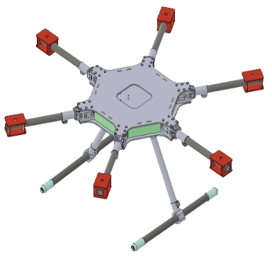
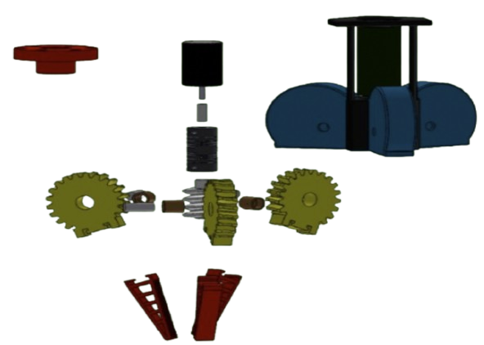
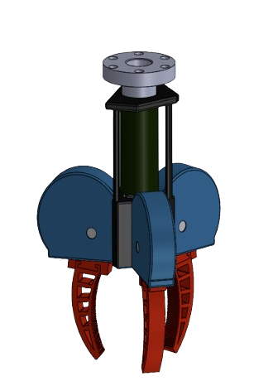
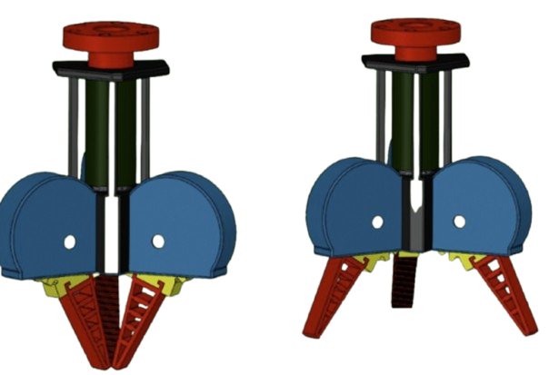
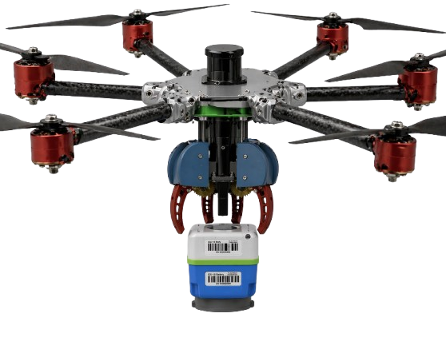
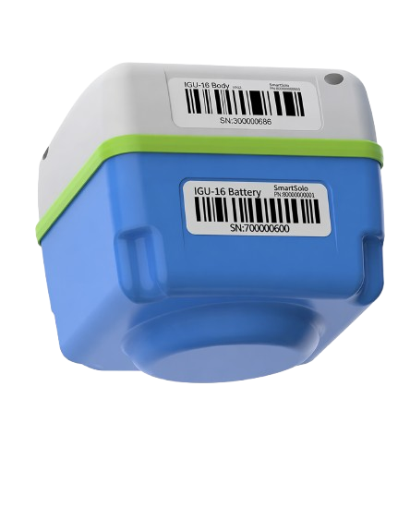

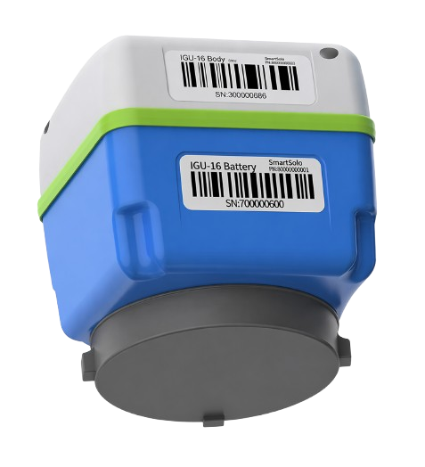
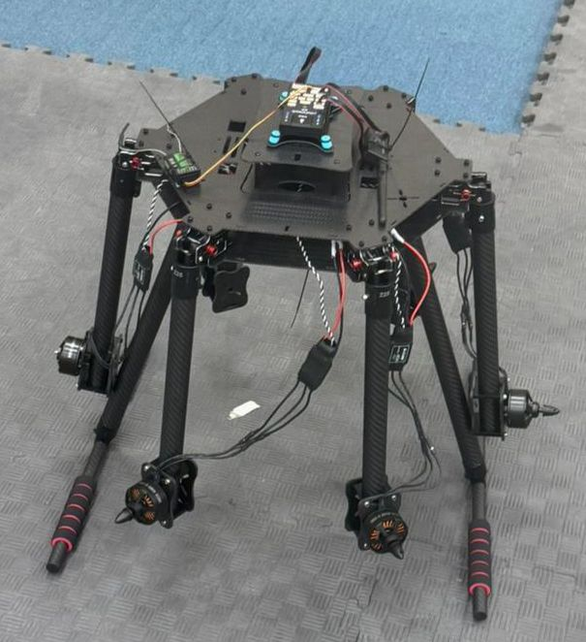
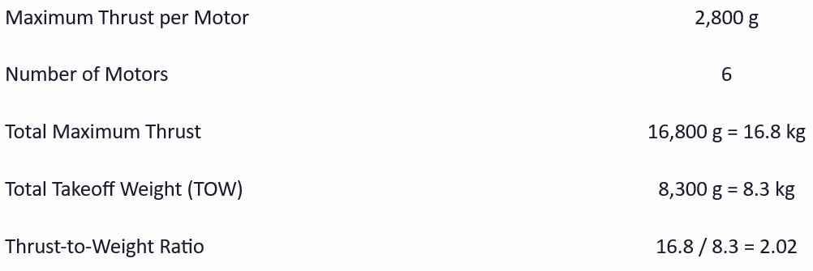
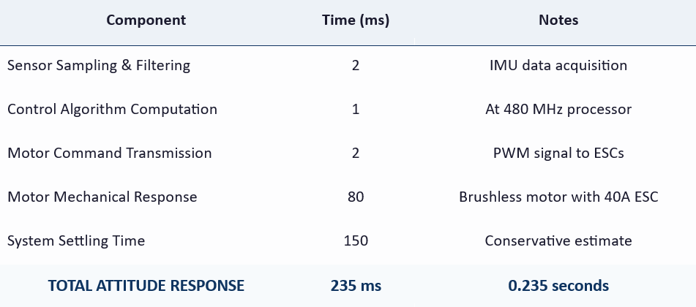
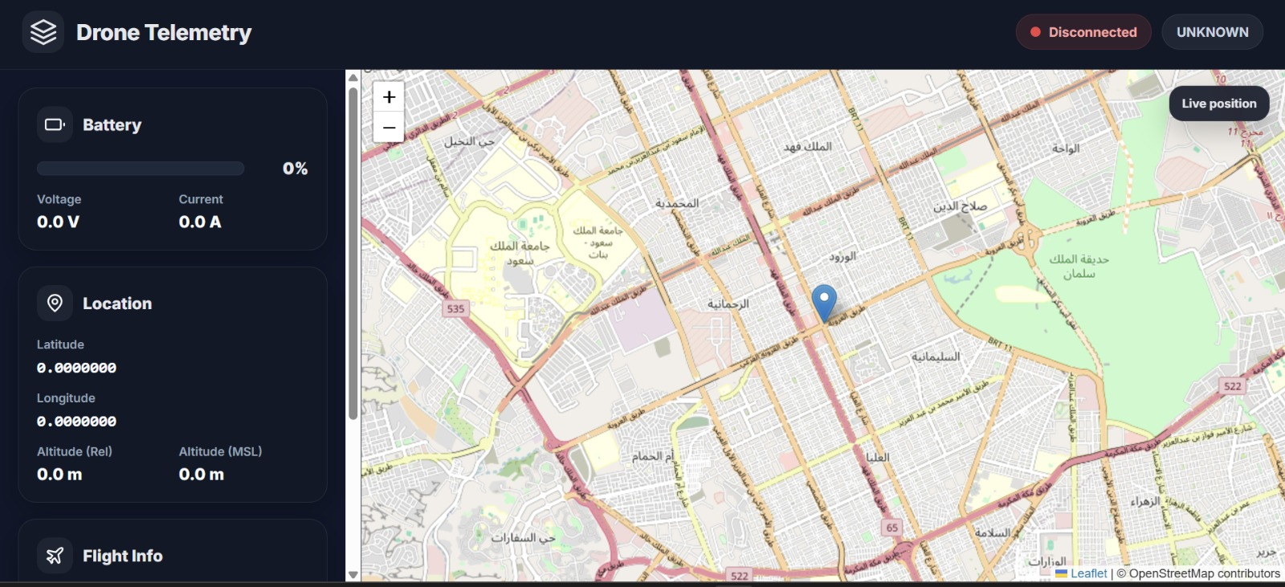
Autonomous Drone System for Geophone Deployment in Difficult Terrains
TEAM
M016
4
Hatem Alanazi , Raed Alqahtani , Bader Aldawood , Fares Alharbi , Nasser Alghannam , Ammar Almulhim
Coach: Dr. Ahmed Mahmoud
Overview
Specifications
Prototype Design
Problem statement:
Geophone deployment in seismic surveys is currently performed manually, making it slow and inefficient in large and difficult terrains.
To address this,
an autonomous drone-based system is developed to deploy geophones at predefined locations with higher speed, accuracy, and consistency.
Thrust-to-weight ratio ≥ 1.5
Attitude response ≤ 1 s
Live tracking update ≤ 2 s
Grip force ≥ 32 N
Gripper load capacity: 1–2 kg
Target Customers
Testing &Validation
Conclusion
Base contact area ≥ 120 cm²
Oil & gas companies
Seismic survey companies
Geophysicists & survey designers
An autonomous drone system enables safe, stable, and highly accurate geophone deployment in difficult and inaccessible terrains.
• Outdoor flight testing was not possible due to current restrictions; some validation was completed using calculations and simulations.
Return time ≤ outbound time + 30 s
Integrated Specifications
Technical Requirement
Constraints
Stable hover ≥ 1 s before release, release time ≤ 0.5 s
Temperature ≤ 50°C
Wind speed ≤ 6 m/s
Deployment time ≤ 60 s (≥ 40% faster than manual)
Future Work
Gripper mass ≤ 1.4 kg
Servo torque ≥ 2.5 kg·cm
Implement multi-drone system for redundancy and mission continuity in case of failure.
Tilt ≤ 5°, position error ≤ 0.5 m

