Slide 1


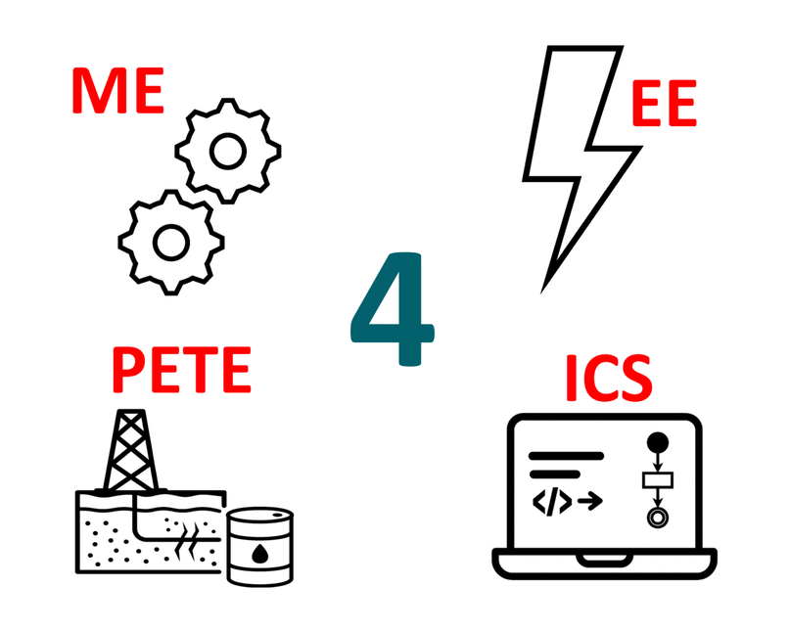



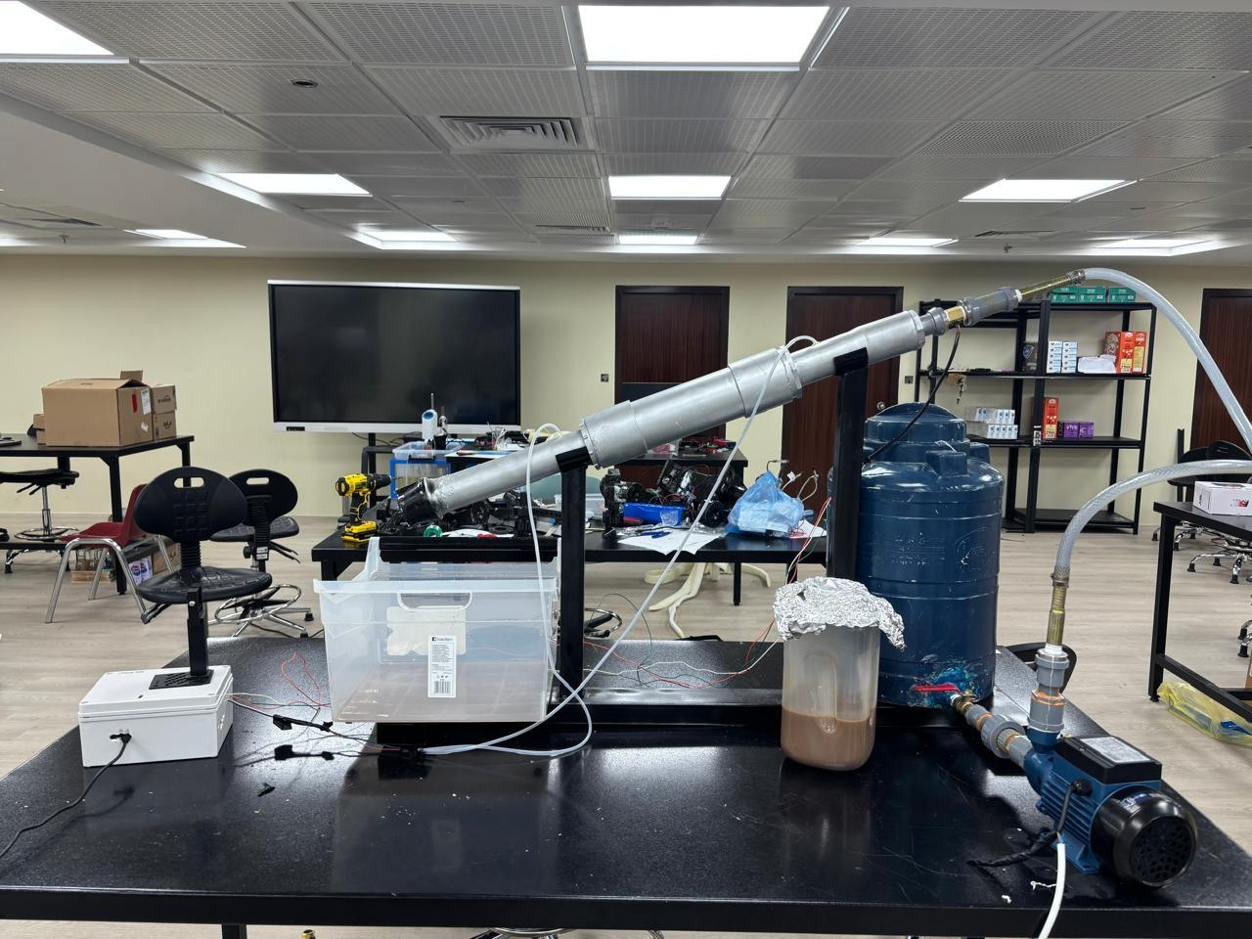
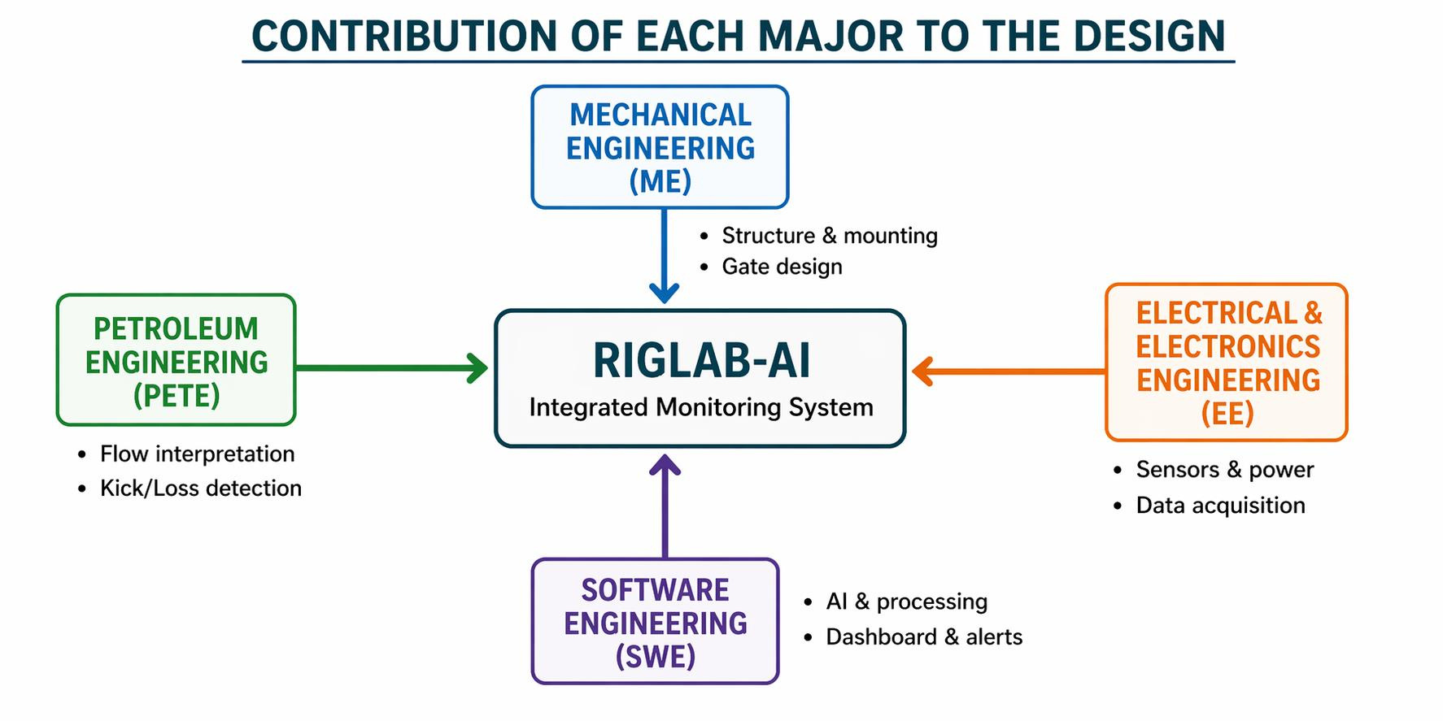
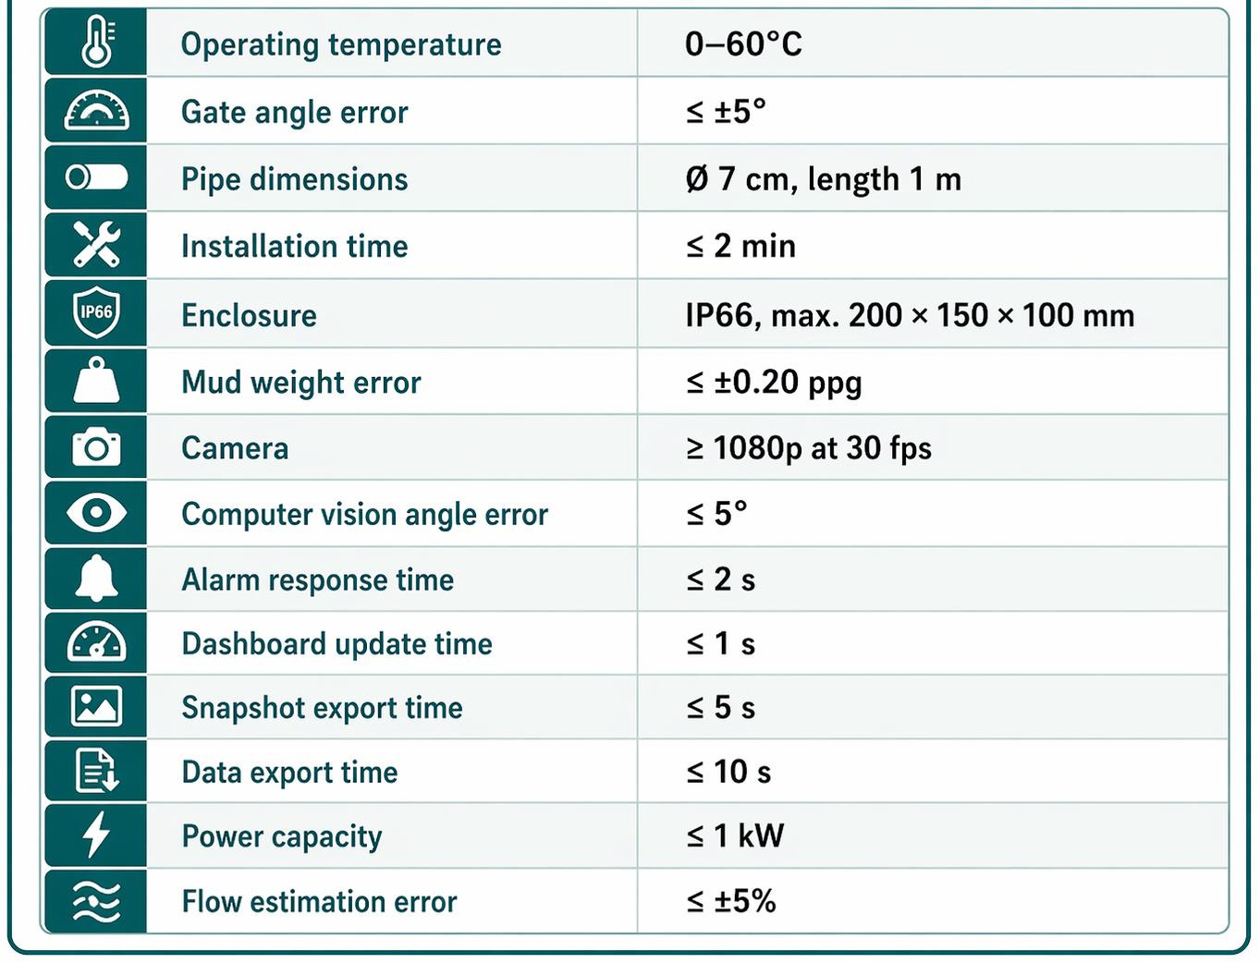

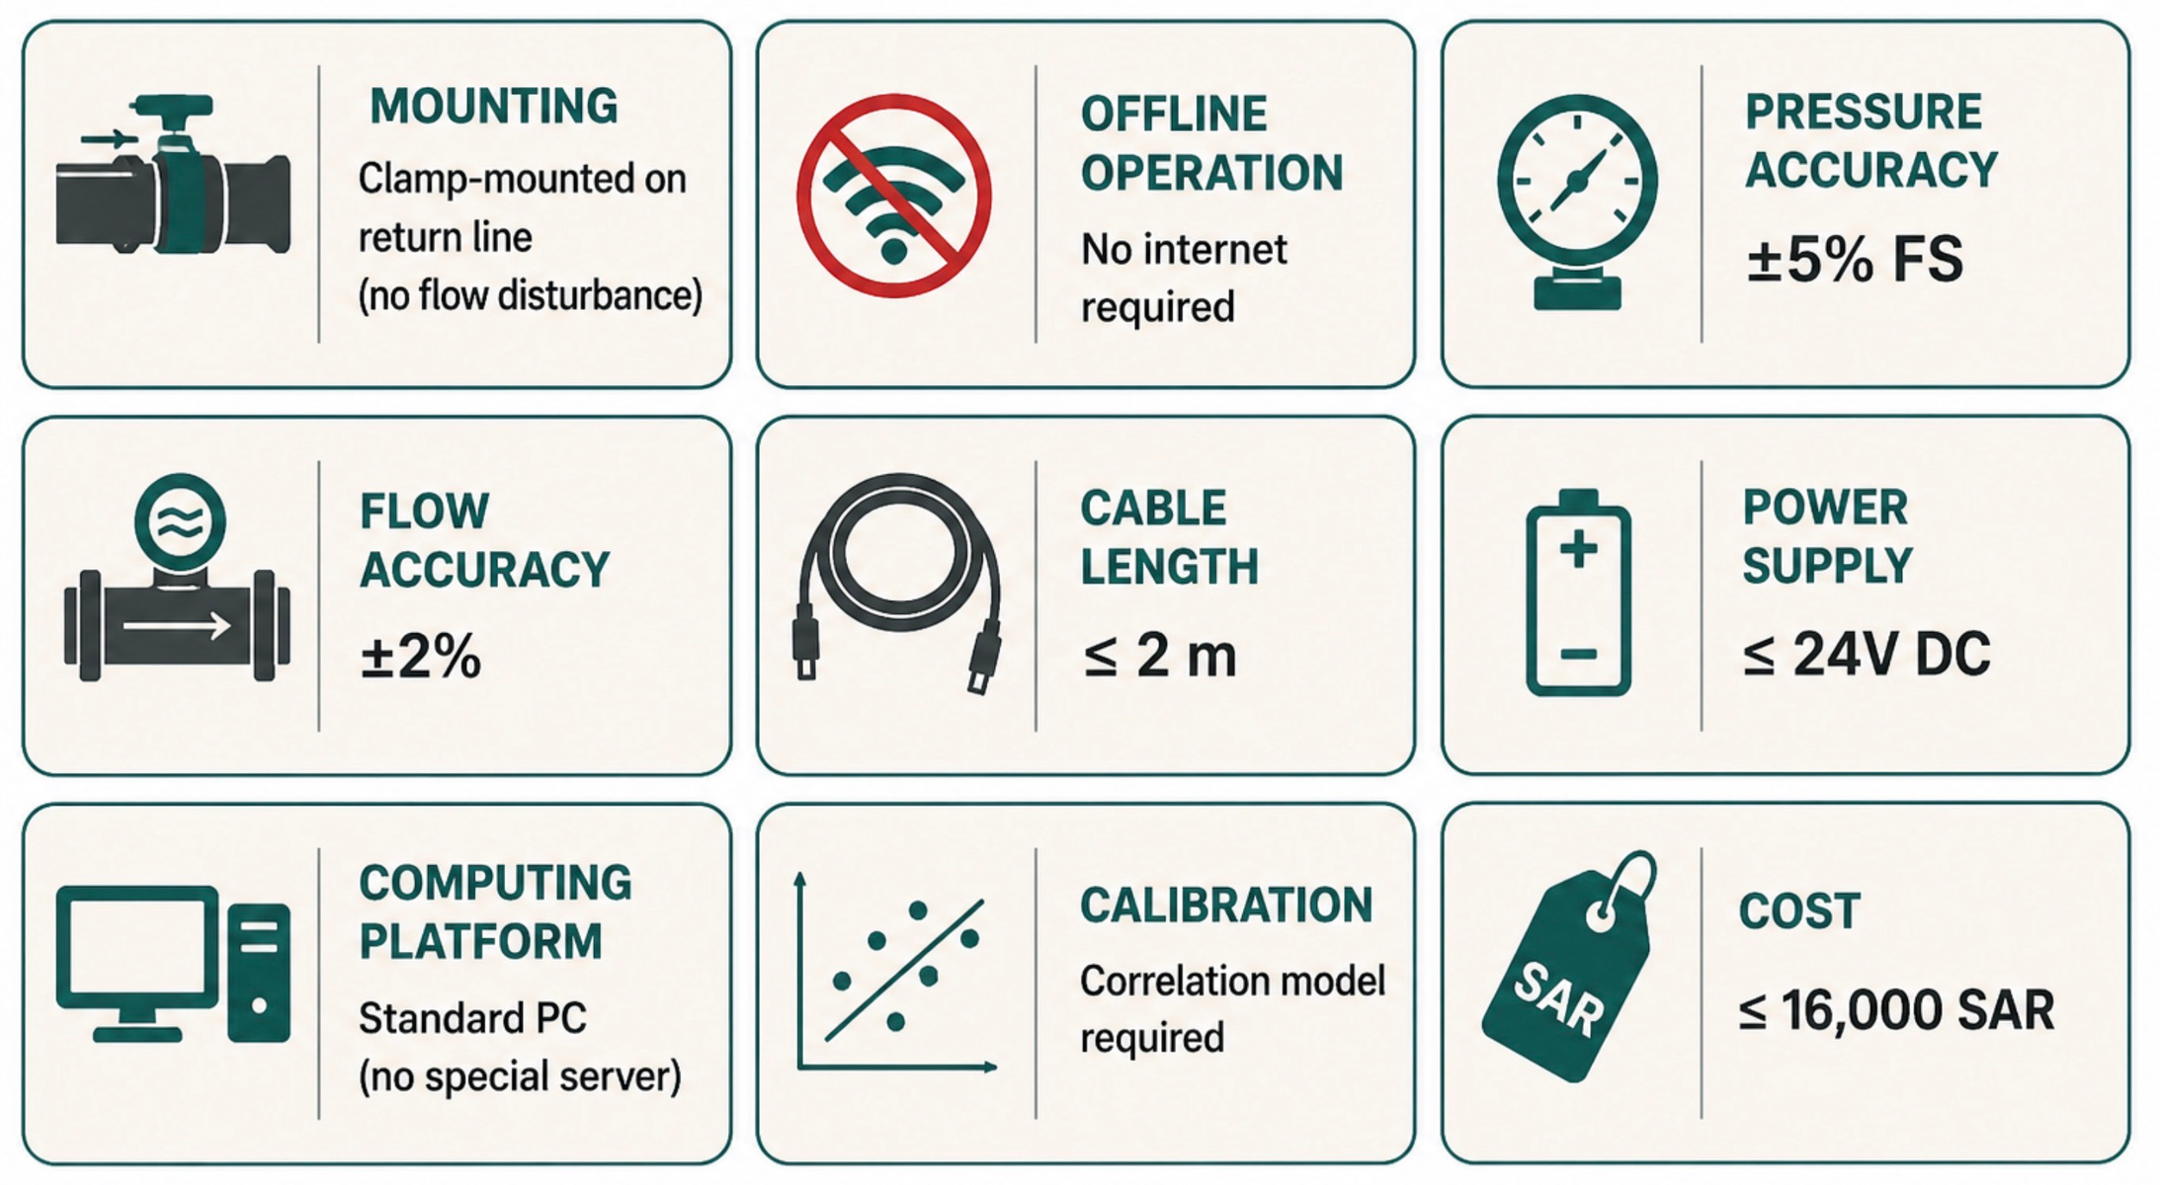
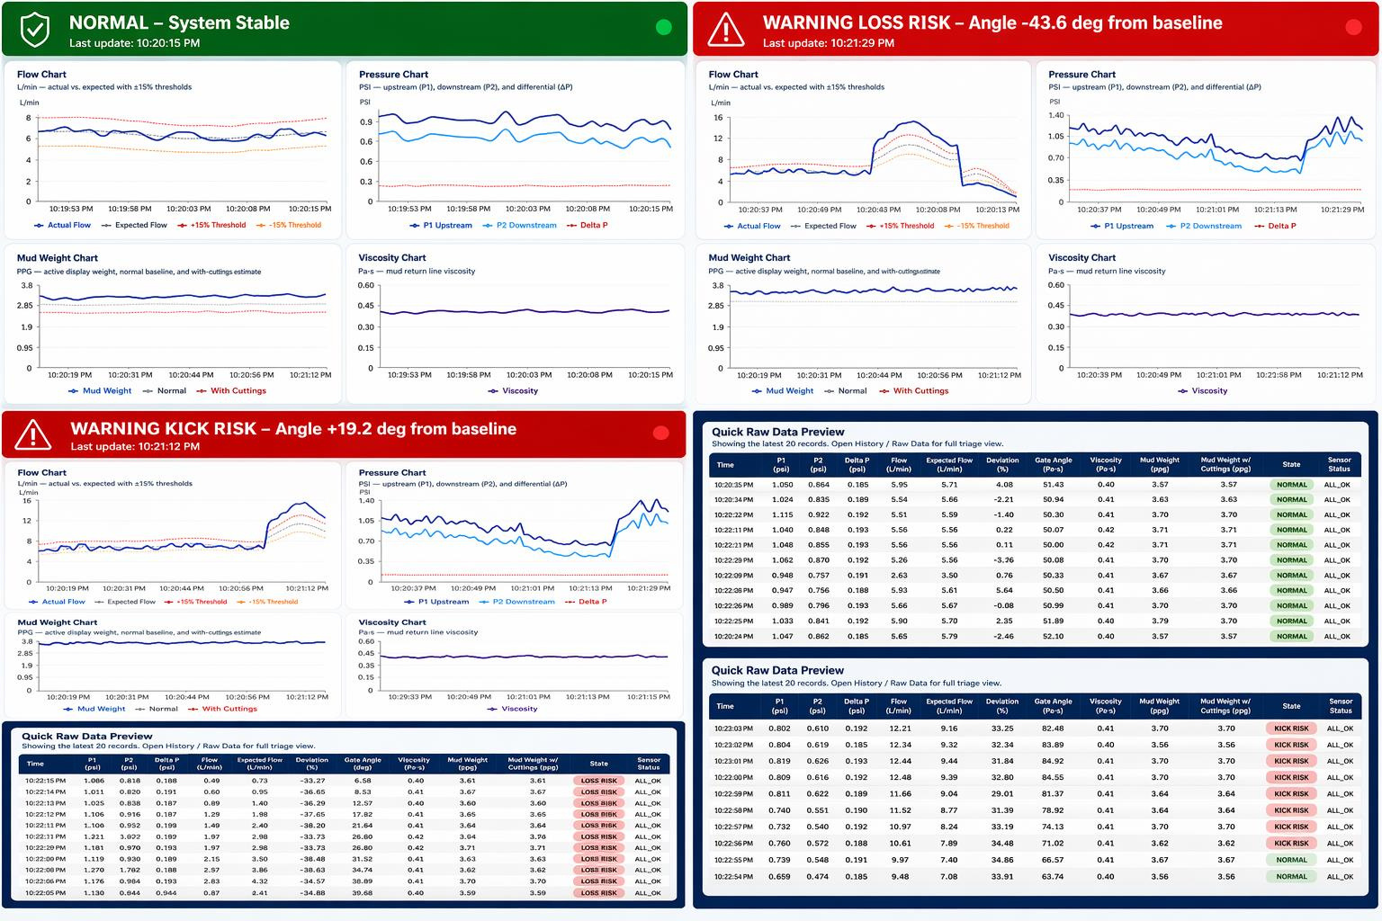
RigLab-AI: Smart Return Line Monitoring System with AI Camera & Sensors
TEAM M014
Abdullah Alruhaili (PETE), Turki Alharbi (PETE), Ziyad Alharbi (ME), Abdulrahman Alburaikan (EE),
Mohammed Alotaibi (SWE), Meshari Alhejaili (SWE) Coach: Dr. Ahmed Mahmoud
PROBLEM STATEMENT
Prototype Design
SPECIFICATIONS
RigLab-AI addresses delayed kick/loss detection and weak traceability in manual return-line monitoring with a low-cost, clamp-mounted, fully offline system integrating cameras, sensors, and automated alerts/reporting.
Constraints
Testing & Validation
CONCLUSION & FUTURE WORKS
RigLab-AI demonstrated a low-cost, fully offline solution for intelligent return-line monitoring, with initial validation under bentonite–water mud and a kick-like event, while future work will improve calibration, loss-event validation, and system robustness.

