Slide 1
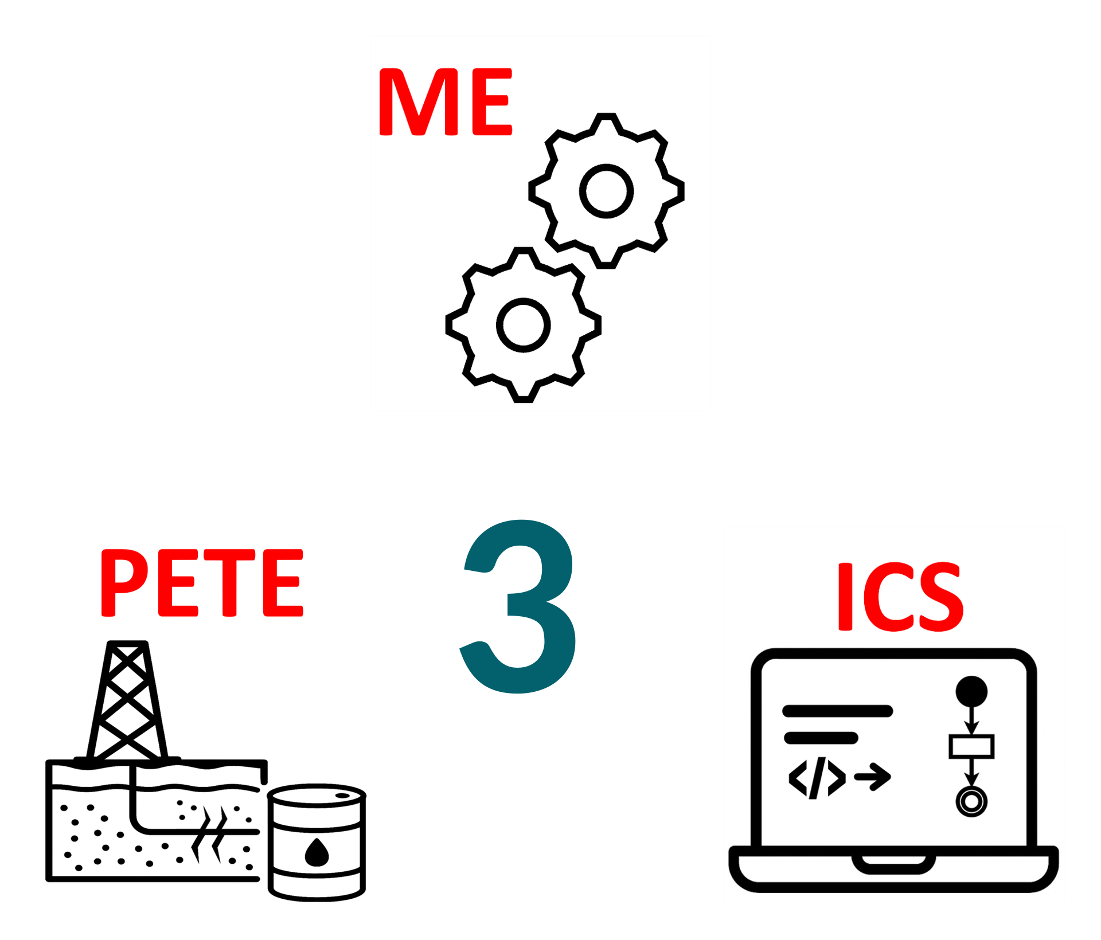
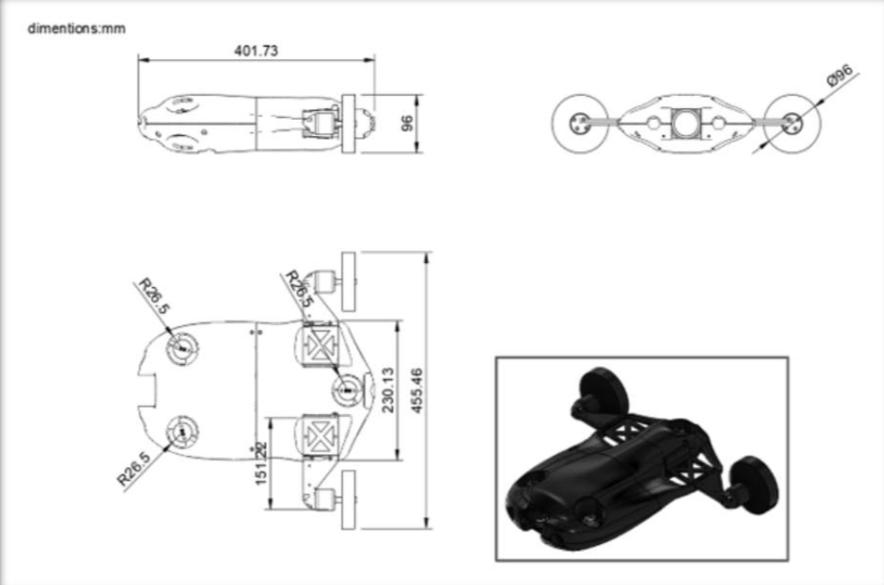
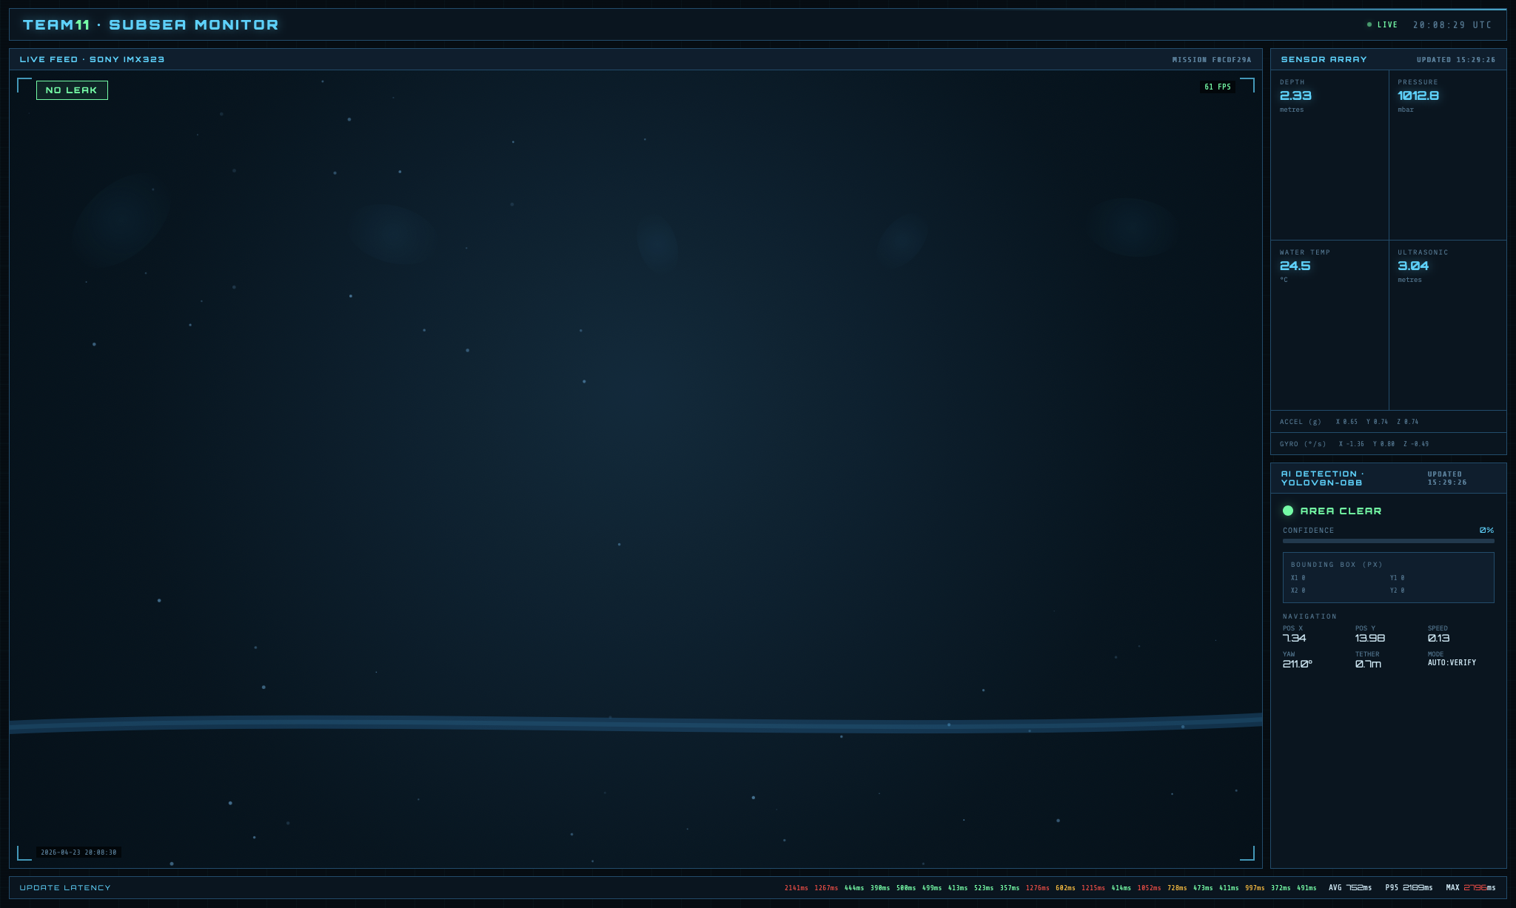
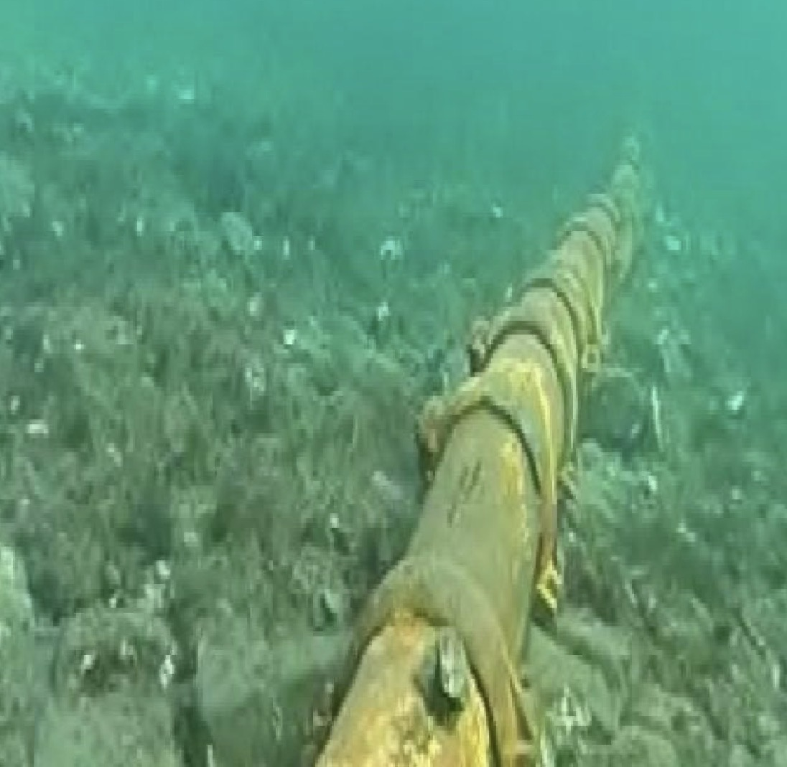
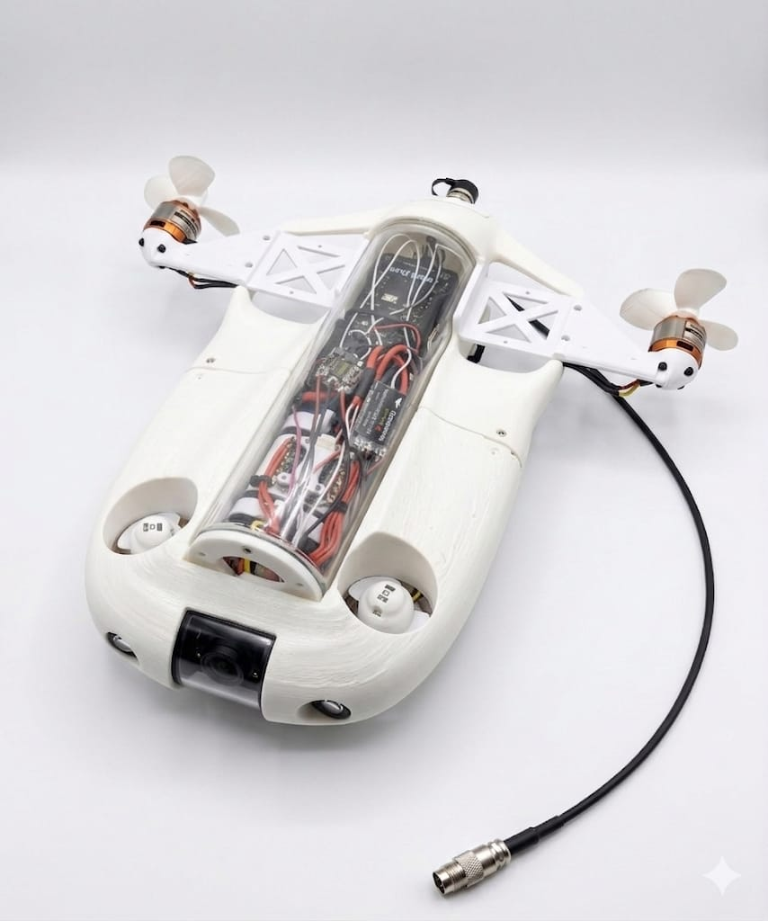
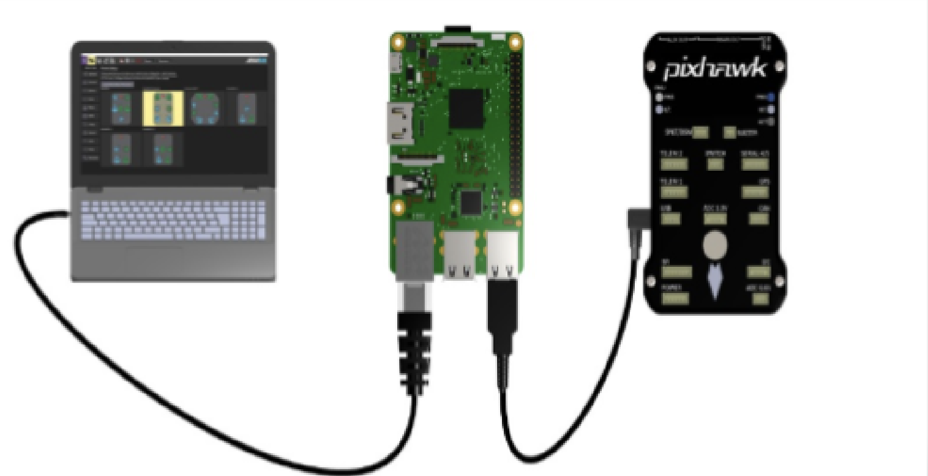
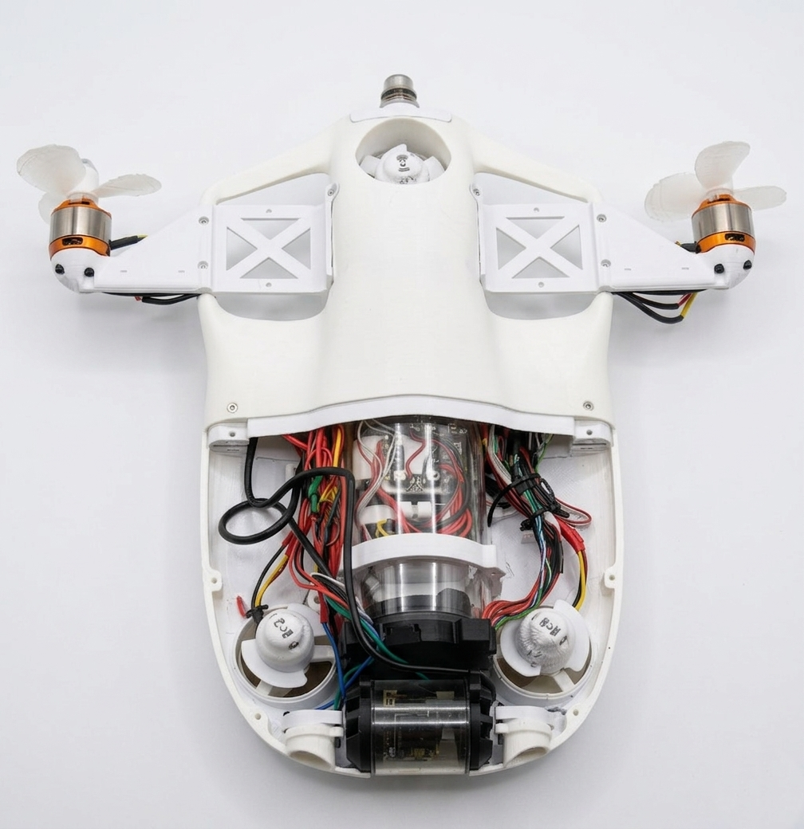

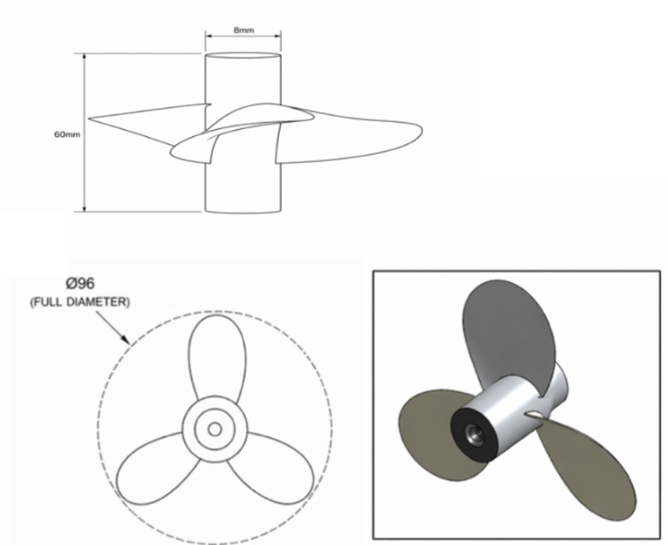
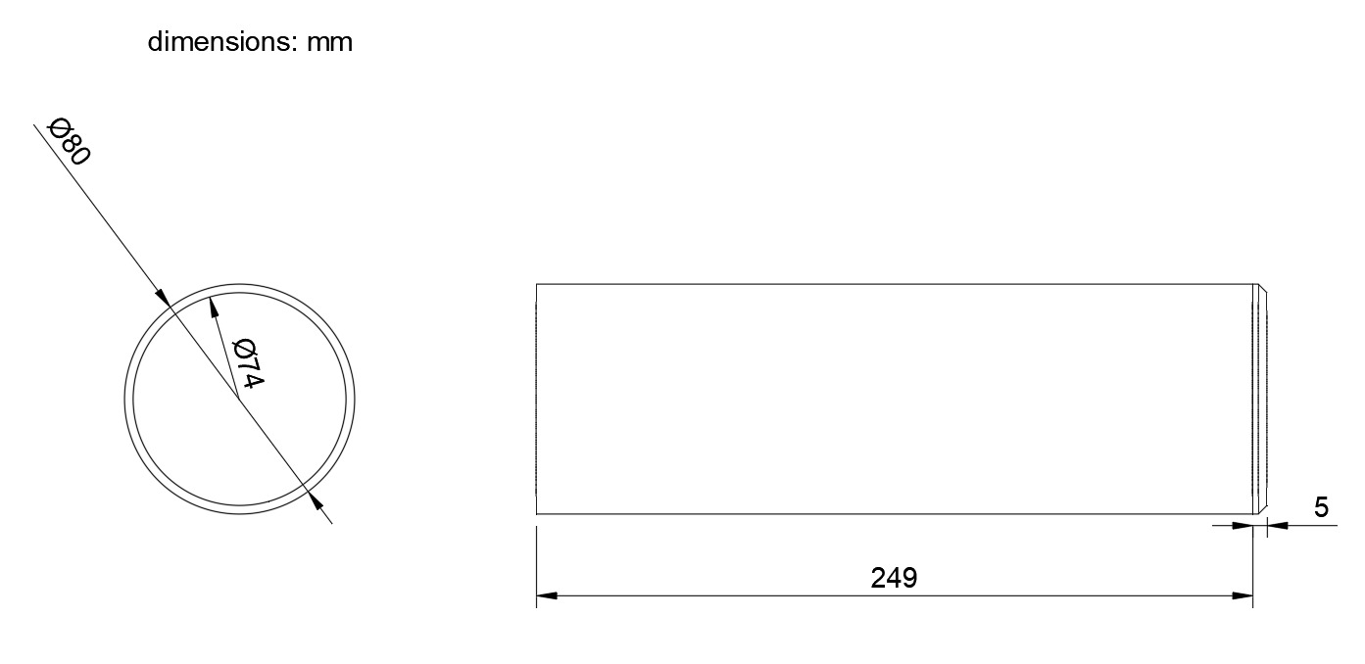
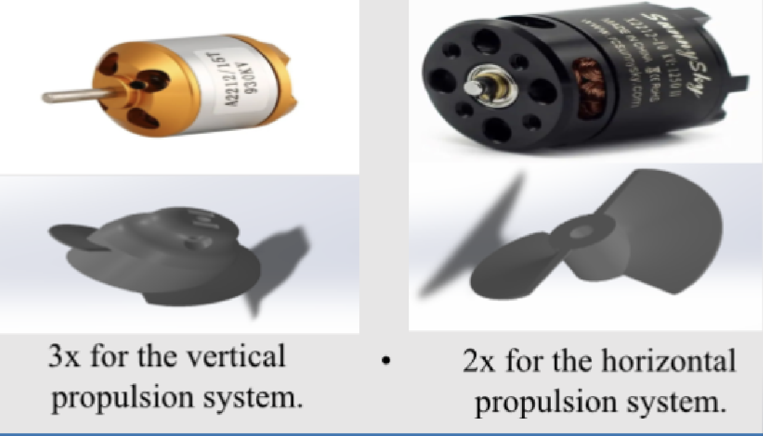
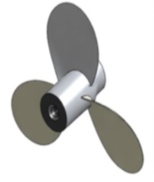


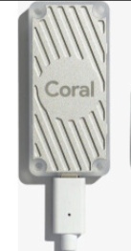
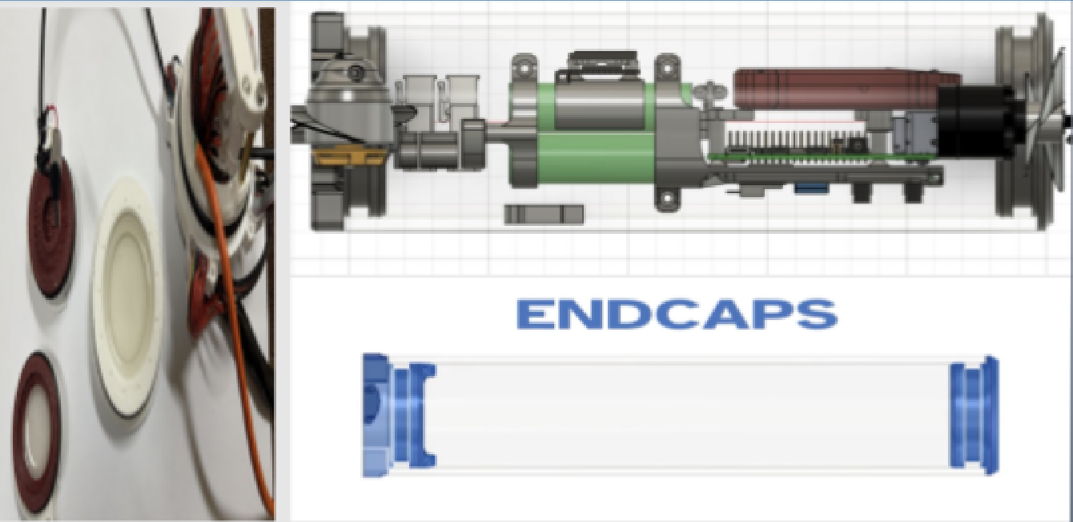
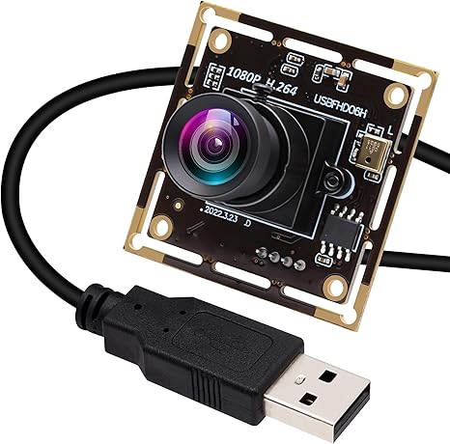
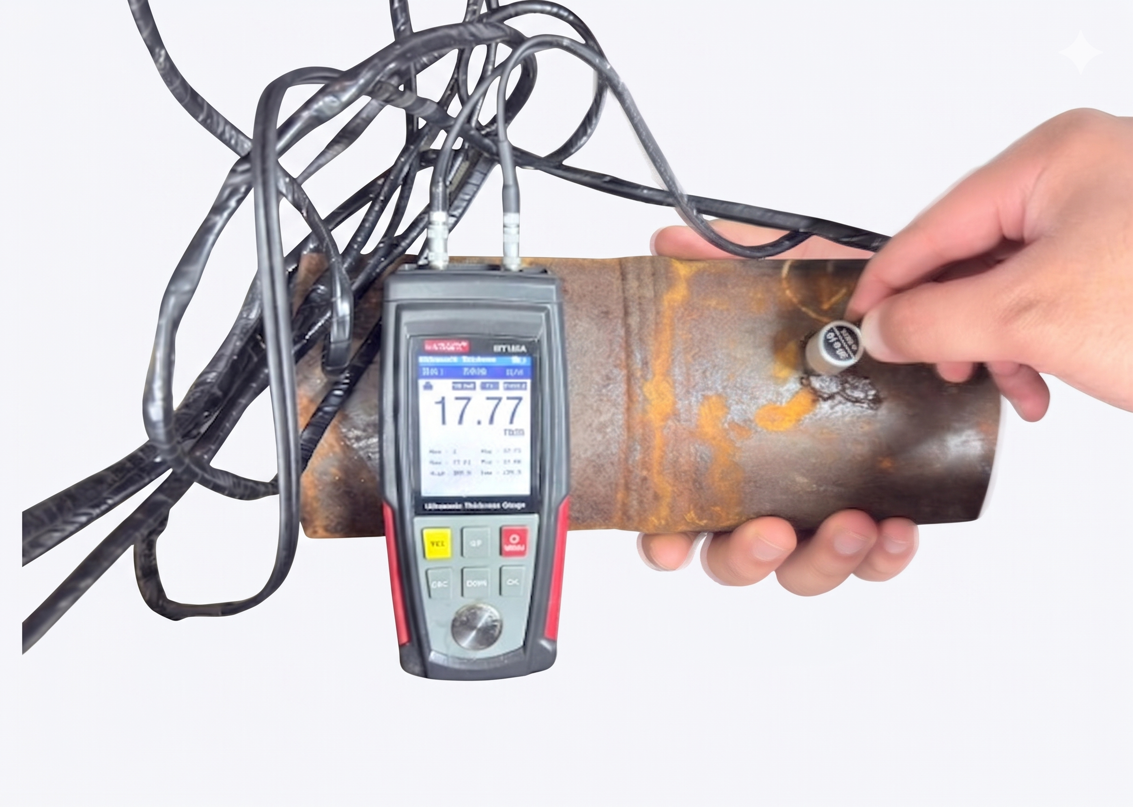
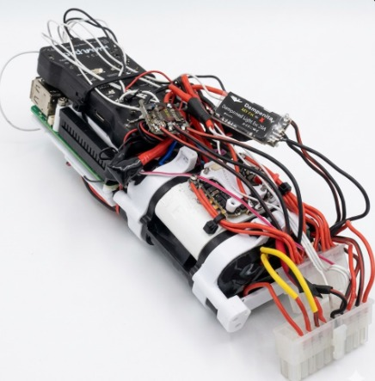
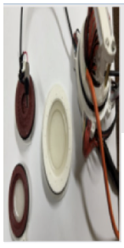
Autonomous Wired Submarine for Oil Leak Detection
TEAM
M11
Hussain Al Abdullah, Hisham Al Ramadhan, Mohammed Al Rasasi, Ibrahim Al Bahrani, Abdullah Buradha
Coach: Fadi Al Badour
Background
Design
Components Diagram
Specifications
Highlights the challenges of underwater oil leak detection, particularly in shallow waters.
Emphasizes the need for a low-cost, connected, AI-based submersible.
Presents the key technical and scientific principles behind the proposed system design.
Secure data transmission using encrypted channels (TLS/SSL)
Database fetching time ≤ 1s
Speed of submarine 1m/s
AI model inference latency ≤ 10s
Maximum flow resistance 0.5 m/s
Problem Statement
To overcome the high costs and safety risks of current methods, this project develops a low-cost submersible for real-time oil leak detection in shallow marine environments
Real-time dashboard update latency ≤ 1s
Corrosion rate ≤ 250 µm/year
Pipeline remanning life estimation accuracy ≤ 90%
Conclusion
Main Sensors
Isolation System
Components Diagram
Prototype successfully demonstrated stable operation, reliable sensing, and real-time leak detection.
Delivers a low-cost, effective solution for underwater monitoring.
Future work: enhance AI accuracy, optimize power efficiency, and improve autonomy.
Key Constraint
Dimensions: Max 50 cm
Operating Depth: 3 m
Latency: 500 ms
Data Cycle: 30 s
Accuracy: ± (0.5 % + 0.05) mm

