Slide 1

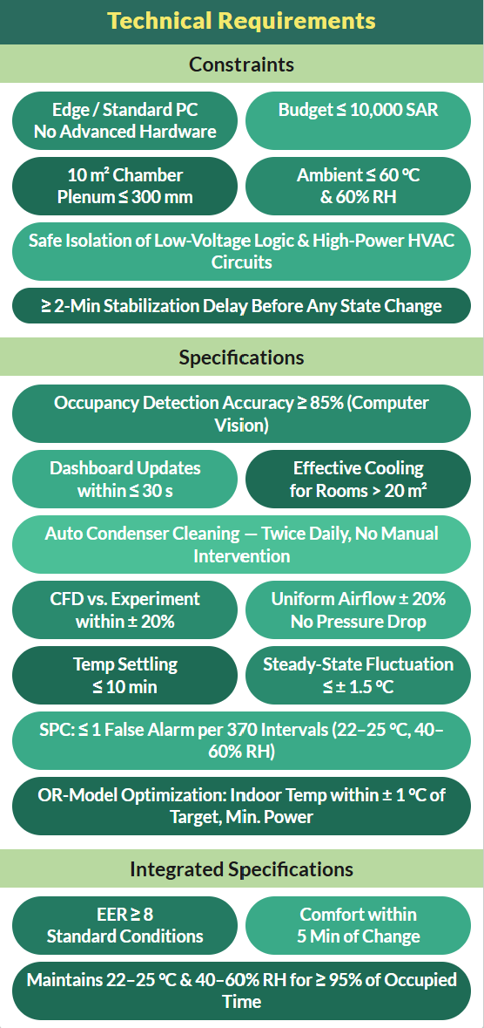
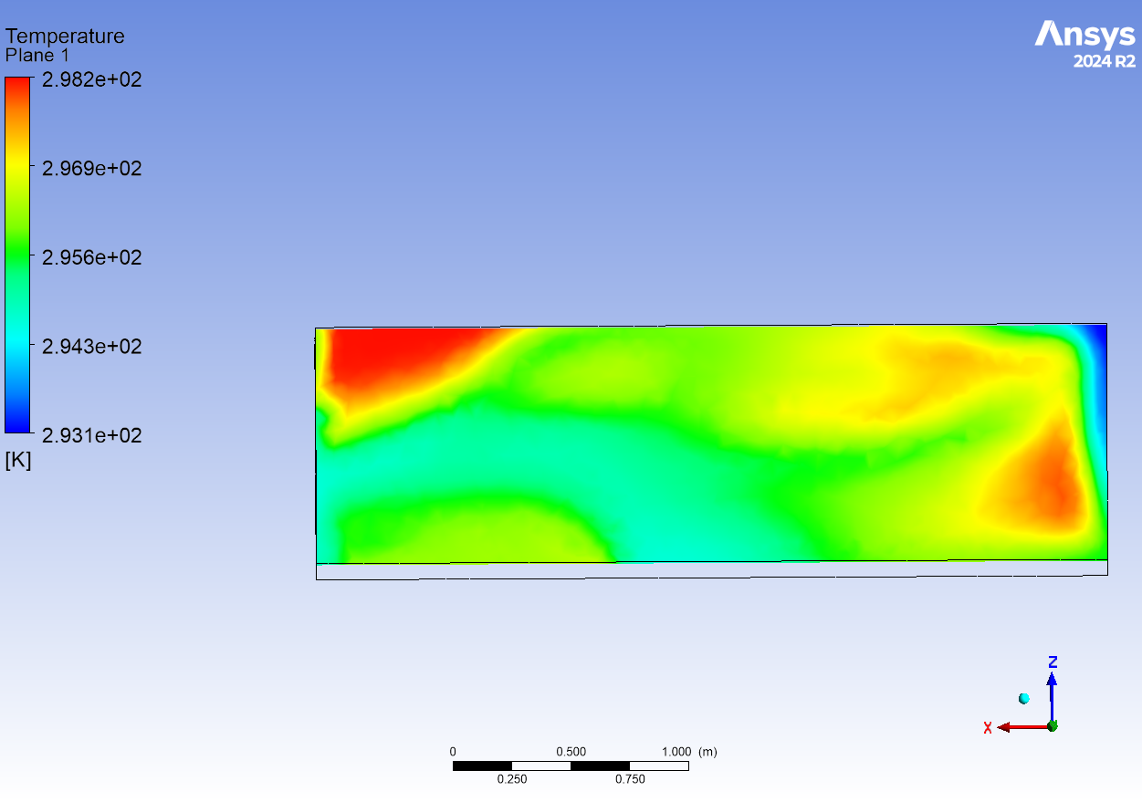
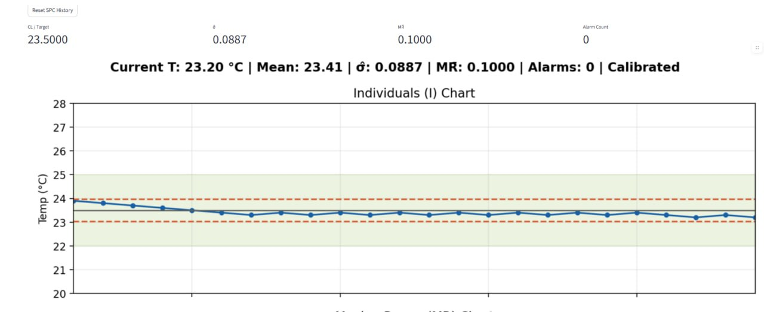
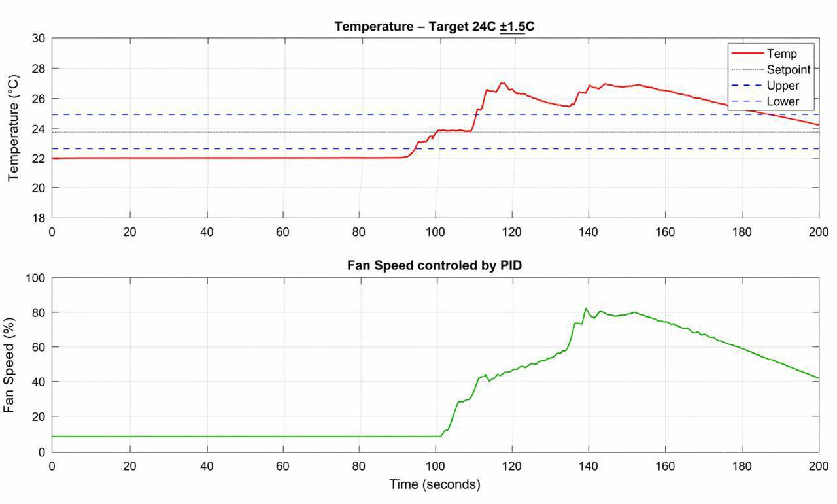
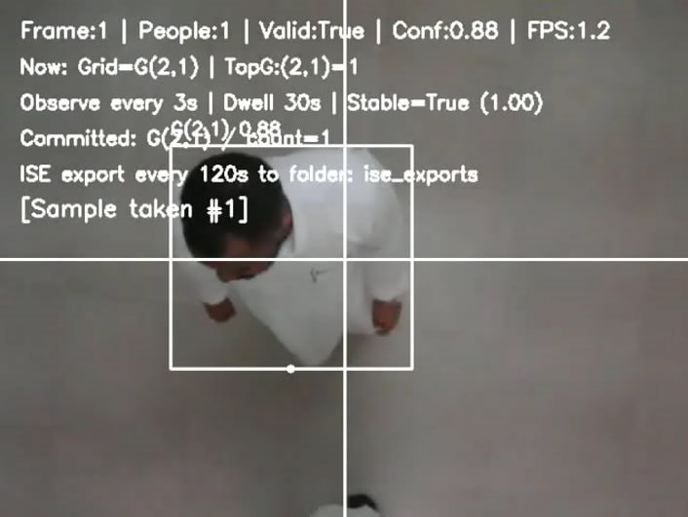
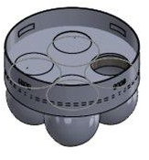
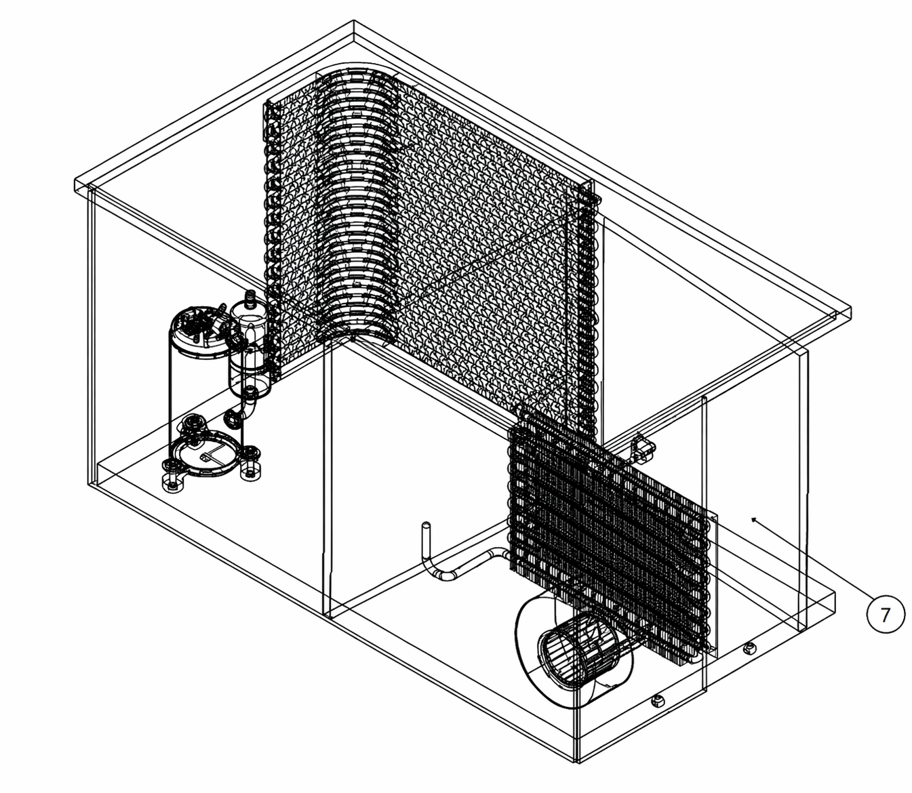
Advanced HVAC System for Thermal Comfort & Energy Optimization in Offshore Rig Cabins
TEAM
M010
Abdullah Alqurashi, Nawaf Al Thawab, Saed Althalabi, Fahad Alaqeeli, Nawaf Aljohani, Abdulrahman Alhaidari
Coach: Ahmed Al-jabr
Background
Constrains
Testing & Validation
Offshore cabin HVAC systems consume a significant share of auxiliary power. Most still rely on fixed setpoints and fixed-direction diffusers, resulting in occupancy-insensitive cooling and inefficient air delivery. Condenser fouling further degrades heat transfer and increases energy use over time.
Problem Statement
Specifications
Conventional offshore-cabin HVAC control is occupancy-blind, airflow-fixed, and fouling-exposed, producing avoidable energy waste, uneven comfort, and progressive efficiency loss.
Objective
Design, build, and validate an integrated HVAC prototype for an offshore-scale cabin that maintains 22–25 °C and 40–60% RH while reducing energy use through computer-vision occupancy sensing, a four-nozzle smart diffuser, an OR/SPC supervisory layer, and automated condenser self-cleaning.
Prototype Design
Conclusion
The project delivered a five-discipline integrated HVAC prototype with smart airflow, automated condenser self-cleaning, and real-time supervisory control, successfully meeting all defined specifications and constraints. It achieved at least 85% occupancy detection accuracy, maintained stable comfort conditions, met the required EER, restored comfort within 5 minutes of state changes, and integrated a live dashboard with SPC monitoring alongside an OR supervisory decision layer.
Integrated Specifications

