Slide 1
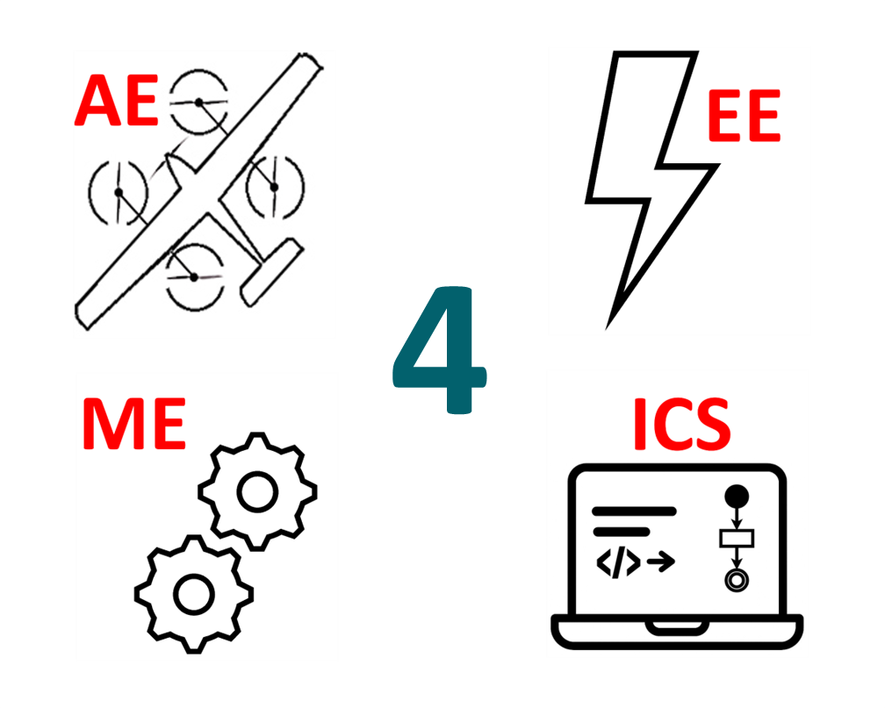
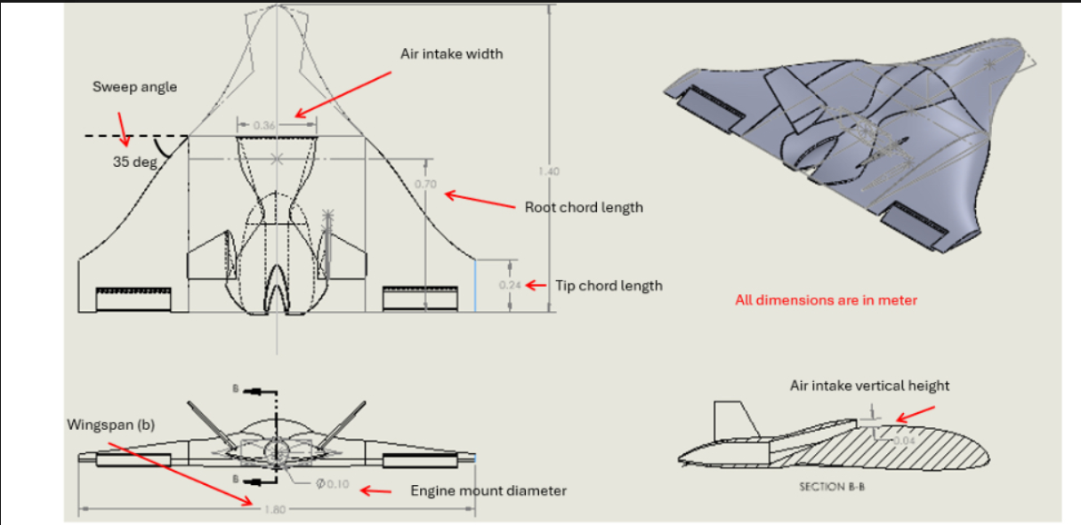
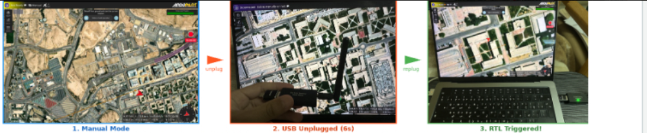
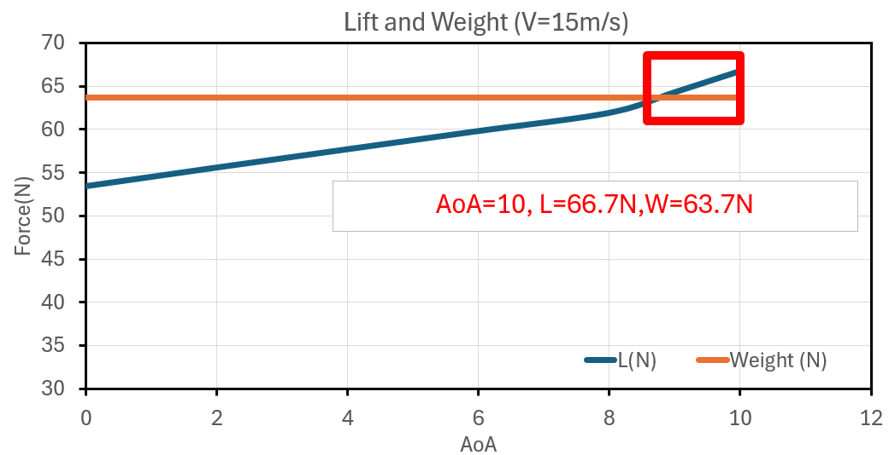
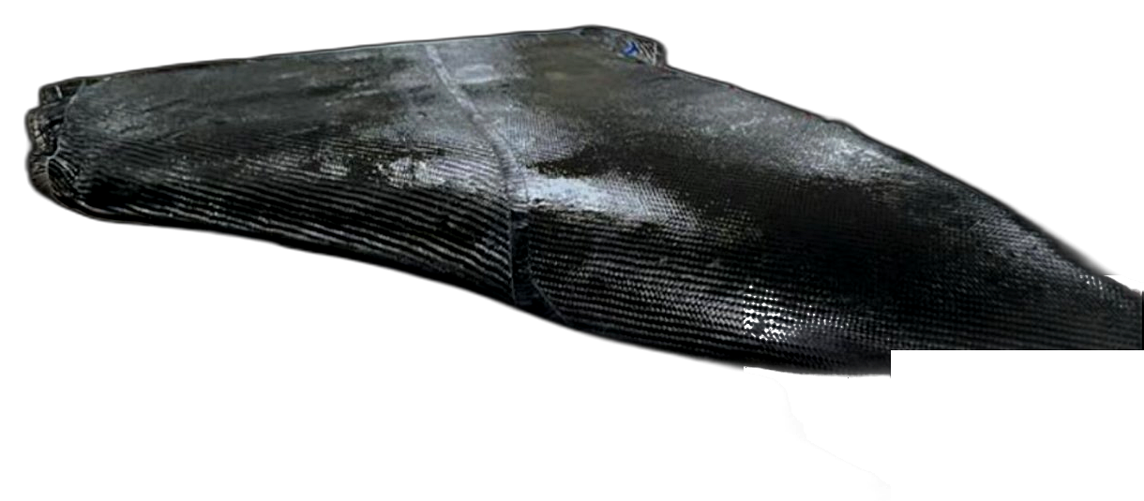
Stealth Loyal Wingman UCAV — Autonomous Takeoff & Landing Prototype
TEAM
M009
Khalil Binsabaan (AE), Abdulaziz alsadrani (CS), Alridha Almajed (CS), Muath alodhaibi (EE), Salman alshaikh (ME), Ahmed Aloufi (AE)
Coach: Dr. Md Abdullah Al Bari
Introduction/Background
Prototype Design
Testing & Validation
Project Impact & Conclusion
Problem statement
The prototype adopts a blended wing body (BWB) configuration with a 1.80 m wingspan and 35° sweep angle, designed to improve aerodynamic efficiency and provide a stealth-inspired geometry. The airframe was modeled in CAD and manufactured using a CNC-cut EPS20 foam core, followed by a carbon fiber wrap with epoxy, resulting in a lightweight and structurally robust design suitable for flight testing.
The system was validated through simulation (SITL), bench testing, and aerodynamic analysis. All 6/6 SITL mission scenarios were successfully completed, verifying autonomous navigation and system reliability. A lost-link condition was physically tested, where the system detected the failure within 4.0 s and triggered return-to-launch (RTL) within 4.5 s. Additionally, aerodynamic analysis confirmed that lift exceeds weight at 10° angle of attack (L = 66.7 N > W = 63.7 N), supporting the feasibility of sustained flight.
This project delivers KFUPM's first stealth-loyal wingman for manned-unmanned teaming in Saudi Arabia. It shifts dangerous sensing and escort tasks from crewed fighters to an affordable unmanned platform, reducing pilot risk and mission cost. The simulation-first framework is directly reusable by Stake-holders for training and evaluation, and the four-discipline integration establishes a model for future capstone aerospace projects.
Jet fighters are costly and high-risk to operate, and since Saudi Arabia lacks a fixed-wing loyal wingman platform, an unmanned loyal wingman test aircraft is needed to reduce pilot risk and enable manned–unmanned teaming in combat and surveillance missions.
Constraints
Conclusion
The UCAV prototype and autonomy framework were successfully designed, built, and validated through analysis, bench testing, and SITL simulation. All six simulation scenarios passed and no avionics brownout occurred under worst-case loads. Structural margins far exceed requirements. The stealth-proxy radar comparison. Next steps: authorized flight tests, stealth-proxy closure, lighter structures, and future AI-assisted onboard functions.
Must comply with GAMI regulations, non-weaponized operation
Battery and payload bays vibration-isolated and securely fastened
In simulation, 4 tests out of 6 pass from different scenarios
No power-rail brownouts under worst-case electrical load
No sensor faults with all transmitters at full power
Specifications
End-to-end control latency ≤ 1 s
Positive control at all distances ≤ 50 m line-of-sight
Lost-link detected ≤ 5 s, auto RTL starts
light telemetry logged every 1 s
Structural safety factor ≥ 1.5 under max flight loads
Flight range ≥ 3 km
Airspeed ≥ 15 m/s in level flight
Landing gear fatigue safety factor ≥ 1.2 at 100 cycles
Modular payload bay supports ≥ 0.5 kg
Wing covered by carbon fiber
Resin

