Slide 1
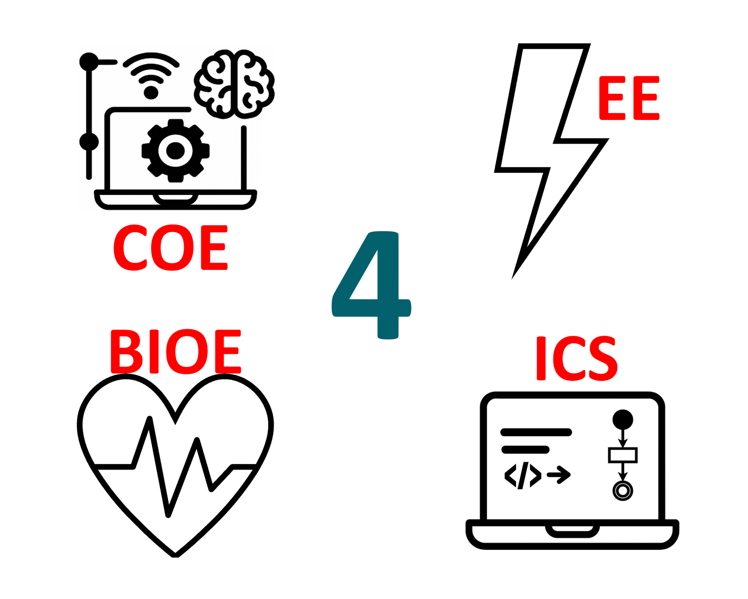
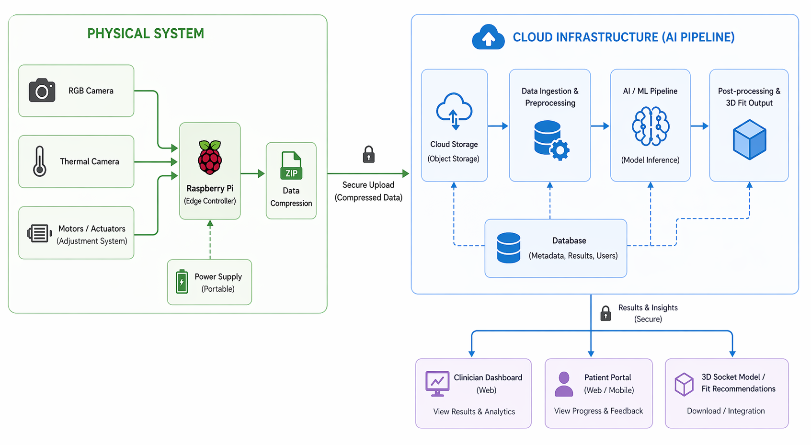
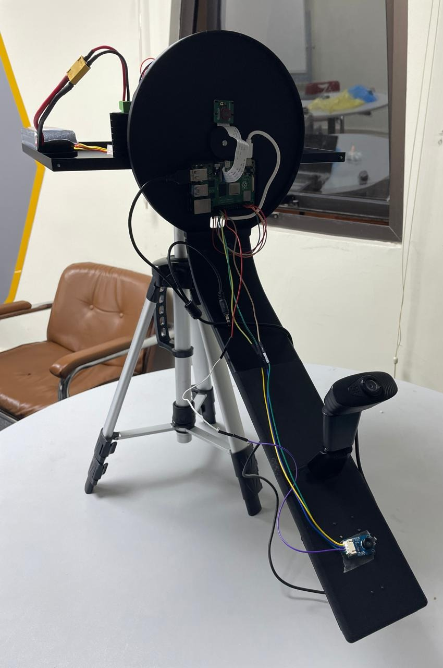
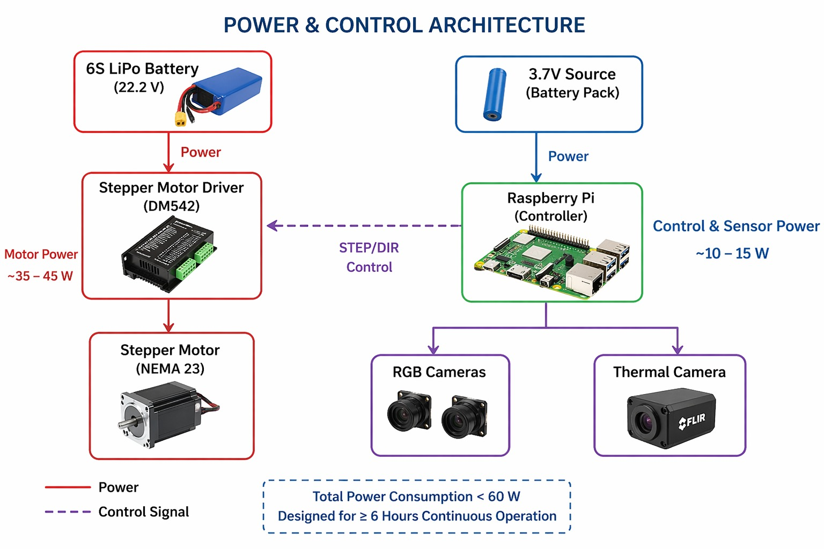
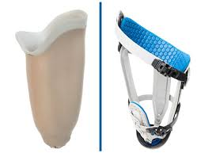
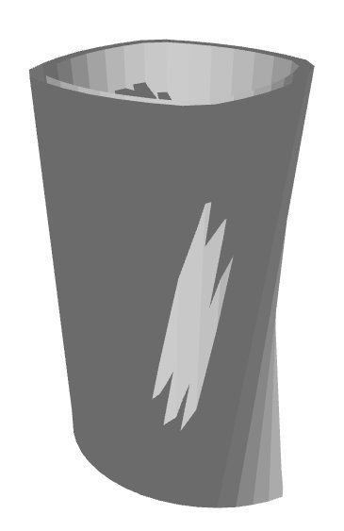
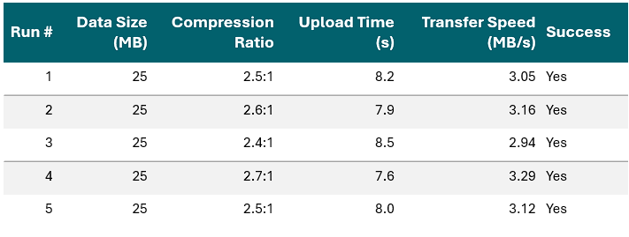
AI-Enabled Pre-Fitting Wearable Device with Multimodal Imaging and Nerve-Sensing for Predictive Prosthetic Socket Design and Enhanced User Comfort
TEAM
M004
Mohamed Serag, Moaz Abdulaziz, Osama ALKaranawi, Alwaleed Faleet, Abdulellah AlMayman, Saleh Alharbi
Coach: Dr. Shujaat Khan
Problem & Solution
Solution In Numbers
System Features & Components
Problem Statement:
Achieving a comfortable prosthetic socket fit remains a persistent challenge in clinical practice. Studies indicate that over 70% of amputees experience discomfort related to their prosthetic sockets, while nearly 60% require multiple refitting sessions. This process is very costive and time consuming.
Solution:
We propose an AI-enabled pre-fitting system that enhances precision and reduces uncertainty in the socket design process. By integrating thermal imaging (to detect areas of stress, inflammation, and pressure buildup) with high-resolution visual data, the system provides a more comprehensive understanding of the limb’s physiological condition. This data fusion approach enables the generation of a manufacturing-ready socket design before fabrication begins.
Socket Accuracy
> 90%
Operation Time
> 10 min
Physical System:
The physical system integrates precise sensors, embedded electronics, and efficient power management to capture reliable data while ensuring stable, portable, and safe operation.
Cloud Infrastructure:
The cloud infrastructure enabled seamless integration between data acquisition and processing. Its scalability supported handling multiple users and large datasets efficiently,
AI pipeline:
Our AI pipeline fused thermal and visual data, enabling accurate predictions, automated socket design, faster processing, and improved fitting outcomes.
Customer Dashboard:
The customer dashboard provides real-time insights, intuitive visualization of fitting data, progress tracking, and seamless communication between clinicians and patients.
“The system was able to produce sockets of more than 90% accuracy based on our testing”
“The total time the system takes to generate an output is on average less than 10 minutes”
Prototype Design
Specification | Constrains
Prosthetic socket fit accuracy ≥ 80%.​ | Clinical safety compliant (e.g.,FDA Class I).
MCU-to-cloud transfer time ≤ 10seconds.​ | Data encrypted at rest; stored inone region.​
Max power consumption ≤ 60 W.​ | Operates in 18–28°C, 30–70%humidity, 300–1000 Lux.​
Motor holding torque ≥ 3.5 N·m​ | ≥ 6 hours continuous operationon portable power.​
Supports ≥ 50 users per hour.​
Thermal resolution ≥ 32 × 24 ​
Retain logs ≥ 90 days & stored ≥ 6 M​
3D–thermal alignment error ≤ 4.00mm RMS.​
Conclusion
The outcome is a more efficient and accurate fitting process— Ultimately, this approach shifts prosthetic fitting from a reactive, iterative process to a more predictive and data-driven one, benefiting both clinicians and patients alike.

