Slide 1
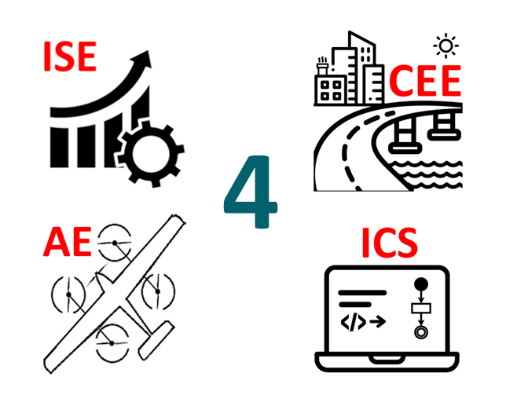
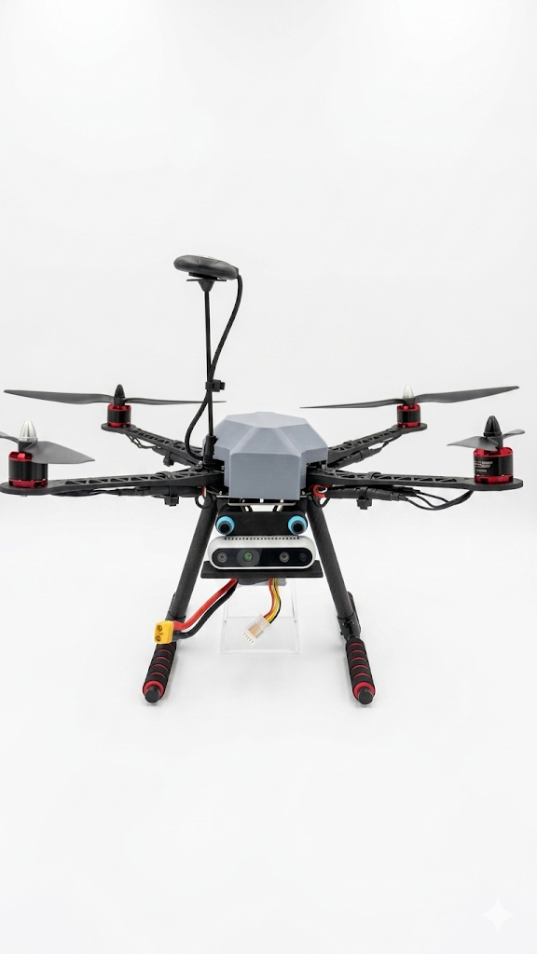
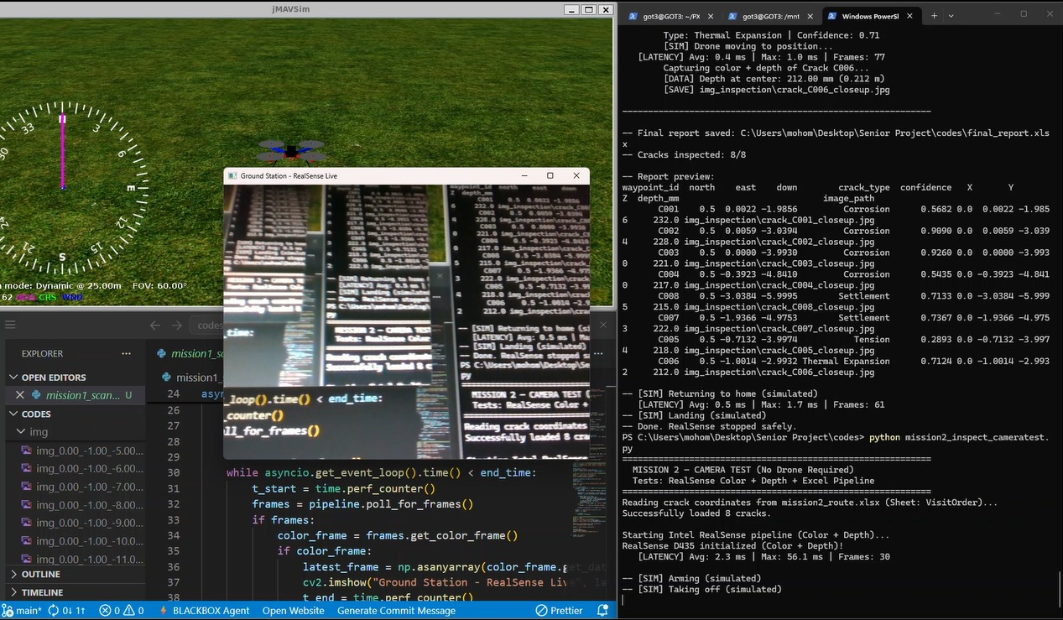
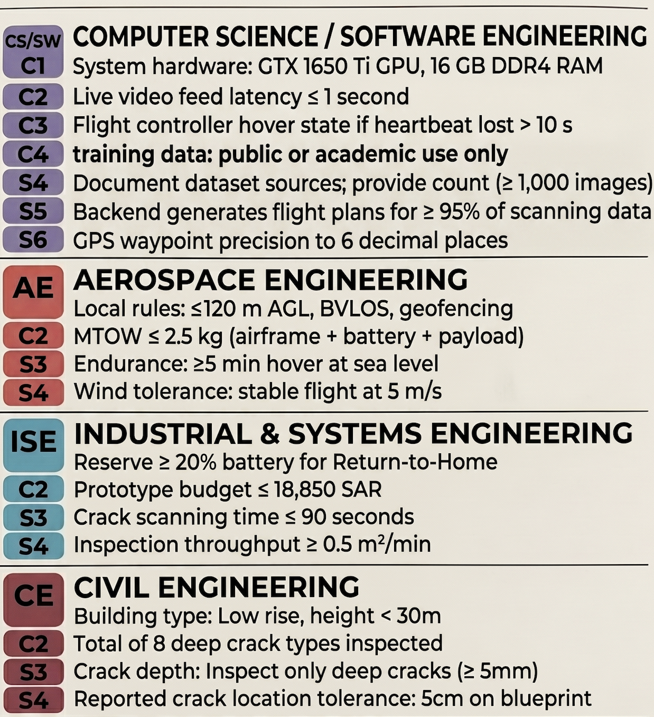
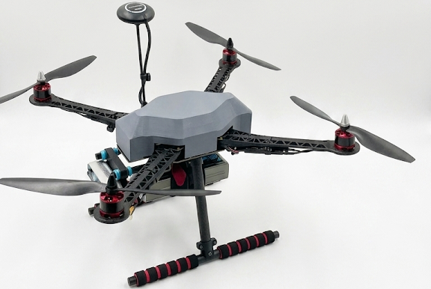
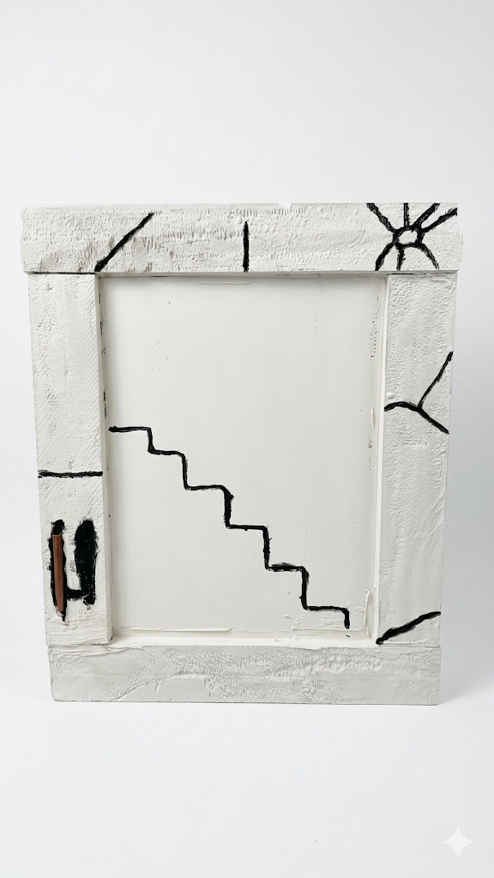
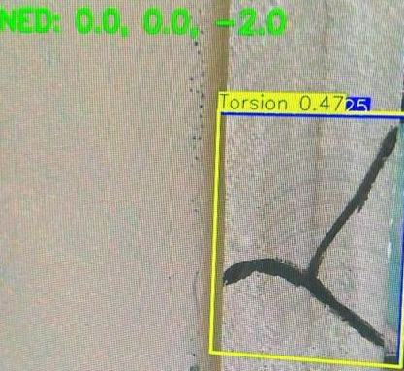
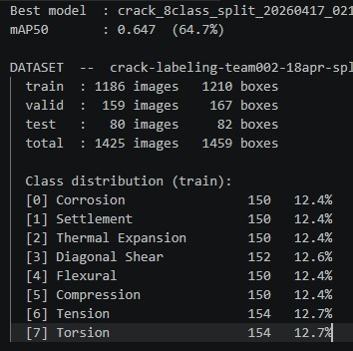
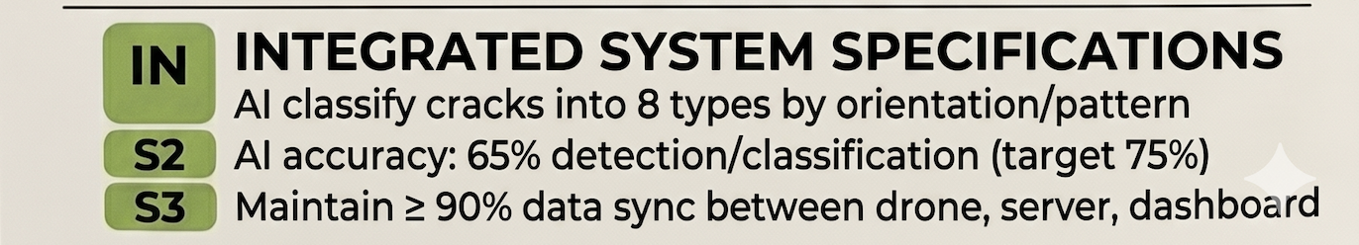
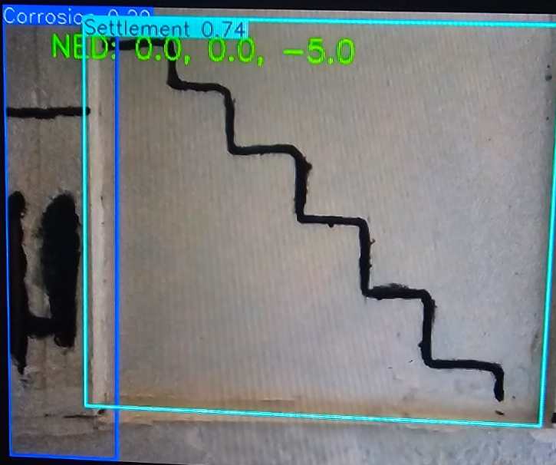
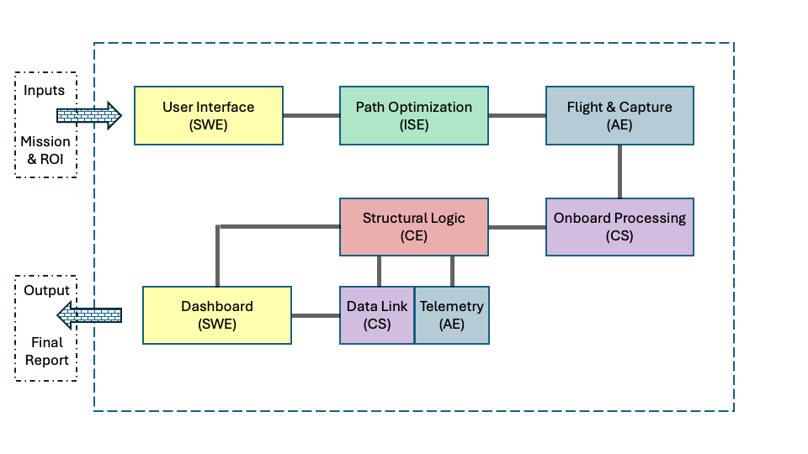
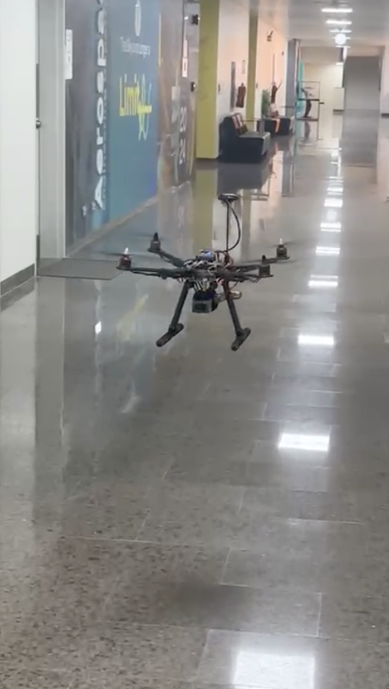
Drone-Based Structural Crack Detection and Classification Inspection System
TEAM
M002
Mohammed Aldahash, Faisal Alabduljabbar, Mohammed Almezail,
Abdulrahman Aloufi, Alwaleed Almutairi, Mohammed Alolayan
Coach: Esam Alhomaidi
Introduction
Prototype
Testing & Validation
Constraints & Specifications
A semi-autonomous drone system tailored for low-rise buildings that detects, classifies, and assesses structural cracks. It combines drone inspection, onboard AI model, crack measurement, and automated reporting to insure fast and clear building assessment.
Problem Statement
The drone includes an S500 quadrotor, Pixhawk controller, Raspberry Pi 5, and Intel RealSense D435 camera.
Validating a successful simulation mission with low-latency live video.
Manual crack inspection is slow, expensive, and unsafe. Existing drones only capture images, but engineers still need to review defects. Our system closes this gap by turning inspection data into actionable crack information.
Validating an AI model trained on a 1,400+ image dataset, reaching 65% accuracy in crack detection.
Deliverables
Conclusion
Prototype proved that drone-based crack inspection can be safer, faster, and more consistent than manual methods. It integrates detection, classification, measurement, and reporting in one workflow offering a solution to low-rise buildings.
The model performs structure scanning, revisits detected cracks, measures depth, and generates a final inspection report.
Validating successful drone flight and stable hovering.

