Slide 1

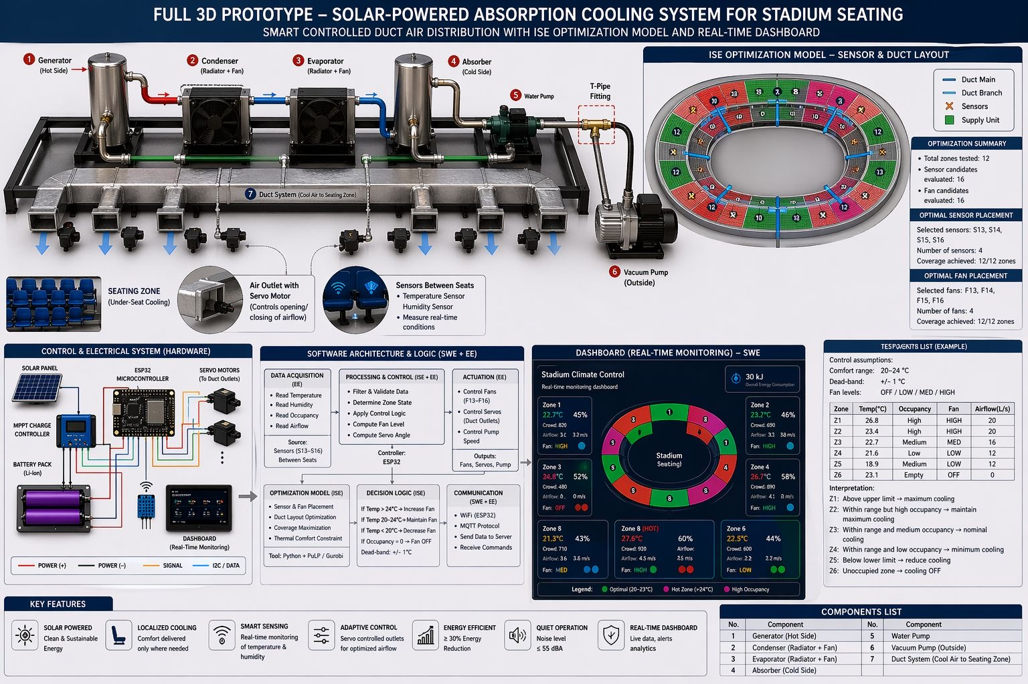
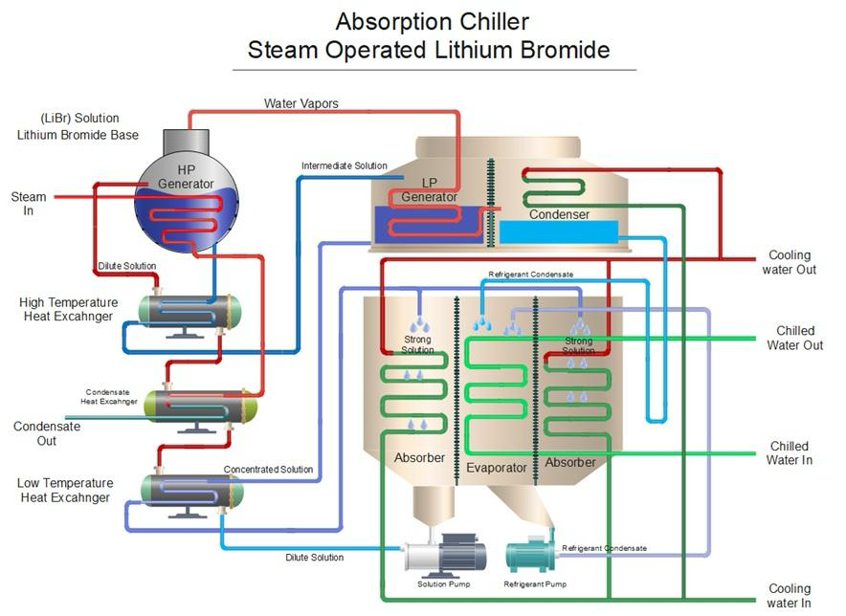
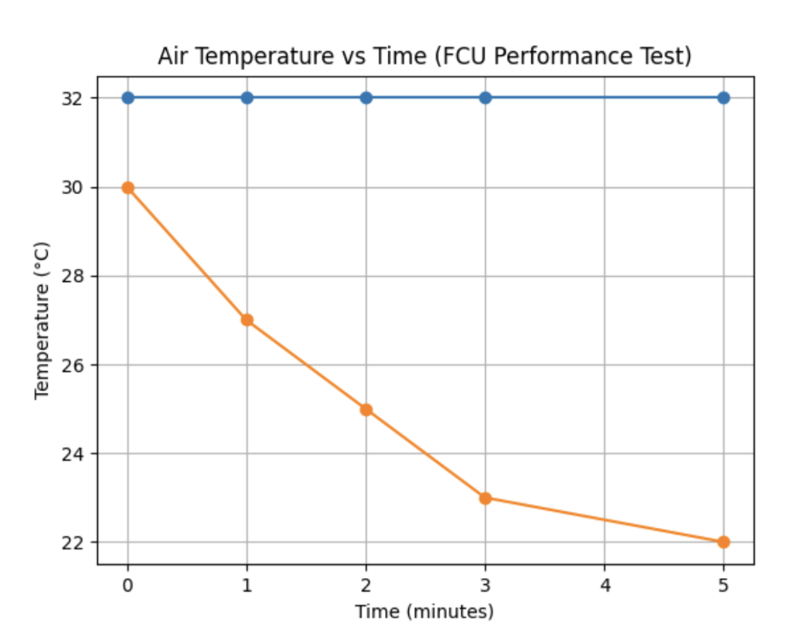



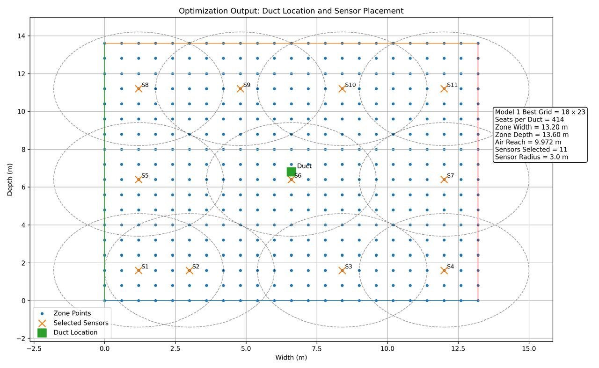
Solar Powered Mechanical Cooling System for Stadiums in Saudi Arabia
TEAM
F043
Joud Aldoukhi, Layan Alharbi, Shahad Aljaafari, Zahra Alhadab, Maha Altamimi, Hadeel Alshuhaib
Coach: Dr. Umer Zahid
Introduction
Prototype
Test and Validation
Outdoor stadiums face extreme heat and high energy demand, making conventional cooling inefficient. This project proposes a solar-powered absorption cooling system with localized air distribution to maintain 20–24°C while improving efficiency and reducing environmental impact.
Problem Statement
50°C+
60K+
40%
Extreme heat and high thermal loads in outdoor stadiums.
Conventional cooling is inefficient and energy-intensive.
Need for a sustainable, energy-efficient cooling solution.
Specification
Conclusion
Achievements
Maintained air temperature within 20–24 °C.
Delivered airflow within 12–20 L/s per seat (design basis).
Chilled water temperature (7–10 °C) validated via simulation.
System availability achieved ≥ 90% (98.5%).
Sensor data latency verified < 60 s (≈18 s).
Fault detection achieved within ≤ 60.
This project presents a solar-powered localized cooling system for outdoor stadiums, maintaining 20–24°C using chilled water, under-seat air distribution, and adaptive control. A hybrid solar–grid setup ensures efficient and reliable operation only in occupied areas.
Designed absorption cooling system.
Developed localized and adaptive cooling strategy.
Achieved efficient temperature control (20–24°C).

