Slide 1
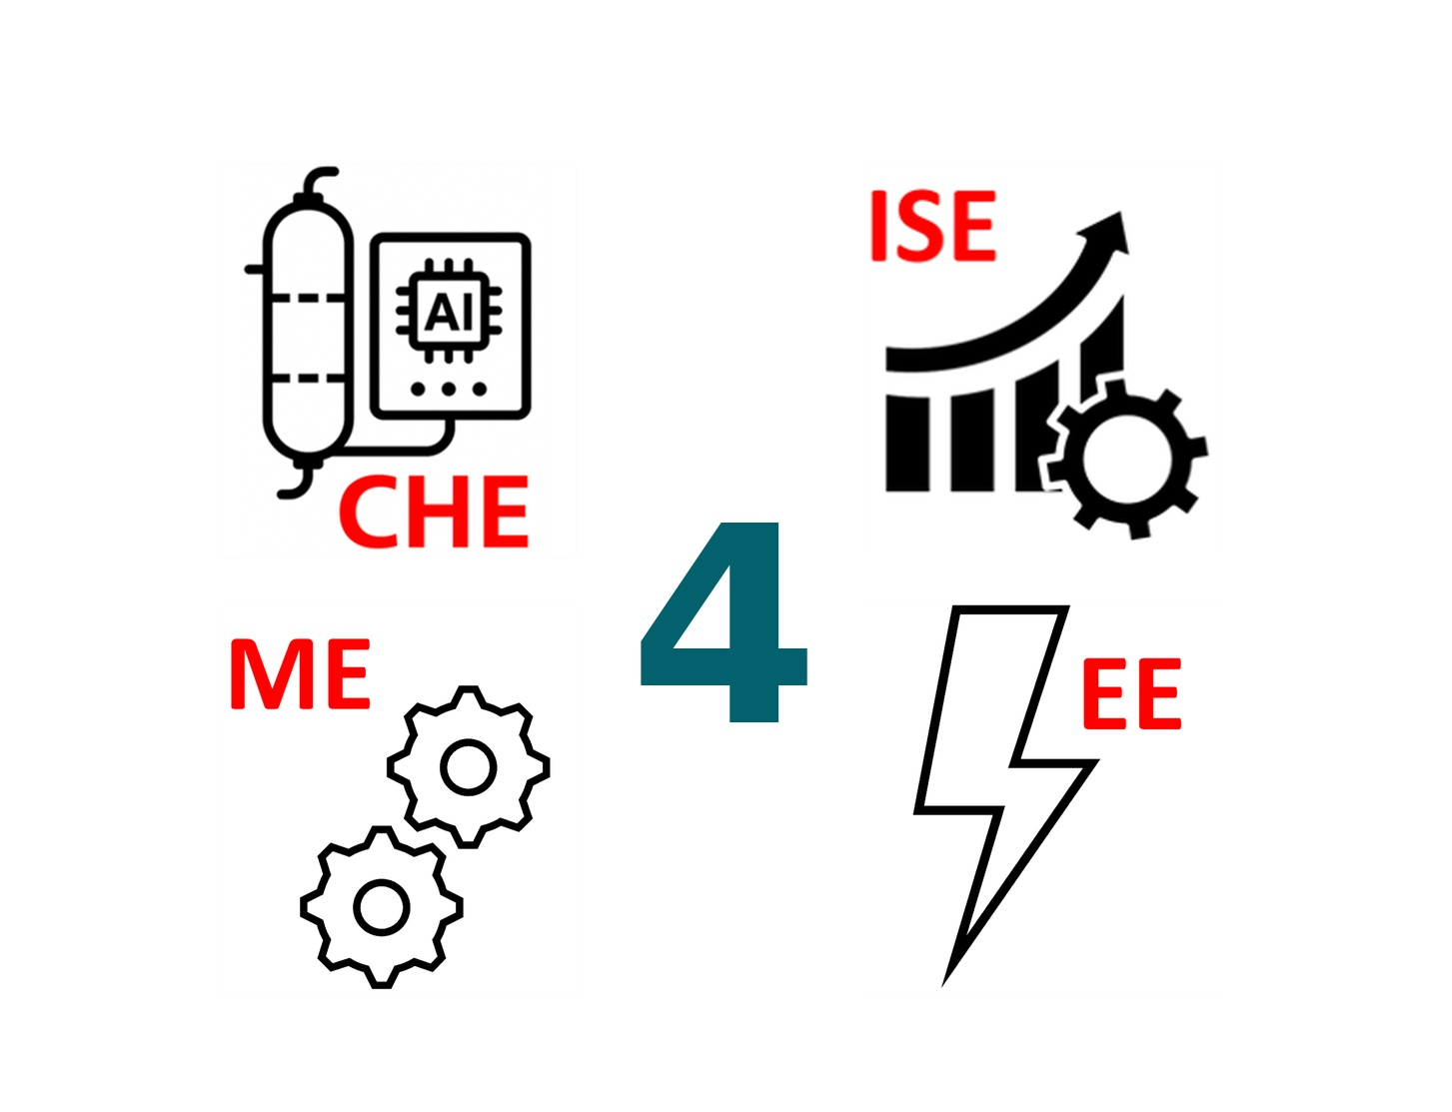
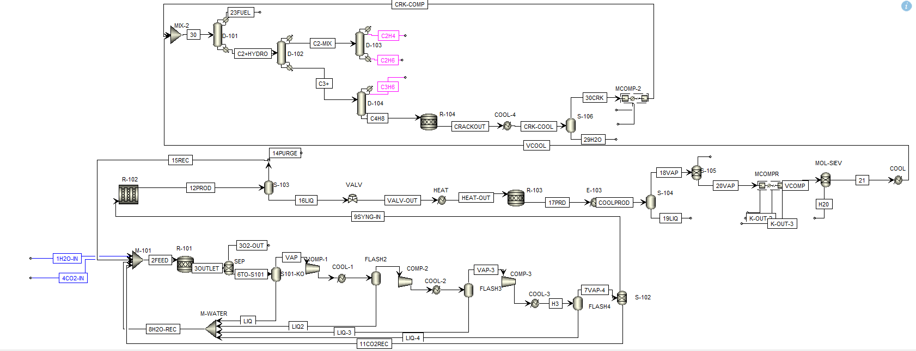
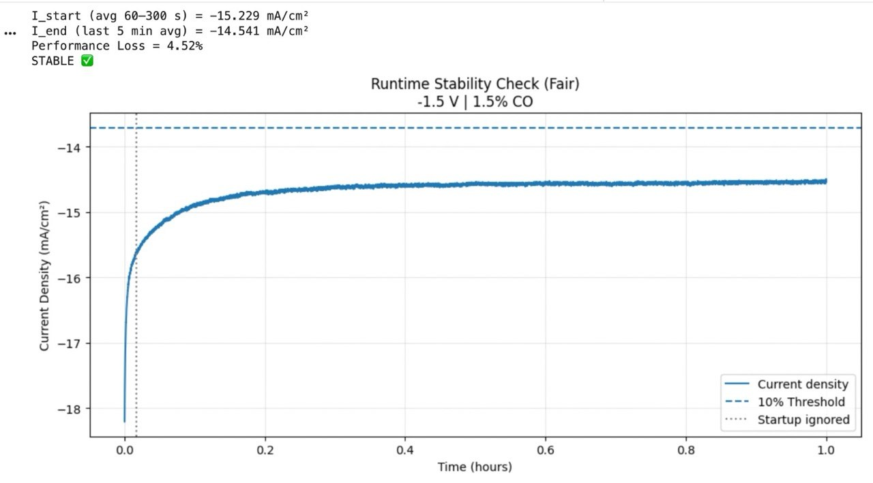
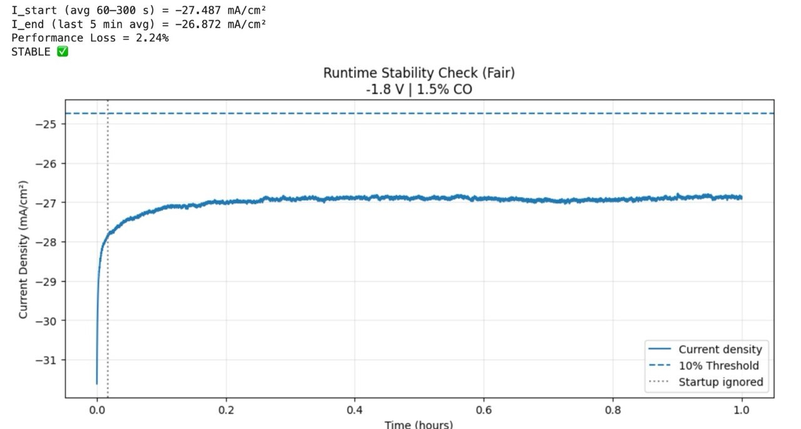
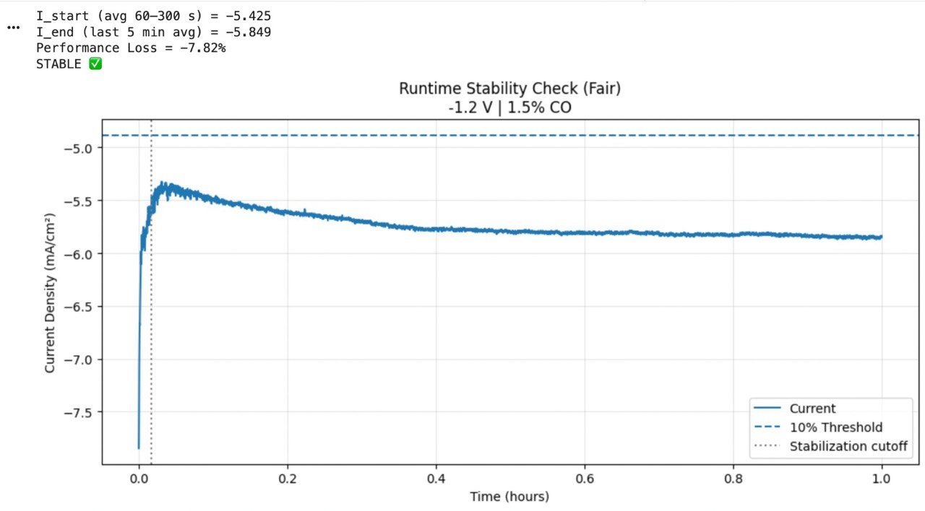
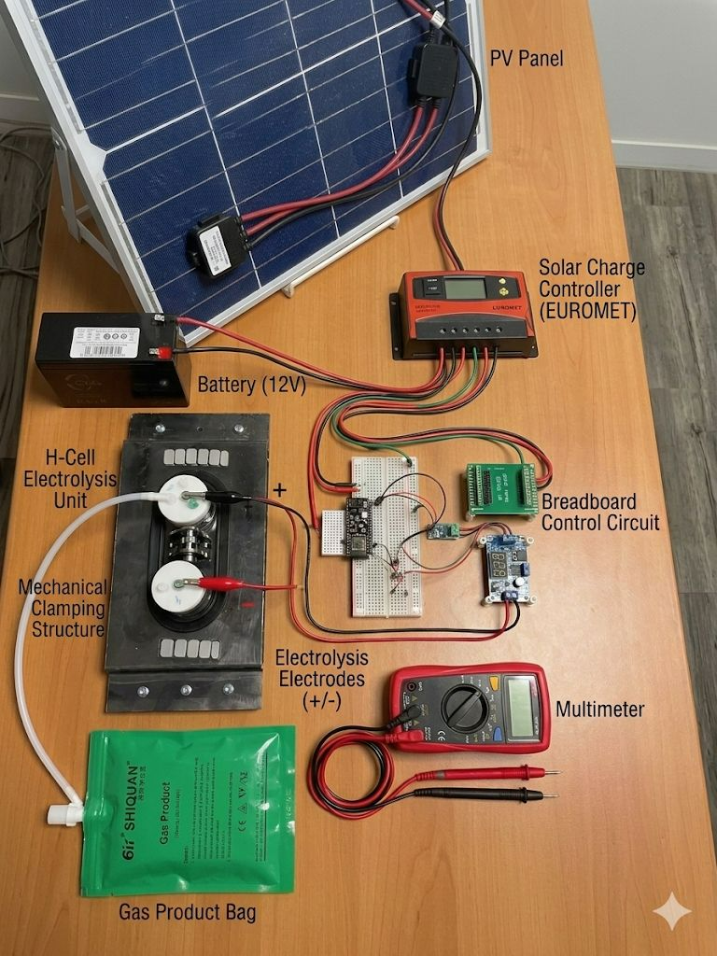
RENEWABLE-POWERED
CO₂-TO-CHEMICALS SYSTEM
TEAM
F39
Mai Algarni , Arwa Al-Saggaf , Jori Alojairi, Sondos Dhabban, Renas Koko, Shahad Aatefi
Coach: Dr. Umer Zahid
Introduction
Prototype
Achievements
Constraints and Specifications
CO₂ is one of the world’s biggest pollution problems—yet it is still treated as waste. This project transforms CO₂ into valuable chemicals by using solar energy to convert it into ethylene, demonstrating a clean and sustainable production pathway.
CHE — Aspen Plus PFD
20%
99.9%
0%
CHE CHEMICAL ENGINEERING
▸ Ambient pressure & temp ≤ 60 °C
▸ CO₂ conversion ≥20% (simulation)
CO₂ +
H₂O
→
Syngas
(Electrochem.)
→
MeOH
Synthesis
→
MTO +
Sep. Train
→
Ethylene
≥99.9%
CO₂
Conversion
Ethylene
Purity
Literature
Deviation
▸ Product purity ≥95% (simulation)
▸ Production capacity ≥ 1.0 kg/h
▸ Conversion literature deviation ≤ ±20%
Test and Validation
EE ELECTRICAL ENGINEERING
▸ Solar PV ≥ 80% of energy (daytime)
ISE — Stability Validation Charts
▸ Cell voltage accuracy ±50 mV
Problem Statement
▸ Battery backup ≥ 3-hour runtime
▸ Overcurrent trip 1.2–1.5 A; GUI ≤ 2 s
CO₂ electroreduction shows promise, but current systems remain lab-bound and lack renewable integration and real-world validation.
ISE INDUSTRIAL & SYSTEMS ENG.
▸ Integration & validation completed
The Prototype
▸ Stability ≤10% loss (1 hr)
Specification | Required | Achieved | Status
CO₂ single-pass conversion | ≥ 20% | 20.00% | ✓
Ethylene product purity | ≥ 95% | 99.9% | ✓
Literature deviation | ≤ ±20% | 0.00% | ✓
PV power output | ≥ 13 W | 18 W | ✓
Battery energy backup | ≥ 30 Wh | 64.26 Wh | ✓
Voltage regulation | ±50 mV | Achieved | ✓
DOE stability criterion | ≤ 10% loss | All 6 pass | ✓
Safety factor (ME) | ≥ 2.0 | > 2.0 | ✓
Project budget | ≤ 10,580 | 8,408 SAR | ✓
▸ Select one optimal operating condition
▸Constraints verified (cost, size, containment)
ME MECHANICAL ENGINEERING
▸ Safety factor ≥ 2.0 (all components)
Deliverable
▸ Footprint ≤ 60 × 40 × 40 cm
▸ Secondary containment ≥ 150% vol.
▸ EPDM isolation; carbon steel tray
Multidisciplinary Roles
SHARED
▸ Total budget ≤ 10,580 SAR
CHE
EE
▸ Integration within 12 weeks
Cu-Co H-Cell Reactor
Aspen Plus Simulation
Solar PV + DC-DC
Power Conversion
▸ IEC 61010 lab safety compliance
Conclusion
ISE
ME
This project demonstrates a validated, solar-powered CO₂ conversion system with integrated multidisciplinary design and clear potential for scale-up.
DOE + MILP
Optimization Model
Carbon Steel Tray
& EPDM Containment

