Slide 1
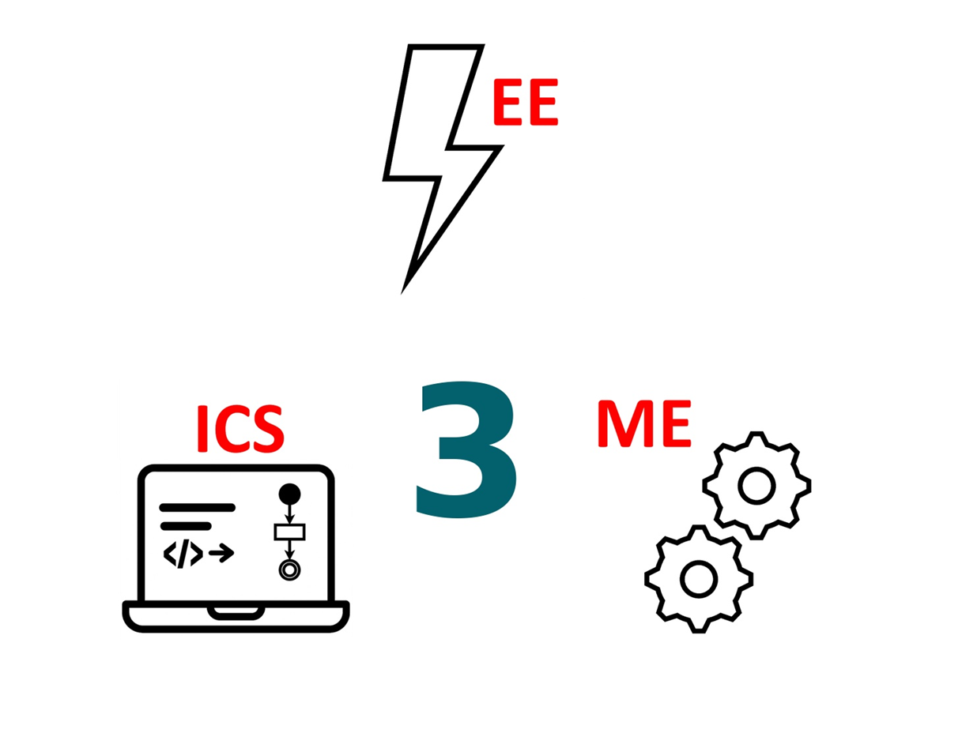
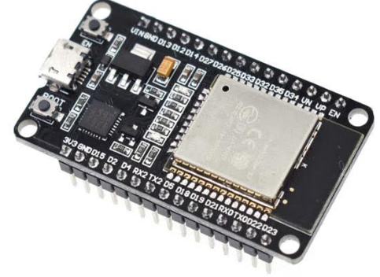
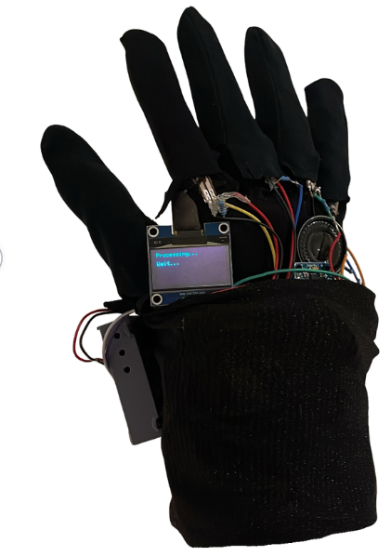
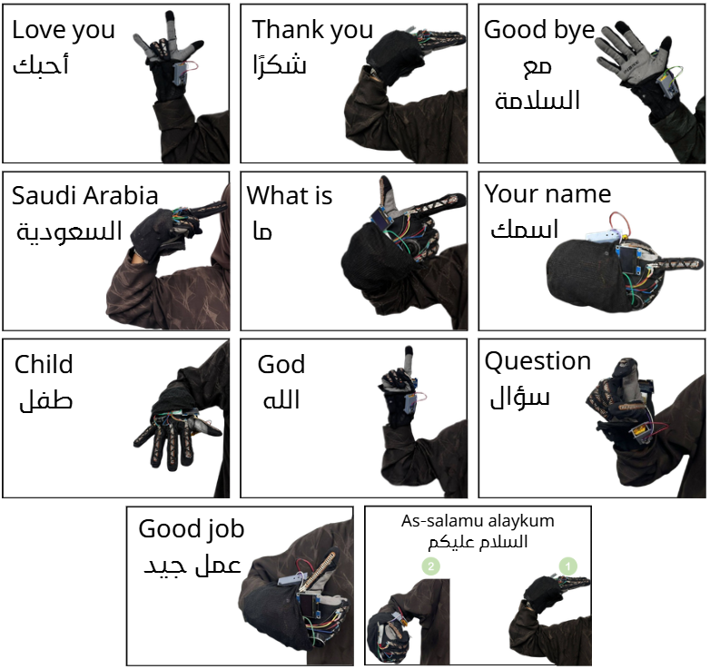
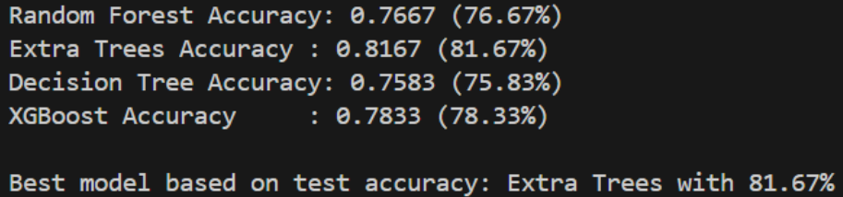
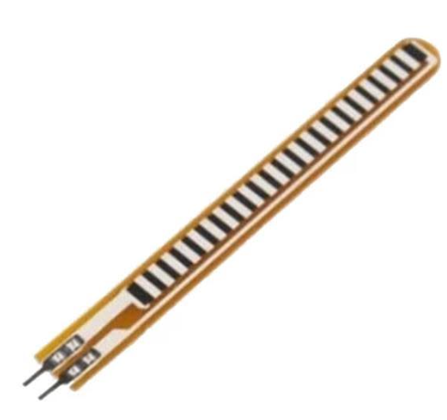
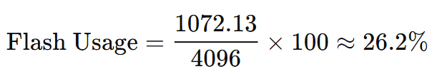
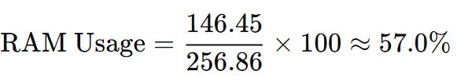
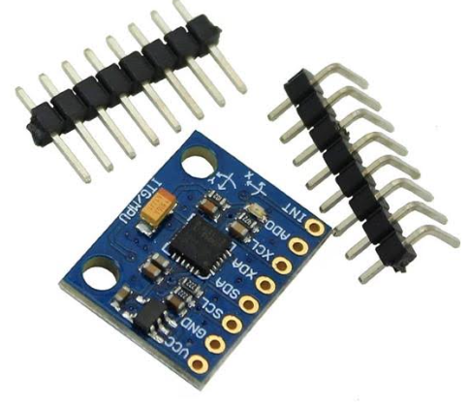
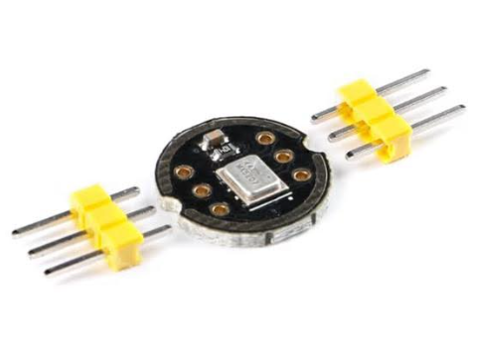
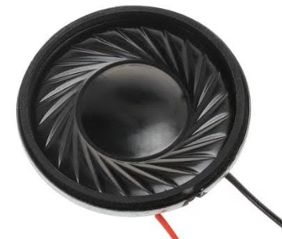
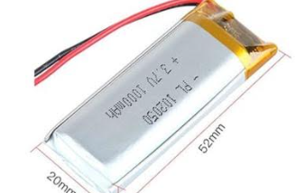
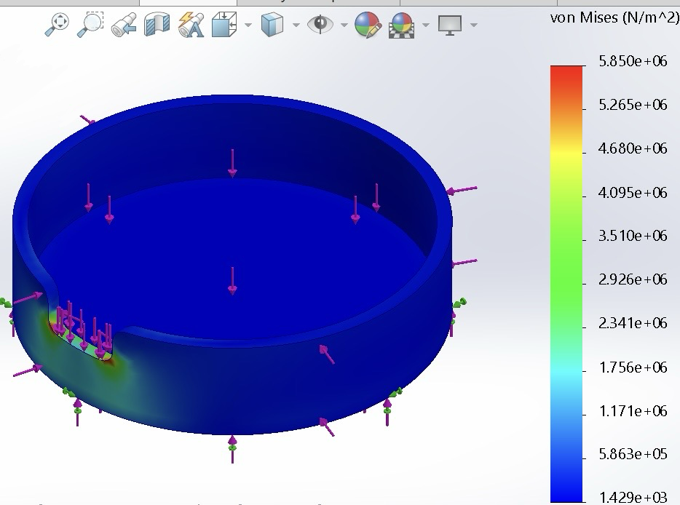
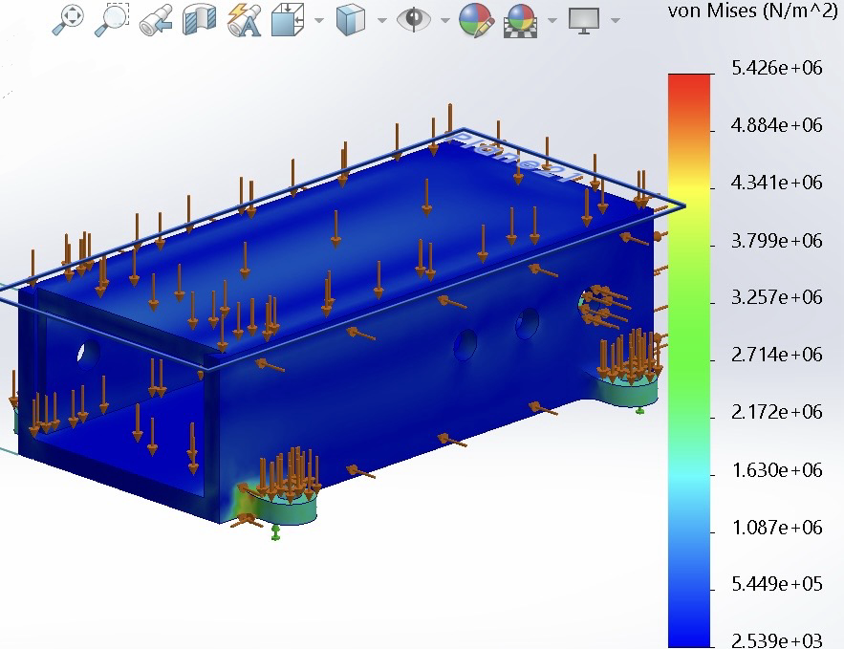
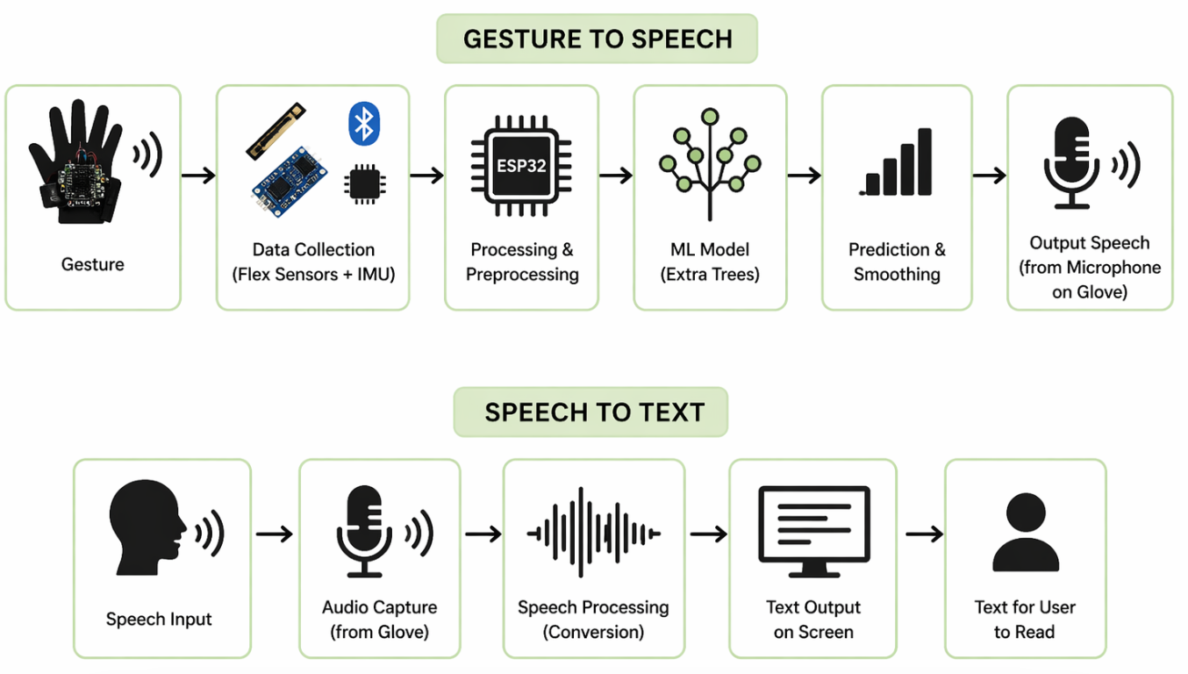
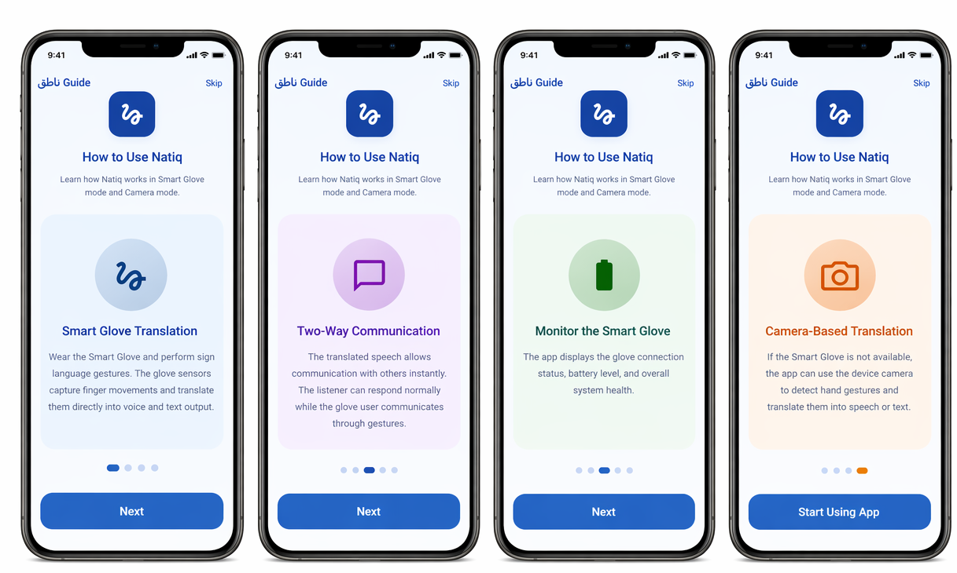
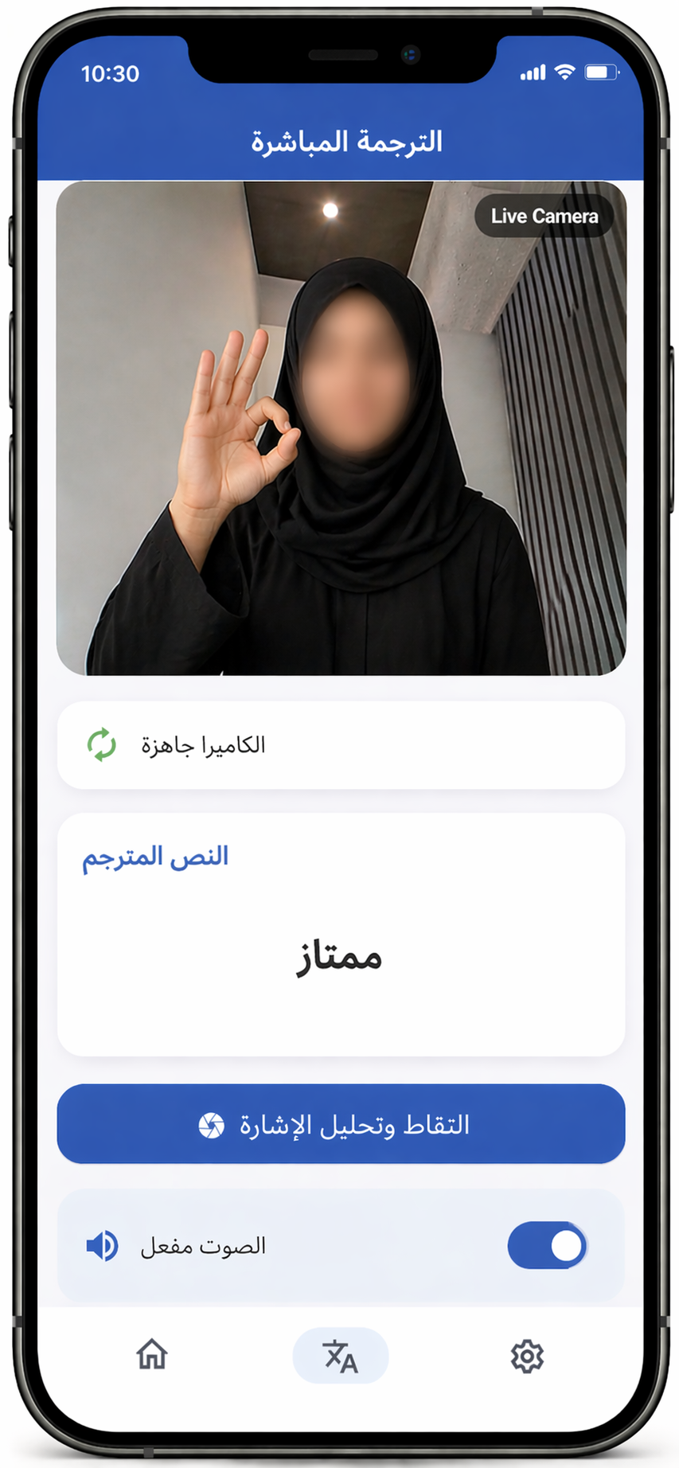
TEAM
F35
Smart Glove for Translating Sign Language into Speech
ICS: Jude Alharbi, Shahad Sulais, Rahf Altwairqi, EE: Raghad Alqahtani, Sadeem Alshaly, ME: Lama Alzahrani
Coach: Dr. Junaid ur Rehman
Introduction
Prototype Design
Testing and Validation
Hearing-impaired individuals face communication barriers due to limited interpreters. This project develops a smart glove enabling real-time, two-way communication by translating Arabic Sign Language to speech and speech to text.
Hardware Components
Software Components
Information & Computer Science
ESP32: Processes data & controls communication
Flex Sensors: Detect finger movement
MPU6050: Detects handmotion (pitch & roll)
Microphone: Speech-to-text (two-way communication)
Speaker (DFPlayer): Outputs speech
Power: 3.7V battery + boost + TP4056
Specifications
The system successfully met specifications with reliable recognition of 11 gestures.
AI Gesture Recognition: ≥ 10 gestures
Bluetooth Range: ≥ 5 m
Recharge Time: ≤ 2 h
Response Time: ≤ 5 s
Operating Time: ≥ 6 h (3.7 V Li-ion)
Weight: ≤ 1 kg, evenly distributed
Audio Level: 40–80 dB
Structural Strength: ≤ 6 MPa, FOS ≥ 1.5
Learning Efficiency: ≥ 80% in 25 min
Font Size & Colours: ≥ 14 pt, readable
Bluetooth Standard: Version 5.0
Standards: IEC 62368-1, ISO 9241-210 compliant
Electrical Engineer
The system was validated by measuring 3.3 V and 130 mA using a multimeter, achieving a charging time of 1.5 hours and an operating time of 6 hours, with Bluetooth connectivity up to 5 meters.
Collected and preprocessed data, trained an Extra Trees model, and enabled real-time prediction with smoothing.
Mechanical Engineer
The components successfully met specifications with ≤ 6 MPa, FOS ≥ 1.5
The total system weight is 212.1 grams
The total prototype cost is 1650 ﷼.
Application
Conclusion
Constraints
Natiq Glove was successfully developed by integrating hardware and software to enable reliable, real-time, two-way communication. The system translates Arabic Sign Language into speech and speech to text, improving accessibility and supporting Saudi Vision 2030.
• Prototype Cost: ≤ 3000 SAR per unit
• Operating: 3.3 V ± 5%, ≤ 500 mA
• Fabric Stress: ≤ 1.5 MPa
• Memory Usage: ≤ 75% flash memory, ≤ 70% RAM of the program
Natiq uses camera-based translation when the glove isn’t available.

