Slide 1
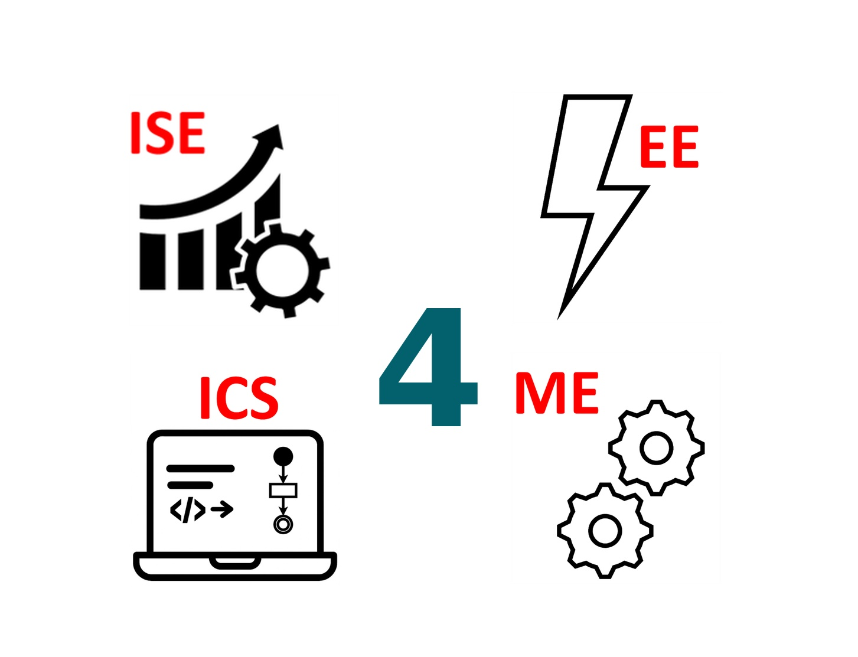
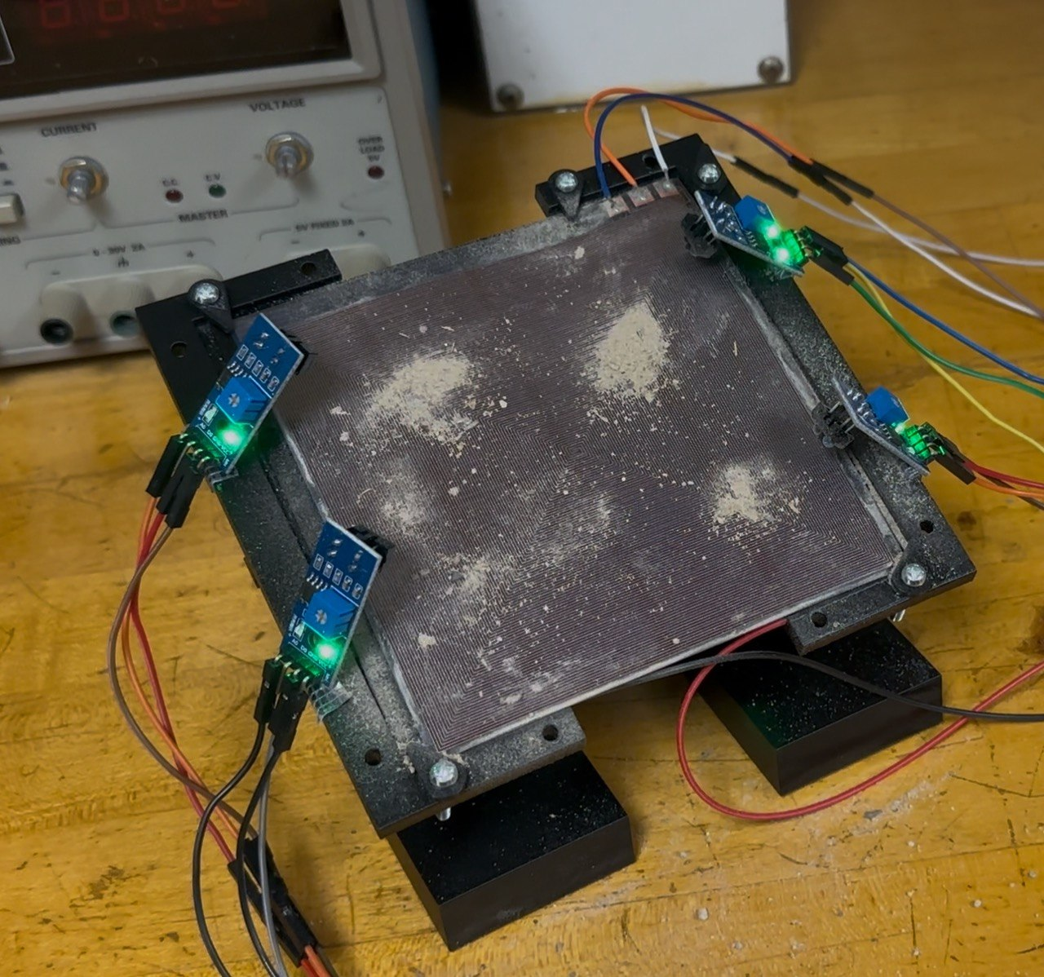
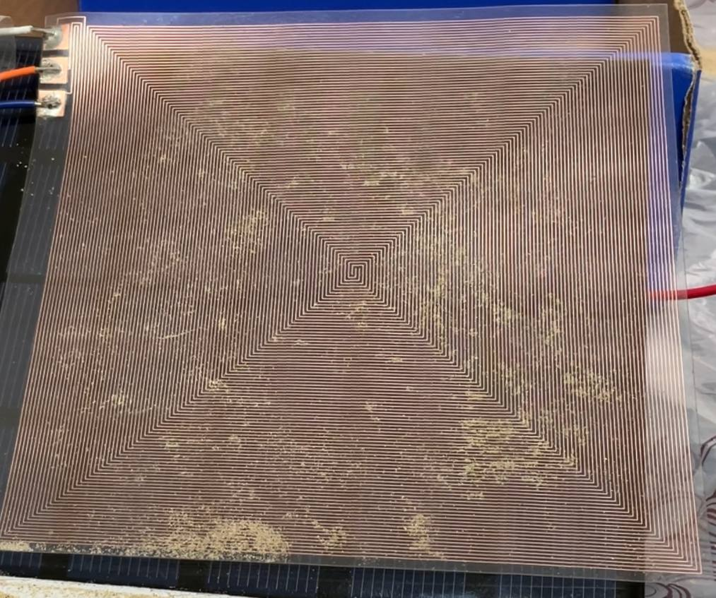
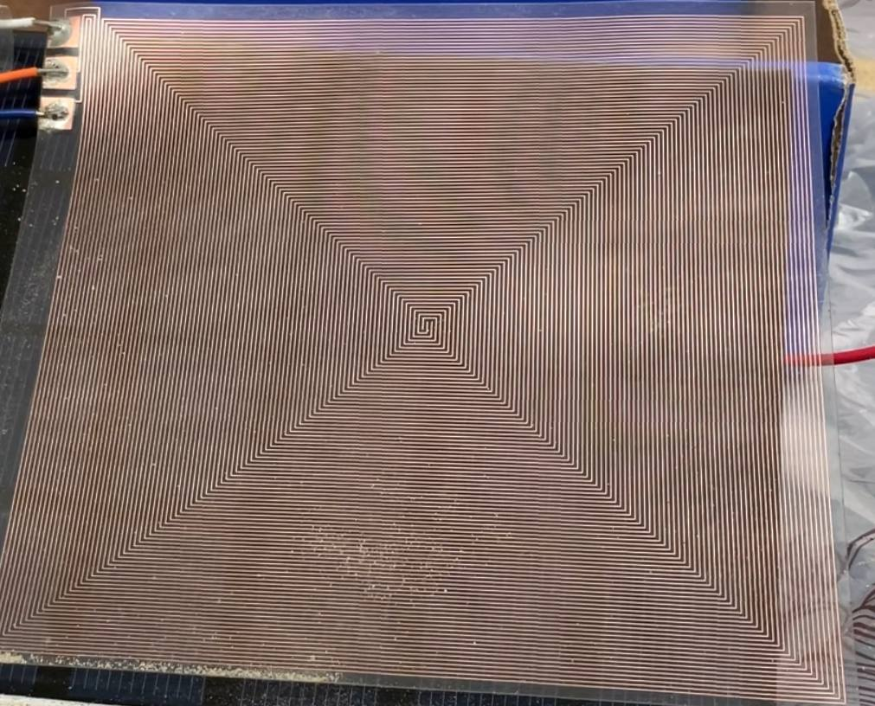
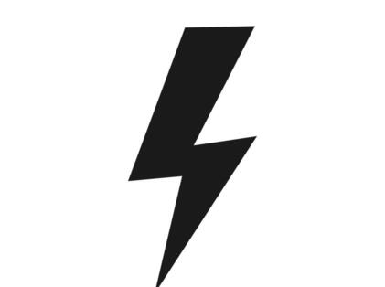
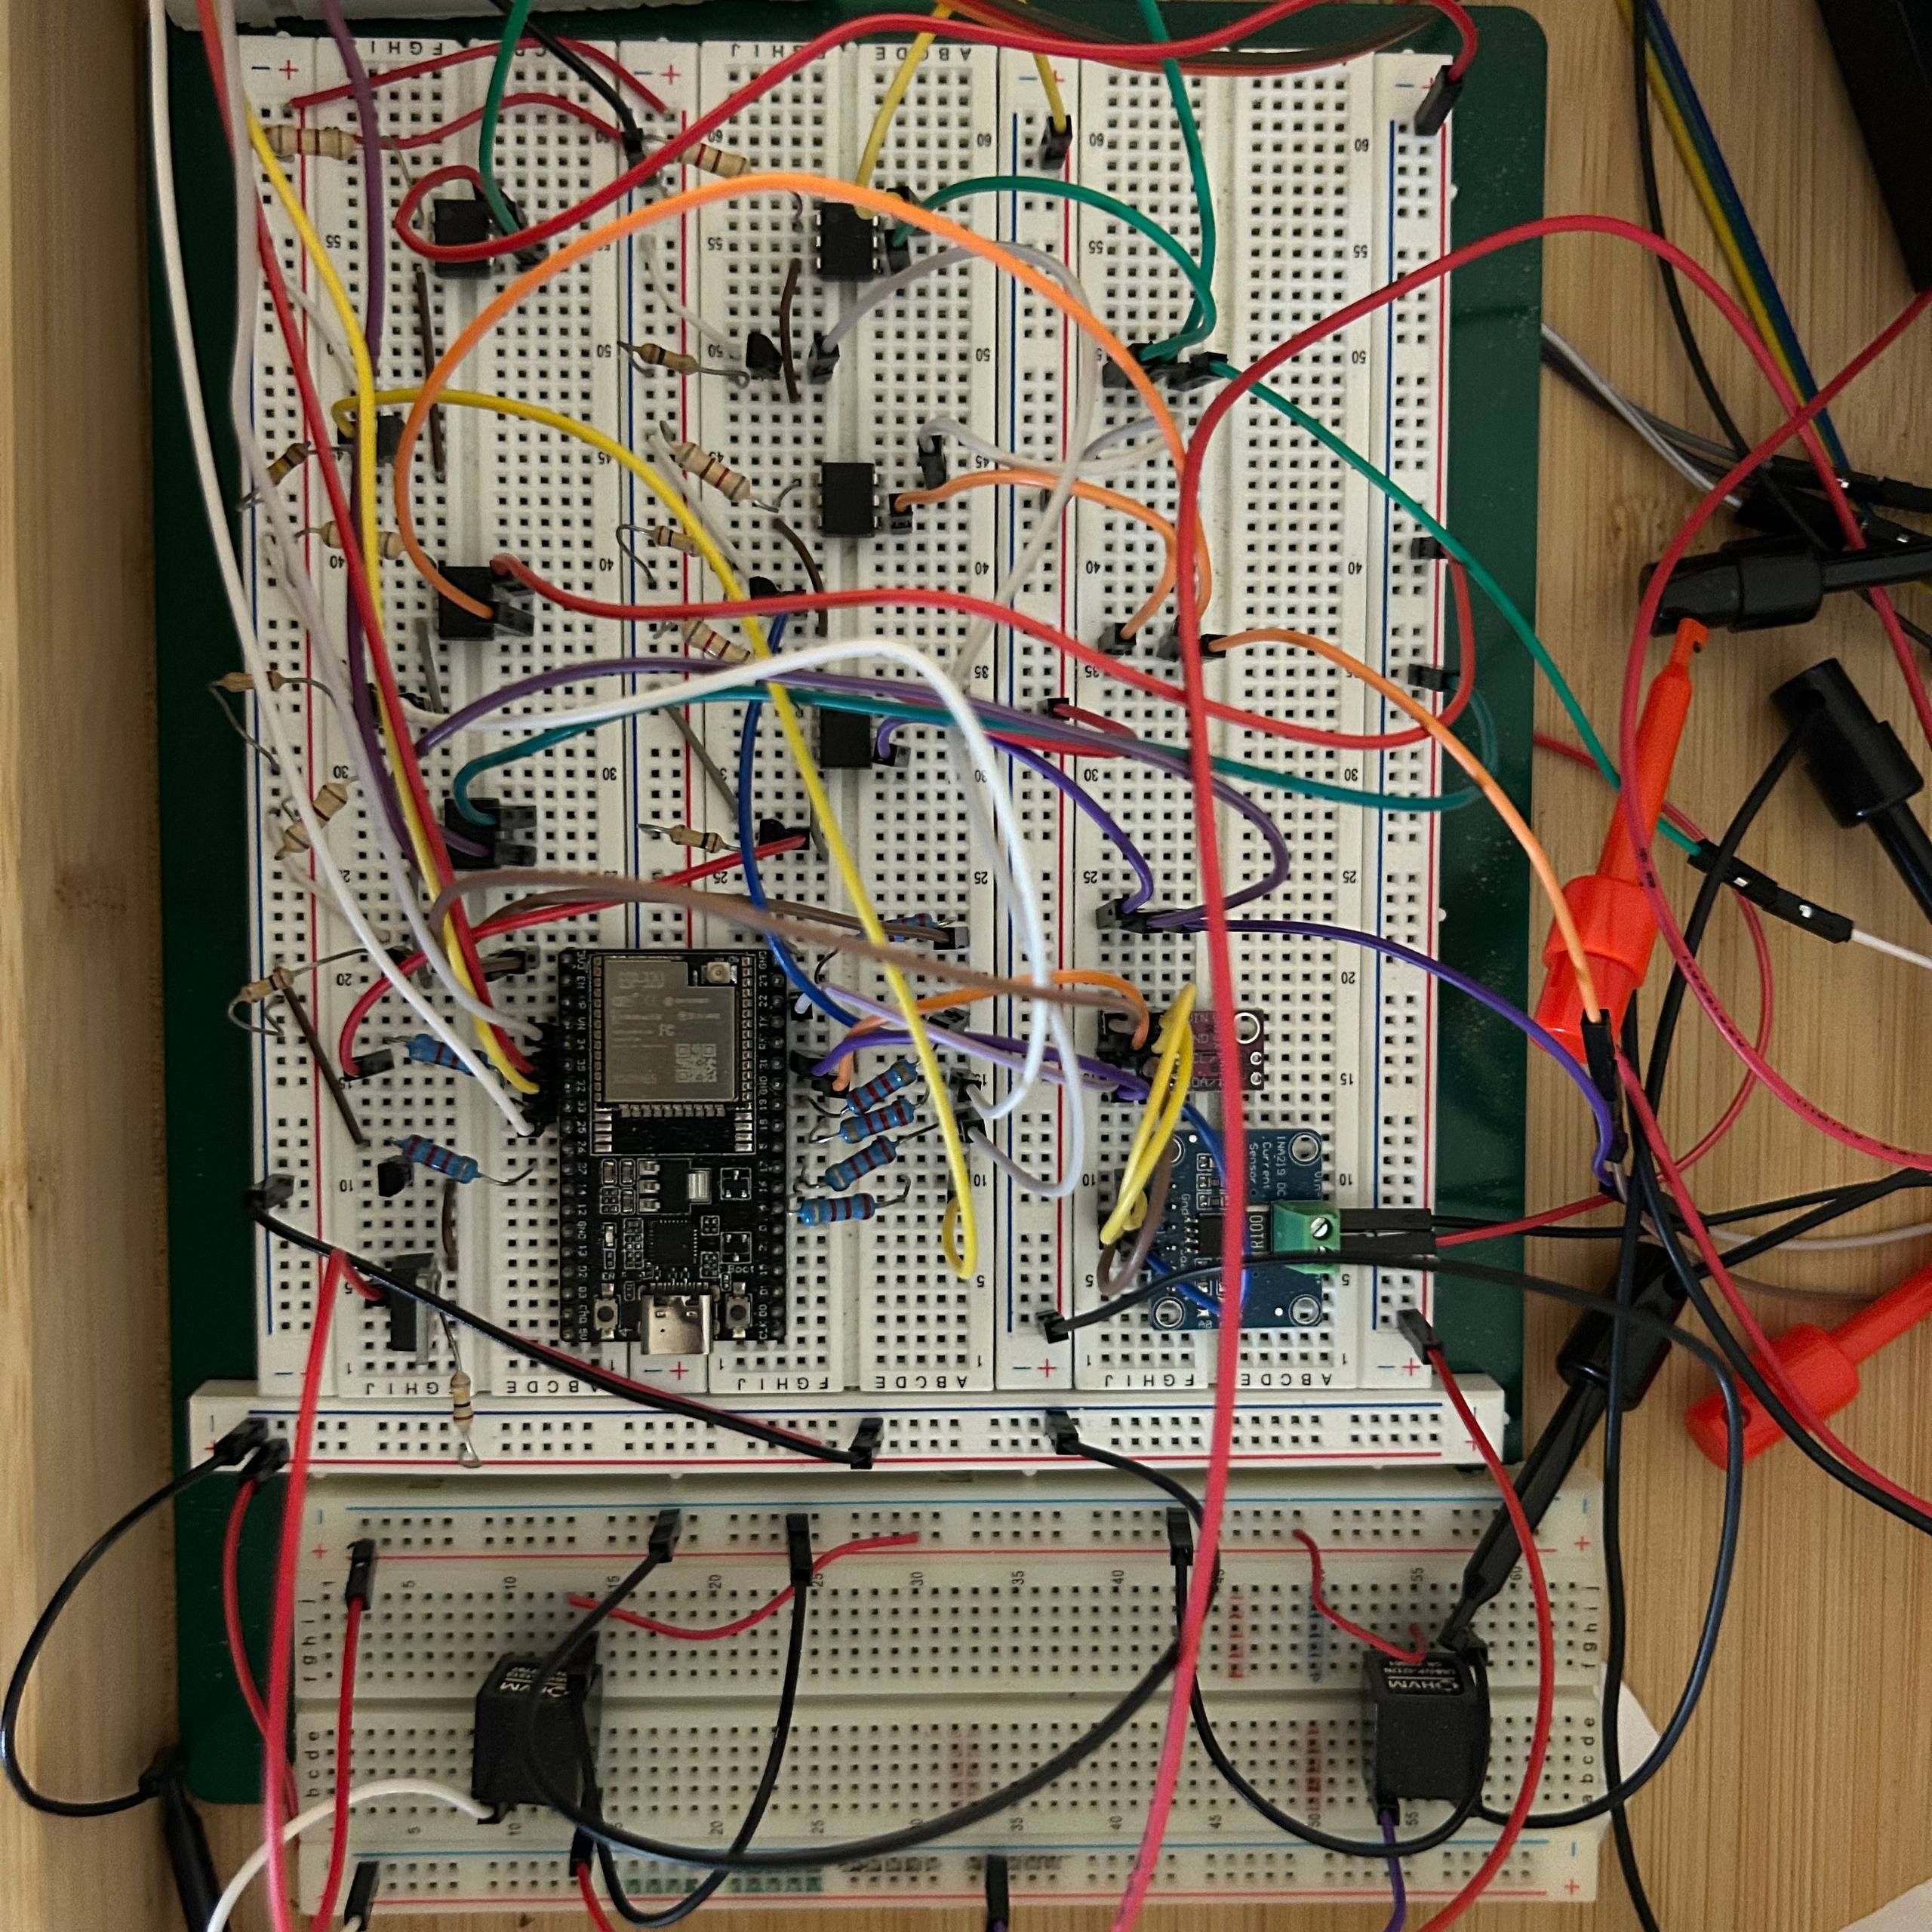
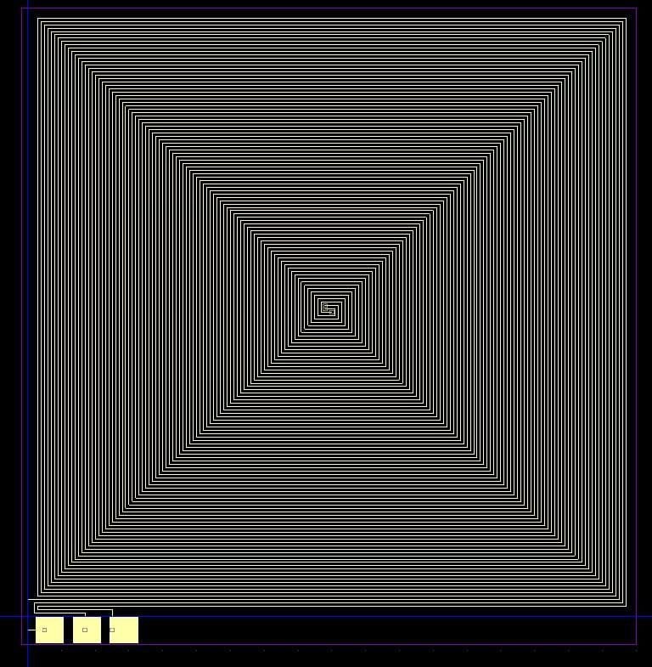

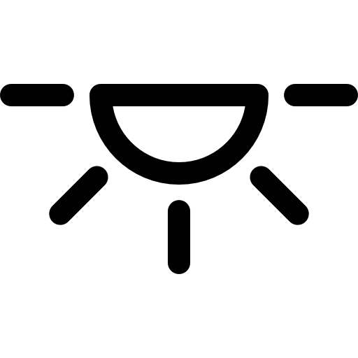
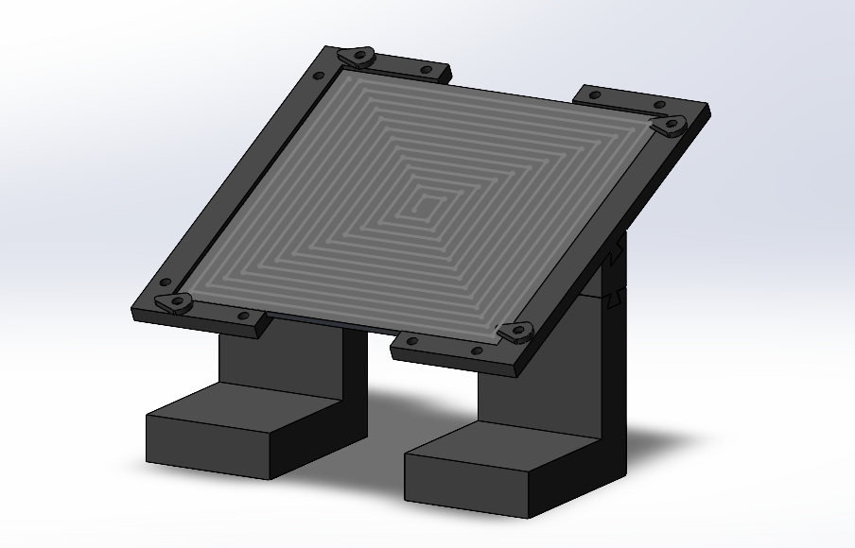
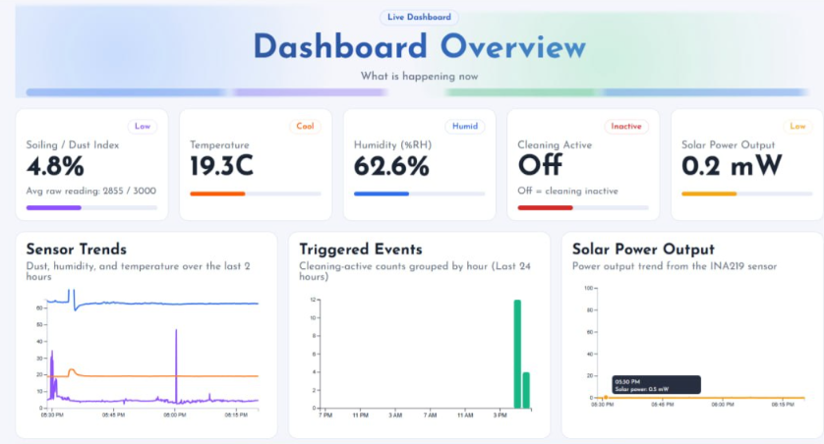
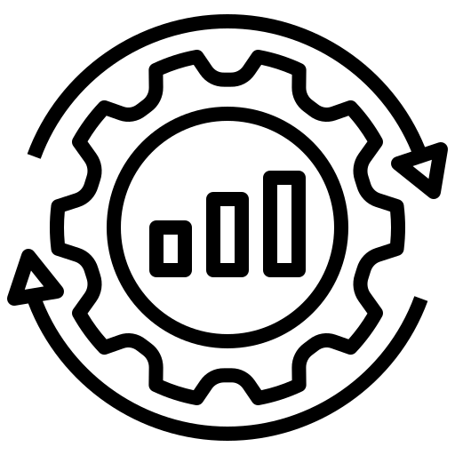

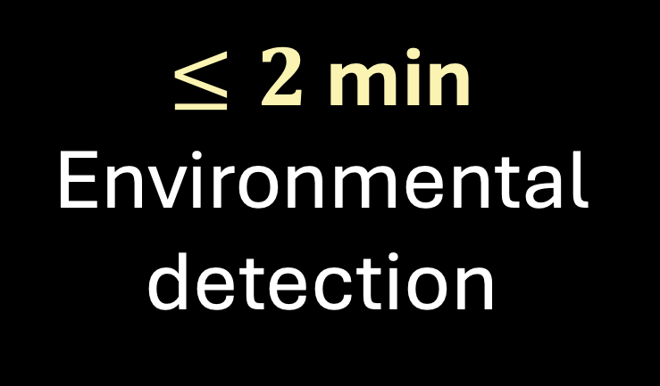
Electrodynamic Self-Cleaning System for Solar Panels
Aljouri Zebany, Asma Alatawi, Rawan Aldamkh, Fatima Al Saif, Sajedah Alghazwi, Rawan Asiri
Coach: Dr. Junaid ur Rehman
TEAM
F34
Problem Statement
Prototype Design
Testing & Validation
Specifications
Solar PV systems in dusty environments suffer from performance degradation due to dust accumulation. Existing solutions rely on manual or water-based methods that are labor-intensive, costly, and unsustainable in arid regions like Saudi Arabia.
Power Supply | 3-phase, 120° ±5°, 50% duty cycle and ≤ 5 Hz
Control | Dual optimized thresholds
Transparency | ≥70%
Installation | ≤15 min/panel
Monitoring | ≤5 min delay
Weight | ≤5% of panel
Cloud Data | ≥85% transmission , 30-day storage
AI Insights | ≤5 min
Our Solution: EDS
The Electrodynamic Self-Cleaning System uses high-voltage, low-current AC signals on transparent electrodes to create an electric field that removes dust without water or manual cleaning, supported by a smart monitoring platform.
Before Cleaning
After Cleaning​
Three-phase with 1.2 kV peak,120° phase shift and 50% duty cycle
Best cleaning achieved at 3 Hz with tilted spiral design
Measured transparency 70%, within acceptable light transmission
Optimal thresholds identified from real data, achieving ~85%
efficiency under all constraints
Real time dashboard and LLM insight generation within 10 seconds
Frame weight validated at 2.75% of panel weight, well below the 5% specification limit
Constraints
Voltage | 1 kV ±10% (Max 1.2 kV)
Environment | −20°C to +80°C
Budget | ≤15,000 SAR
Connectivity | ≥85% uptime
Power | ≤10% of output
Security | Backend-only API keys
>75%
Cleaning Efficiency
≤20 W/m²
Power Consumption
$≤2$ min
Environmental detection
Power Supply
Electrode Sheet
Objectives
Conclusion
Efficient cleaning
Low energy consumption
Smart automation
Reliable monitoring
Sustainable design
Optimized threshold-based activation
An autonomous system for removing dust from solar panels using optimized electrodes, thresholds, a durable frame, and an LLM-powered dashboard, improving cleaning efficiency while reducing water use in arid environments.
Frame
Monitoring

