Slide 1

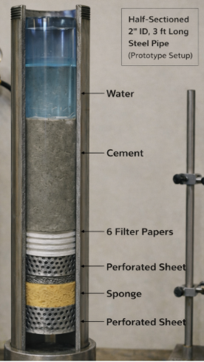
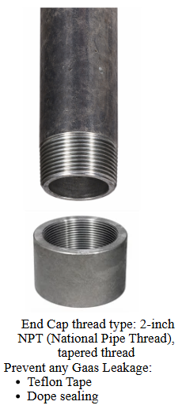
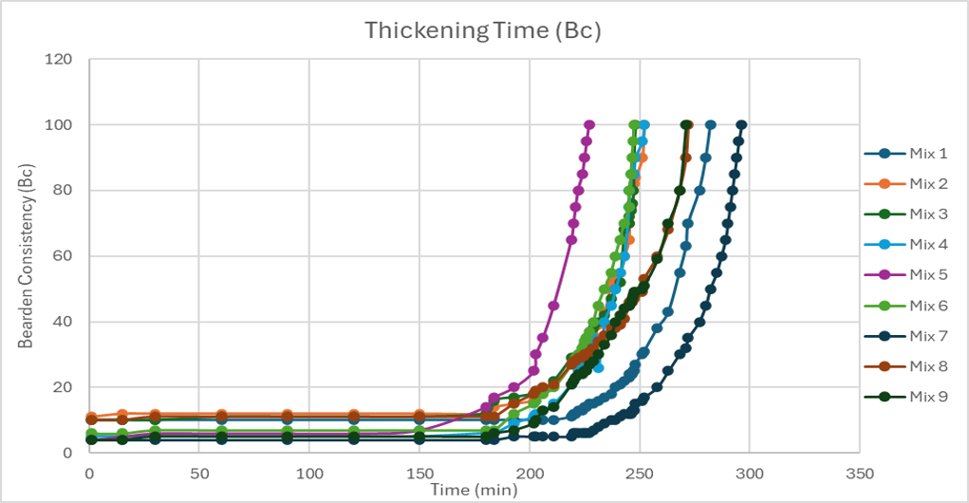
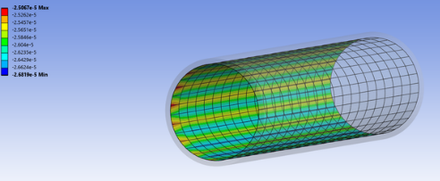
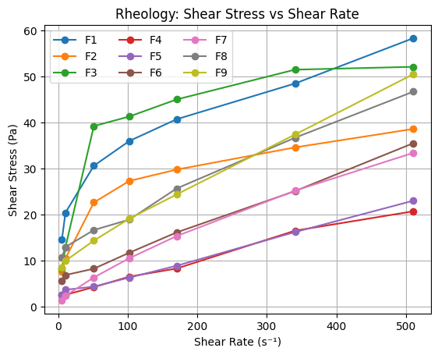
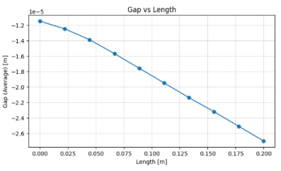
TEAM
F032
Development of a Cement Formulation to Prevent Gas Migration and Debonding
Khadijah Al Darwish, Ghaida Alsulami, Jumana Al Ali, Shahad Al-mutairi, Rand Al-mutairi
Coach: Tabassam Yasmeen
Introduction
Design Specifications
Result / Validation
Gas migration is a critical well integrity issue during cement setting, where insufficient early gel strength can create flow pathways within the cement and compromise zonal isolation.
Problem Statement:
Conventional cement systems often lack the balanced rheological, fluid-control, and mechanical properties required to prevent gas flow and ensure reliable long-term sealing.
Specifications
Category | Target
Fluid | Free water <2%, Fluid loss <100 mL
Density | 15–16 ppg
Rheology | YP: 5–30 Pa, PV: 15–60 cP, n<1, K: 0.1–8
Gel Strength | SGS: 30–45 min
Setting | 8–12 hr
Strength | UCS ≥10 MPa
Poisson’s Ratio | ν = 0.15–0.30, E < 17.5 Gpa
Expansion | 0.1–0.3%
Geometry | Pipe: 3 ft, 2 in
Final Goal | No gas Migration and Debonding
Mix
Additives
(% BWOC)
FW
FL
Rheology
ME Properties
F1
0% Mb, 0% R
✓
✓
✓
✓
F2
1% Mb, 0% R
✓
✓
✓
✓
F3
2% Mb, 0% R
✓
✓
✗
✗
F4
0% Mb, 1% R
✓
✓
✓
✗
F5
1% Mb, 1% R
✓
✓
✗
✗
F6
2% Mb, 1% R
✓
✓
✓
✓
F7
0% Mb, 2% R
✓
✓
✓
✓
F8
1% Mb, 2% R
✓
✓
✗
✓
Objective of The Project
F9
2% Mb, 2% R
✓
✓
✗
✗
Mb = Microbond, R = Resin
To develop and validate a Class G cement formulation containing resin and Microbond additives that minimizes gas migration and debonding.
  Prototype Setup
Constraints: DI water (±2°C), UCA profile, Class G, Microbond/Resin (0‑2%), HPHT, 85°C
Section | Details
Components | Steel pipe, cement column, filter papers, perforated sheets, sponge
Connection | 2-in. NPT threaded end cap with Teflon tape and dope sealing
Test Conditions | N₂ injection at 60 psi for 30 min
Measured Outputs | First bubble time, leakage intensity
Surface Roughness | Ra ≈ 1.6–6.3 µm
Test Results
  Debonding
  Simulation
Methodology
Formulation Design
Fresh Tests (FW, FL, Density, Rheology)
Thickening Time & SGS
Hardened-State Test
(UCS & Scratch)
Prototype Validation
Data Analysis & Decision Matrix
Conclusion
Future work
The optimized formulation (F6) met all design targets, providing balanced rheology, strength, and effective control of gas migration.
Field validation under HPHT conditions.
Improve testing accuracy
Optimize formulation

