Slide 1
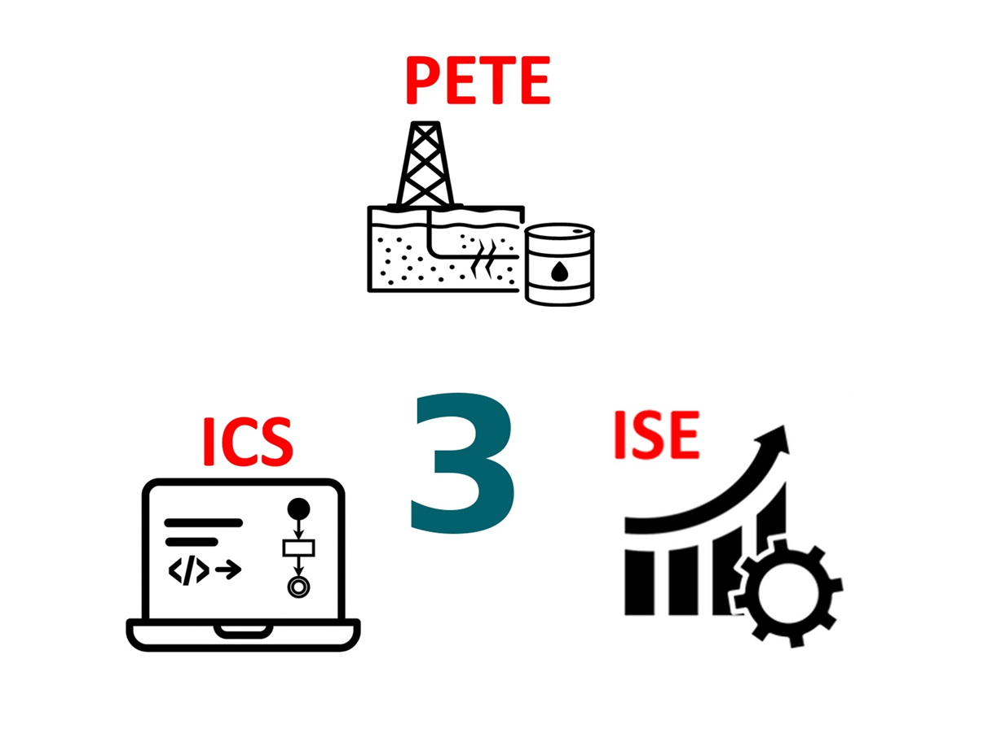
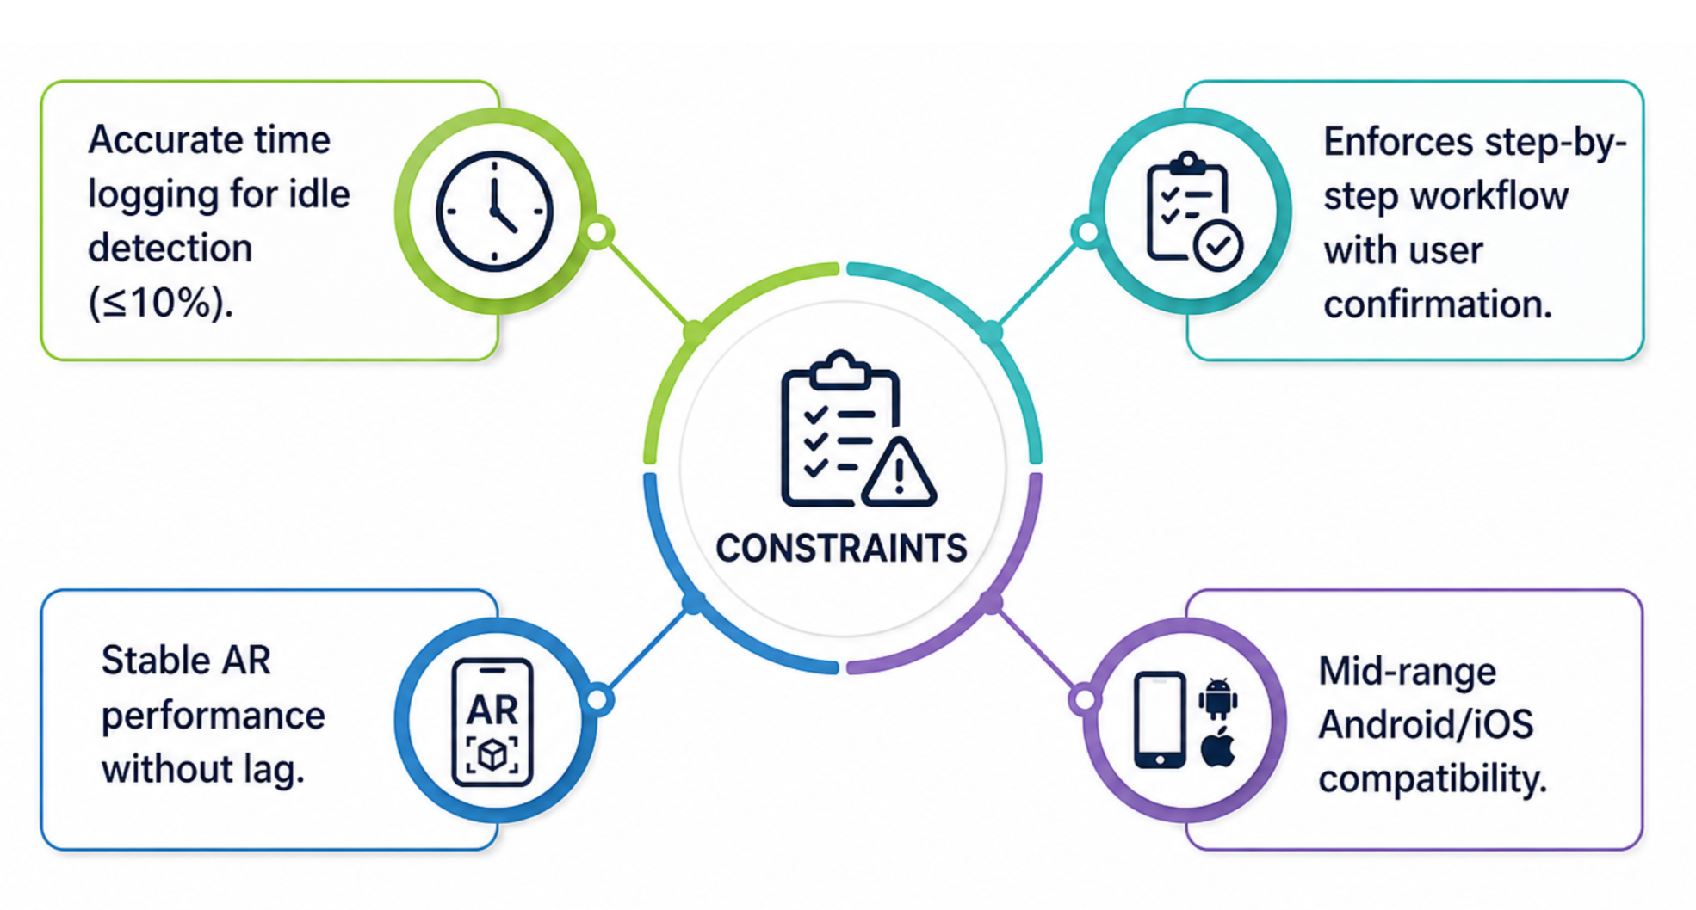
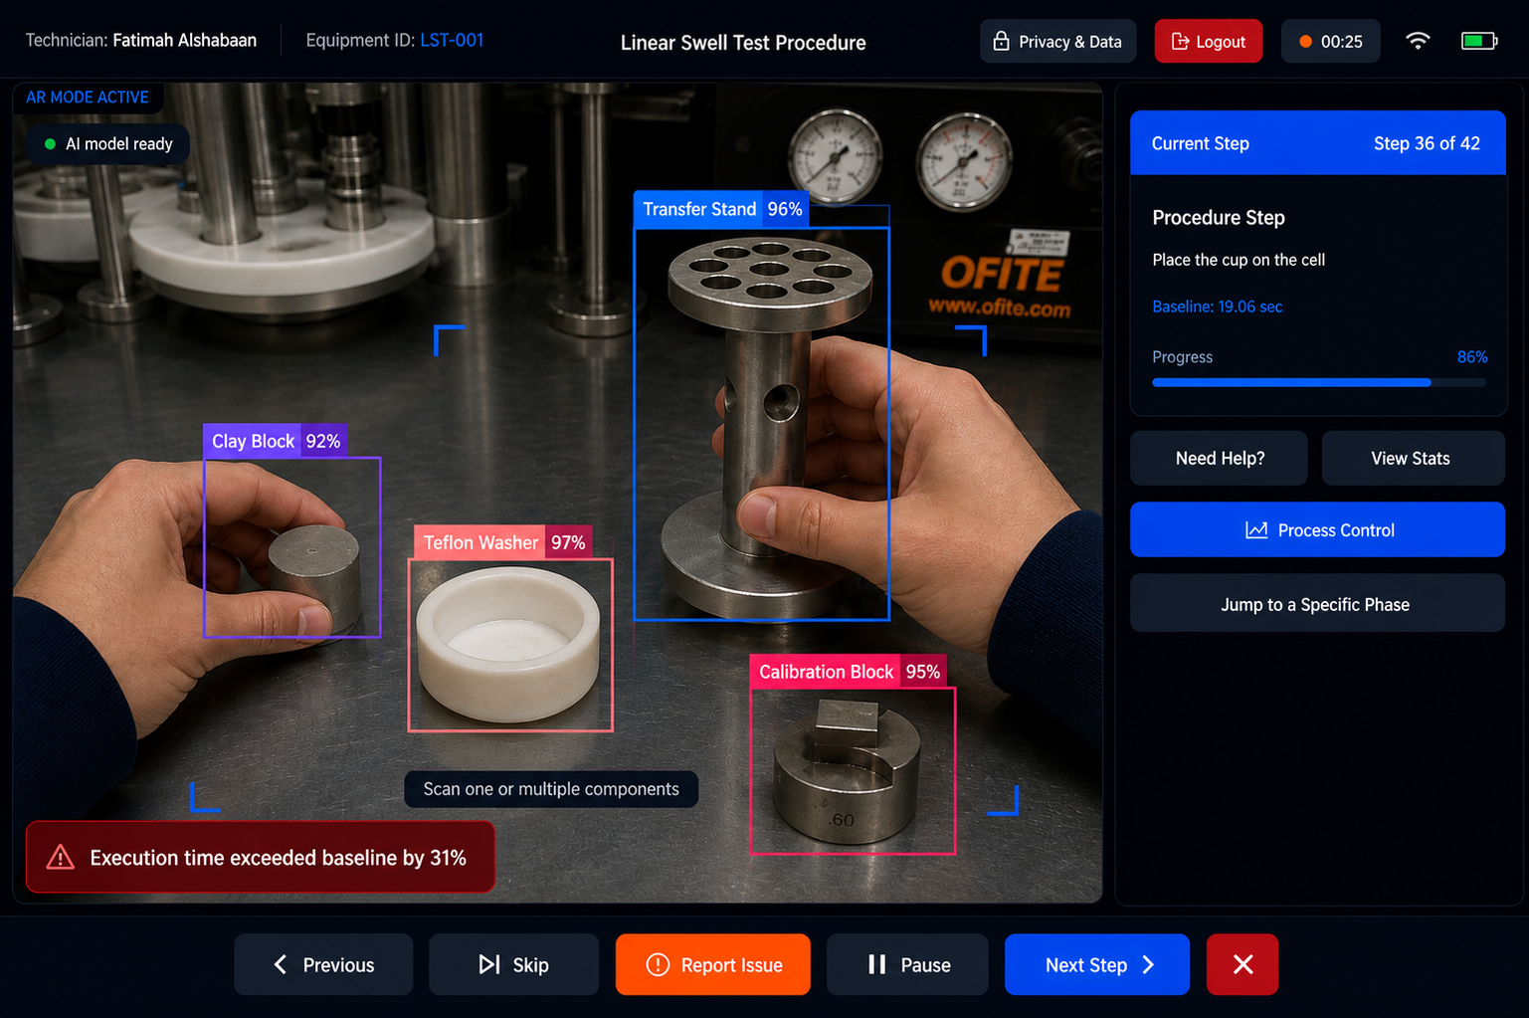
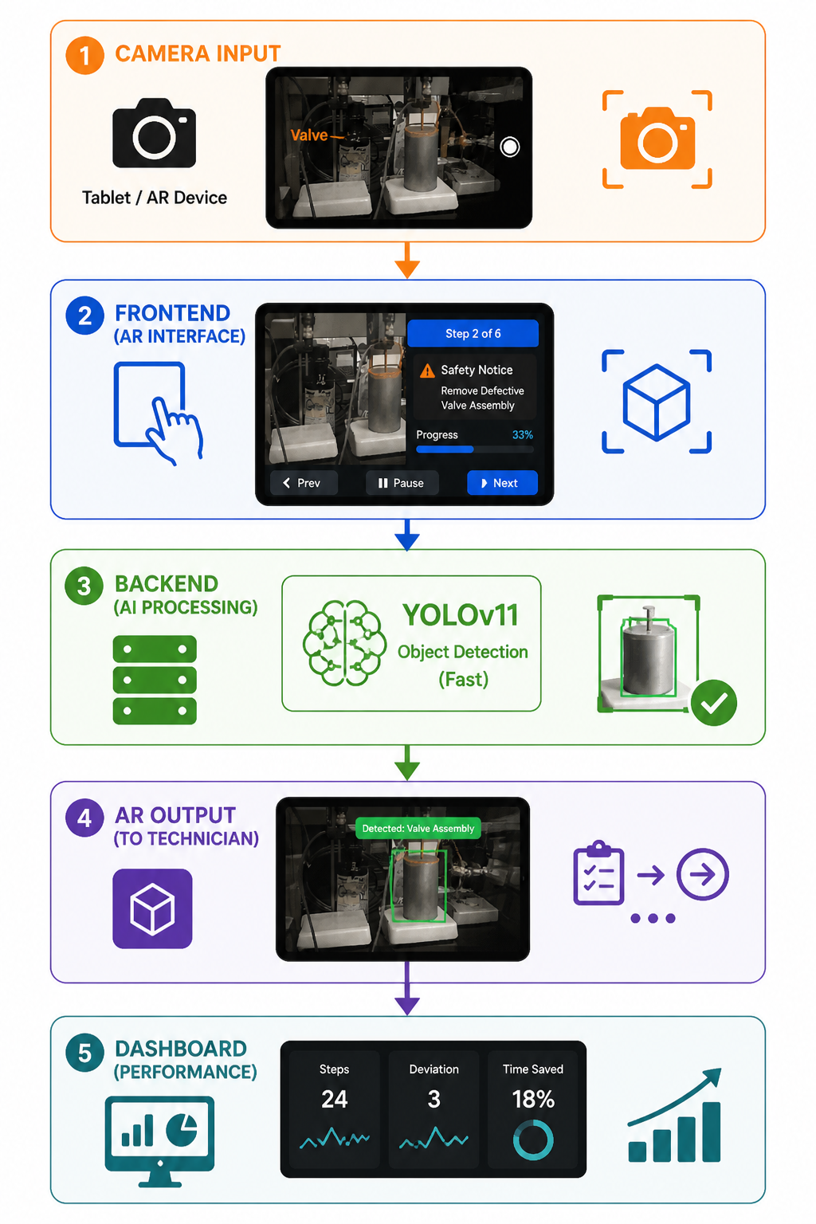
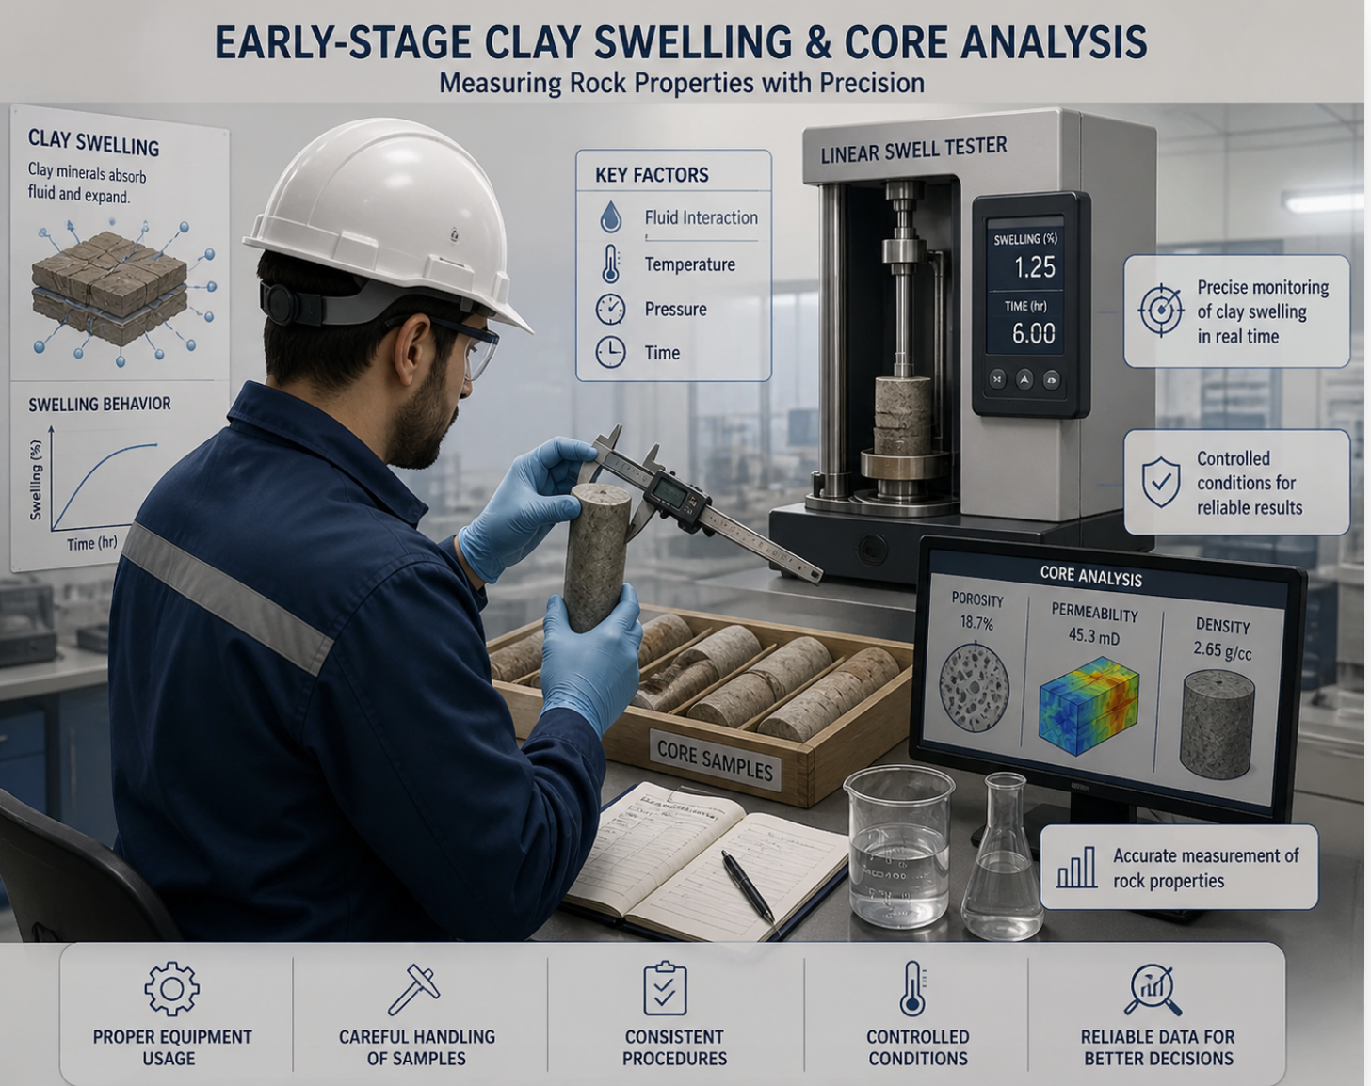
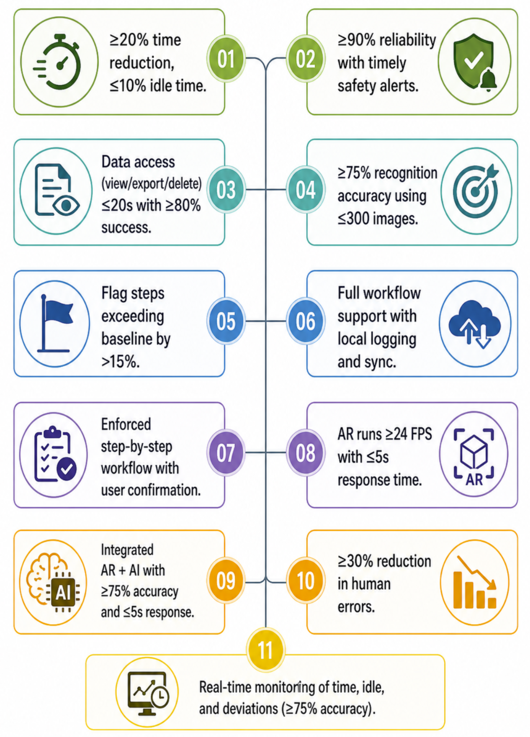
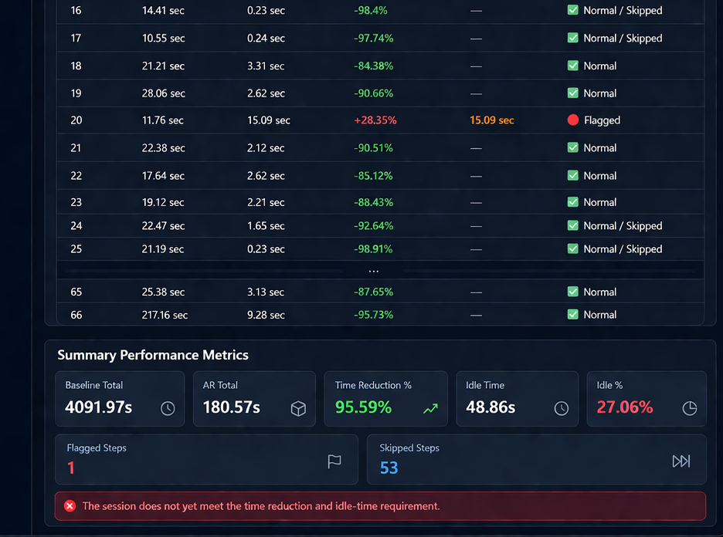
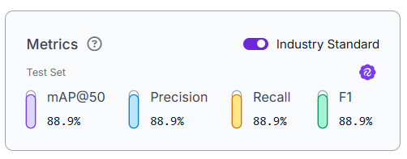
TEAM
030
Smart AR Guided Operation and Maintenance System for Linear Swell Tester Equipment
Manar Almaskeen, Raneem Almousa, Duaa Alhassan, Fatimah Alshabaan, Fatima Muqaibel, Tayf Alrasheedi
Coach: Ismail Al-Maraj
Introduction / Background
Constraints
Prototype Design
Test / Validation
Early-stage clay swelling tests need careful handling.
Clay is sensitive to fluid interaction.
Measurements depend on proper use of testing equipment.
System Architecture
Specifications
Problem Statement
Current maintenance relies heavily on manual instructions and technician experience, with no real-time validation or performance tracking.
This leads to:
20–30% longer task time
15–25% higher error rates
10–20% increased idle time
Result: Lower productivity and lack of standardization.
Object Detection Performance Metrics
Conclusion
Practical solution for Linear Swell Tester maintenance.
Provides step-by-step guidance and monitoring.
Reduces time and operator idle time.
Enhances training and reliability.
The model achieves high accuracy across key metrics, ensuring reliable component detection in real-time.

