Slide 1
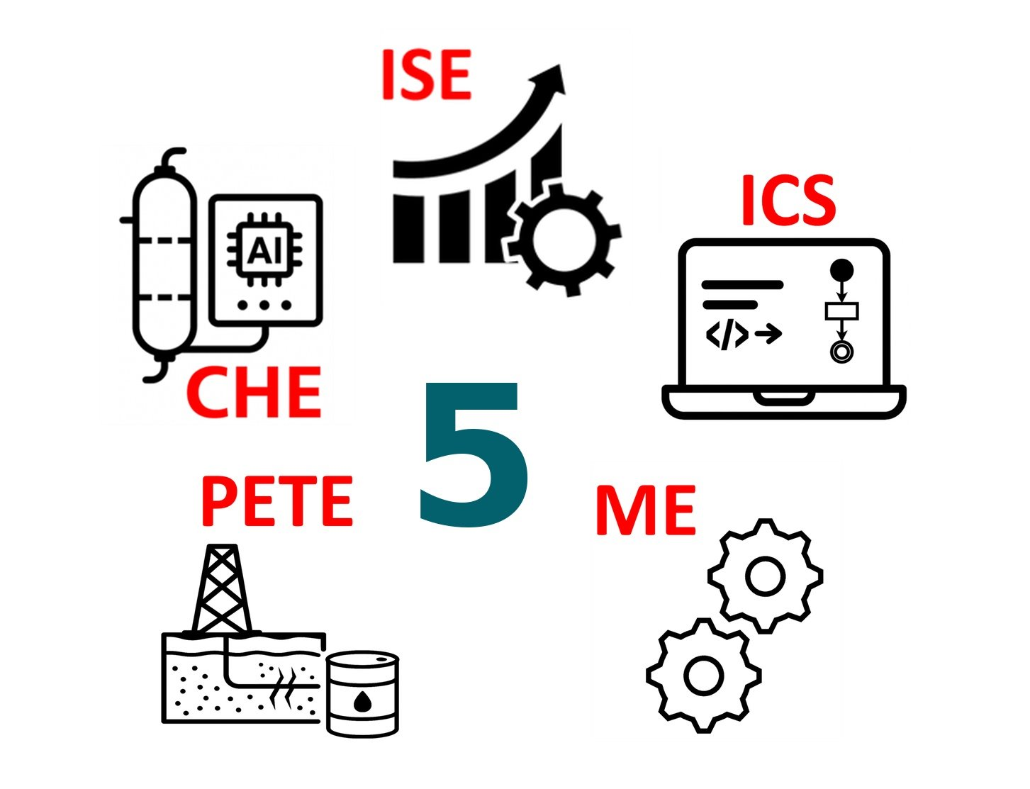
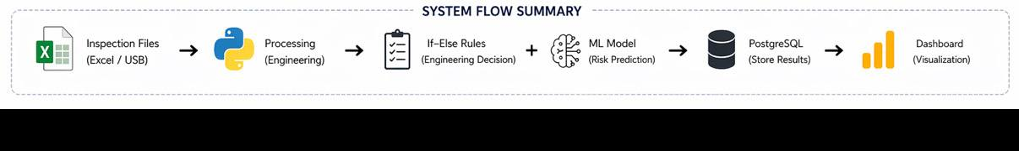
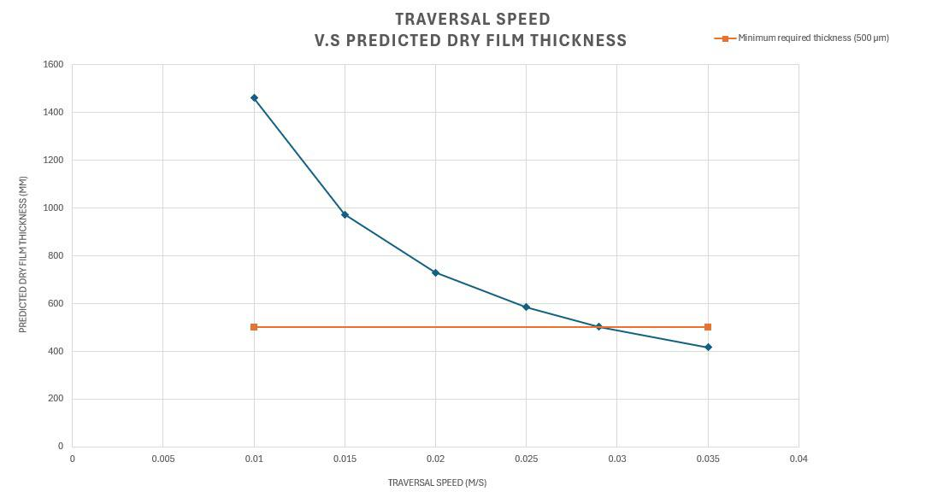
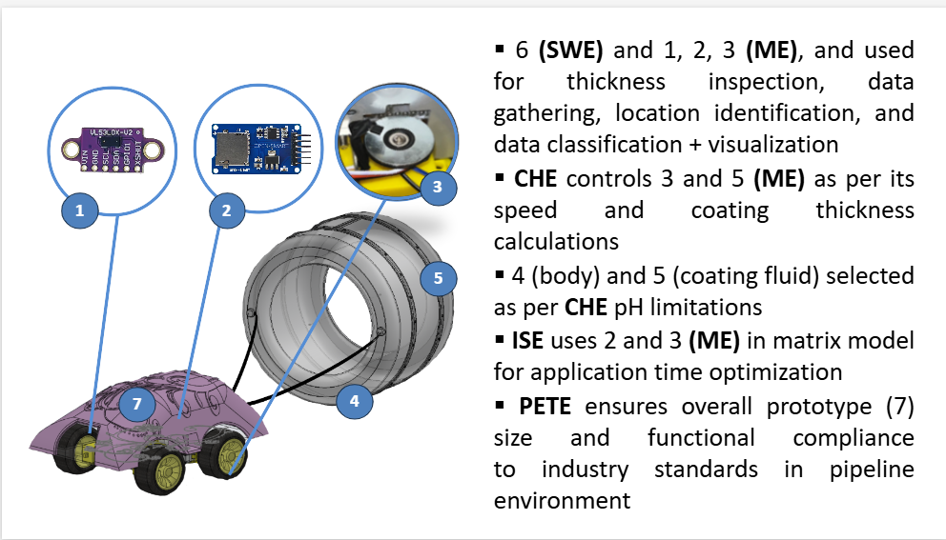
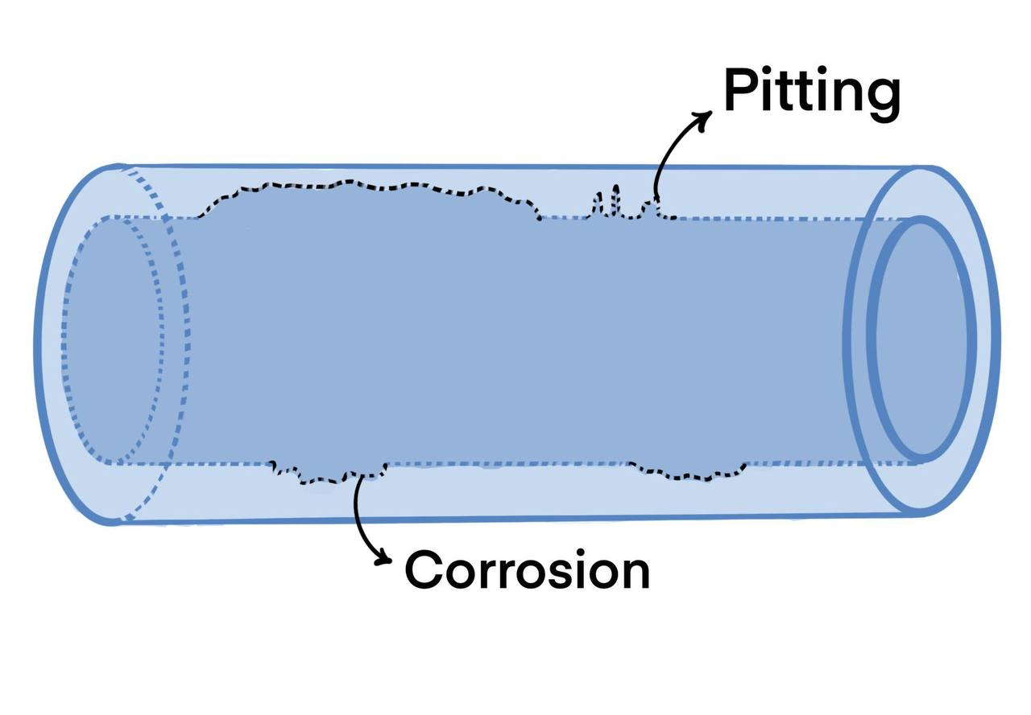
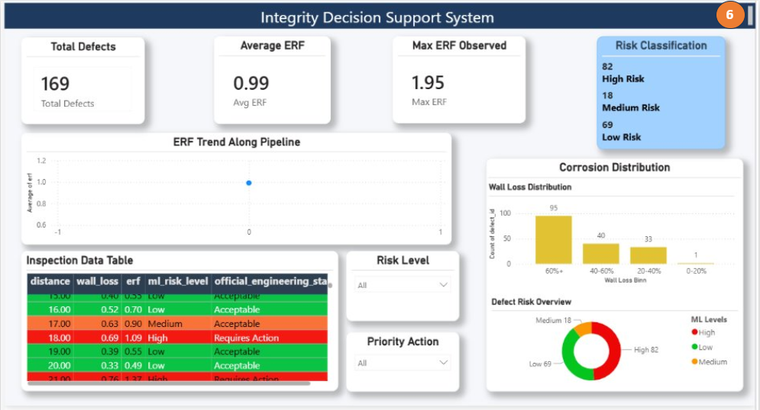
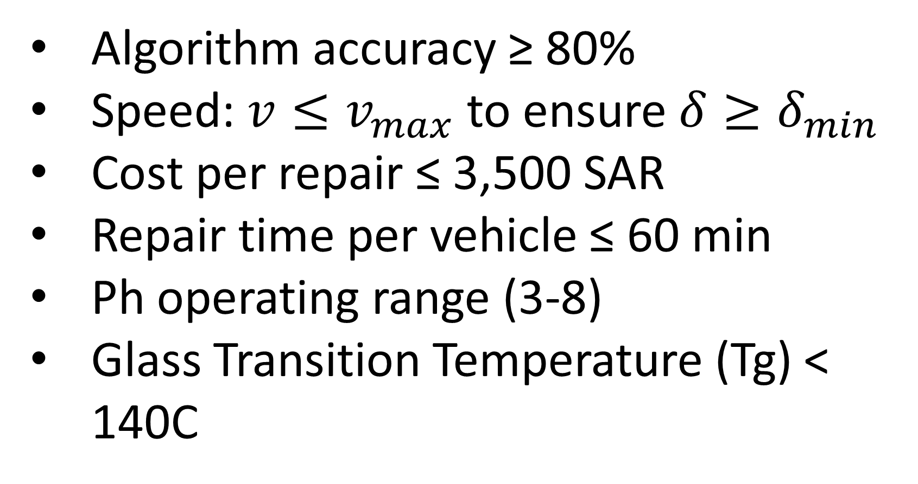
Expandable In-Line Repair Device for Pipelines
TEAM F029
Amnah Alkhater, Zaina Bujlala, Hoor Almadan, Maryam Hamidaddin, Munirah Alhajri, Walah Alrobayan
Coach: Yasmin Seid ahmed
Background & Problem
Prototype & System Design
Testing and Validation
Pipeline operators face challenges when addressing severe internal corrosion.
Current methods require full pipeline shutdowns and section cutting.
This leads to costly downtime & increased safety risks.
Repair methods treat entire sections instead of targeting localized damage, resulting in inefficient and resource-intensive maintenance.
Objective: Minimize number of vehicles
Const.Vehicle Time Capacity
Output: Optimal speed and minimum number of vehicles
Sample # | Weight Before (g) | Weight After (g) | Surface Area (cm^2) | Density (g/cc) | Time (hrs) | Corrosion Rate (lb/ft^2)
1 | 59.1638 | 54.7940 | 32.1664 | 7.85 | 24 | 0.00028
2 | 53.6505 | 50.0460 | 15.2197 | 7.85 | 24 | 0.00048
Constrains
Specifications
Conclusion
Algorithm accuracy ≥ 80%
Speed: $v≤v_{max}$ to ensure $δ≥δ_{min}$
Cost per repair ≤ 3,500 SAR
Repair time per vehicle ≤ 60 min
Ph operating range (3-8)
Glass Transition Temperature (Tg) < 140C
Offline training ≥ 30,000 samples
Defects classified by status and risk level
t_expansion < 5min
Optimal traveler speed to balance repair time and coating quality
The system achieves 92% ML accuracy
Efficient and scalable pipeline repair solution.

