Slide 1

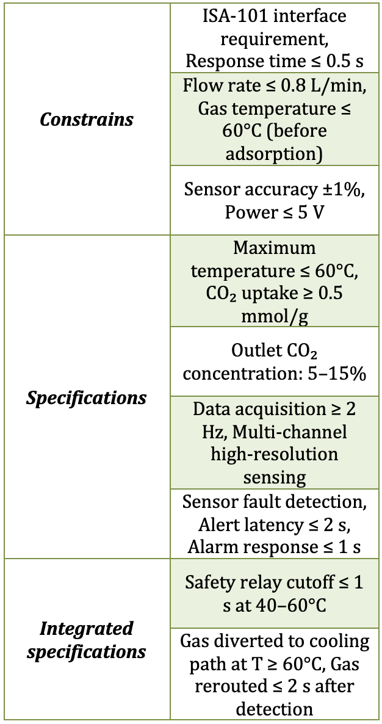
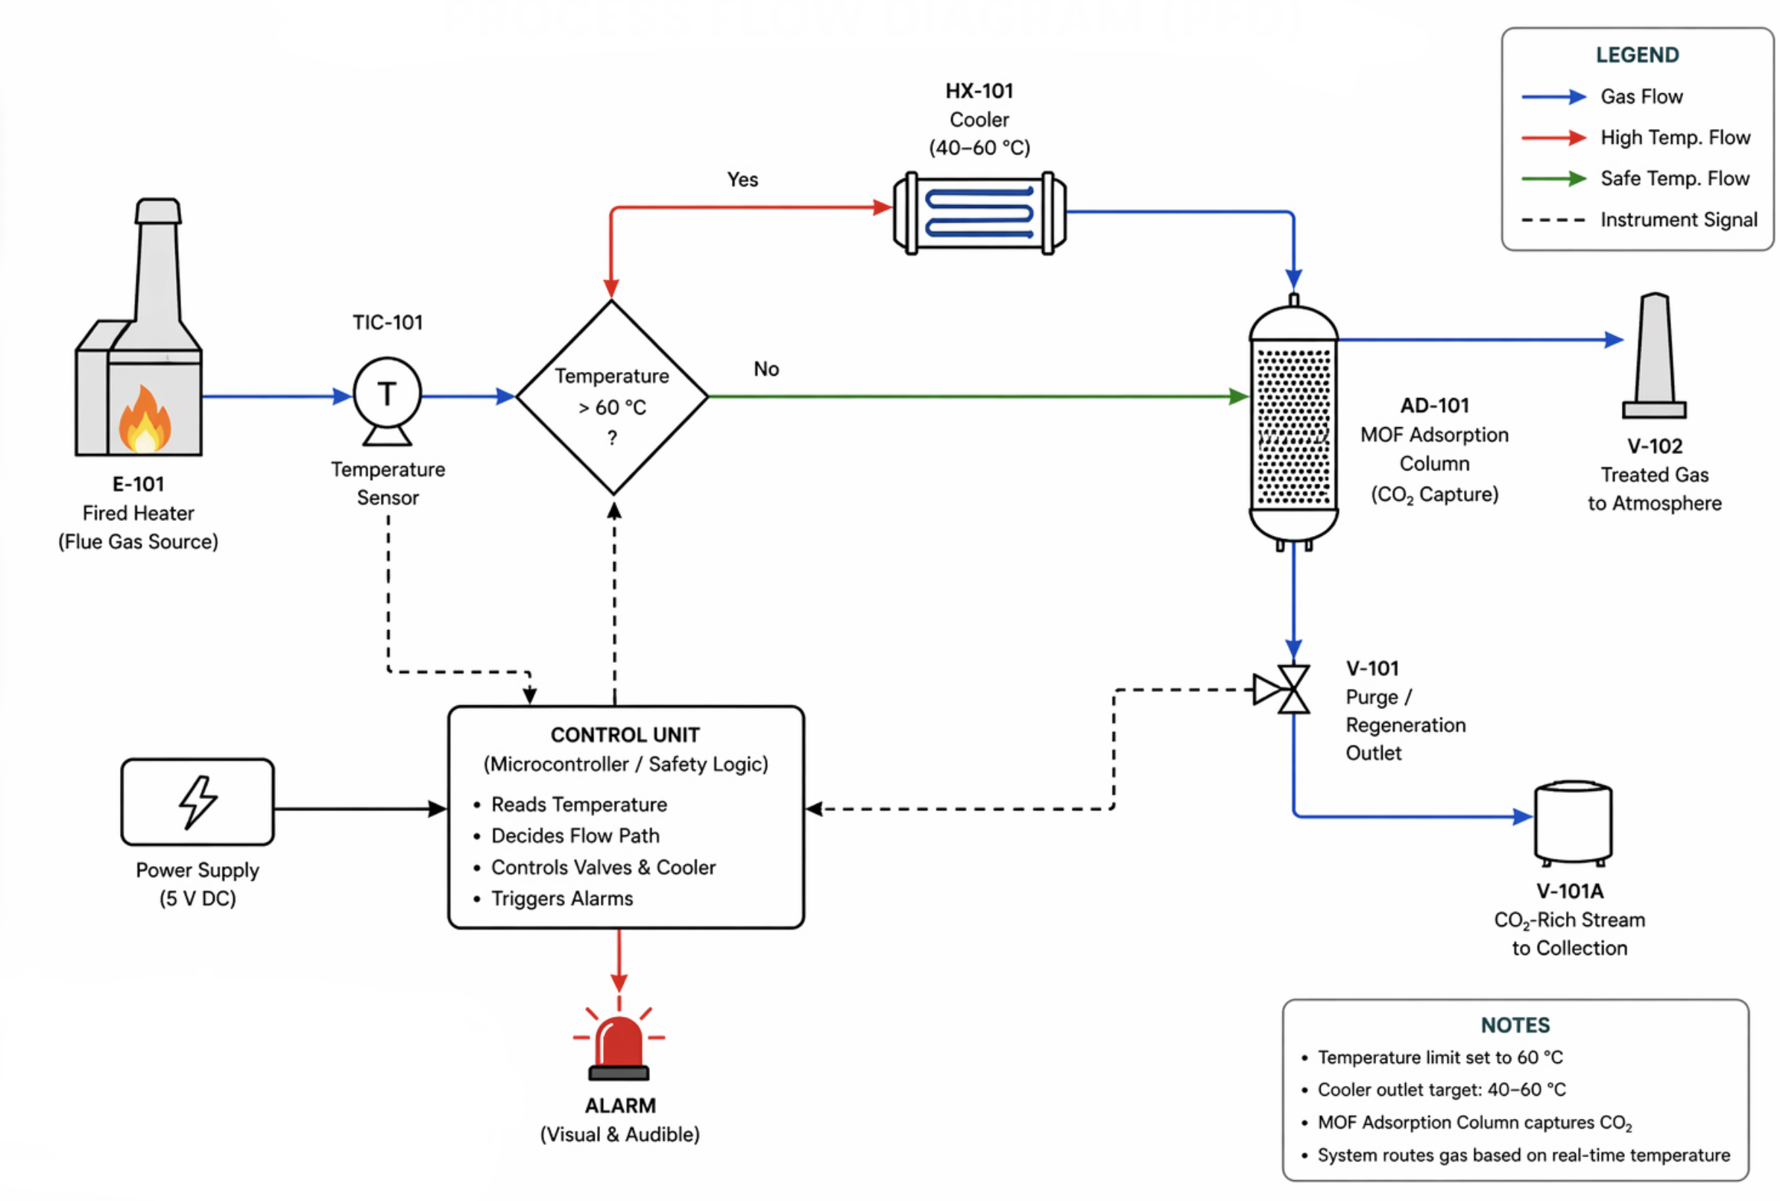
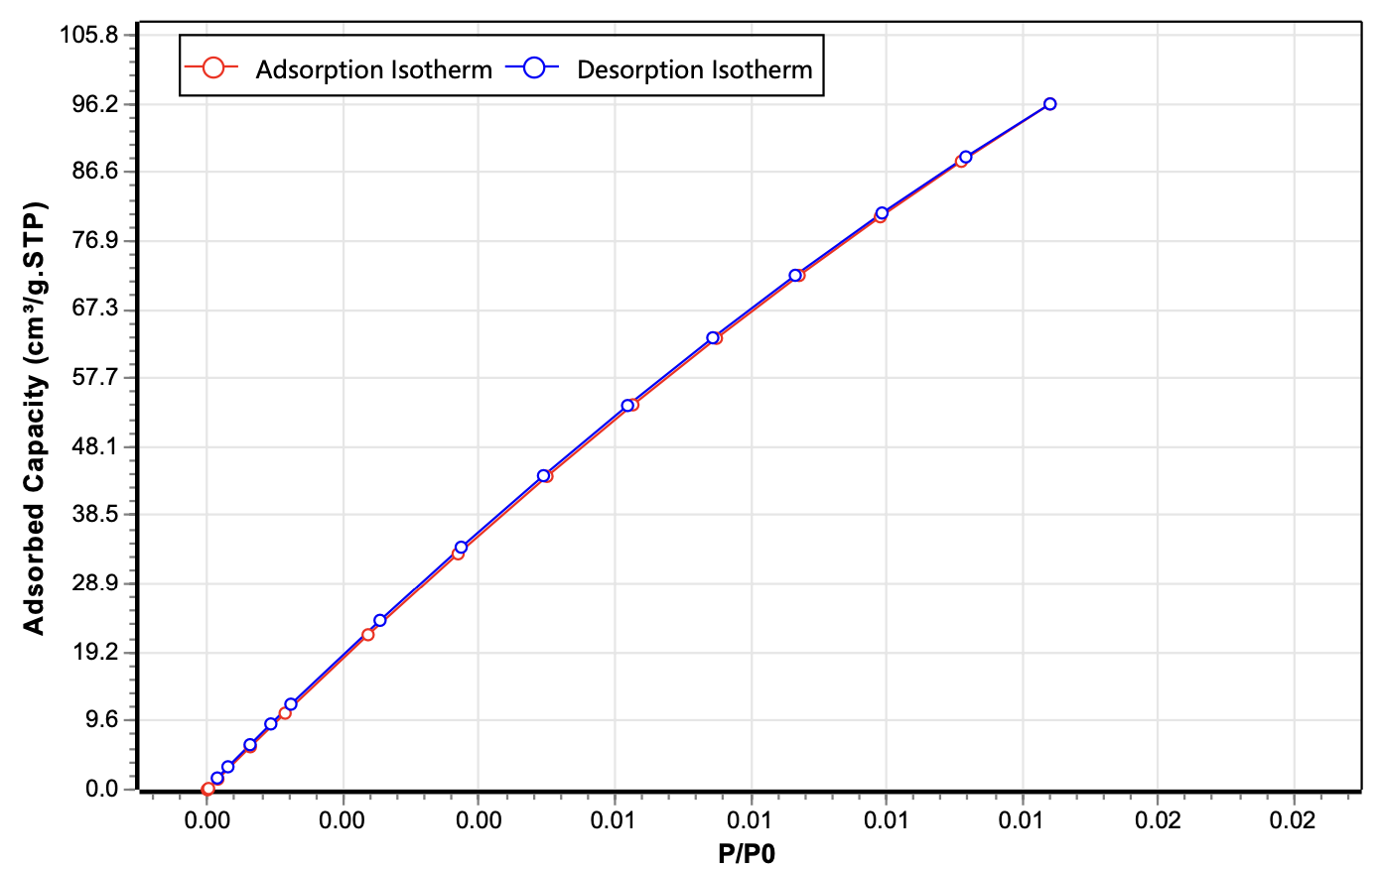
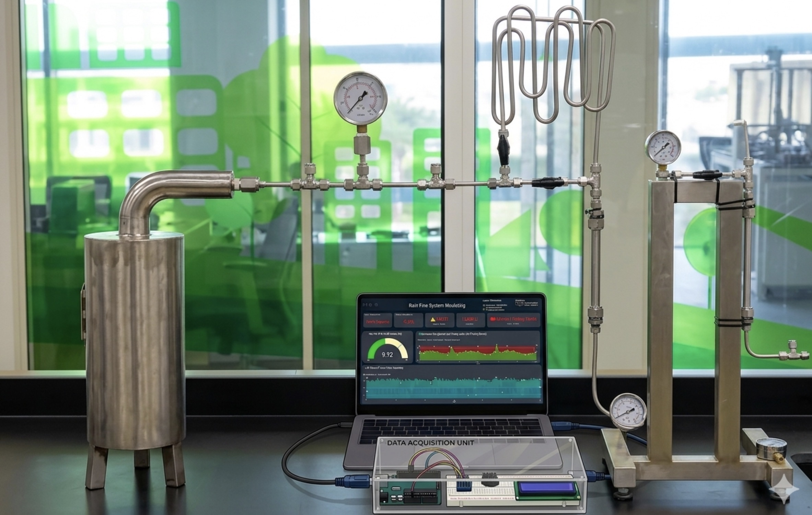
TEAM
F024
SAFETY-DRIVEN CO₂ CAPTURE FROM INDUSTRIAL FIRED HEATERS USING MOF-BASED SYSTEM
Jamayel Alhajri, Rose Alzaghebi, Latifah Alessa, Noor Alzhrany, Mona Almoushrif, Areeg Alsawad
Coach: Abdulrahman Al Qadami
Introduction
Constrains & Specifications
Process Flow Diagram
Testing & Validation
Industrial fired heaters are a major source of CO₂ emissions due to continuous high-temperature combustion. Existing carbon capture systems are typically separate from safety systems, increasing complexity and limiting safe operation.
Problem Statement
​
​
HKUST-1 shows higher CO₂ adsorption (~96 cm³/g) vs UiO-66 (~33 cm³/g)
Accurate temperature monitoring and CO₂ detection
Fast system response above 60°C
Industrial fired heaters produce high CO₂ emissions, but existing capture systems are separate from safety controls. During unsafe conditions, CO₂ capture is stopped completely, creating a trade-off between safety and performance.
Prototype Design
Conclusion
Our Solution
A lab-scale CO₂ capture prototype was developed to simulate fired-heater exhaust conditions. The system integrates gas heating, cooling, and a fixed-bed MOF adsorption column for CO₂ removal, while enabling safe operation through continuous monitoring of temperature and CO₂ concentration. It also provides a practical platform for evaluating CO₂ reduction performance and collecting data for system assessment.
We propose a safety-driven, integrated CO₂ capture system that combines temperature control, real-time monitoring, and MOF-based adsorption. The system automatically adjusts operation based on safety conditions, allowing controlled CO₂ capture while maintaining safe and stable performance.
Prototype Components
Gas inlet: controlled flue gas supply
Cooling unit: reduces temperature to safe range
MOF column: captures CO₂
Sensors: monitor temperature & CO₂
Control system: ensures safe operation

