Slide 1
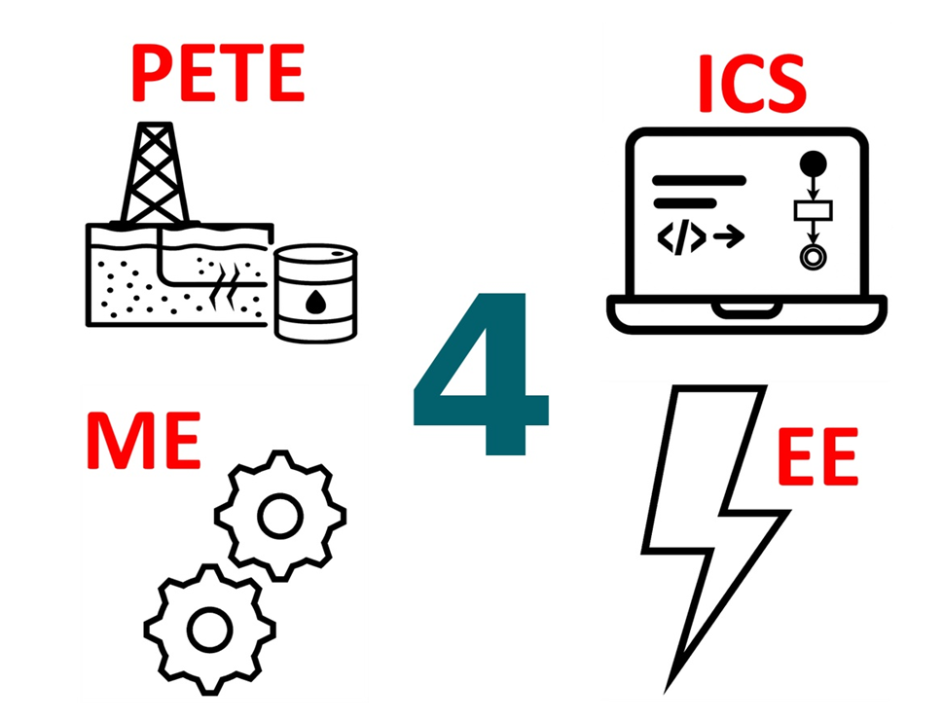
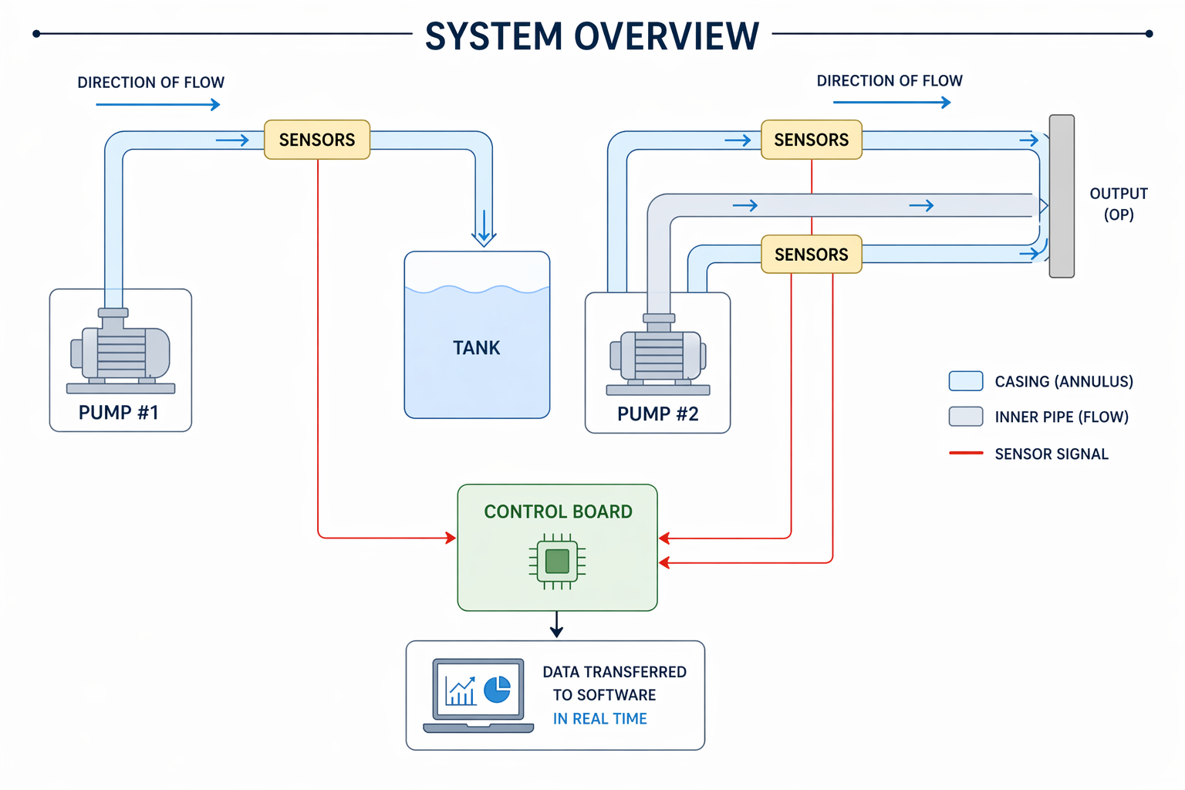
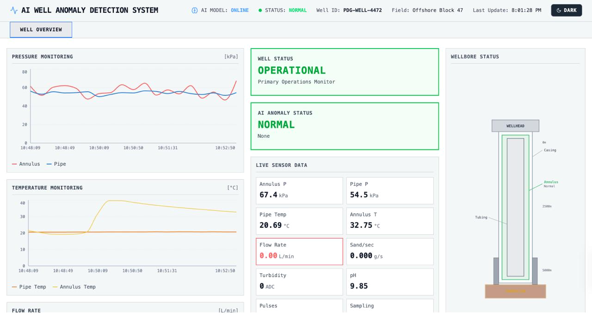
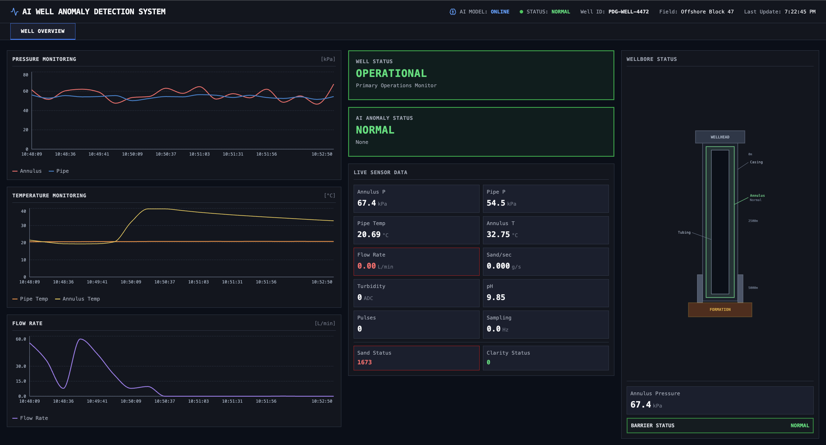
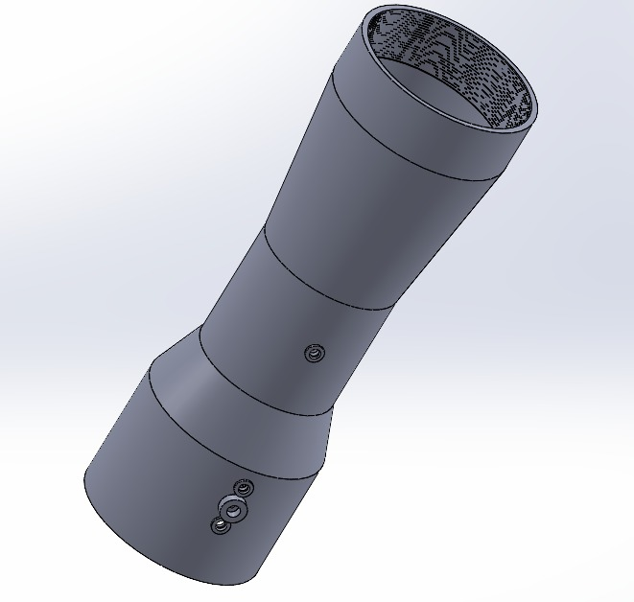
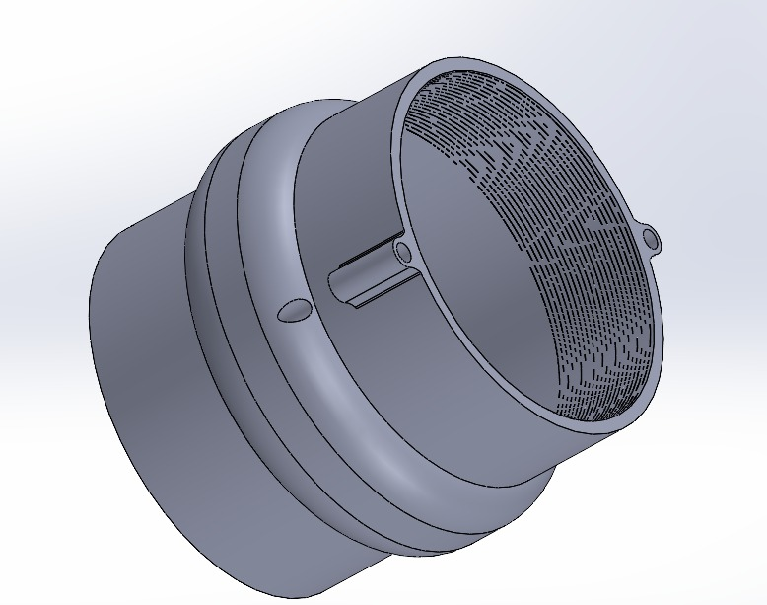
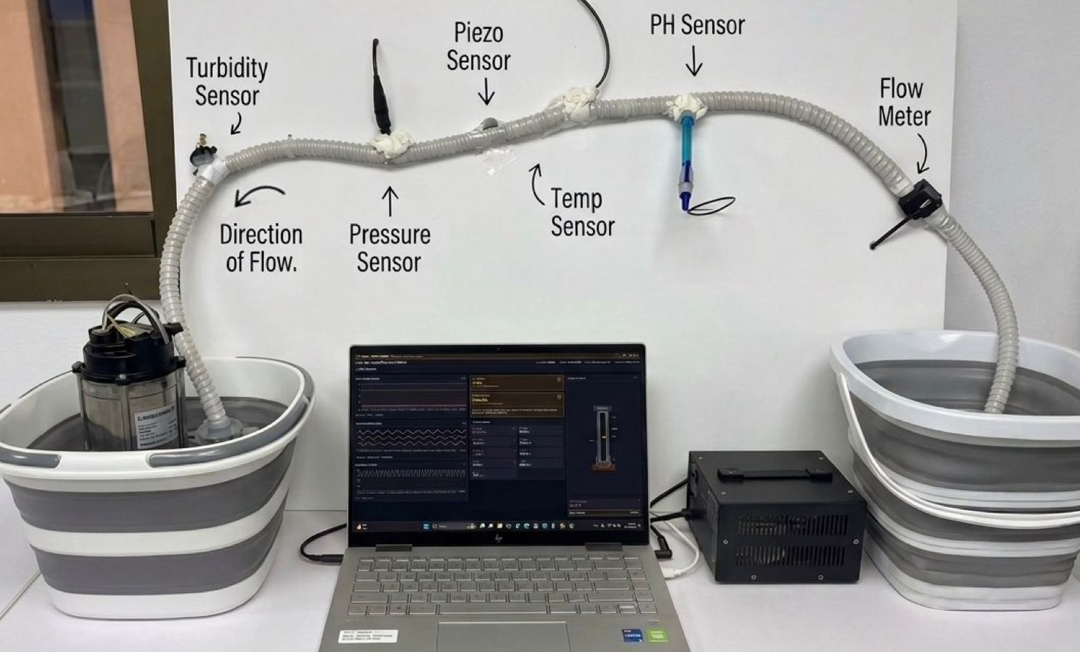
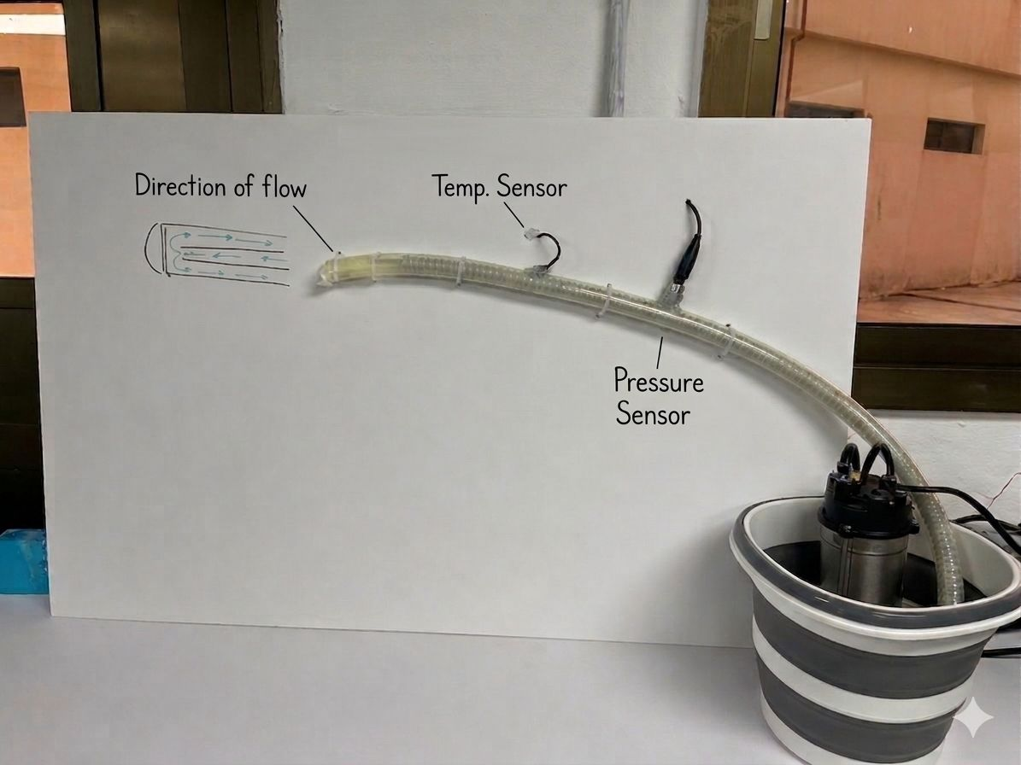
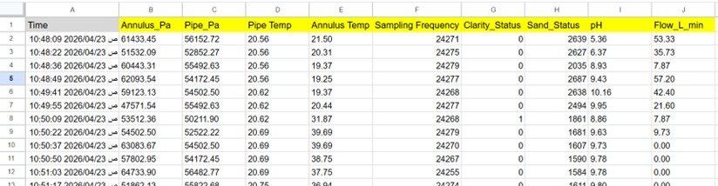
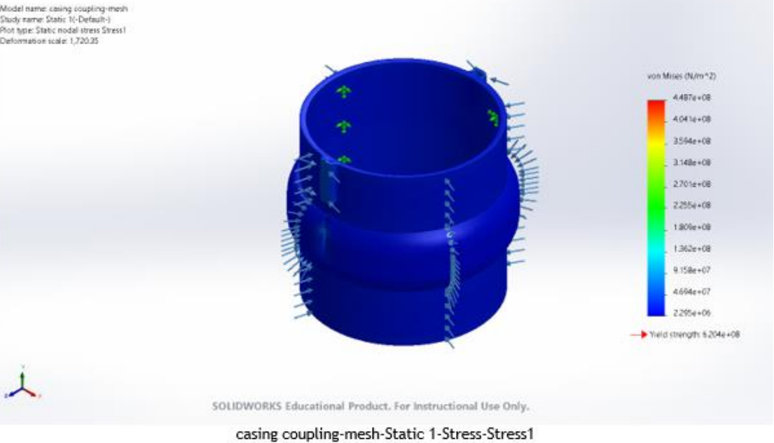
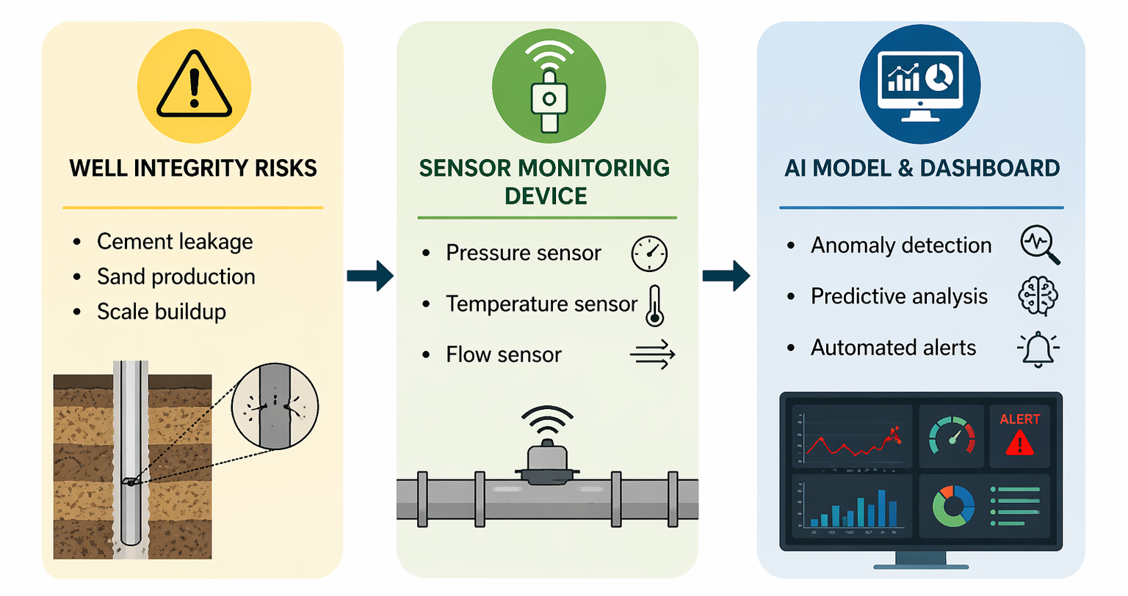

Al-Powered Well Integrity Monitoring System: Early Detection of Cement Leaks, Sand Production, and Scale Formation
TEAM
F23
Fatemah Al Sulaiman (ME) , Joud Alsayid (SWE), Danah Alotaibi (SWE), Ruba Buali (EE), Danya Alfozan (PETE) , Tala Aboalnaja (ME)
Coach: Dr. Yassmin Seid Ahmed
Problem Statement
Technical Requirements
Prototype Design
The 2010 Deepwater Horizon disaster killed 11 workers, triggered the largest offshore oil spill in U.S. history.
Resulted in over $65 billion in fines, settlements, and cleanup costs.
Well integrity failure is one of the most critical risks in oil and gas operations: significant human, environmental, and economic consequences.
Constraints
10 ± 5 min alerts
Pressure/ flow variations
AI model trained on sample data; validated on live inputs
Test conditions should closely represent real well conditions
ESP32* limited memory
Specifications
Field-Deployable Mechanical Design
Real-Time Monitoring Dashboard
Objectives
Operates within 20–200°C
Scaling detection accuracy ≥70%
Develop a lab-scale well integrity monitoring system
Design multi-sensor system
Implement an AI-based model to detect anomalies
Develop a real-time dashboard to visualize sensor data, trends, and automated alerts
Sand detection at 2–3 m/s flow
Power ≤ 200 w
Outside well sensor holder
Inside well sensor holder
Future work
Testing and Validation
Dashboard refresh rate :10 ± 5min
Scale to field deployable system for real wells
Integrate additional sensors
Develop cloud-based monitoring platform
User learns ≤5 h
SF* ≥ 1.5
Piezo sampling rate of ≥2 kHz
AI model accuracy ≥65%
Our Proposed Solution
Microcontroller provides
Wi-Fi telemetry<5
Sampling rate of ≥10 Hz
SF* = 1.5
Lab-scale multi-sensor AI detects & forecasts well-flow anomalies
T ≈ 25°C
Conclusion
Integrated system: sensor → DAQ* → AI (PETE-calibrated)→ dashboard.
This work demonstrates the feasibility of an AI-powered, multi-sensor well monitoring system for early anomaly detection, enabling more proactive well management.
*ESP32: A compact microcontroller used to process sensor data and enable Wi-Fi communication
*SF (Safety Factor): A design margin indicating how much stronger the system is than expected operating conditions
*DAQ (Data Acquisition System): System that collects and transfers sensor data for analysis
Notes:
AI model ≥65% accuracy

