Slide 1
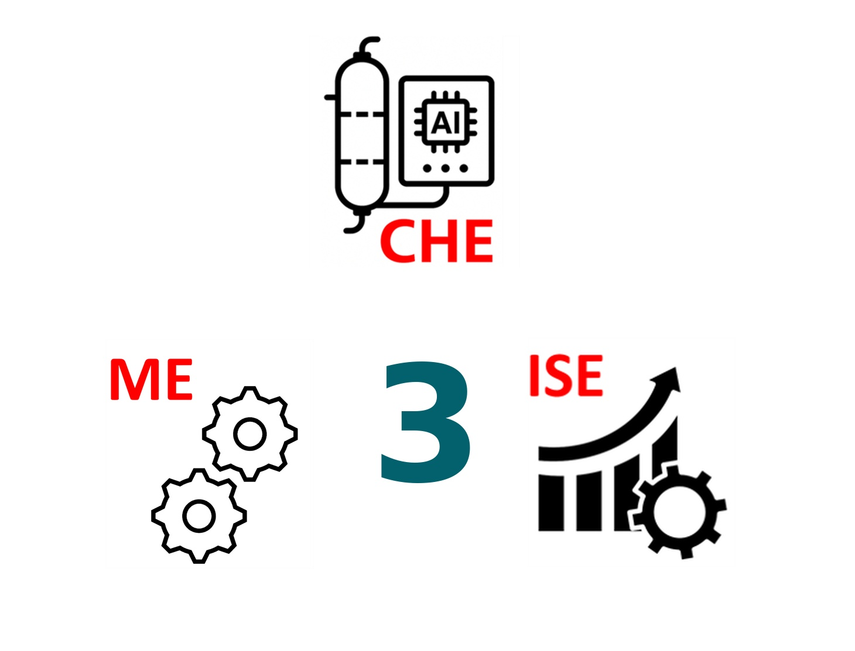
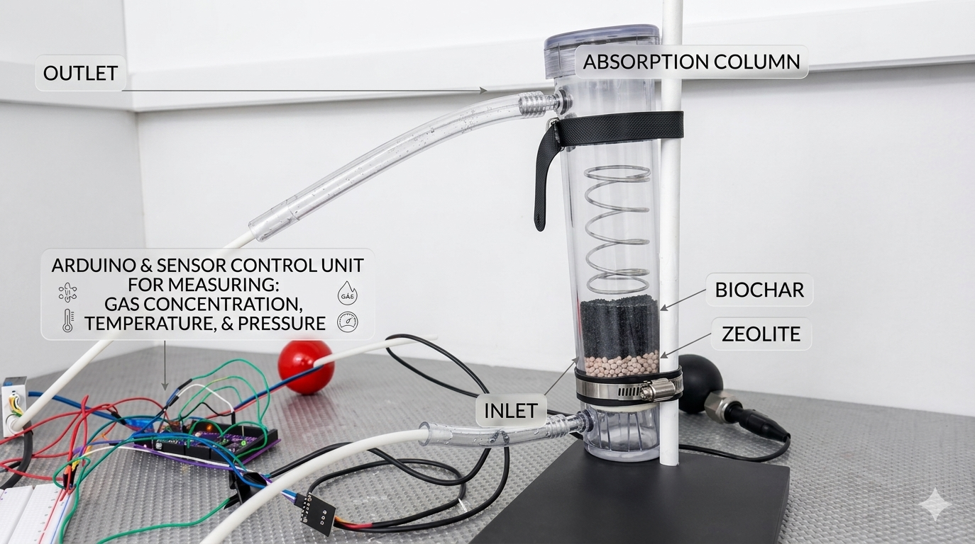
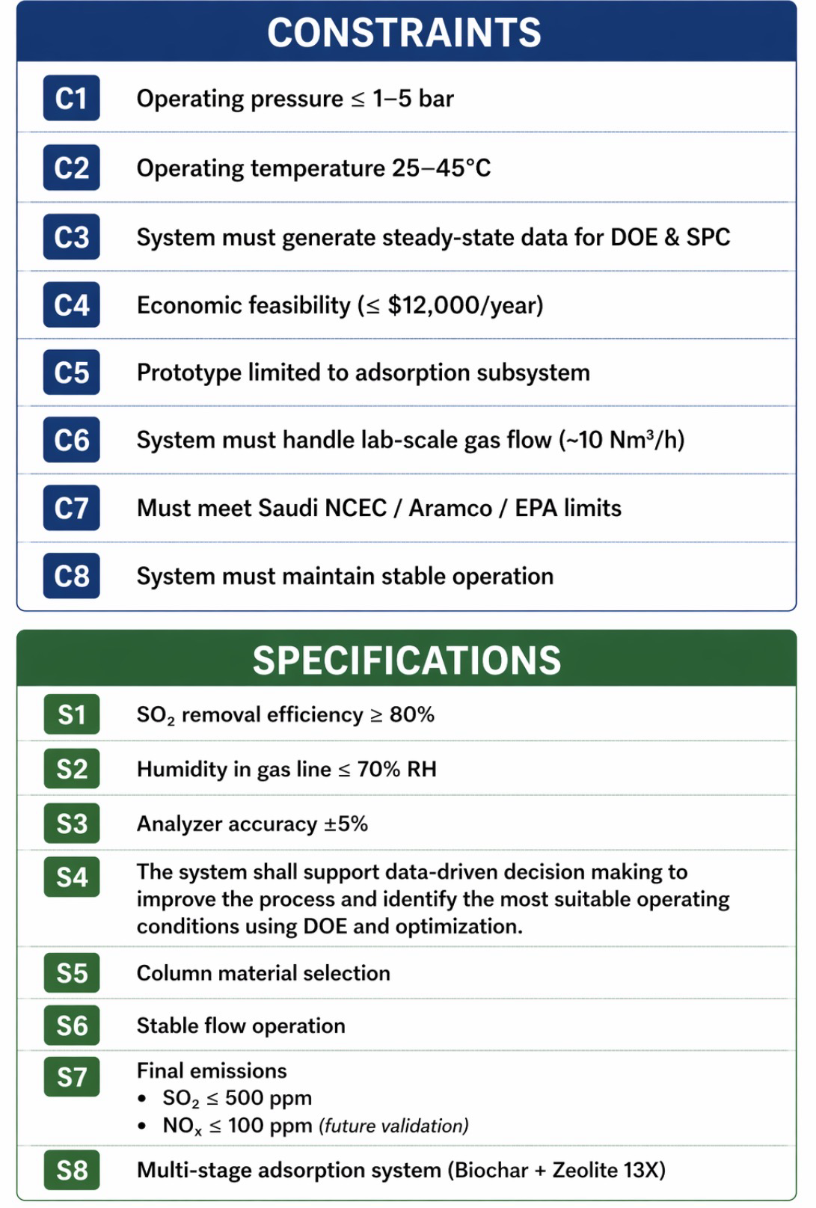
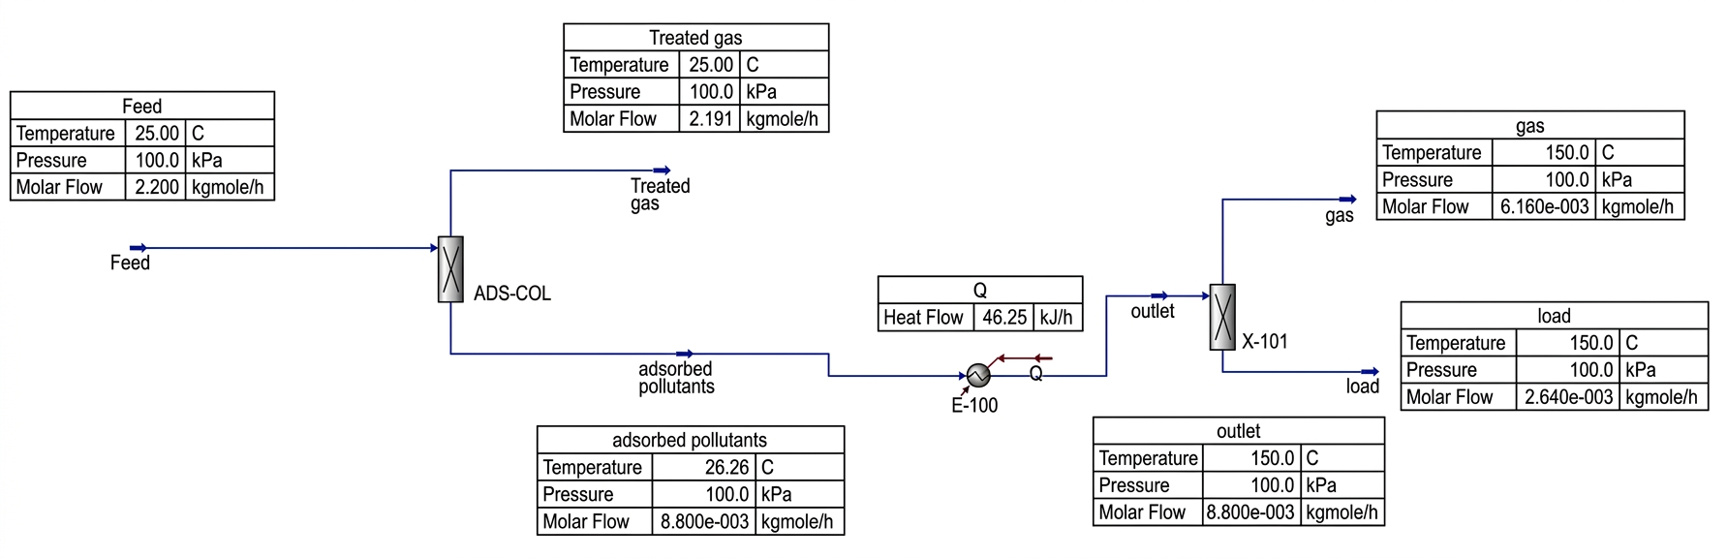
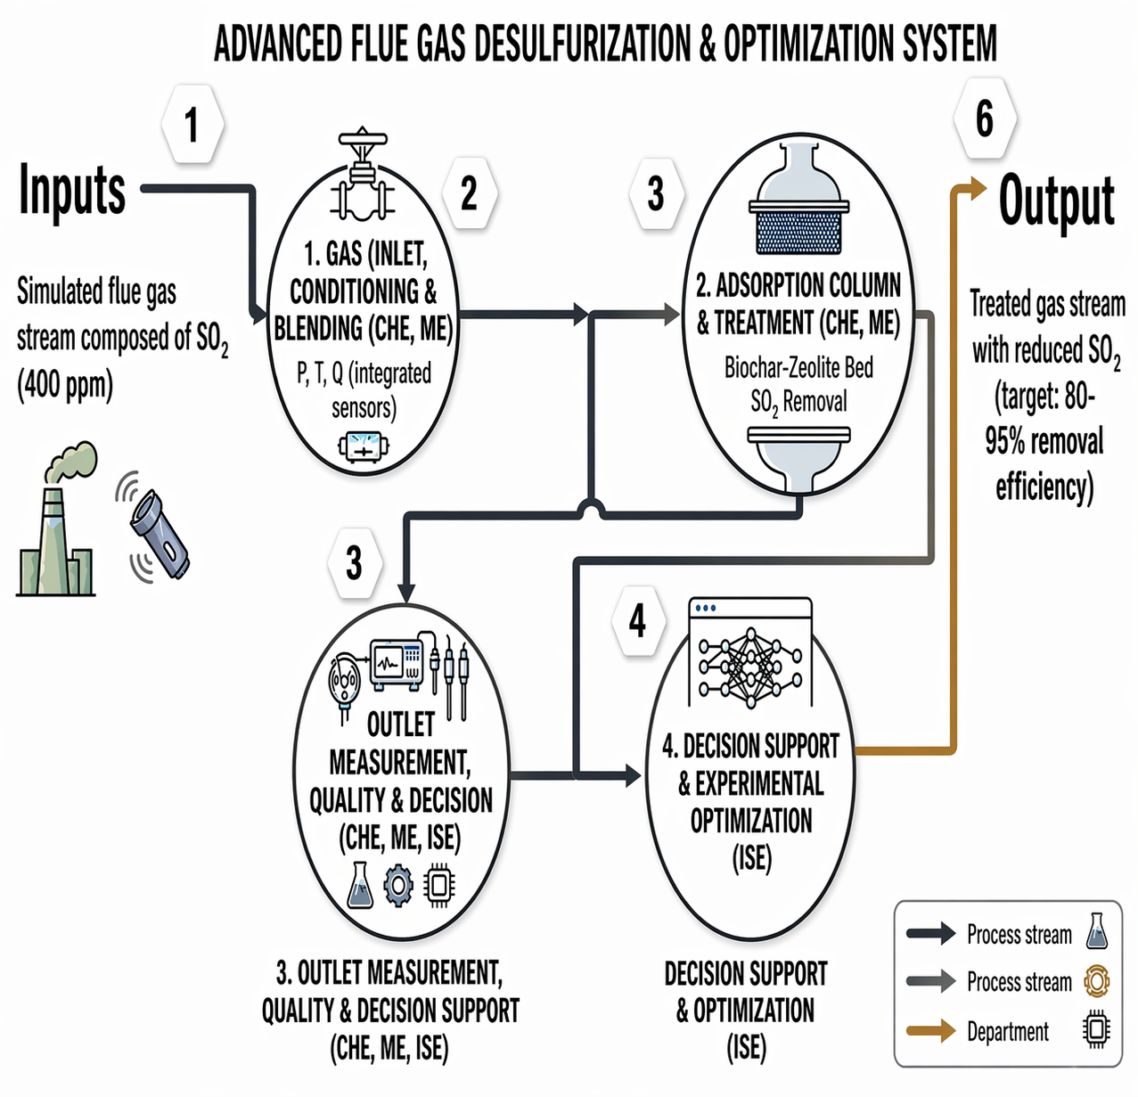
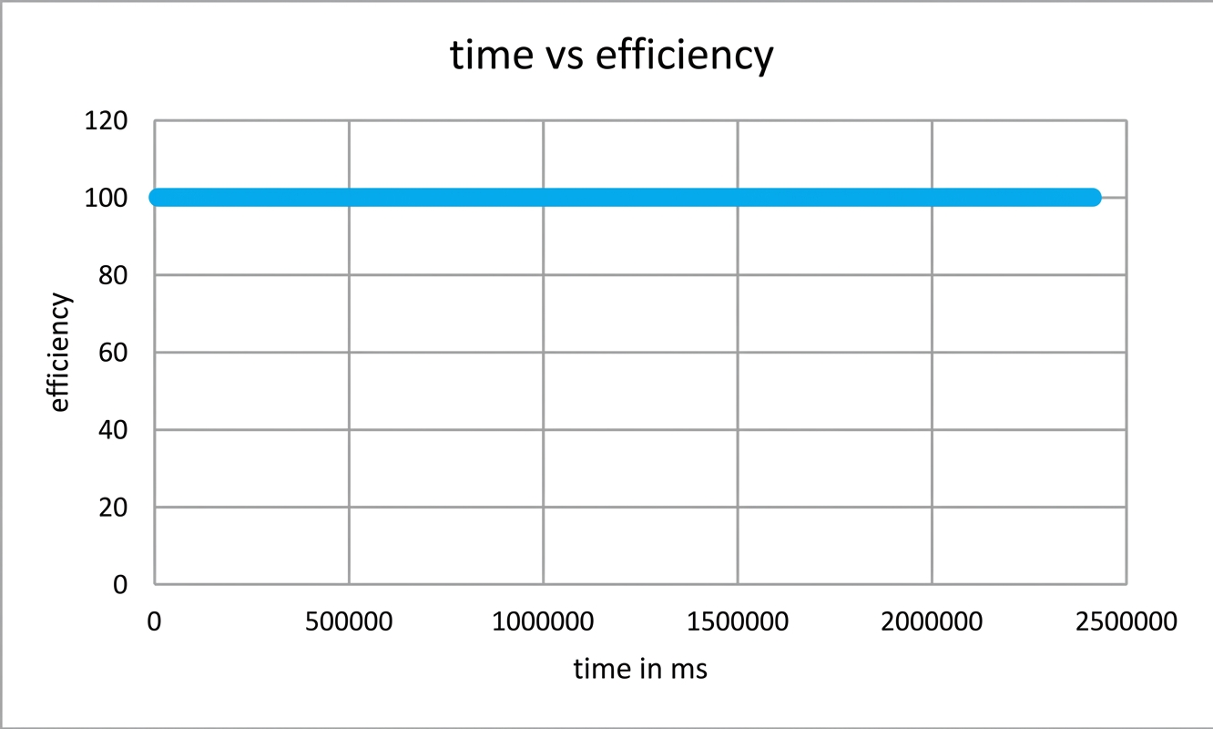
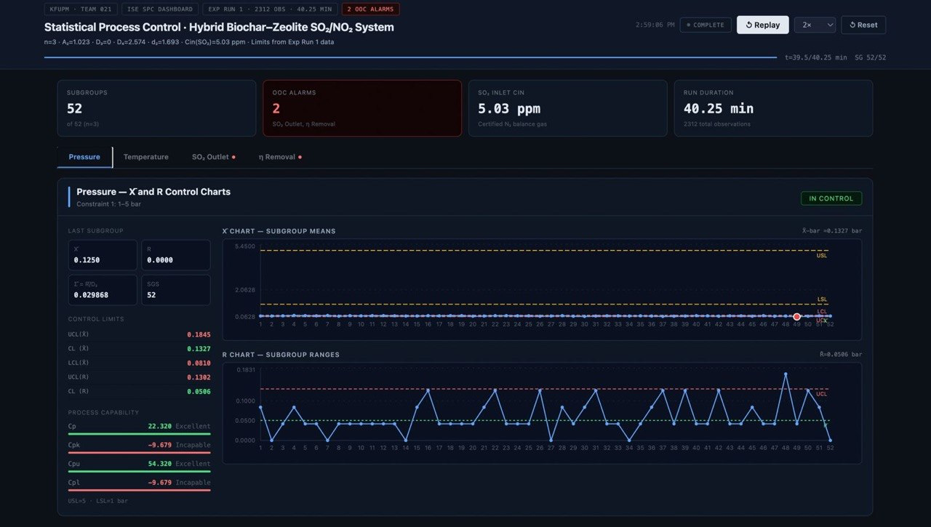
Hybrid Biochar-Zeolite System for SO2 Removal
TEAM
F021
Fatmah Alshaban (CHE), Noor Almuallim (CHE), Ghadi Alqurashi (ME) , Shahad Almoraya (ME)
Ghadah Alamri (ISE), Zahra Alqffas (ISE)
Coach: Dr. Yassmin SeidAhmed
Introduction
Prototype
Constraints and Specifications
Industrial emissions of SO₂ are major contributors to air pollution and health concerns. Conventional treatment methods can reduce these pollutants effectively.
However, these methods often involve:
  High energy demand
  High cost
  Complex operation
Problem Statement
Achieve efficient removal of SO₂ using a low-energy and reliable system
Develop a hybrid biochar–zeolite adsorption system
Provide a simple and sustainable solution for laboratory-scale use
Prototype Setup
Deliveries
Dynamic Simulation
Testing and Validation
Conclusion
The hybrid biochar–zeolite system effectively removes SO₂ with low energy use and simple operation
The system is cost-effective and easy to implement
It offers a sustainable solution for air pollution control

