Slide 1
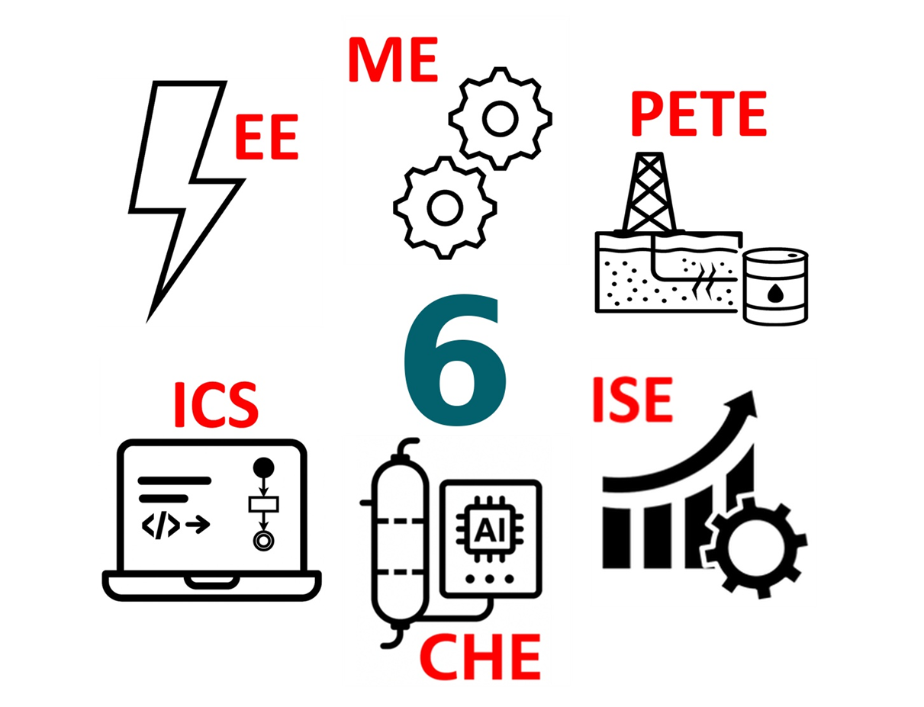
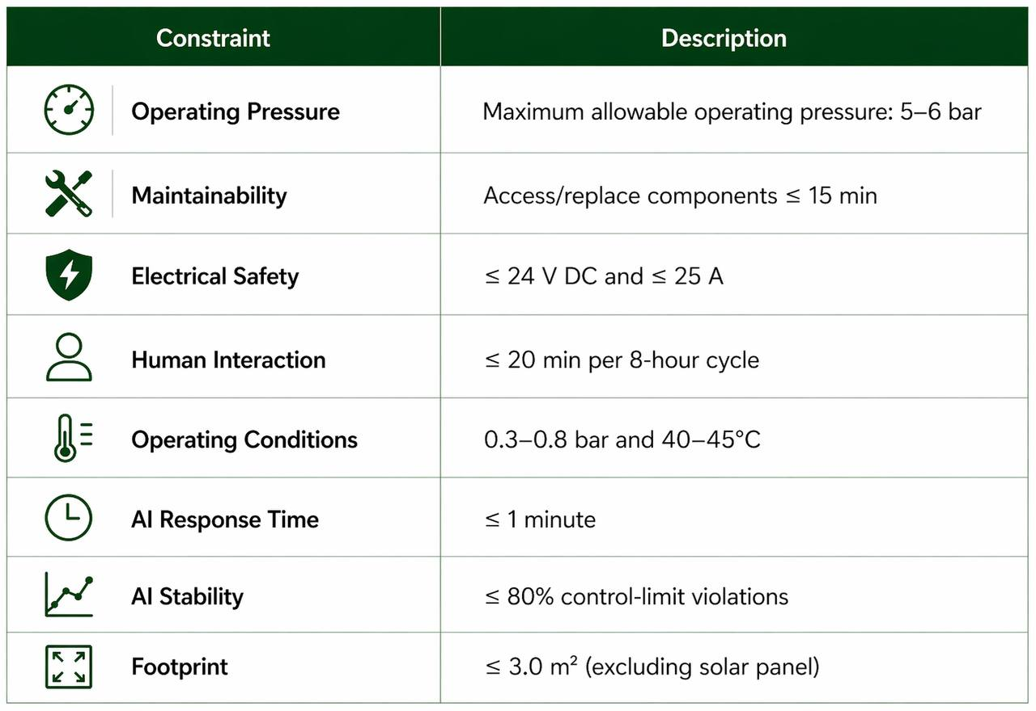
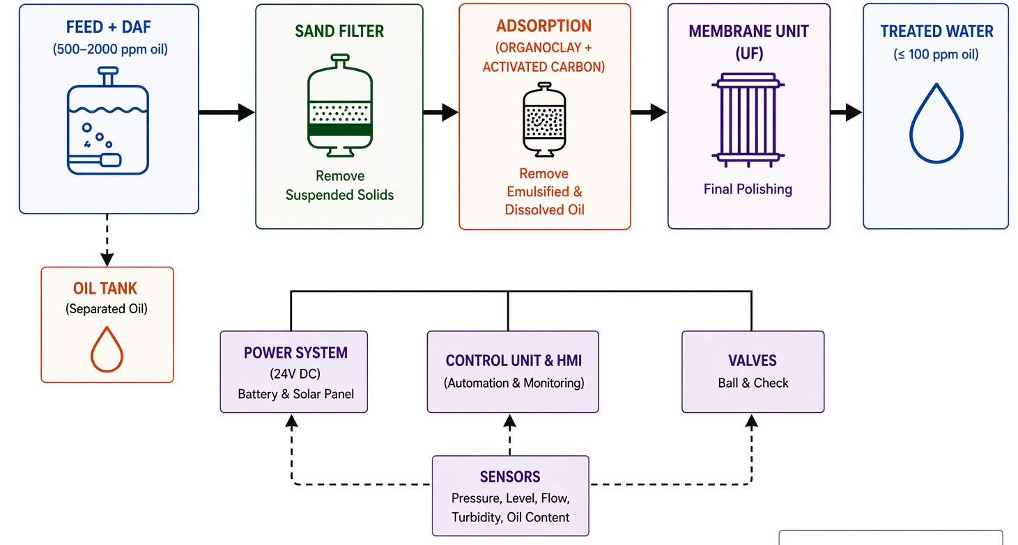
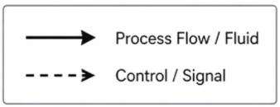
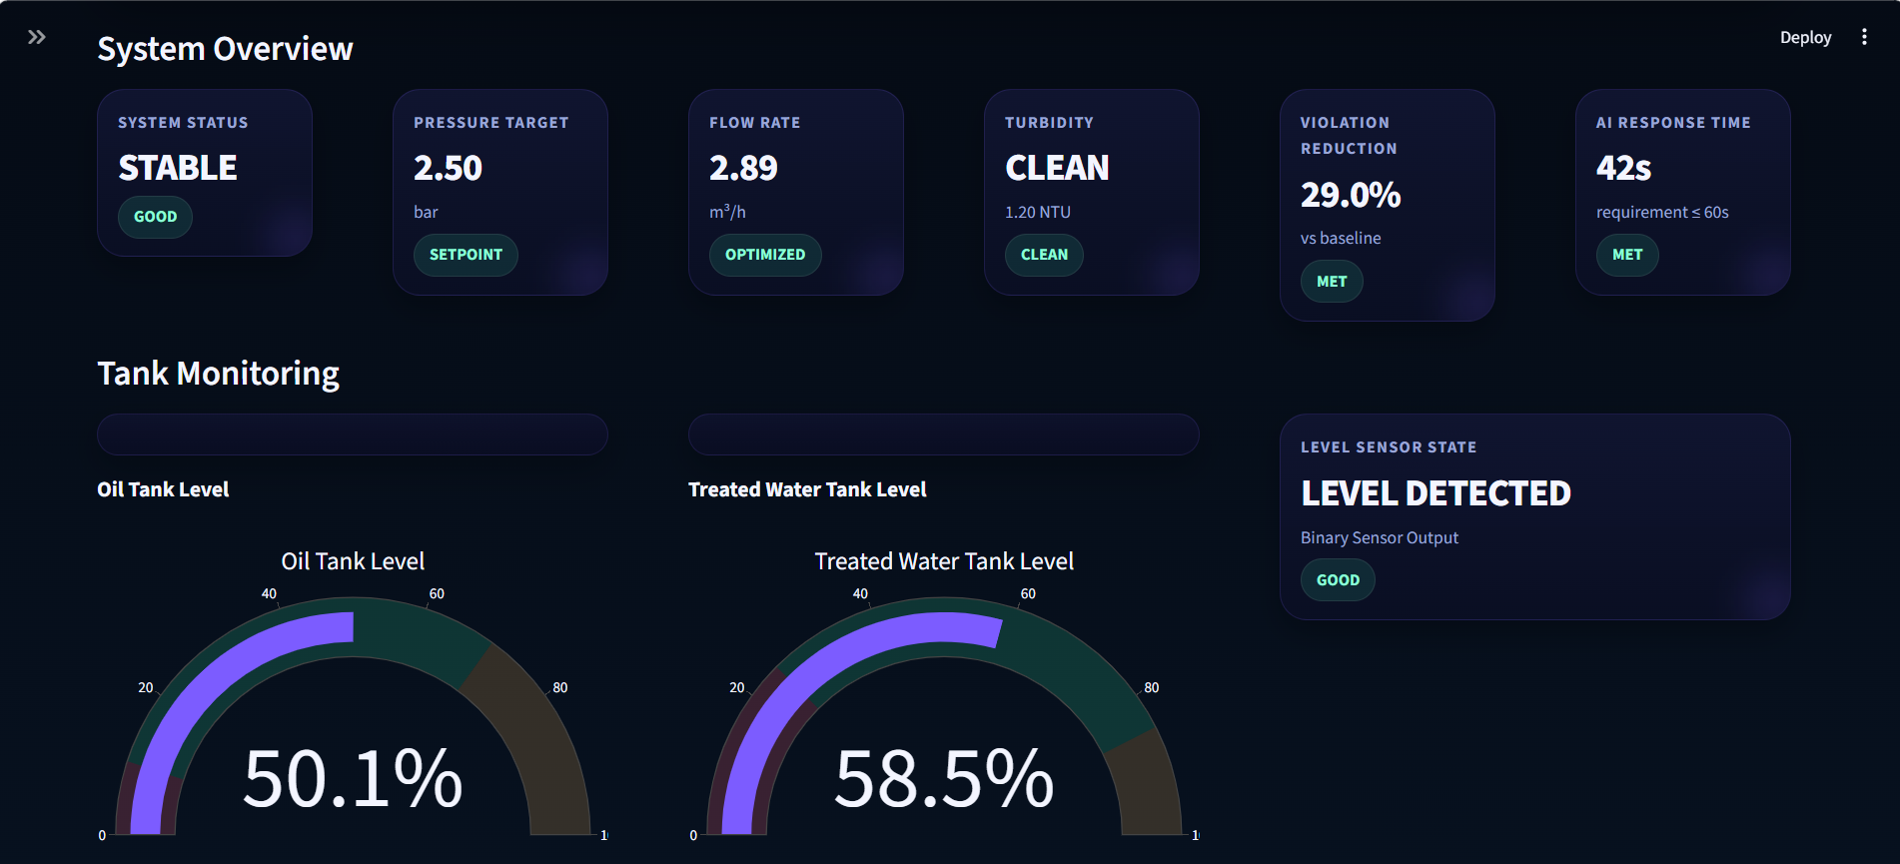
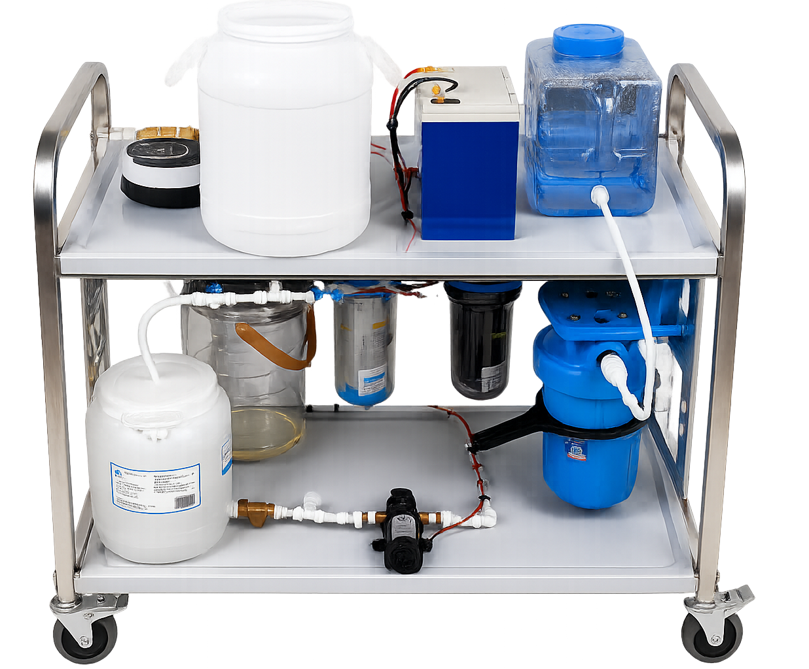
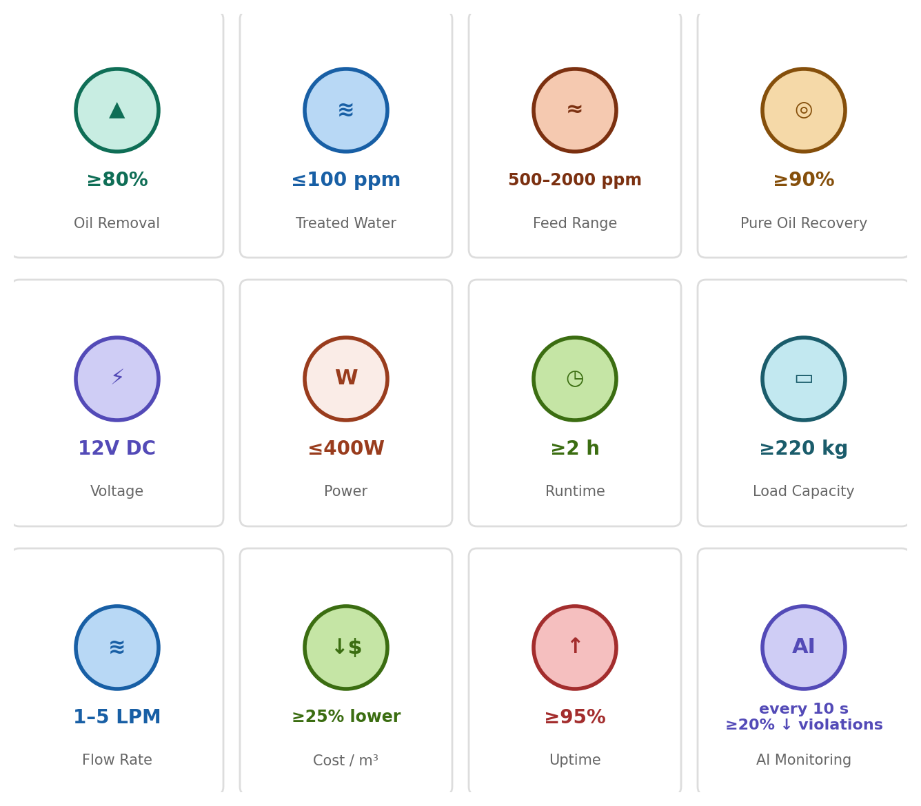
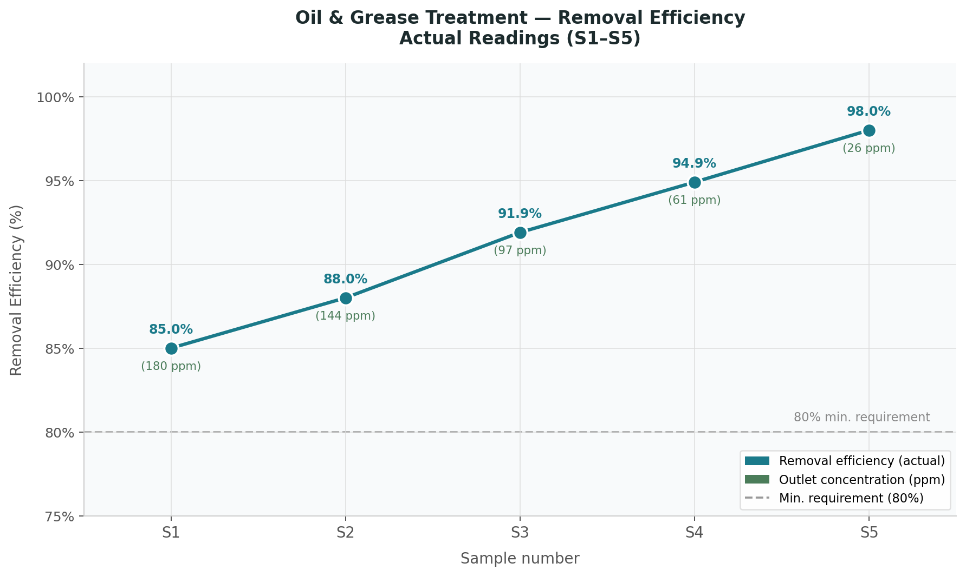
Smart Mobile Oily Water Treatment Unit
TEAM
F20
Laila Meshi, Yara Alanazi, Reem Abdelgawad, Fatima Alattas, Rawan Nazal, Anfal Alamodi, Fatimah Al Mubarak
Coach: Dr. Abdulrahman Al Qadami
Background
Constraints
Prooses Flow Diagram
Produced water contains oil, solids, and chemicals that must be treated before discharge to prevent environmental pollution. Conventional systems are large and costly, making them unsuitable for field use. This project develops a compact, smart mobile unit with integrated treatment and AI monitoring for efficient on-site water treatment.
Problem Statement
Remote and pilot-scale oilfield operations lack practical on-site solutions for treating oily produced water, as conventional systems are large, costly, and not suitable for field deployment.
Testing & Validation
Prototype Development
Conclusion
The smart mobile unit provides an effective and compact solution for oily water treatment, achieving 91.9% removal with stable, low-voltage operation and reliable AI monitoring for on-site use.
Specifications

