Slide 1
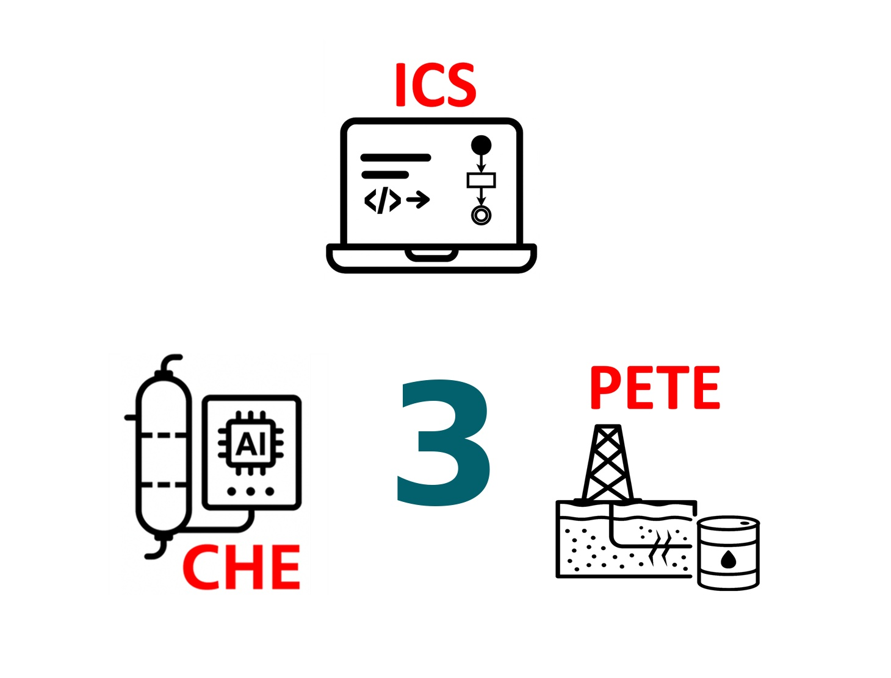
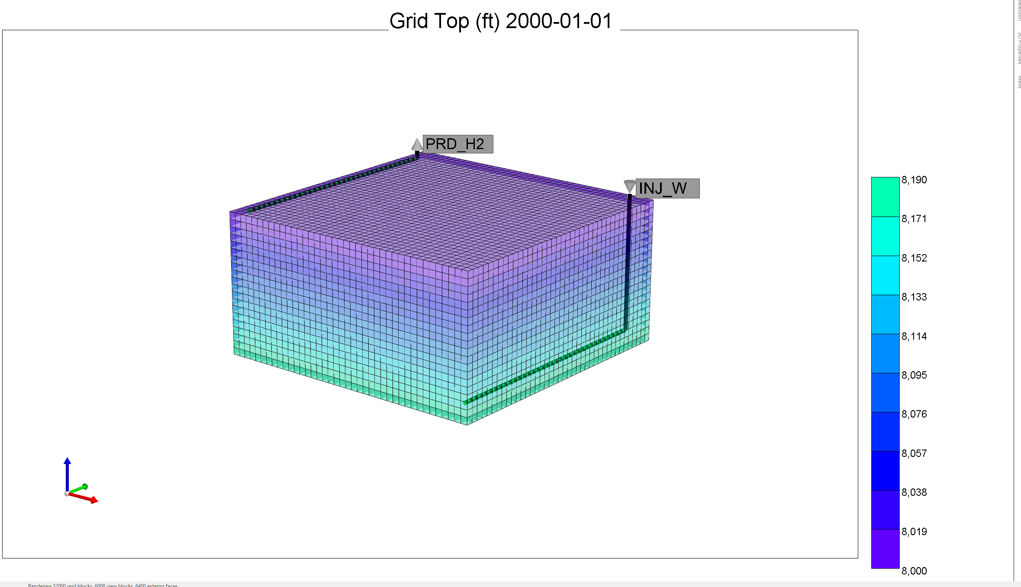
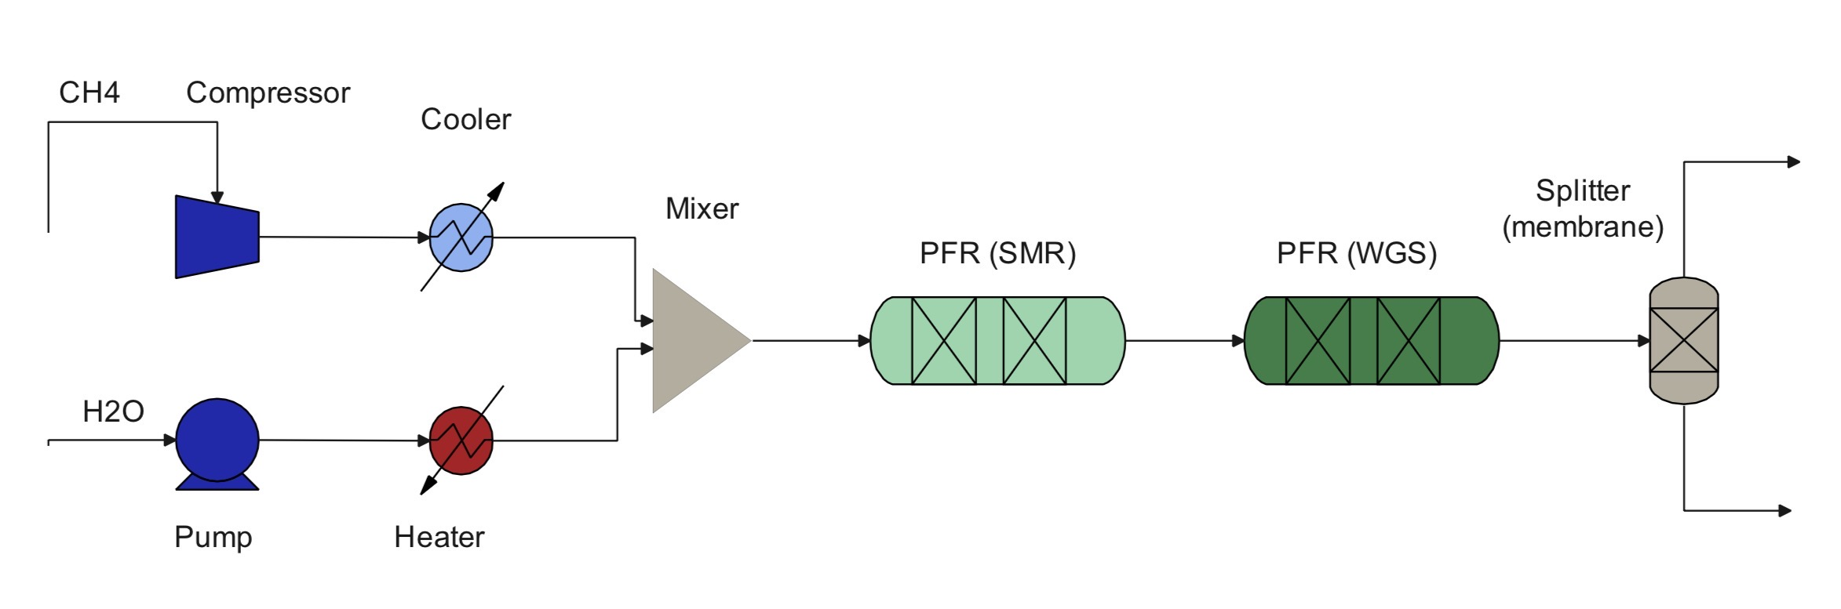
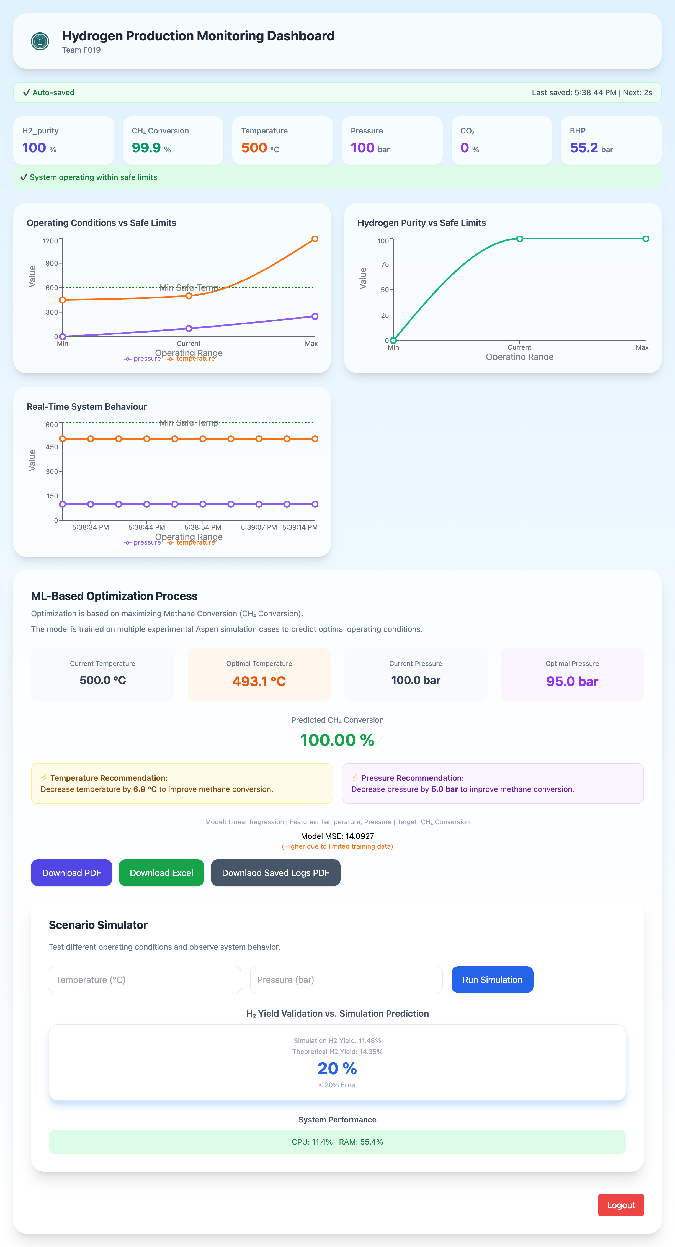
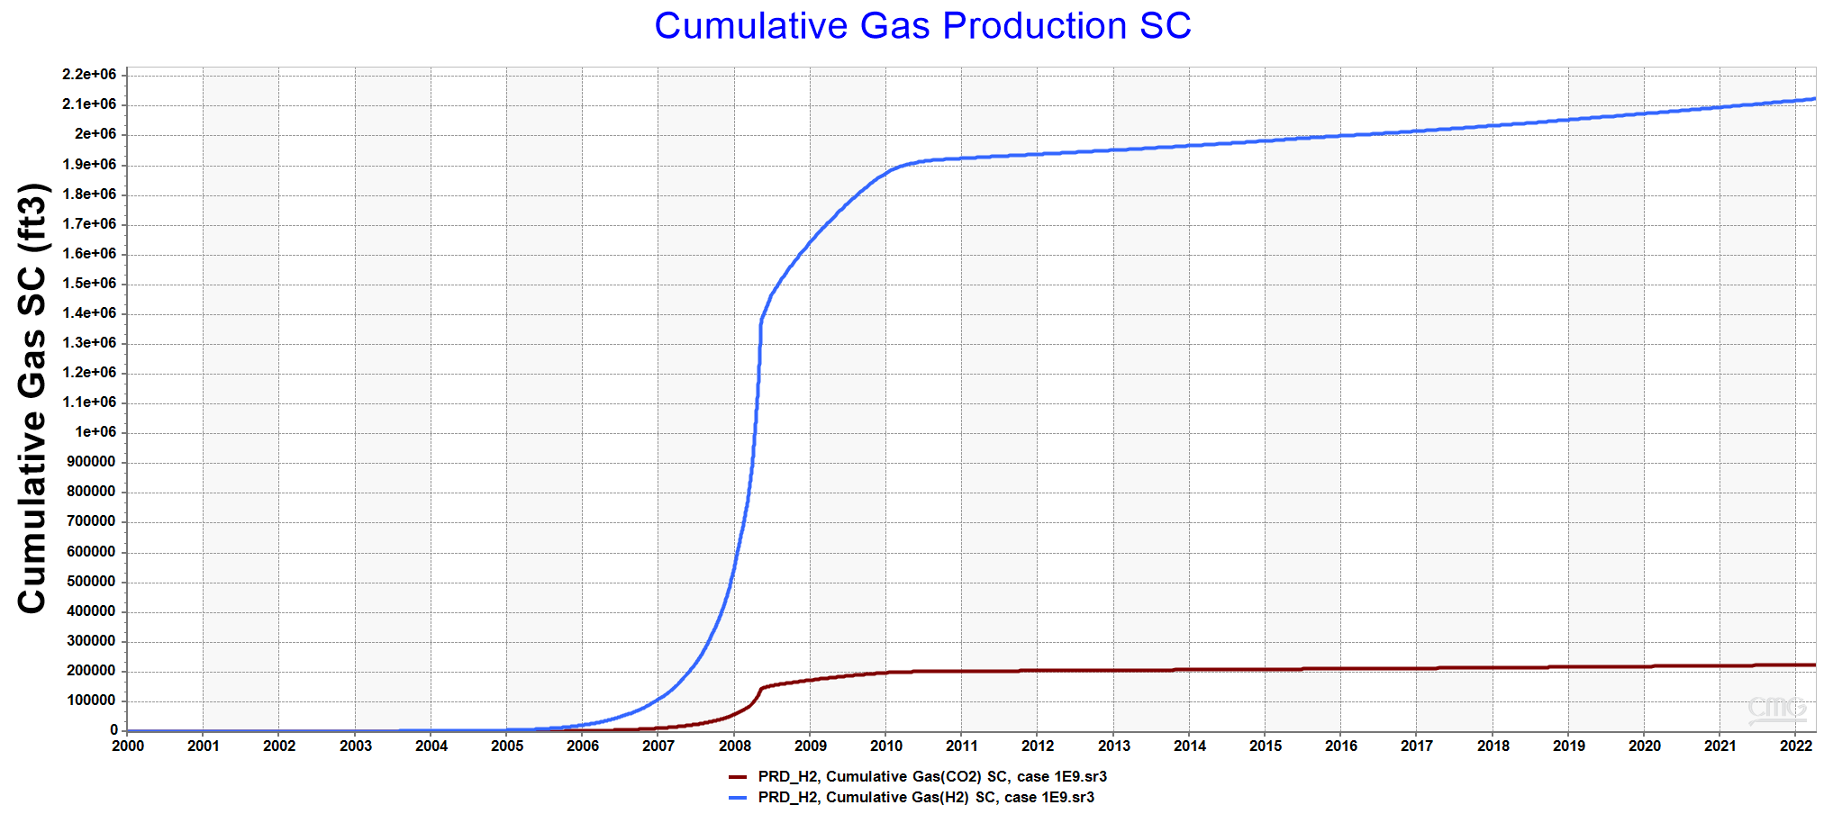
TOWARD IN-SITU HYDROGEN PRODUCTION FROM SUBSURFACE NATURAL GAS
TEAM
F019
Hoor Al Kubaish, Zainab Al-Abdrabalnabi, Shahad Almarhoon, Nora Alkuwaihes, Raghd Tawfik, Maryam Bokhamseen
Coach: Duaa Abdelwahab
Background
Reservoir Simulation
Process Simulation
Testing & Validation
Hydrogen is essential for the energy transition, yet conventional methods such as SMR are energy-intensive and carbon-intensive. In-situ hydrogen production presents a promising alternative by enabling hydrogen generation from subsurface natural gas with inherent CO₂ retention.
Process Simulation Flow Diagram
The hydrogen rise to the producer while CO₂ stays deeper in the reservoir.
Constraints & Specifications
Prototype Design
Problem Statement
Constraints |  | Maximum operating limited to 250 bar.
 |  | System usage ≤ 80% CPU and RAM
 |  | Dashboard visualizes ≥3 live parameters simultaneously.
 |  | Access restricted with authentication (127.0.0.1)
Specifications |  | ≥70% CH₄ conversion
 |  | ≥50% H₂ purity
 |  | Operating temperature range 400C to 1200C
 |  | Dashboard with ≤ 5s data latency and real-time plotting
 |  | ML-based optimization module with latency ≤ 10s
 |  | System auto-saves data every 30s
Integrated Specifications |  | Safety auto-shutdown if CO₂ leakage>10%.
 |  | Validation of H₂ yield vs. simulation prediction (≤20% error).
 |  | Real-time calculation of CH₄ conversion updated every ≤ 10 s.
Current hydrogen production methods like SMR are energy-intensive and carbon-heavy, highlighting the need for a cleaner, scalable alternative such as in-situ hydrogen generation from subsurface natural gas with CO2 retention underground.
Max pressure: 901.42 psi
Max temperature: 837.8C (1540F)
Cumulative CO₂: 224,273 ft³
Cumulative H₂: 2,124,997 ft³
Objectives
Conclusion
To model and simulate the underground hydrogen production process using Aspen Plus.
To model the reservoir behavior and production well performance using CMG.
To integrate, visualize, and optimize data, ensuring safe operating limits.
This project presents an integrated system for underground hydrogen production with no surface CO₂ emissions. The monitoring dashboard enables real-time Visualization. Using membrane separation, 100% hydrogen purity was achieved, with methane conversion range of 70.5–99.9%.

