Slide 1
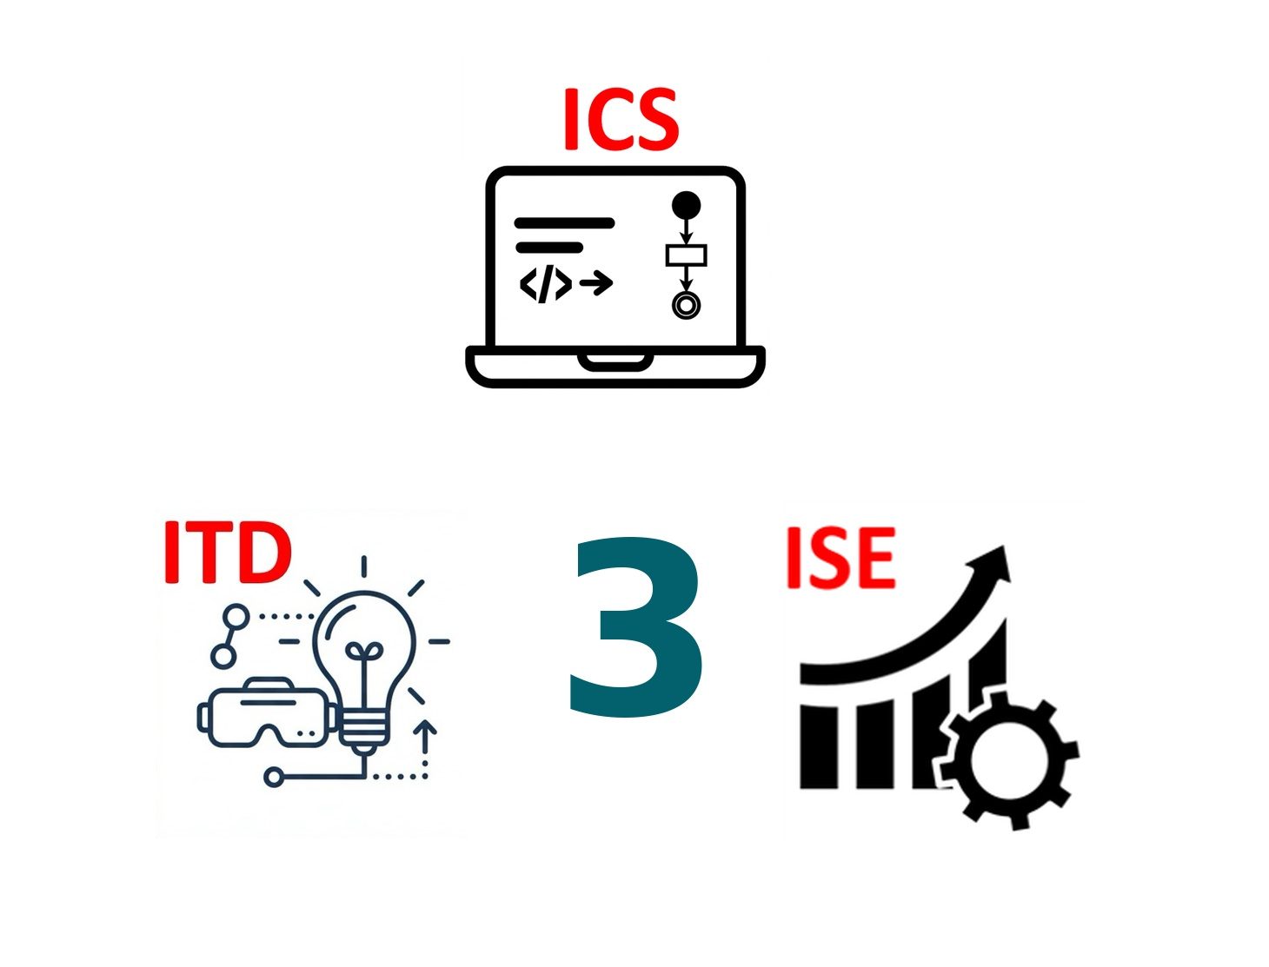
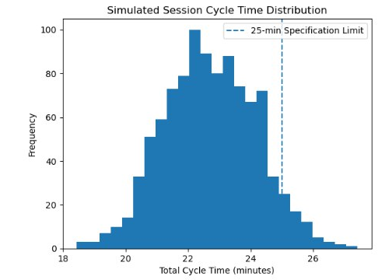
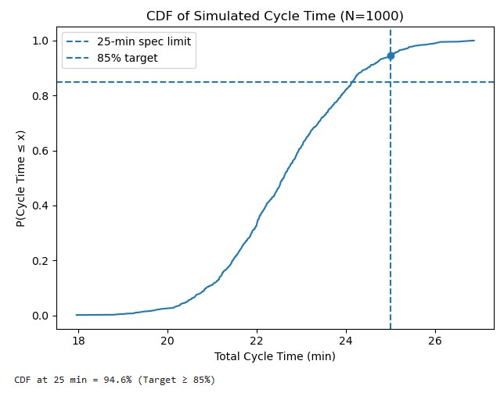
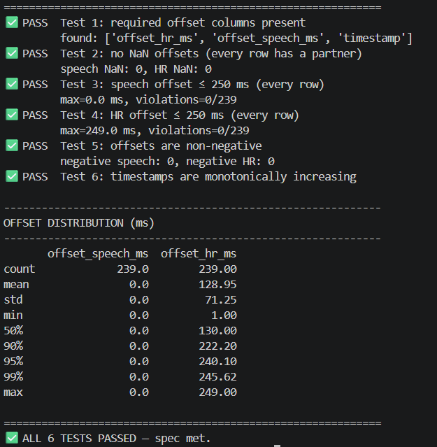
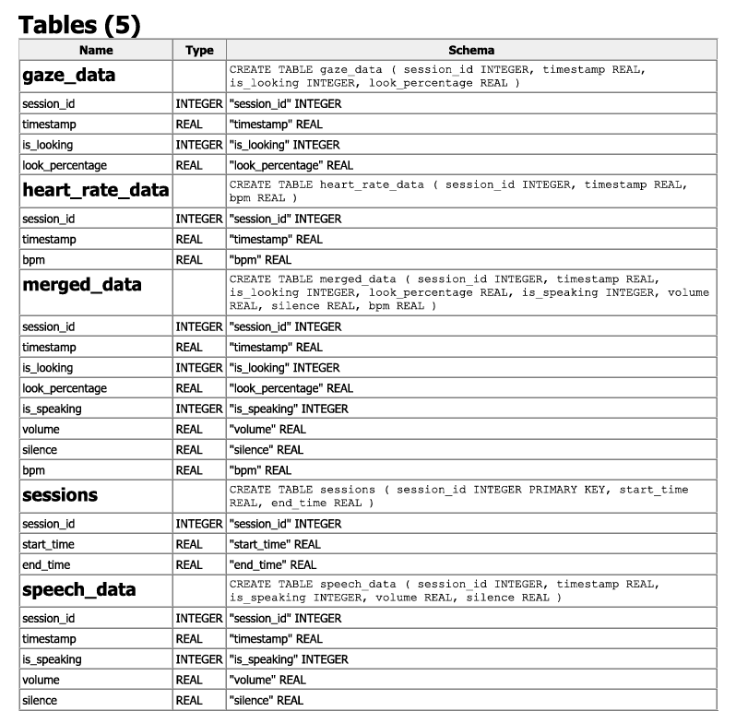
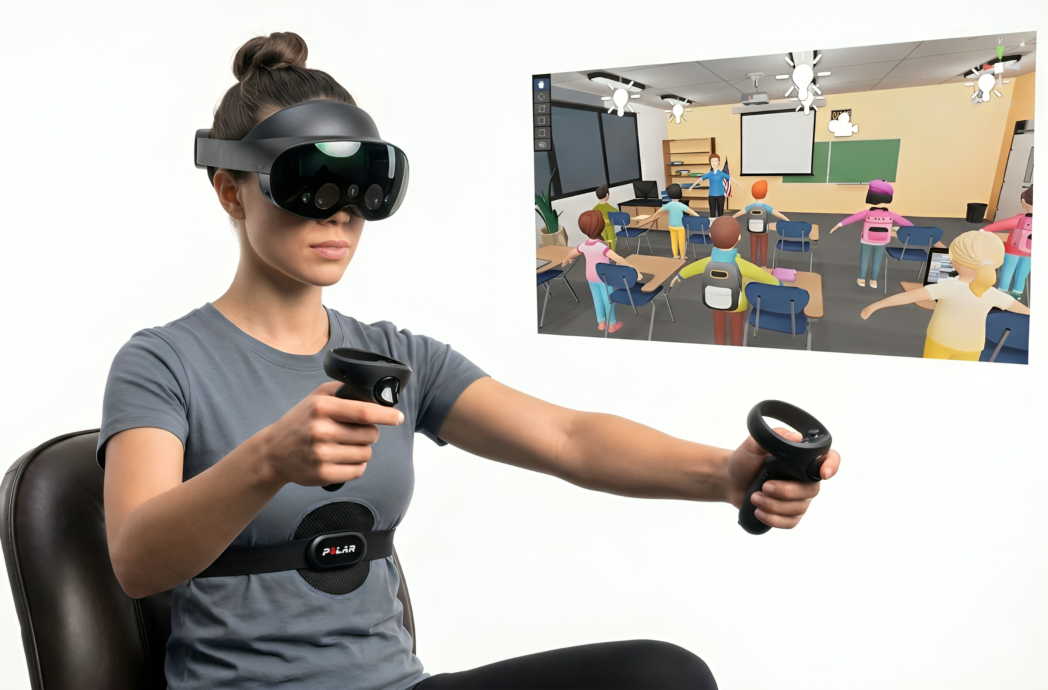
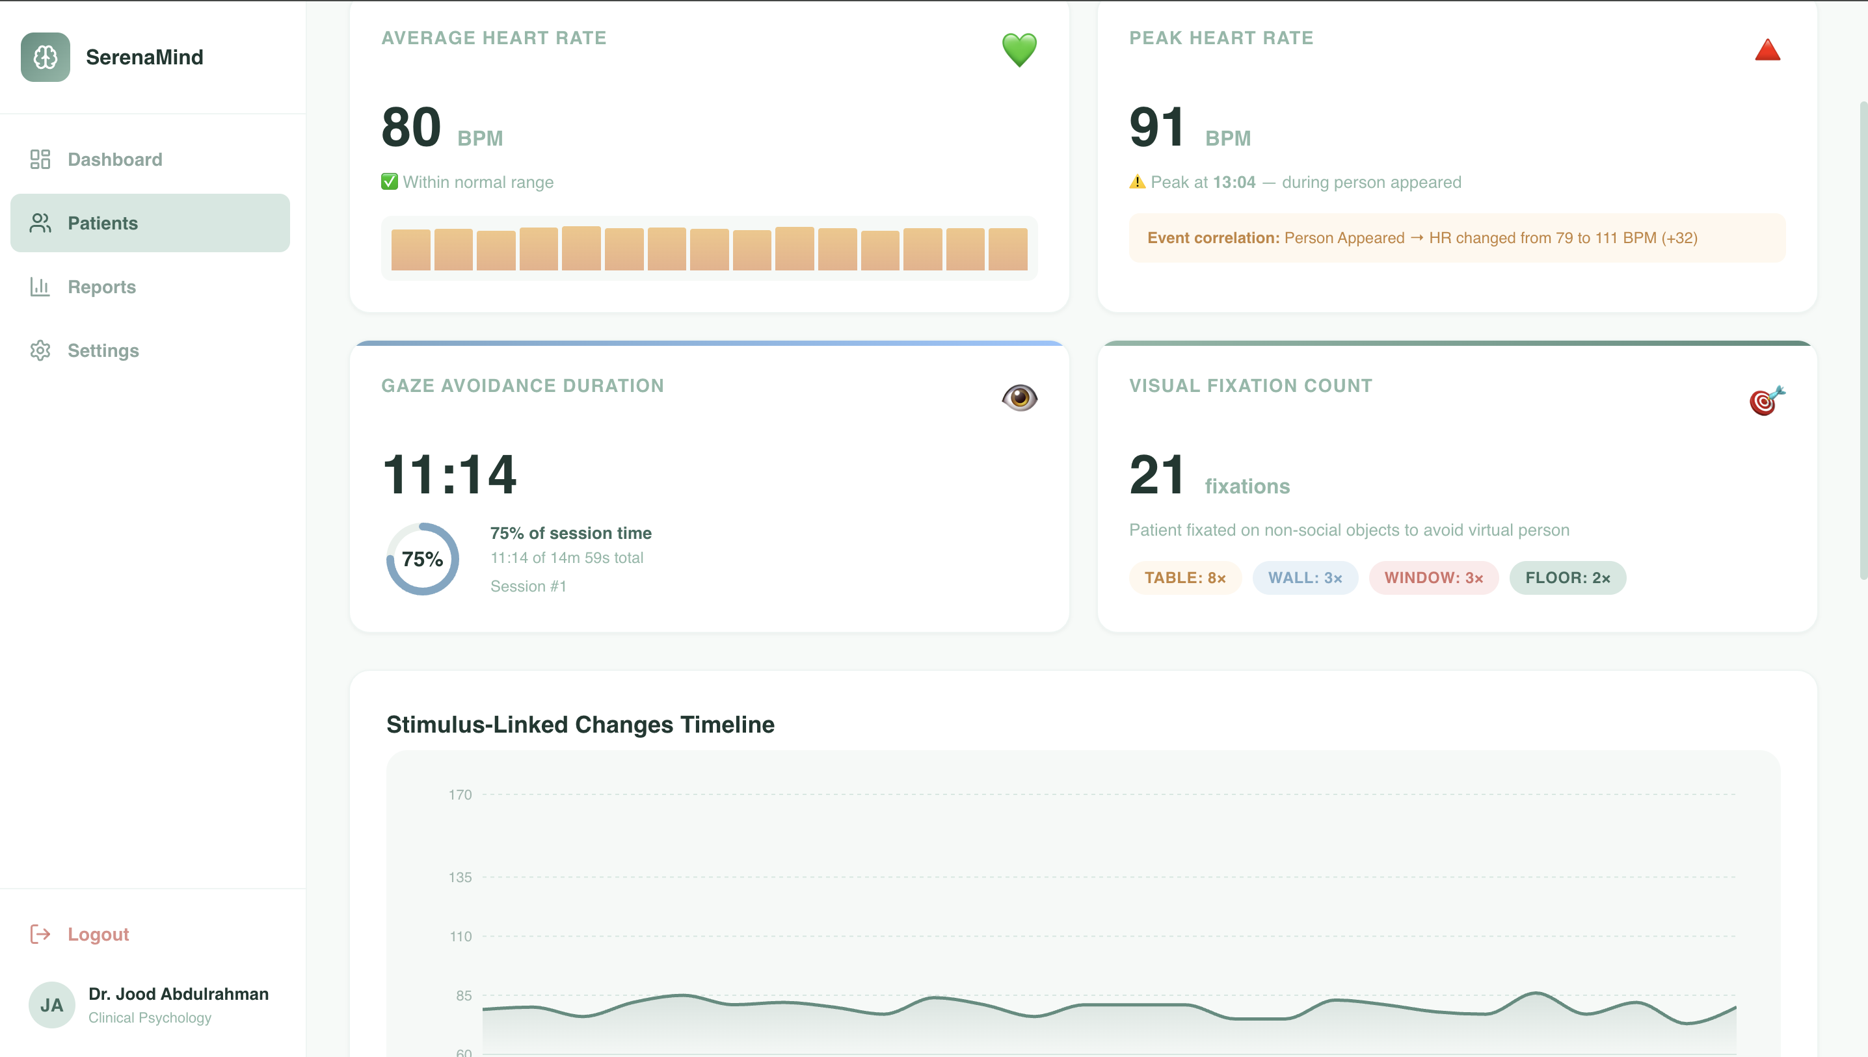
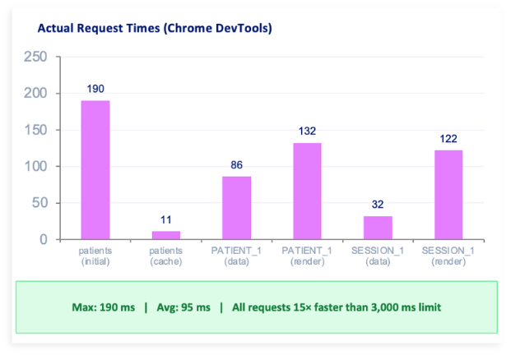
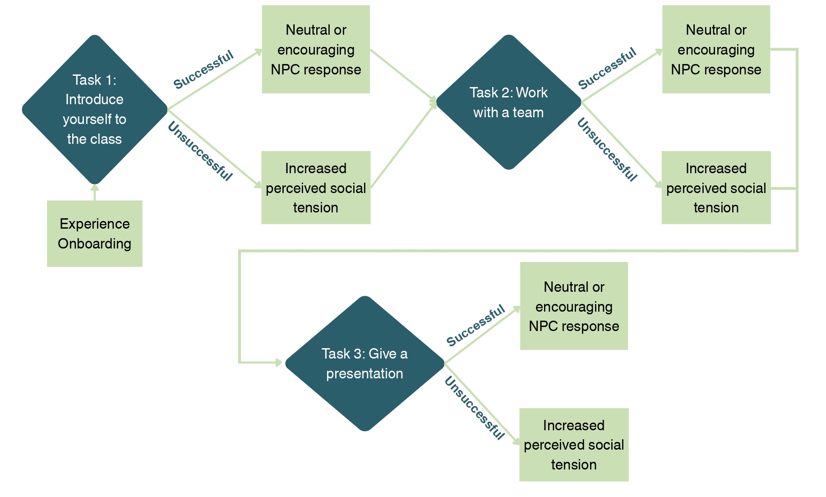
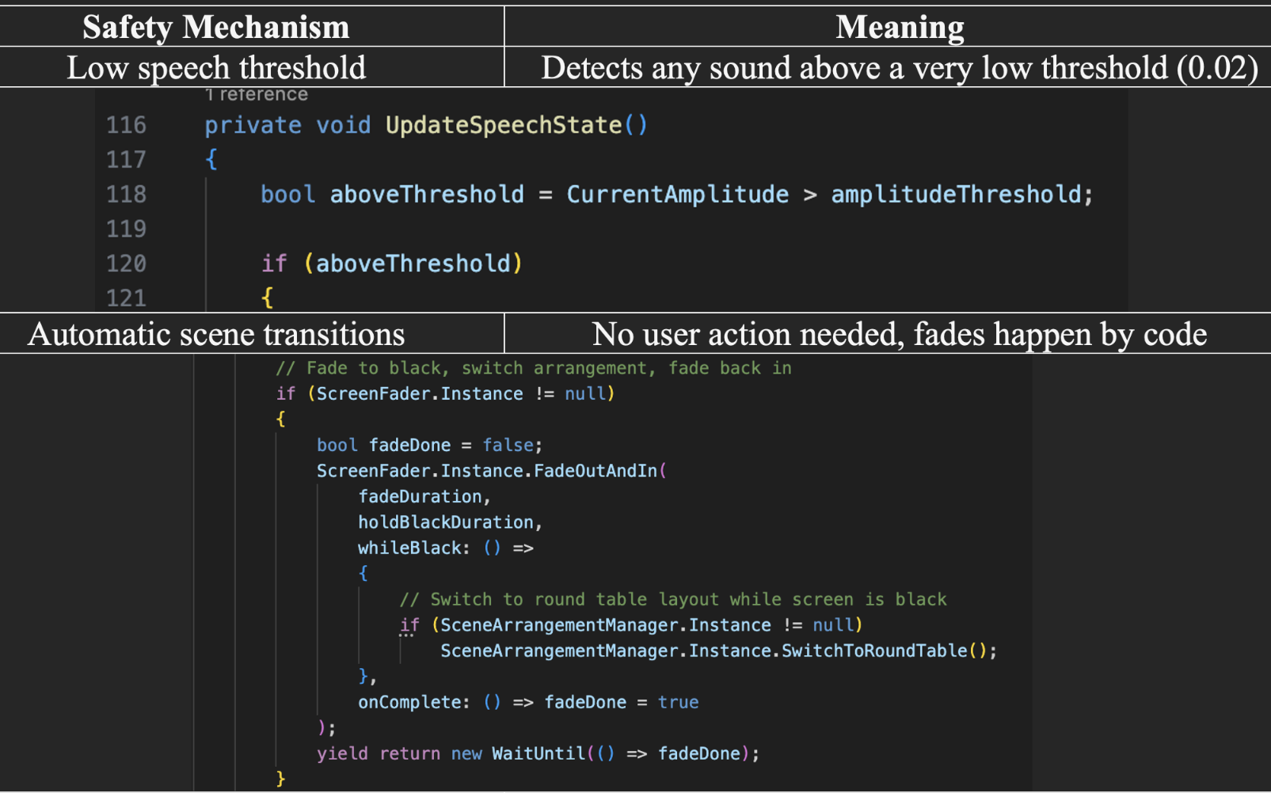
VR Experience to Help the Diagnosis Process
of Mental Health Issues
TEAM
007
Lujain Alem, Safana Elachi, Aryam Alshehri, Aeshah Almahmoud, Joof Faqera, Banan Alshahrani
Coach: Dr. David Wynn
Introduction
Specifications
Prototype Design
Monte Carlo simulation & Process flow analysis
Problem Statement
Mental health clinicians face challenges in making consistent and accurate diagnoses because assessments rely heavily on retrospective patient self-reporting outside symptom-triggering contexts, which can lead to incomplete information and inconsistent diagnostic outcomes
Project Objective
This project proposes a VR-based experience that simulates real-world scenarios while collecting behavioral and physiological data to support more accurate and consistent mental health assessments.
All biometric signals aligned within ≤250 ms
Organized database for multi-signal session data
≥80% rate system ≥4/5 for ease of use by therapists
≤25 min session cycle, ≥65% flow efficiency
Task mapping that directly connects with symptoms
Realistic environment with ≥85% user immersion (≥4/5)
Smooth performance with ≥90% runtime stability
≥95% successful user actions on first attempt
Dashboard load time ≤3 seconds
Integrated Specifications
Complete session (7–15 min) maintains ≥90% user comfort
Multi-sensor data captured, synchronized, stored, and processed into a report ≤1.5 minutes
≥95% interaction/report success, ≤2% rework, supports ≥100,000 records/session without degradation
System Workflow Diagram
Patient
VR Experience
Synchronized Data
Biometric Sensors
Automated test suite using Python to validate synchronization accuracy & Applied data encryption using Fernet
Therapist Report
Constraints
Symptoms differ across users, affecting scenario effectiveness
User familiarity with VR impacts comfort and interaction
Dashboard limited to 2–7 items per view
Evaluation restricted to controlled, simulated settings
All data must use a unified timestamp (≤100 ms resolution)
Database must support ≥ 100,000 records per 15-minute session
Dashboard load time optimization, & user interactions
Testing & Validation
User journey task mapping (SAD symptom-related)

