Slide 1

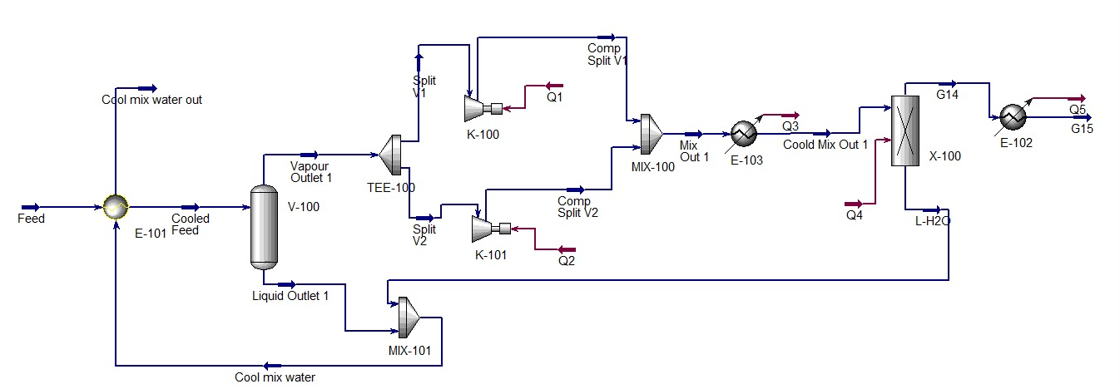
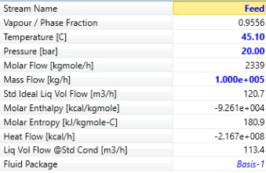
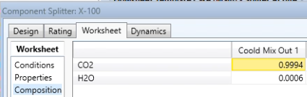
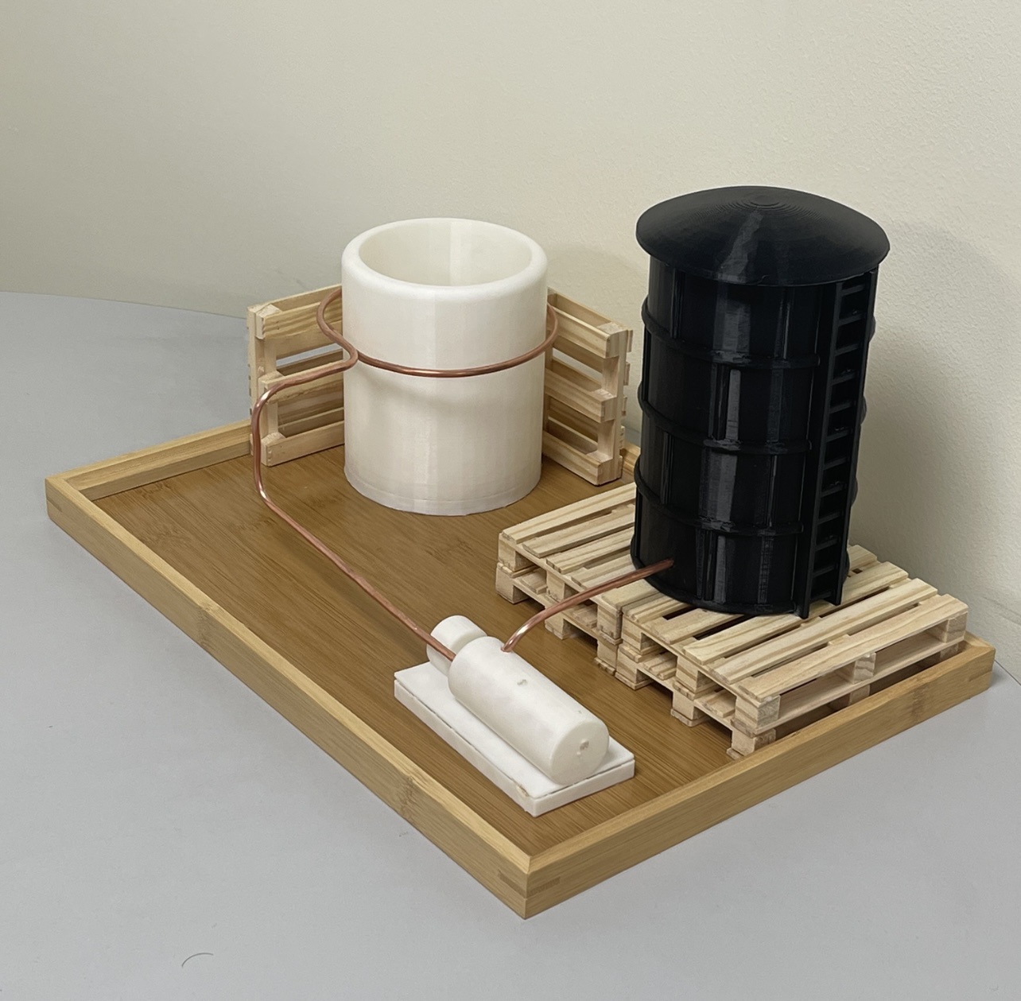
Utilizing the emitted carbon dioxide and using it as cooling agent
Faisal Al-Malki CHE
201916650
Abdulaziz AL-Halafi
CHE
201951710
Mohammed Khomayes
ISE
201971390
Turki Al-Subhi
ISE
201934290
Team number
90
Introduction
Simulation Prototype
Validation
Purification unit that separate carbon dioxide from water that coming as by product from producing Ethylene Oxide, then a liquidation unit to change the phase of CO₂ from gas to liquid to be used as cooling agent.
The purity of the output CO₂ above 98%.
The feed at 20 bar and contain CO₂ and Water only.
Reducing the energy used by do recycling and use the product as cooling agent for the plant.
Type of material used to handle and storage the liquid CO₂.
Problem Statement
Excessive CO₂ emissions contribute to global warming, resulting in rising temperatures and climate change. This disrupts ecosystems, alters plant distributions, and threatens biodiversity, ultimately jeopardizing food security and the health of our planet. Urgent action is needed to mitigate these impacts.
Project Impact
Purification unit deal with feed of CO₂ and water that come as byproduct of Ethylene Oxide process with temperature and pressure 45ºC and 20 bar respectively. Goes to separator that separate the CO₂ and water, then split the product to two streams. Two compressors used to increase the pressure, and to avoid shutdowns. Two cooler used to lower the temperature that relate to change the phase of the CO₂ from gas to liquid. We got above 98% purity of CO₂. The product temperature is -28ºC and the pressure 23 bar.
Environmental: Reducing the CO₂ emission.
Economic : Use the product as cooling agent instead of using external source.
Productivity: Cool down the reactor faster to keep high amount of desired product of the process.
Constrains
Model Prototype
Conclusion
Type of material of the tube.
Handling and storage.
Requirements for specialist equipment maintenance and servicing.
The prototype is designed to demonstrate the functionality of using CO₂ as a cooling agent. In real life applications stainless steel will be used in the tank's design to withstand high pressures (23 bar) and extremely low temperatures (-28°C). To preserve thermal efficiency, copper or insulated stainless steel will be applied for the pipes. Flexible materials will surround the reactor, replacing tough plastic to direct diffuser valves effectively, enhancing the cooling process and ensuring system performance and safety.
This project aims to develop a purification and liquefaction unit to efficiently separate CO2 from water produced in the Ethylene Oxide process. By achieving over 98% purity and using CO2 as a cooling agent, we can reduce emissions, lower energy costs, and enhance productivity. Validated outputs confirm over 98% purity while ensuring safe handling with suitable materials, benefiting both the environment and the economy.
Target Specifications
Above 98% of purity of CO₂.
Suitable real feed.
Reduce Energy consumption.

