Slide 1


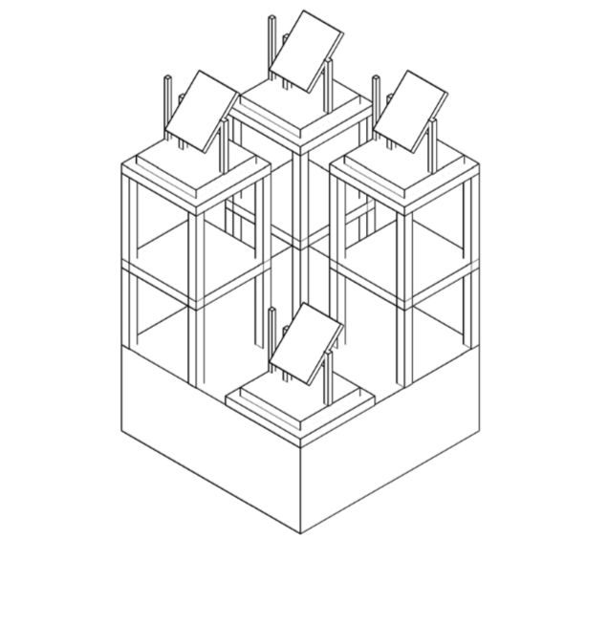
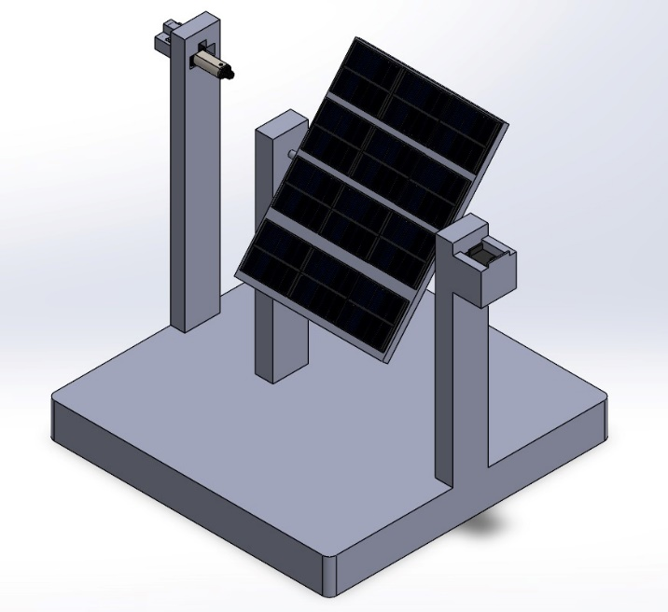
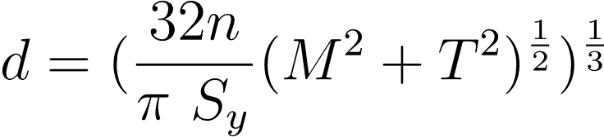
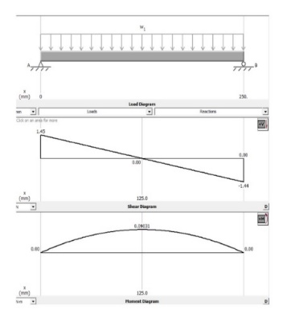
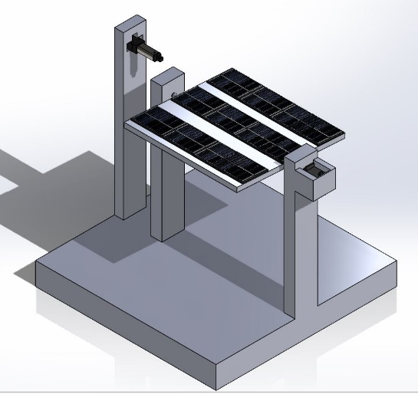
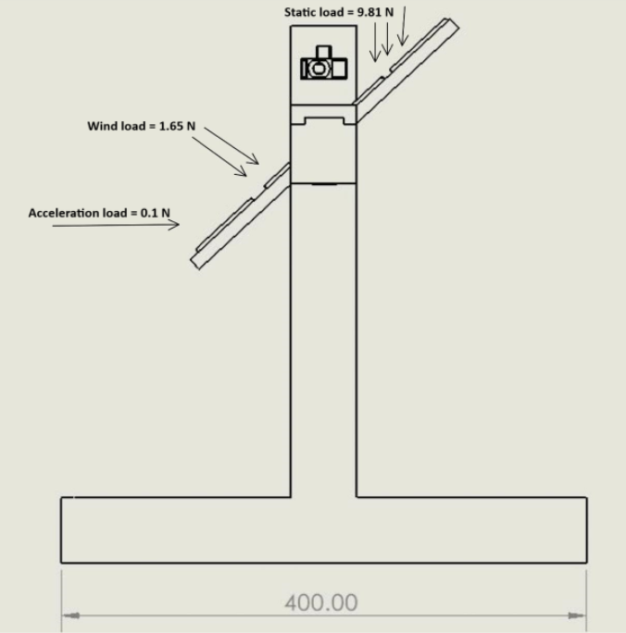
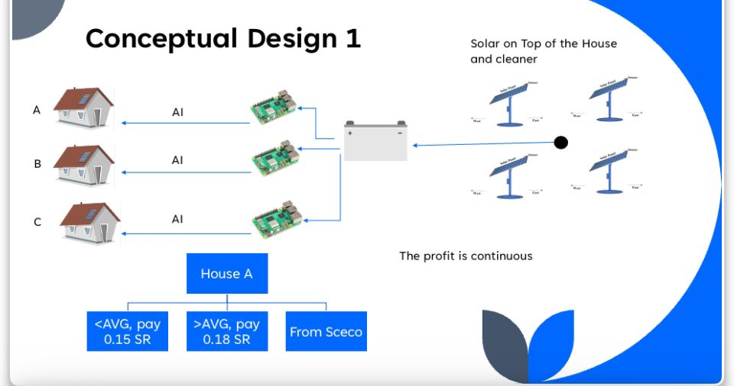
AI – Driven Solar Integration for Optimized Clean Energy Distribution and Reduced Consumption in Housing Compounds
Team Coach : Muhammad Emzir
Abdulrahamn AlHarbi 201965940 EE
Bader Basmaih 201923050
EE
Hassan AlHadhrami 201919830
ISE
Nawaf AlZahrani 201948490
ME
Saud AlBabtain 201935650 ME
Elevator Pitch
Current residential energy systems are inefficient, costly, and environmentally unsustainable. These systems fail to integrate renewable energy sources effectively, resulting in high greenhouse gas emissions. Additionally, the absence of smart technologies limits the ability to optimize energy distribution and consumption in real-time.
Problem Statement
Residential compounds face a problem with optimizing energy consumption while reducing carbon emissions and operational costs. For developers and homeowners needing a sustainable, cost-efficient system, AI-Driven Solar Integration is a smart energy management solution that optimizes solar distribution, reduces fossil fuel reliance, and lowers energy costs by 15%. Unlike traditional systems, it uses AI for real-time optimization and includes advanced solar tracking and cleaning to maintain peak efficiency
Constraints
Extreme Temperature Constraints:, which can degrade solar panel efficiency and battery life. This necessitates the integration of heat-resistant materials and cooling mechanisms to mitigate thermal stress. Cloudy Weather & Storage Limitations: The system must handle cloudy conditions for up to two days, requiring a balanced energy storage solution with AI optimizing usage without oversizing the battery. Legacy Infrastructure Compatibility: The solar system must integrate seamlessly with the existing grid, using advanced inverters and smart meters to avoid costly upgrades while supporting grid-tied operations like net metering.
Target Specifications
Minimum system efficiency of 15%. Energy Independence: providing more than 5KWh per month per house. 1024Wh battery storage. Solar tracker with tilt range ±60° Step : ±5° User friendly Interface, operatable within 3 minutes. Cleaning time less than 35s
Prototype Design
Testing & Validation
Efficiency: tested the power output, and the overall system efficiency is approximately 15% Energy Independence: the total generation for a house is more than 5KWh per month Battery storage: the total storage capacity of the batteries is 1296WH Ease of use : multiple subjects tested for time of dashboard, less than 3 minutes Cleaning time: the linear actuator used for cleaning system successfully achieve 33 second in cleaning . Solar tracker with tilt range ±60 Step : ±5°: we ensure accurate angular ffpositioning, smooth and consistent movement under load.
Project Impact
Economic: The AI-powered solar integration project reduces energy costs, increases solar efficiency, promotes renewable energy adoption, creates job opportunities, and supports local economies through sustainable energy practices. Societal: The AI-powered solar integration project promotes sustainable energy, enhances quality of life, empowers communities with smart monitoring, reduces pollution, and fosters social stability, leading to healthier, safer, and more resilient living conditions. Environmental: The AI-powered solar integration project reduces fossil fuel dependence, lowers carbon emissions, optimizes energy production, minimizes waste, and contributes to environmental sustainability by promoting clean energy and reducing ecological footprints.
Conclusion
Our solar-powered electricity distribution system integrates AI-driven forecasting, dynamic pricing, and a solar tracker with a cleaning mechanism to maximize efficiency. This project offers a sustainable alternative to traditional electricity sources by optimizing solar energy utilization and promoting energy conservation through reinforcement learning, empowering users with an intelligent and cost-effective energy solution for their homes.
The system aims to provide alternative electricity to SCECO by using solar panels and distributing power between complexes using AI-modeled forecasting. If more than predicted consumption occurs, a 0.18 SAR price will be implemented whereas if less than the average it will be 0.15 allowing reinforcement learning to reduce overall electricity with the help of solar panels fitted on top of the houses, aided by solar tracker and cleaner for maximum efficiency.
CAD Design
Motor shaft safety validation:
Factor of safety (FOS), n=5.51
Load analysis

