Slide 1


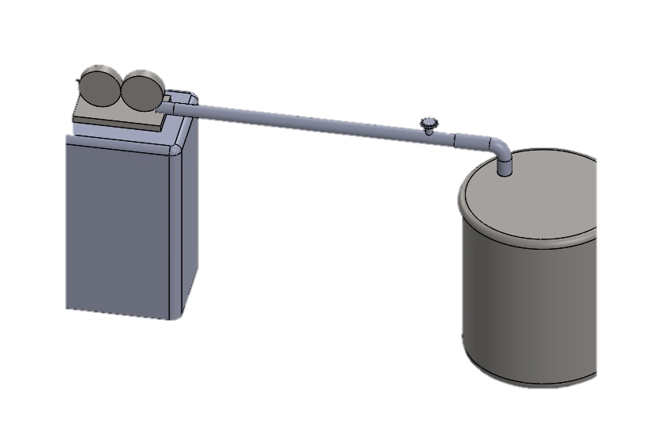
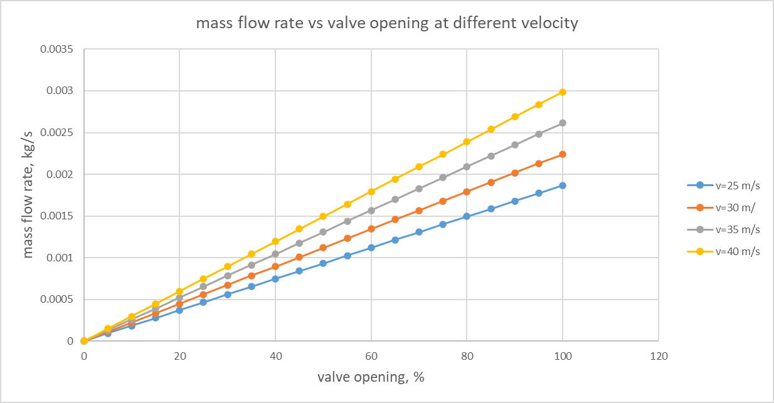
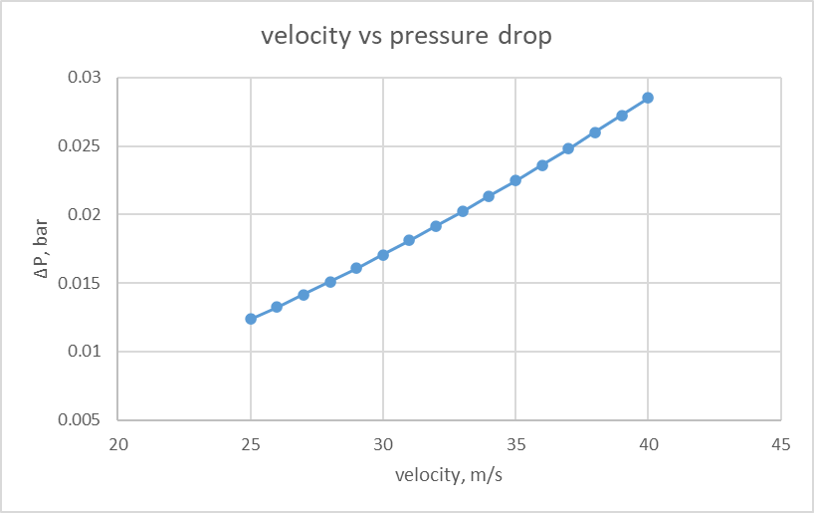
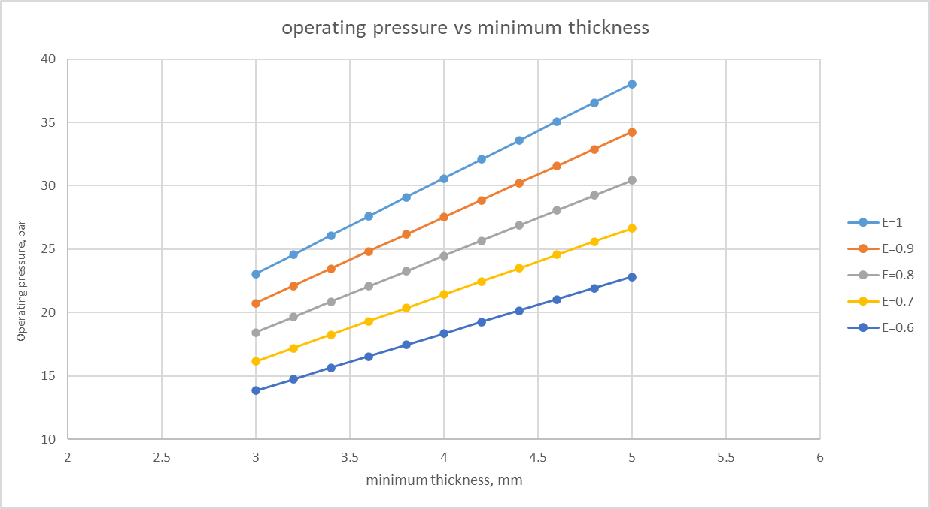


FAISAL ALMESNED
MOHAMMAD ALQAHTANI
SALMAN SHEBAM
HUSSAIN MASOUD
KUMEL MASHAL
CHEMICAL ENGINEERING
CHEMICAL ENGINEERING
CIVIL ENGINEERING
MECHANICAL ENGINEERING
MECHANICAL ENGINEERING
Optimization of Steam Distribution System Through Utilization of Lost Pressure
Group: 78
Introduction
Prototype Design
Final Design Calculations
Background:
Sabic Utility uses 7 boilers to produce steam at various levels for use in chemical plant
Three levels of steam: HP,MP, and LP
Time to reach specific conditions:
Foundation Column Dimensions | Symbol | Dim (cm)
 | C1 | 120 * 120
 | C2 | 110 * 110
 | C3 | 98 * 98
 | B1 | 100* 120
 | B2 | 50 * 120
 | B3 | 50* 120
Structural Parameters | Parameters | Value
 | ƒ'c (Mpa) | 70.00
 | ƒy (Mpa) | 420.00
 | q_{ult} (Kpa) | 257
 | M_{u} (KN) | 280
 | Maximum Settlement in 150 year (mm) | 23.7
Specific enthalpy at $25℃ and 1 bar=\text{1888.6 }\text{kj}\text{/}\text{kg}$
Specific enthalpy at $150℃ and 2 bar=\text{2769.09 }\text{kj}\text{/}\text{kg}$
$∆H=880.49 kj/kg$
Time =$\frac{∆H∗m}{P}$ where m is the water content for this prototype, the time is between 45-90 minutes depending on the water amount
Problem statement:
The reliance of pressure reducing valves and DS wastes the thermal potential energy of high pressurized steam.
No alternative pathway for the steam incase of maintenance or shutdown.
Proposed solution:
Proposes a bypass system with a steam turbine to recover lost energy, improving efficiency.
Enhances mechanical power generation and provides operational flexibility.
Graphs and Charts
Testing/ Validation
HP – MP |  | Turbine Design (Large)
10000 | RPM
2 m | Diameter pitch
5 | Number of stages
38 | Number of blades in ring
2.4 m | Blade height of stage 1
3.3 m | Blade height of stage 2
4.5 m | Blade height of stage 3
5.8 m | Blade height of stage 4
7.3 m | Blade height of stage 5
44 kJ/kg | Drop of enthalpy in stage
MP – LP |  | Turbine Design (Small)
8000 | RPM
2 m | Diameter pitch
4 | Number of stages
44 | Number of blades in ring
3.4 m | Blade height of stage 1
5.4 m | Blade height of stage 2
6 m | Blade height of stage 3
7 m | Blade height of stage 4
44 kJ/kg | Drop of enthalpy in stage
The prototype is significantly smaller than the actual final design, a scale down is done to do the comparison
$$\frac{m_{prototype}}{m_{large turbine}}=\frac{8.065}{500∗{10}^{3}}=1.613∗{10}^{−5}$$
$$\frac{{∆H}_{prototype}}{{∆H}_{Large turbine}}=\frac{120}{216.15}=0.55$$
Power of large turbine if 100% efficiency = 30.02 MWh
Expected power from prototype (0.4)x(0.9) efficiency since it is lower than 100W = $\left(30.02∗{10}^{6}\right)\left(1.613∗{10}^{−5}\right)\left(0.55\right)\left(0.4\right)\left(0.6\right)=63.91Wh$
Actual measured power of prototype = $88Wh$
Specification is met since $63.91Wh$ < $88Wh$
Specifications |  | Large Turbine (HP to MP) | Small Turbine (MP to LP)
 | Metric | Value | Value
 | Steam condition (inlet) | 45 bar & 400°C | 20 bar & 220°C
 | Steam condition (outlet) | 20 bar & 220°C | 7 bar & 165°C
 | Steam flowrate (inlet) | 500 ton/h | 375 ton/h
 | Steam flowrate (outlet) | 500 ton/h | 375 ton/h
 | Length | 16 m | 10 m
 | Width | 6m | 4 m
 | Height | 6.5m | 5.5 m
 | power produced | 22.31 MW | 15.92 MW
Nozzle Design (Large) | HP – MP
 | RPM | 10000
 | Diameter pitch | 2 m
 | Number of stages | 5
 | Number of blades in ring | 38
 | Blade height of stage 1 | 2.4 m
 | Blade height of stage 2 | 3.3 m
 | Blade height of stage 3 | 4.5 m
 | Blade height of stage 4 | 5.8 m
 | Blade height of stage 5 | 6.3 m
 | Drop of enthalpy in stage | 44 kJ/kg
Nozzle Design (Small) | MP – LP
 | RPM | 8000
 | Diameter pitch | 2 m
 | Number of stages | 4
 | Number of blades in ring | 44
 | Blade height of stage 1 | 3.4 m
 | Blade height of stage 2 | 4.4 m
 | Blade height of stage 3 | 5 m
 | Blade height of stage 4 | 6.1 m
 | Blade height of stage 5 | 44 kJ/kg
 | Drop of enthalpy in stage | 8000
Conclusion
The design is innovative and practical approach to sustainable energy recovery
Optimizes turbine output and steam efficiency.
Affordable solution balancing environmental sustainability and functionality.
Potential improvements:
Use of advanced materials for enhanced durability.
Integration of smart monitoring systems for real-time optimization.
Constraints | 1.Steam demand variability in the 2.Pressure and temperature drop across turbines | Pressure Level | HP | MP | LP
 |  | Total Demand | 961.9 | 609.3 | 685.5
 |  | Total steam used for all conditions | 2256.7
 | Pressure drop across turbines
 |  | Average Demand | 400 | 250 | 750
 |  | Total steam used for all conditions (assuming no steam excess) | 1400

