Slide 1
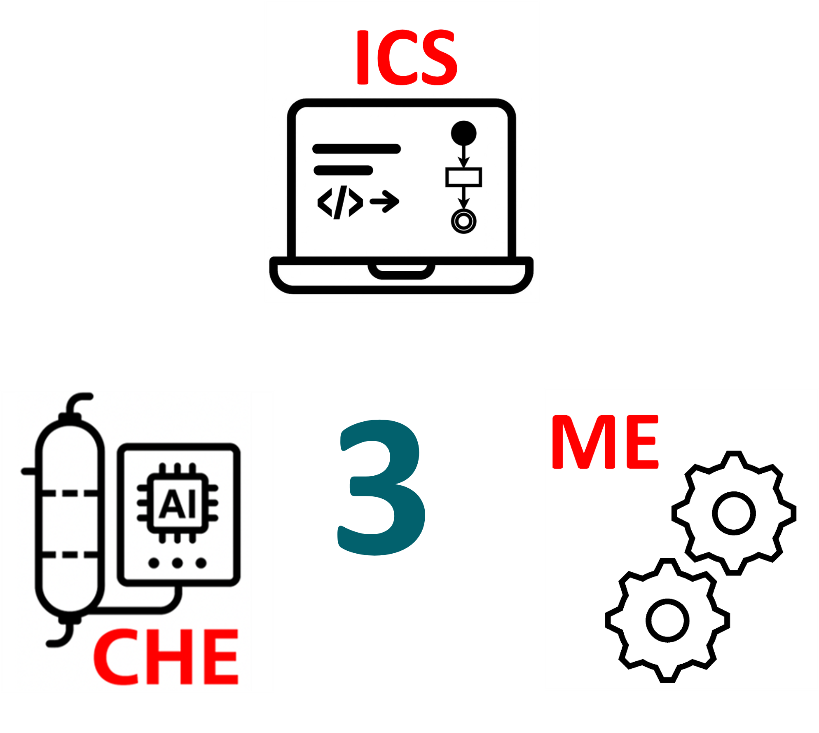
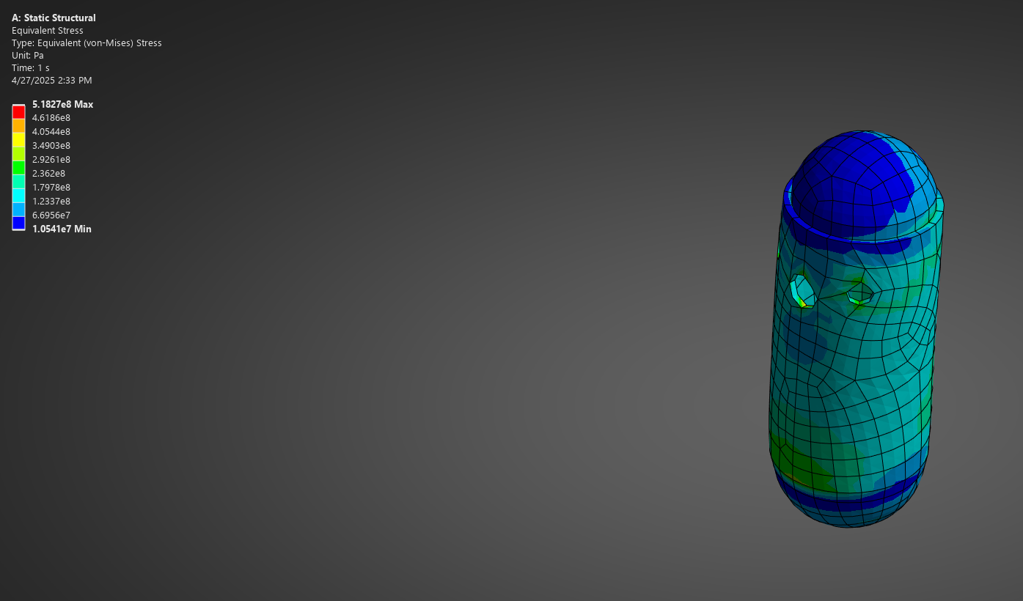
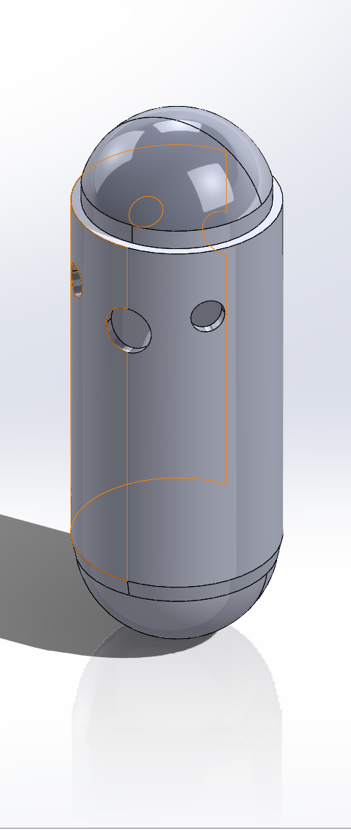
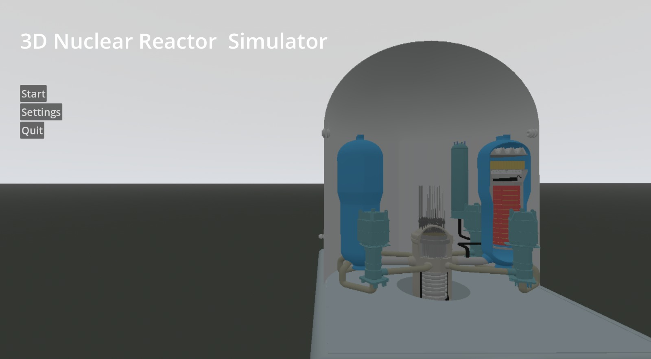
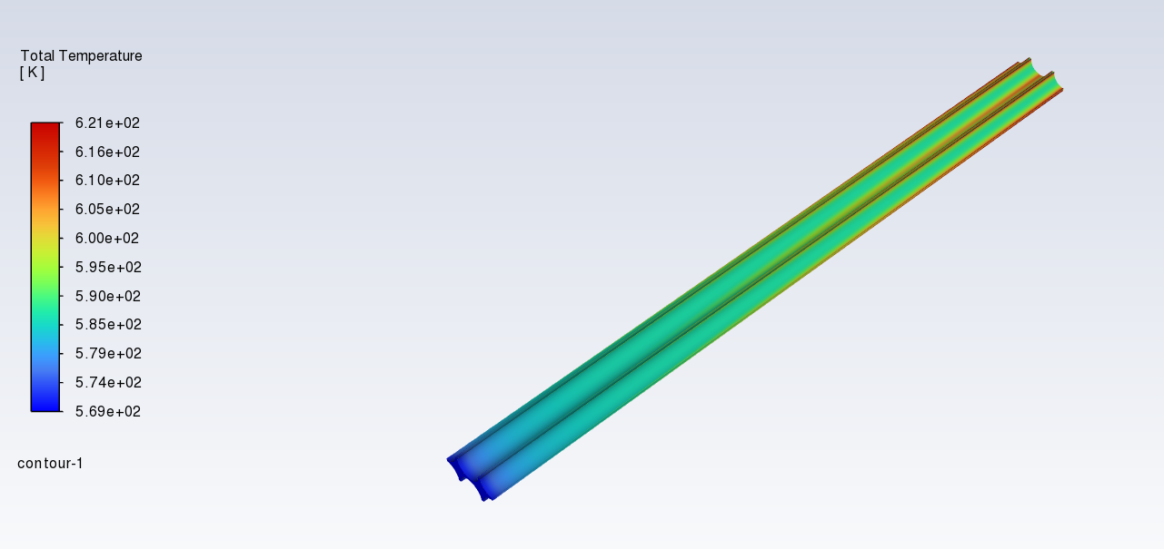
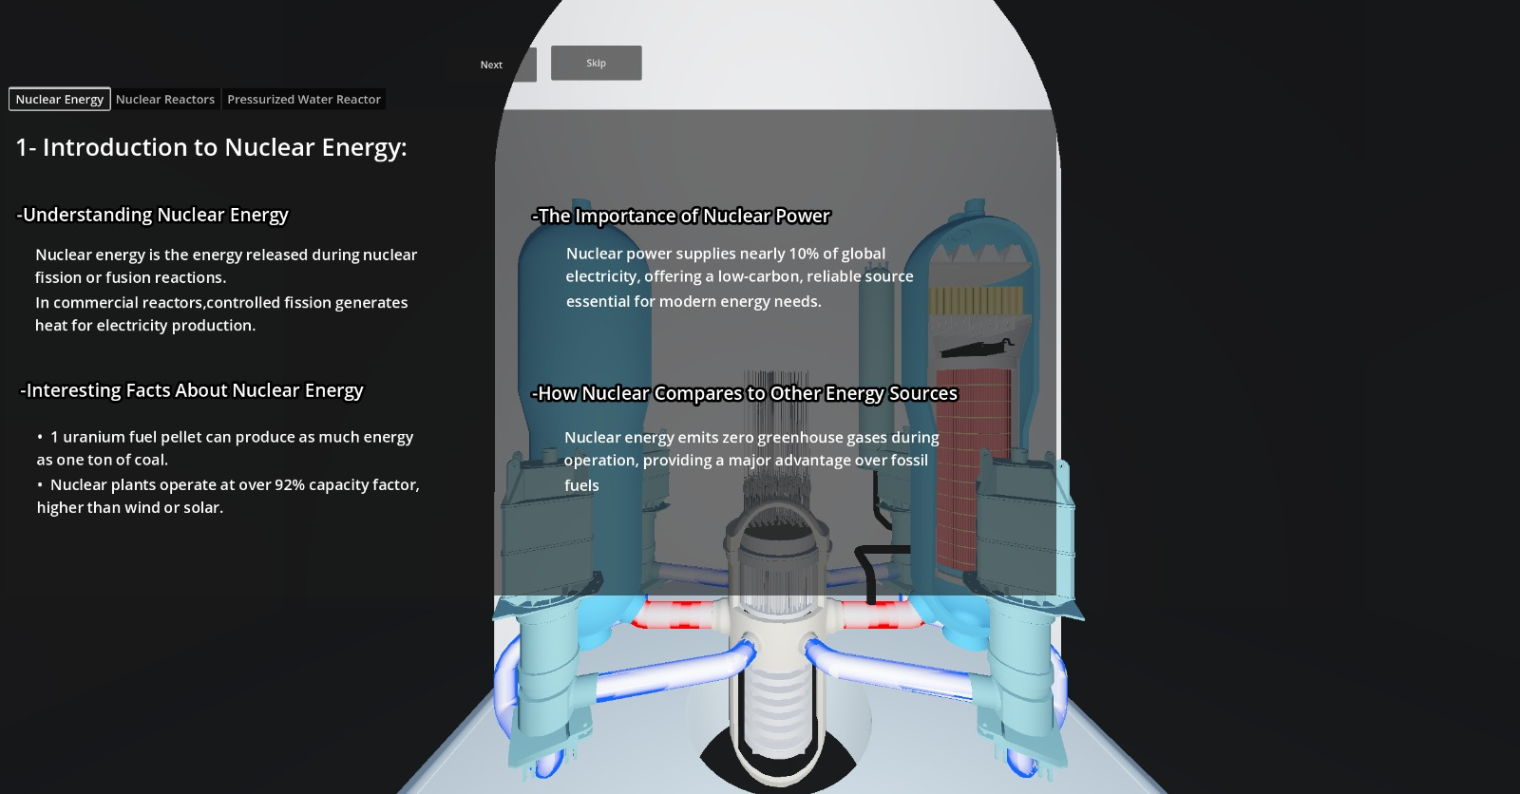
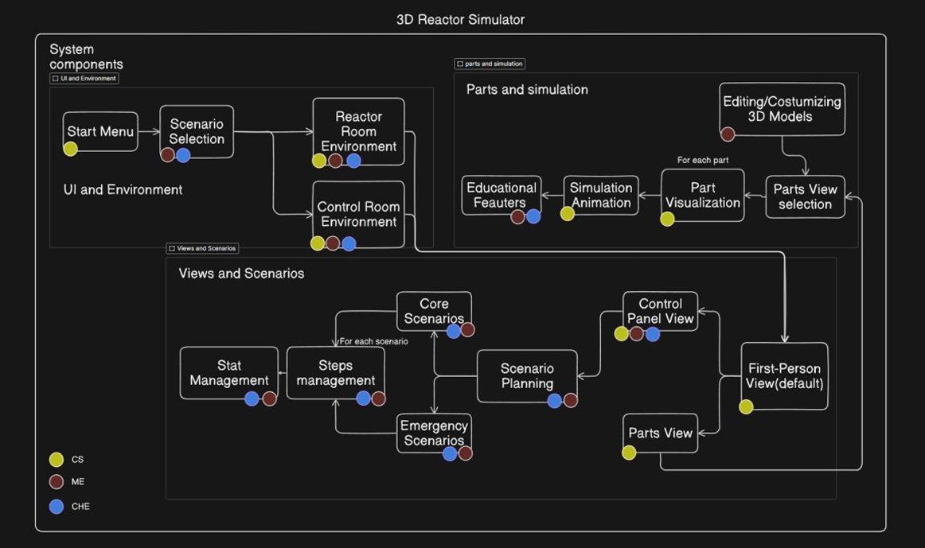
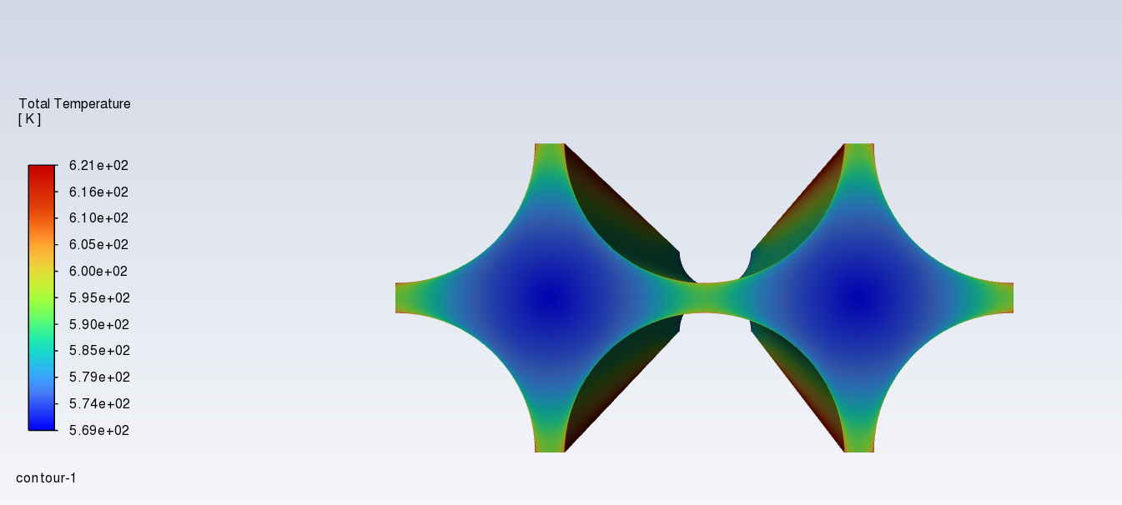
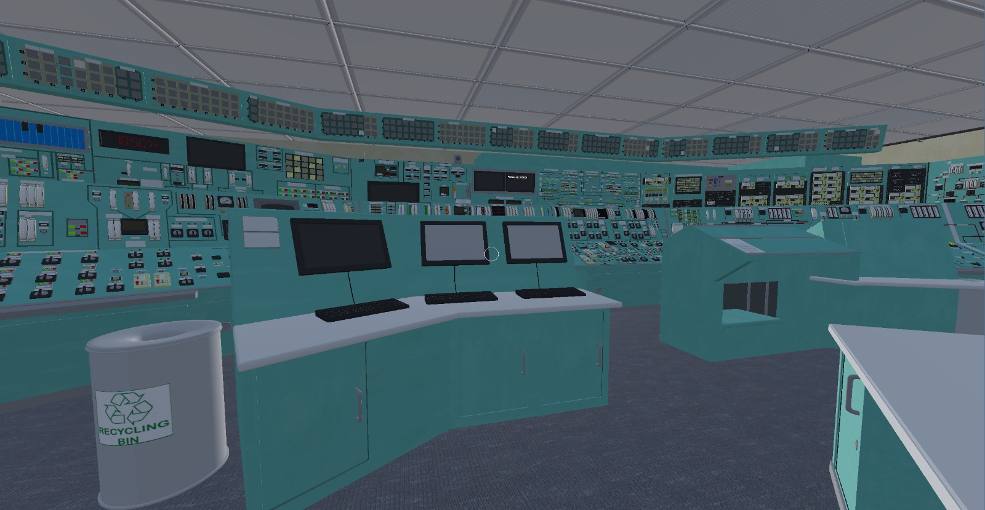
3D Structural Simulator of a Nuclear Reactor ​
TEAM
063
Abdulaziz A. Alsulami, Abdullah E. Alabbad, Abdullah J. Adawi, Saad T. Alharbi, Yasir M. Almulhim Coach: Abdul-Hadi Al-Juhani
Overview
Constraints & Specifications​
CFD & SolidWorks​
Simulator & UI Design​
This project presents an interactive 3D Structural Simulator of Pressurized Water Reactor (PWR). Traditional nuclear training is costly, with reactor shutdown for training reaching ~$1.3 million/day. To overcome this, we developed an interactive simulator. It integrates critical reactor components, thermal-hydraulics, real-time interaction, and multiple scenario. This platform allows trainees and students to safely explore reactor operations and responses, providing realistic educational scenarios without the cost or safety risks of an actual reactor.
Coolant Property: Density of coolant 750-850 kg/m^3 at 15 MPa and 300-350 C​
Complexity of phenomenon​
Minimum: laptops with 8 GB RAM, i5 processors,and integrated GPUs (to run 30 FPS)​
Lack of data​
Heat Transfer Mechanisms​
Load time for simulation < 10 seconds ​
Number of scenarios included > 3​
Number of navigation steps for main actions < 5 steps​
Figure 1.Reactor Pressure Vessel stress analysis
Architecture
Problem Statement
Shutting down a reactor for training purposes is extremely costly, significantly limiting hands-on training and creating a substantial gap between theoretical knowledge and practical reactor operation skills.
Figure 2.Fuel Rods CFD analysis
Why Our Project Unique?​
Data Collection​
Conclusion & Recommendation
The program provides thermofluids properties. Acquiring data was challenge due to the nuclear engineering industry. However, necessary data was gathered to simulate system behavior.
Developed a 3D nuclear reactor simulator to support education and training.
Features interactive models and friendly UI
Runs on laptops, making it accessible users.
Future improvements should include:
complex & automated scenarios
Real-time data integration
Customizable content.
3D Simulator
First-Person
Open-Source

