Slide 1








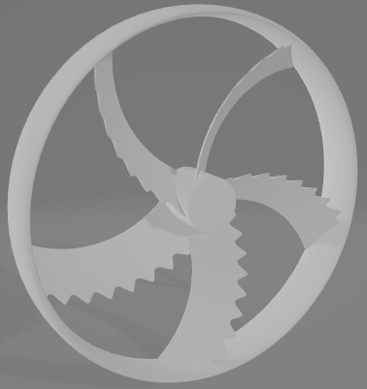


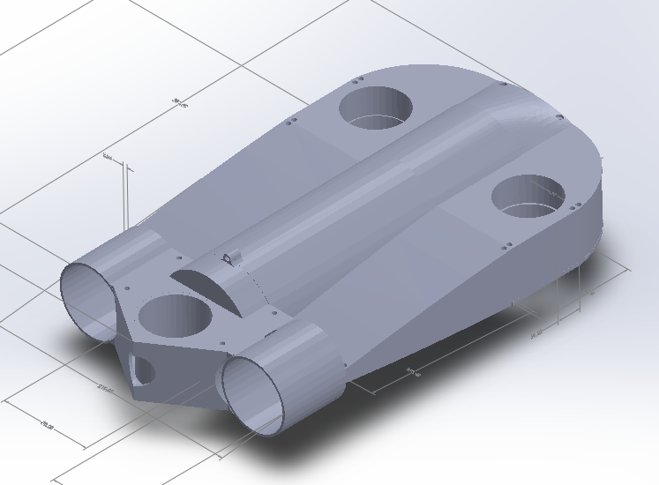
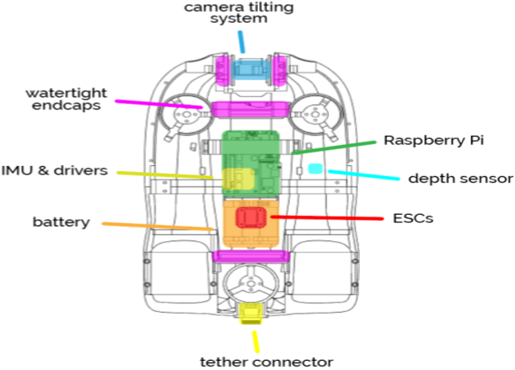
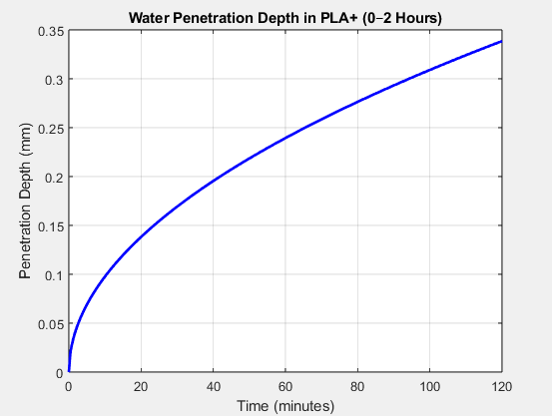
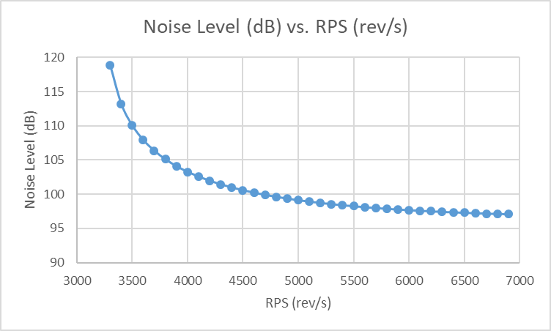

EcoBot: An Underwater Unmanned Vehicle (UUV) for Marine Exploration
TEAM
058
Omar Al-Juhani, Mohammad Al-Aayedh, Faris Alhumaid, Abdulrahman Bunaiyan Coach: Shihab Uddin
Introduction
Specifications
Novelty
Project Impact
Marine exploration often requires expensive, bulky systems. EcoBot offers a compact and affordable underwater drone with integrated sensors real-time data visualization and more efficient and environmental considerate method
Material Thermal Conductivity> 0.2 W/m*K
PID & FOPID Control Schemes for 5DOF
Compact design that minimizes ecological disturbance, making it suitable for studying sensitive marine ecosystems.
Propulsion Mass < 30% of Total Mass
Underwater Radiated Noise < 120 dB
Camera Resolution = 1080p HD
Camera Framerate = 30 FPS
Constraints
Maximum Allowed Retrieval Force (Manual) <= 55 N
Creativity
Conclusion
Temperature Inside The UUV < 60°C
Maximum Pressure Tolerance(Depth) <= 200 kPa
Biomimetic Propellers
The EcoBot project addresses the growing need for efficient, accessible, and sensor-integrated underwater monitoring systems. Designed with modularity, affordability, and usability in mind. focusing on cost-effective manufacturing, ease of deployment, and environmental awareness.
Base Area of The Design < 4 $m^{2}$
Water Penetration to UUV < 5 mm
< 95% Non-Toxicity for The Wetted Material
Energy Mass/ Total Mass < 40%
Bandwidth > 100 mbps
Operating Temperature < 45°C
Operating Depth < 10 m
Prototype Design
Testing & Validating

