Slide 1

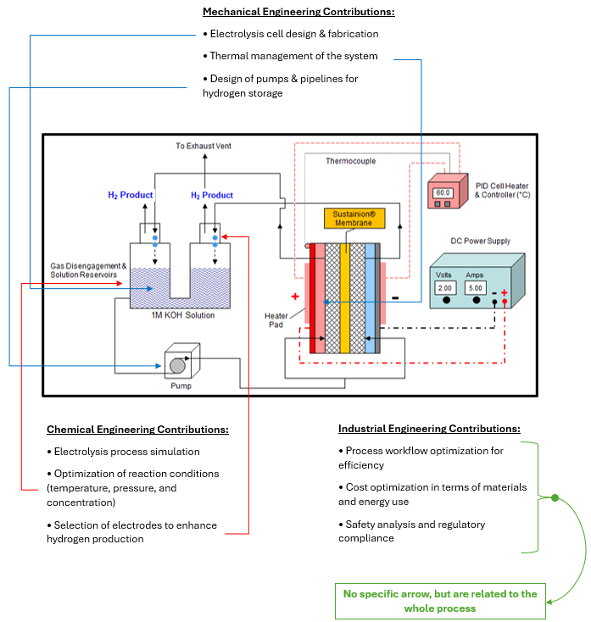
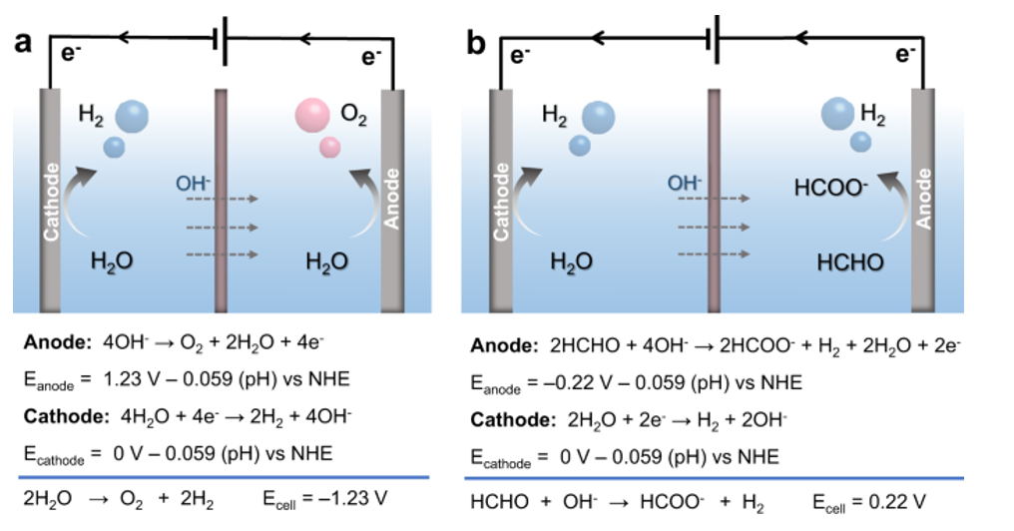
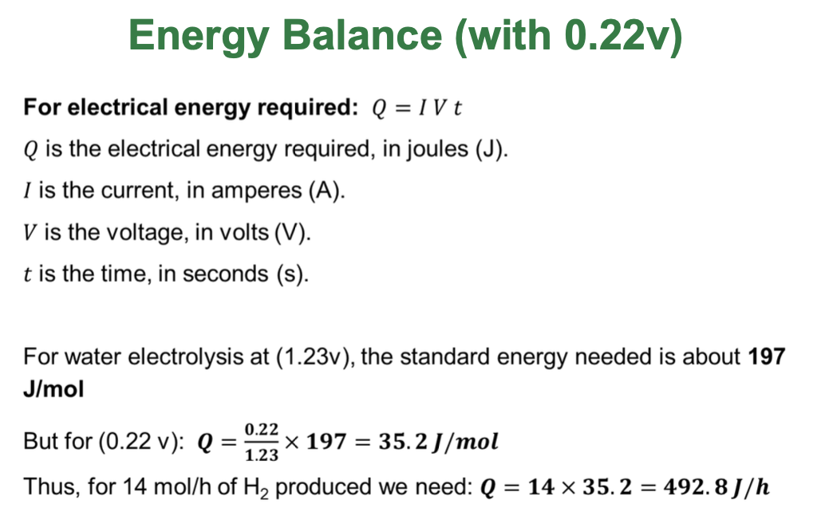
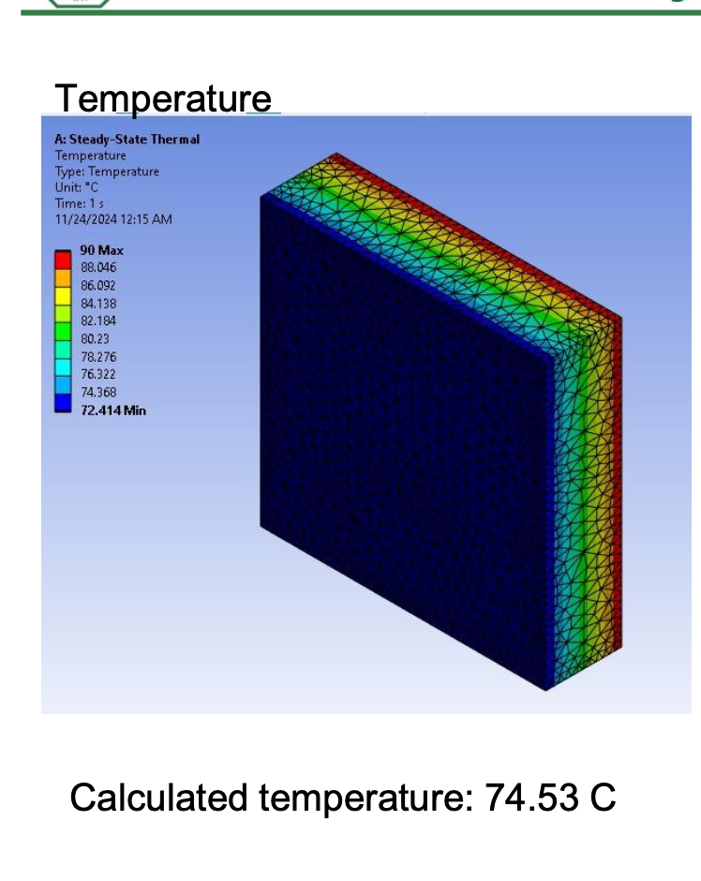
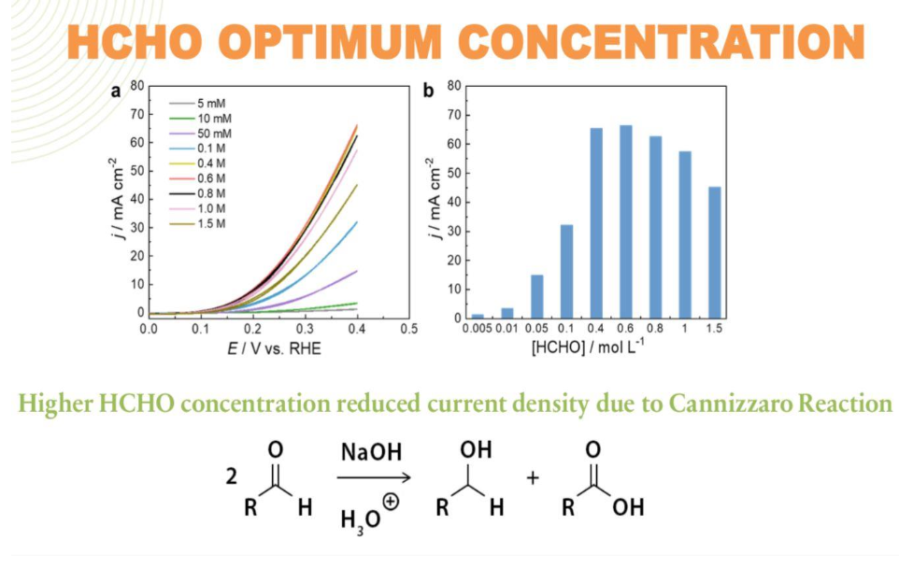
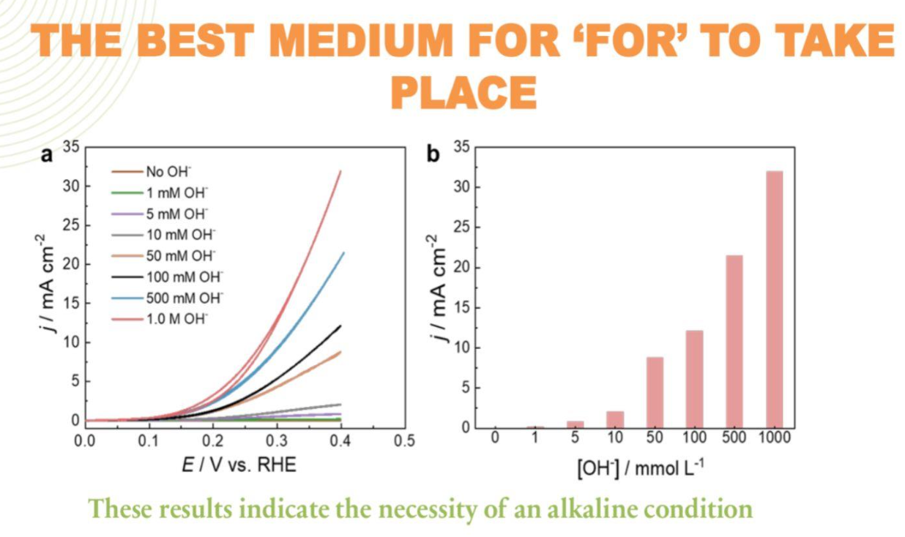
Enhanced Green Hydrogen Production with Formaldehyde Integration King Fahd University of Petroleum & Minerals Team 55
Muhammad Almaa CHE
AbdulQader Abdulla CHE
Ahmad Alhussaini ISE
Saud Alhagan ME
Abdulmajeed Alkhannani ME
PROBLEM STATEMENT
OBJECTIVE
PROTOTYPE DESIGN
Hydrogen production through traditional water electrolysis is characterized by high energy requirements, with a voltage demand of approximately 1.23V, leading to substantial energy consumption and elevated operational costs. These inefficiencies hinder the scalability of the process for industrial applications. Furthermore, achieving the high levels of hydrogen purity necessary for industrial use remains a persistent challenge, limiting the effectiveness and broader adoption of conventional methods.
The project aims to enhance the efficiency of hydrogen production through formaldehyde integration into the electrolysis process, reducing energy requirements, improving scalability, and achieving industrial-grade hydrogen purity.
CONSTRAINTS
TARGET SPECIFICATIONS
Testing & Validation
CONCLUSION
Safety Aspects
• Emission control to make sure no more than 0.3 ppm of
Formaldehyde
is released into the environment (as per OSHA standards)
• Proper ventilation in the reaction area
ISO Standards
• ISO 14687 (hydrogen fuel quality )
• ISO 22734 (Hydrogen generators using water electrolysis)
Sustainability
• Achieve 15% less energy consumption
• Maximize the use of recyclable material to 80%
1- Target an electrolysis efficiency improvement of at least 20-30%
compared to conventional water electrolysis.
2- Operate at a significantly lower voltage requirement compared to
traditional electrolysis methods, targeting a value between 0.23 Volt to 0.5
Volt.
3- The system should be capable of producing 14 mole/hour of hydrogen.
4- Hydrogen purity should be at least 99.99% for industrial application
use.
5- System Scalability: Design the system with modular expansion
capability to allow for scalability up to 10 times the base unit's capacity.
The prototype underwent rigorous validation, achieving: - Hydrogen purity of 90% - Energy consumption of 35.2 J/mol - Consistent production at 14 moles/hour Iterative improvements included sealing mechanisms and pump recalibration.
The project successfully enhanced hydrogen production efficiency by integrating formaldehyde into the electrolysis process, reducing energy consumption by 20–30% and achieving a consistent output of 14 moles/hour with 90% purity. The scalable, cost-effective design meets industrial standards and demonstrates significant potential for widespread adoption, contributing to sustainable and efficient hydrogen production. Notably, the project earned first place in a Shark Tank competition organized by the Female Energy Club at KFUPM, showcasing its innovative impact and commercial viability.

