Slide 1

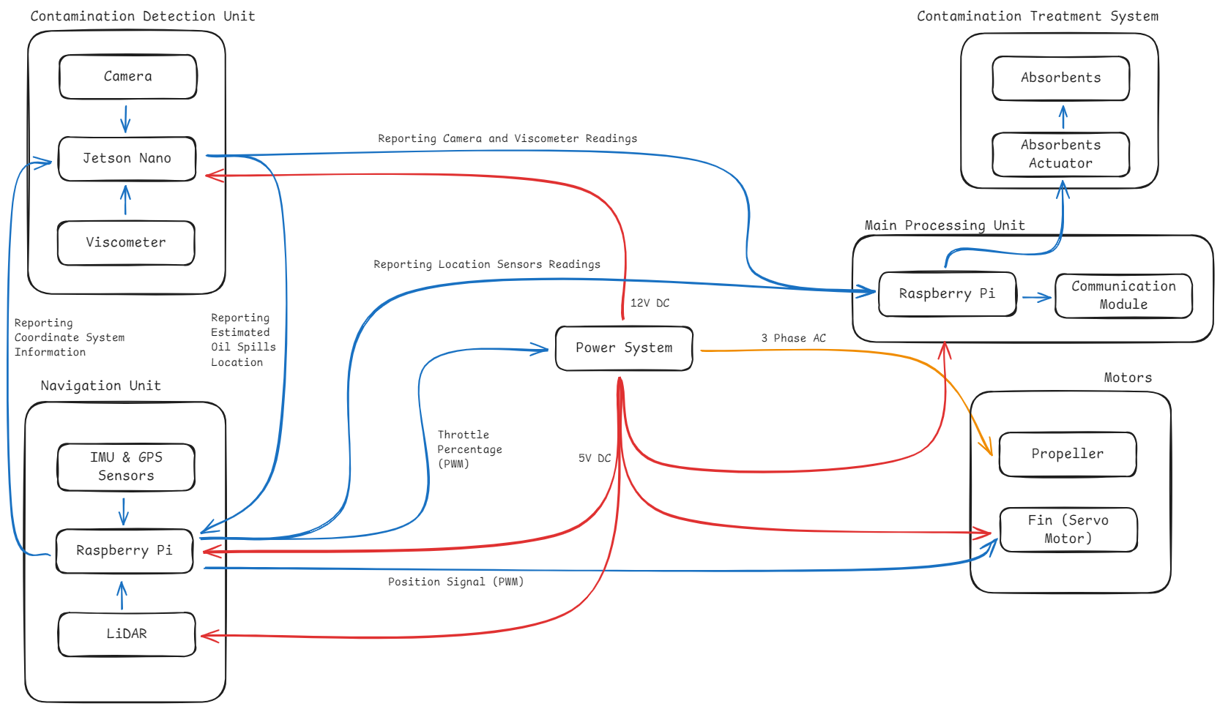
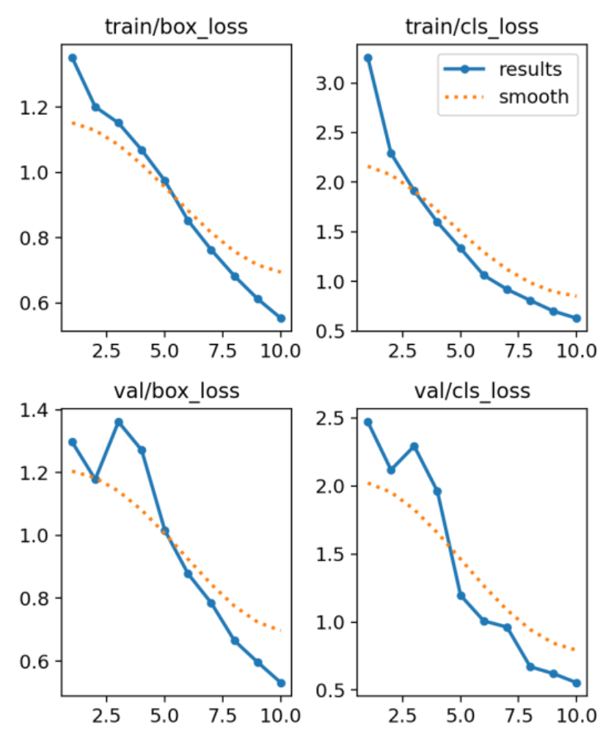
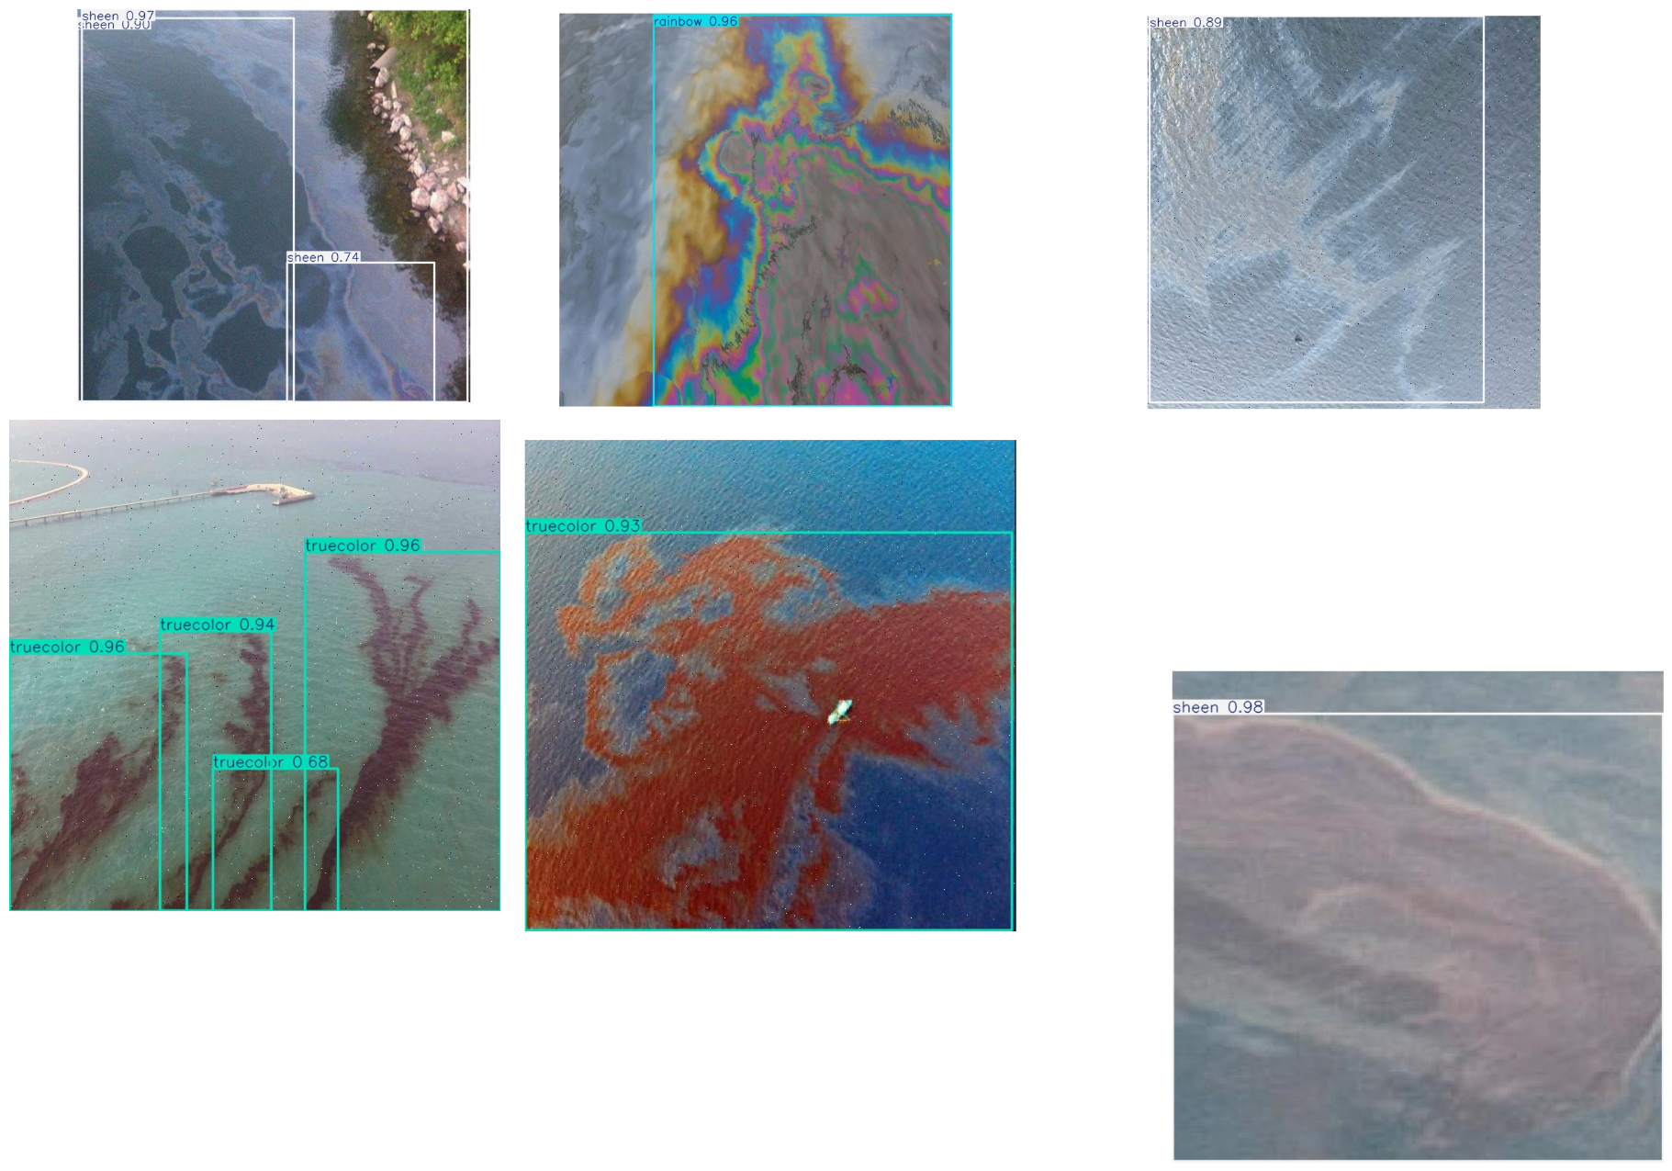
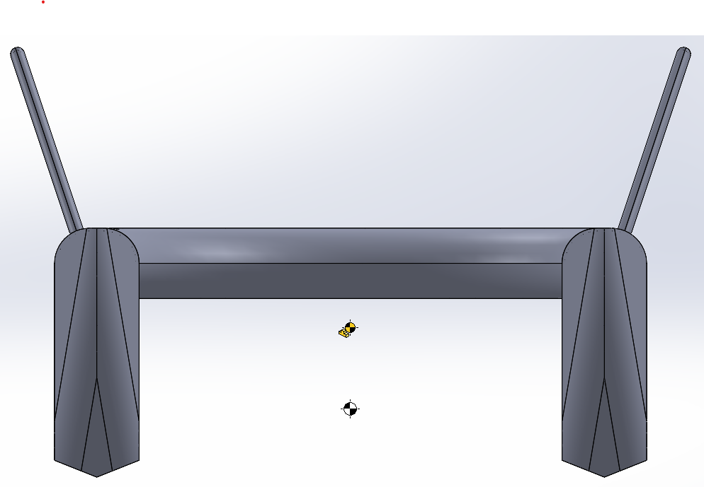
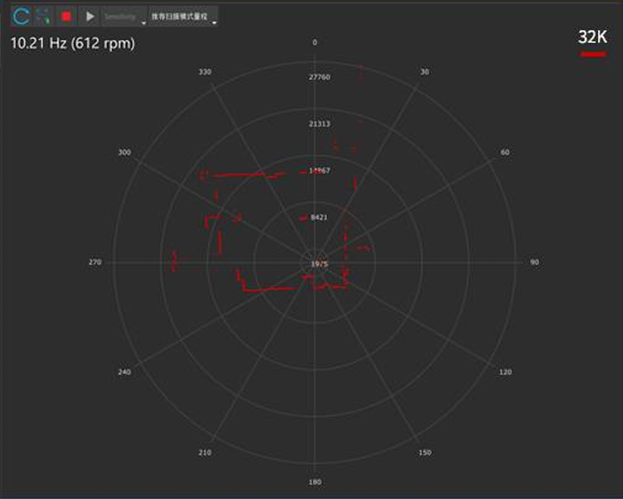
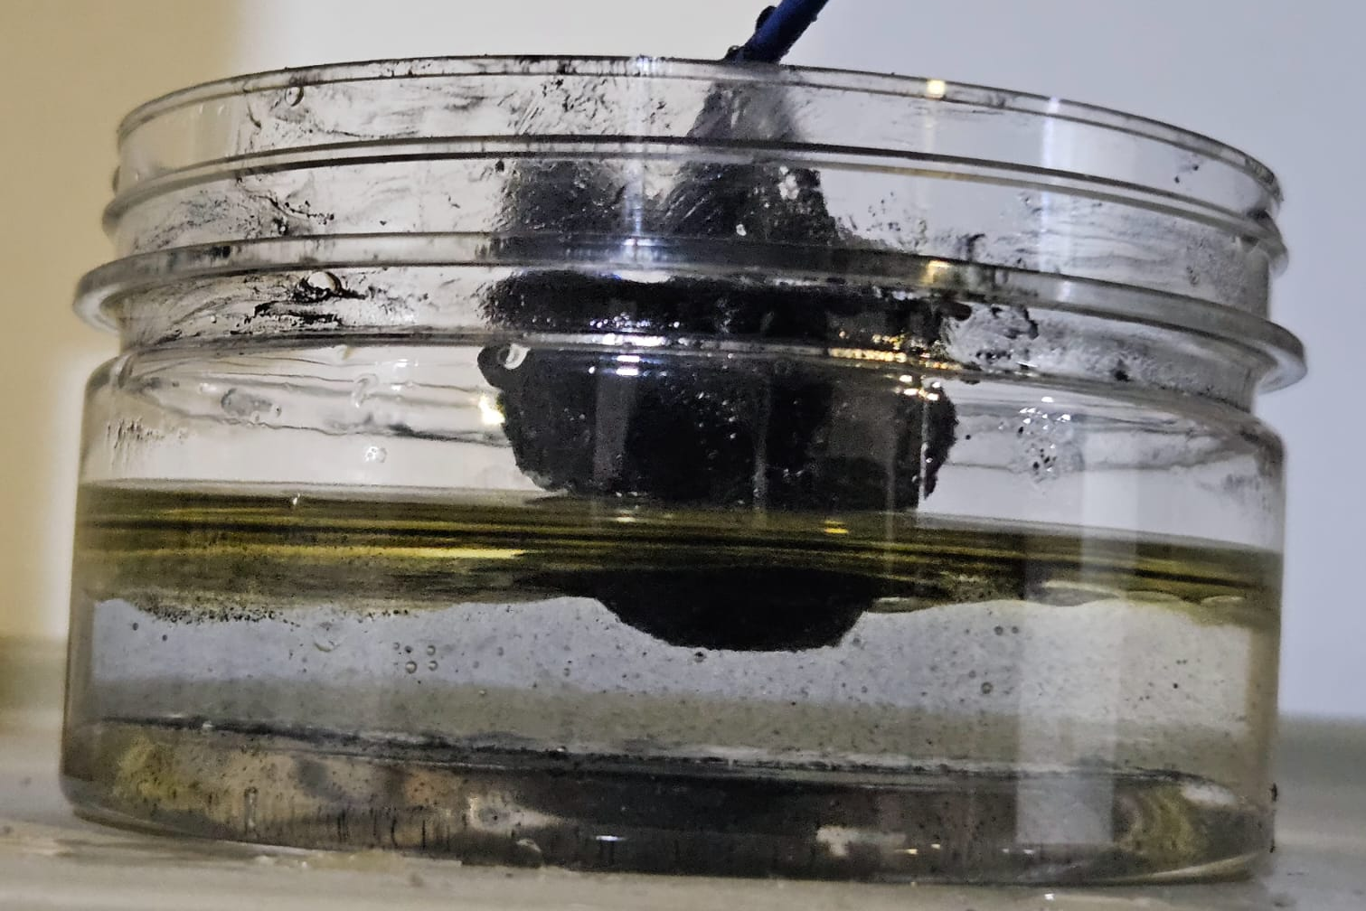
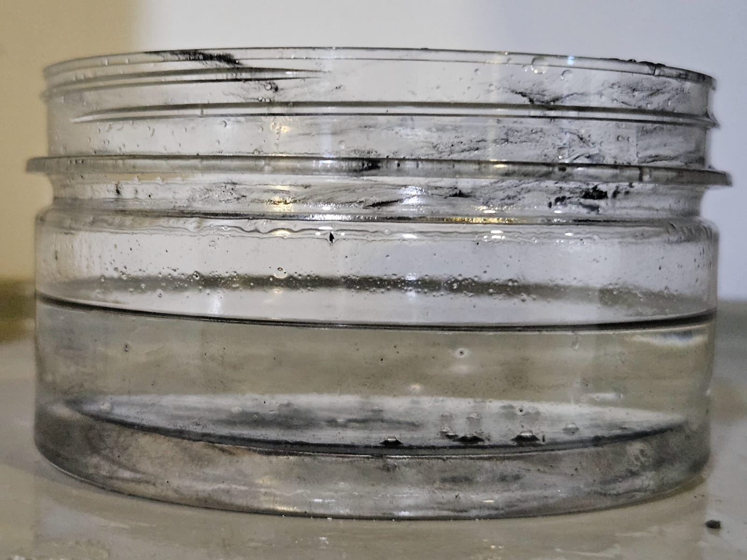

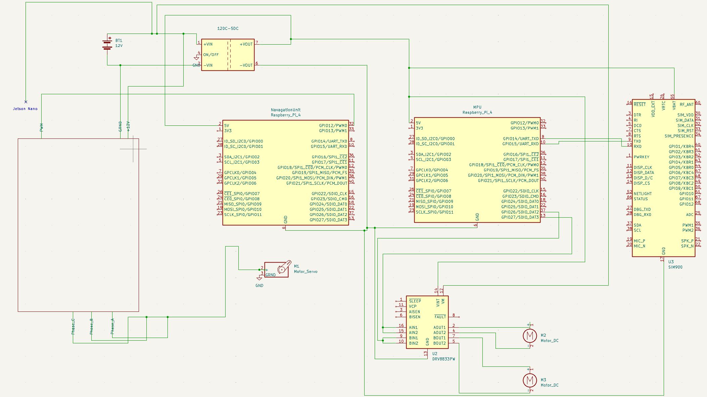
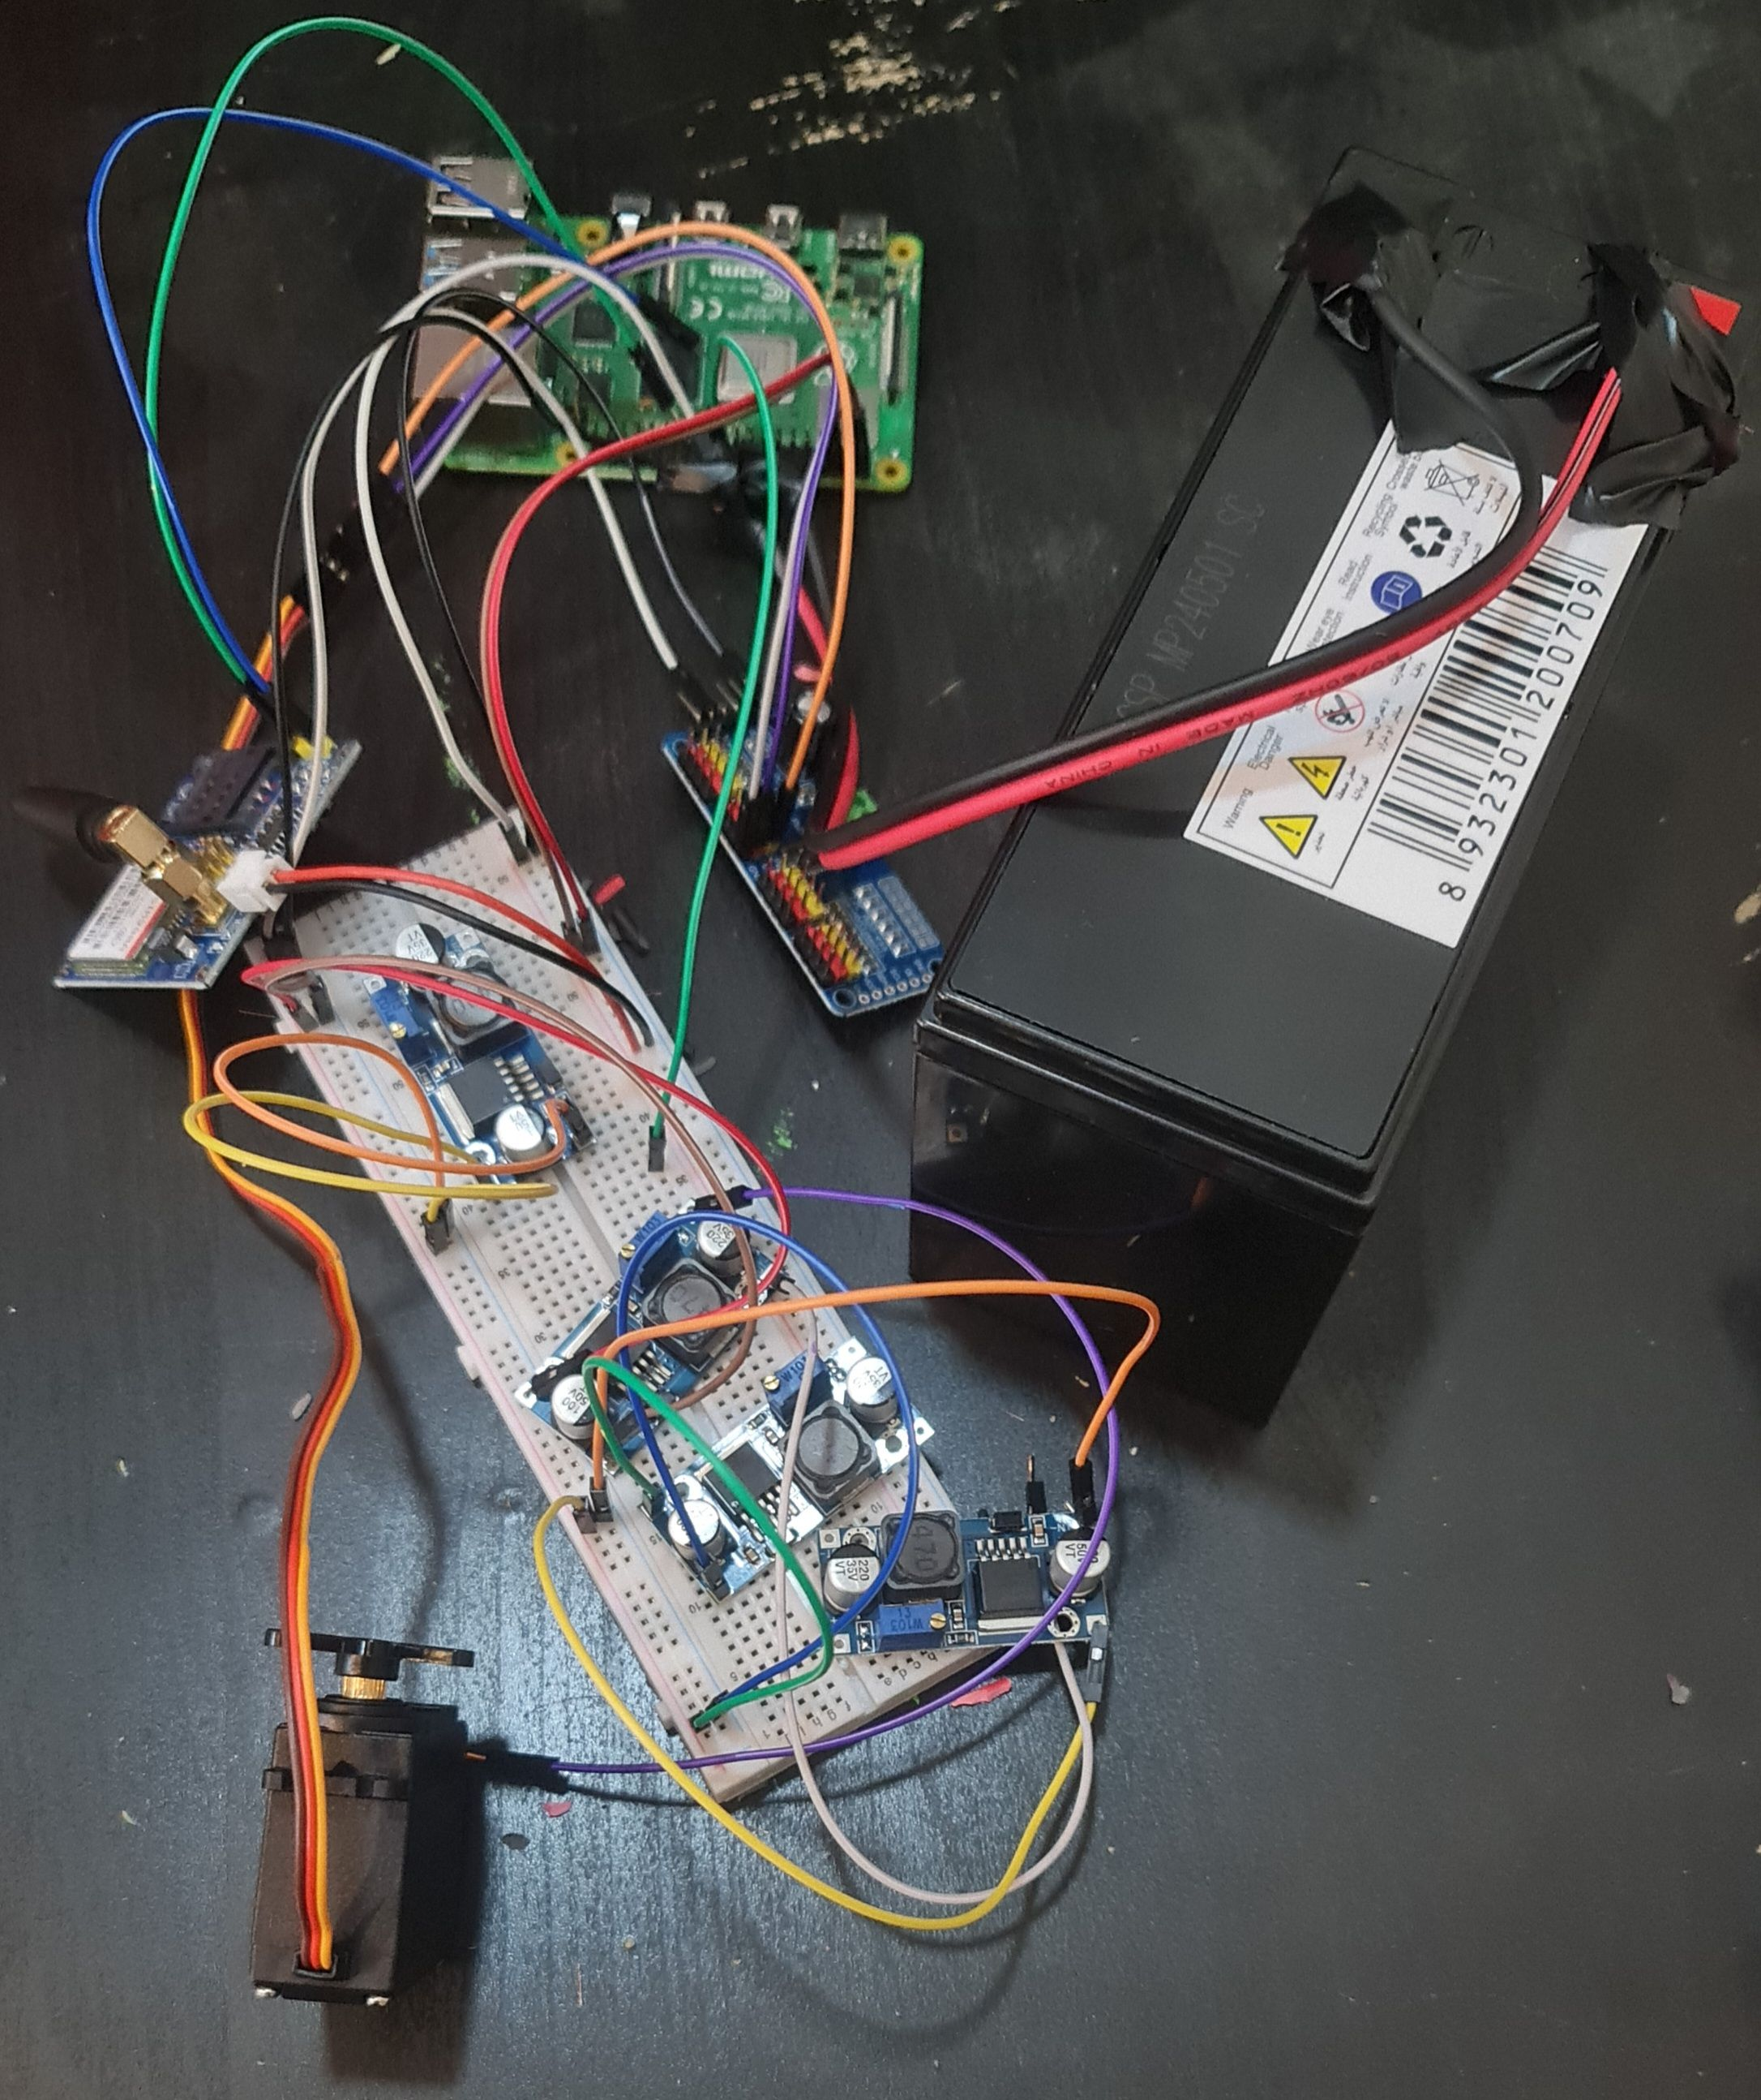
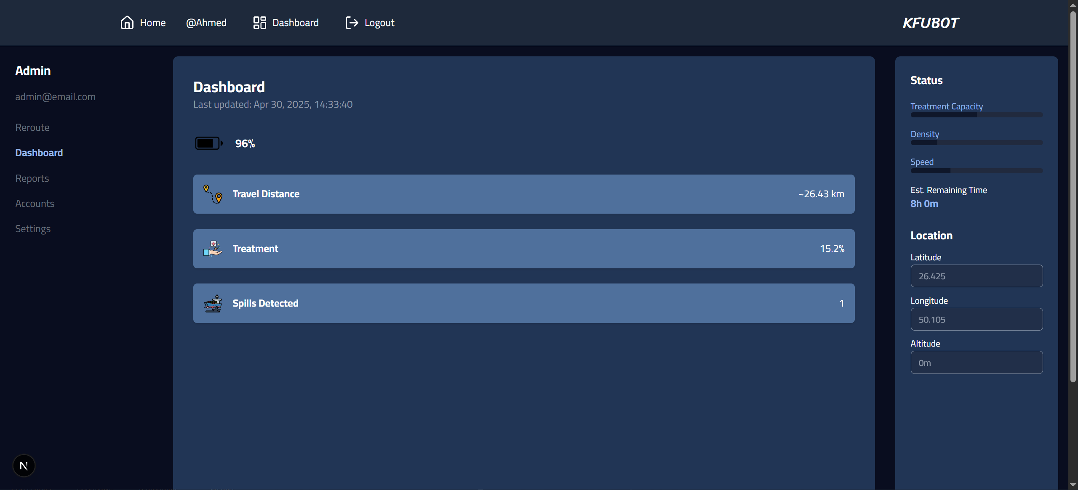
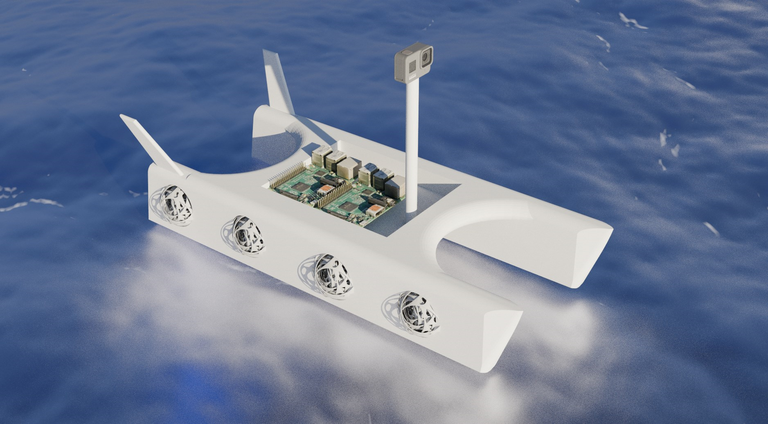
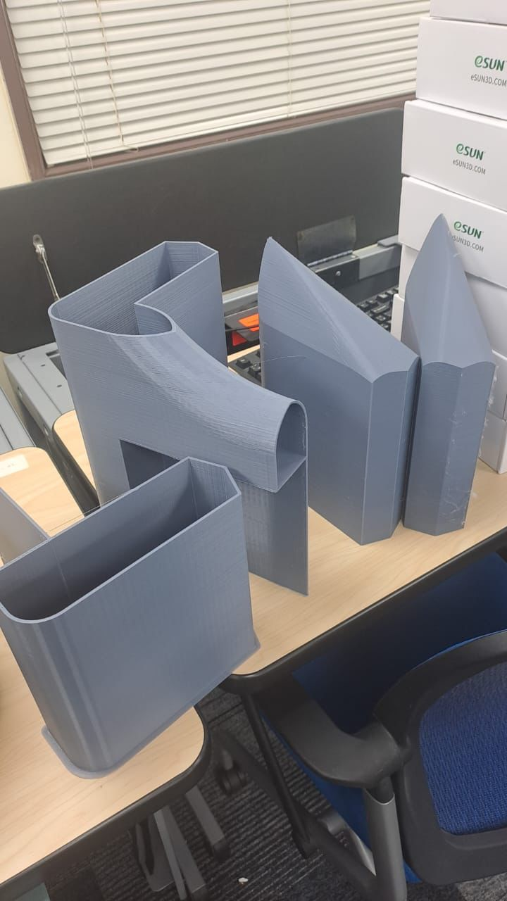
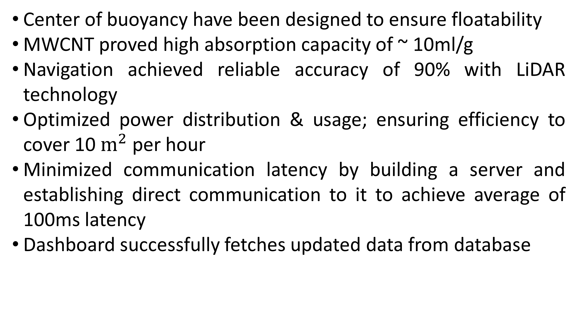
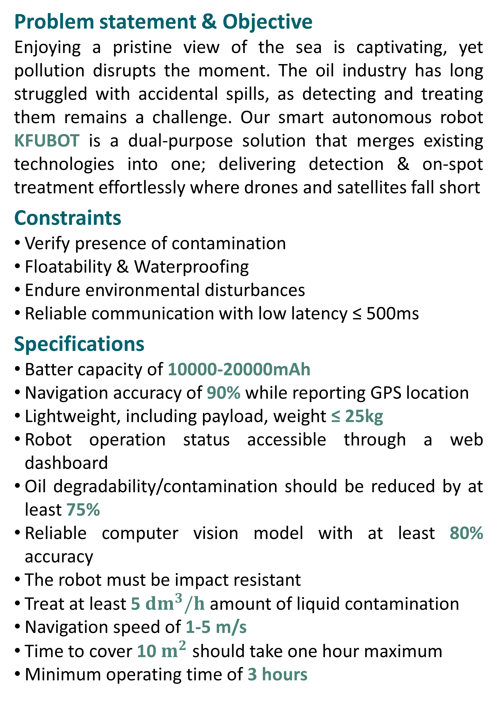
Smart Autonomous Robot for Detecting and Reducing Contaminated Liquids in the Sea
TEAM
005
Ahmed Alabdulaal, Ridha Al Talaq, Sajjad Al Darweesh, Hassan Alfakih, Hassan Altaweel, Ali Alsenan
Coach: Mohammed Emzir
Background
Prototype Development
Testing & Validation
Problem statement & Objective
Enjoying a pristine view of the sea is captivating, yet pollution disrupts the moment. The oil industry has long struggled with accidental spills, as detecting and treating them remains a challenge. Our smart autonomous robot KFUBOT is a dual-purpose solution that merges existing technologies into one; delivering detection & on-spot treatment effortlessly where drones and satellites fall short
Constraints
Verify presence of contamination
Floatability & Waterproofing
Endure environmental disturbances
Reliable communication with low latency ≤ 500ms
Specifications
Batter capacity of 10000-20000mAh
Navigation accuracy of 90% while reporting GPS location
Lightweight, including payload, weight ≤ 25kg
Robot operation status accessible through a web dashboard
Oil degradability/contamination should be reduced by at least 75%
Reliable computer vision model with at least 80% accuracy
The robot must be impact resistant
Treat at least 5 ${dm}^{3}/h$ amount of liquid contamination
Navigation speed of 1-5 m/s
Time to cover 10 $m^{2}$ should take one hour maximum
Minimum operating time of 3 hours
Center of buoyancy have been designed to ensure floatability
MWCNT proved high absorption capacity of ~ 10ml/g
Navigation achieved reliable accuracy of 90% with LiDAR technology
Optimized power distribution & usage; ensuring efficiency to cover 10 $m^{2}$ per hour
Minimized communication latency by building a server and establishing direct communication to it to achieve average of 100ms latency
Dashboard successfully fetches updated data from database
Conclusion & Impact
KFUBOT successfully integrates AI detection, real-time navigation, and efficient treatment using nanotech-based absorbents. It achieves reliable oil spill response with low-latency communication, high detection accuracy, and sustainable treatment; offering a scalable, eco-friendly solution for marine contamination.

