Slide 1


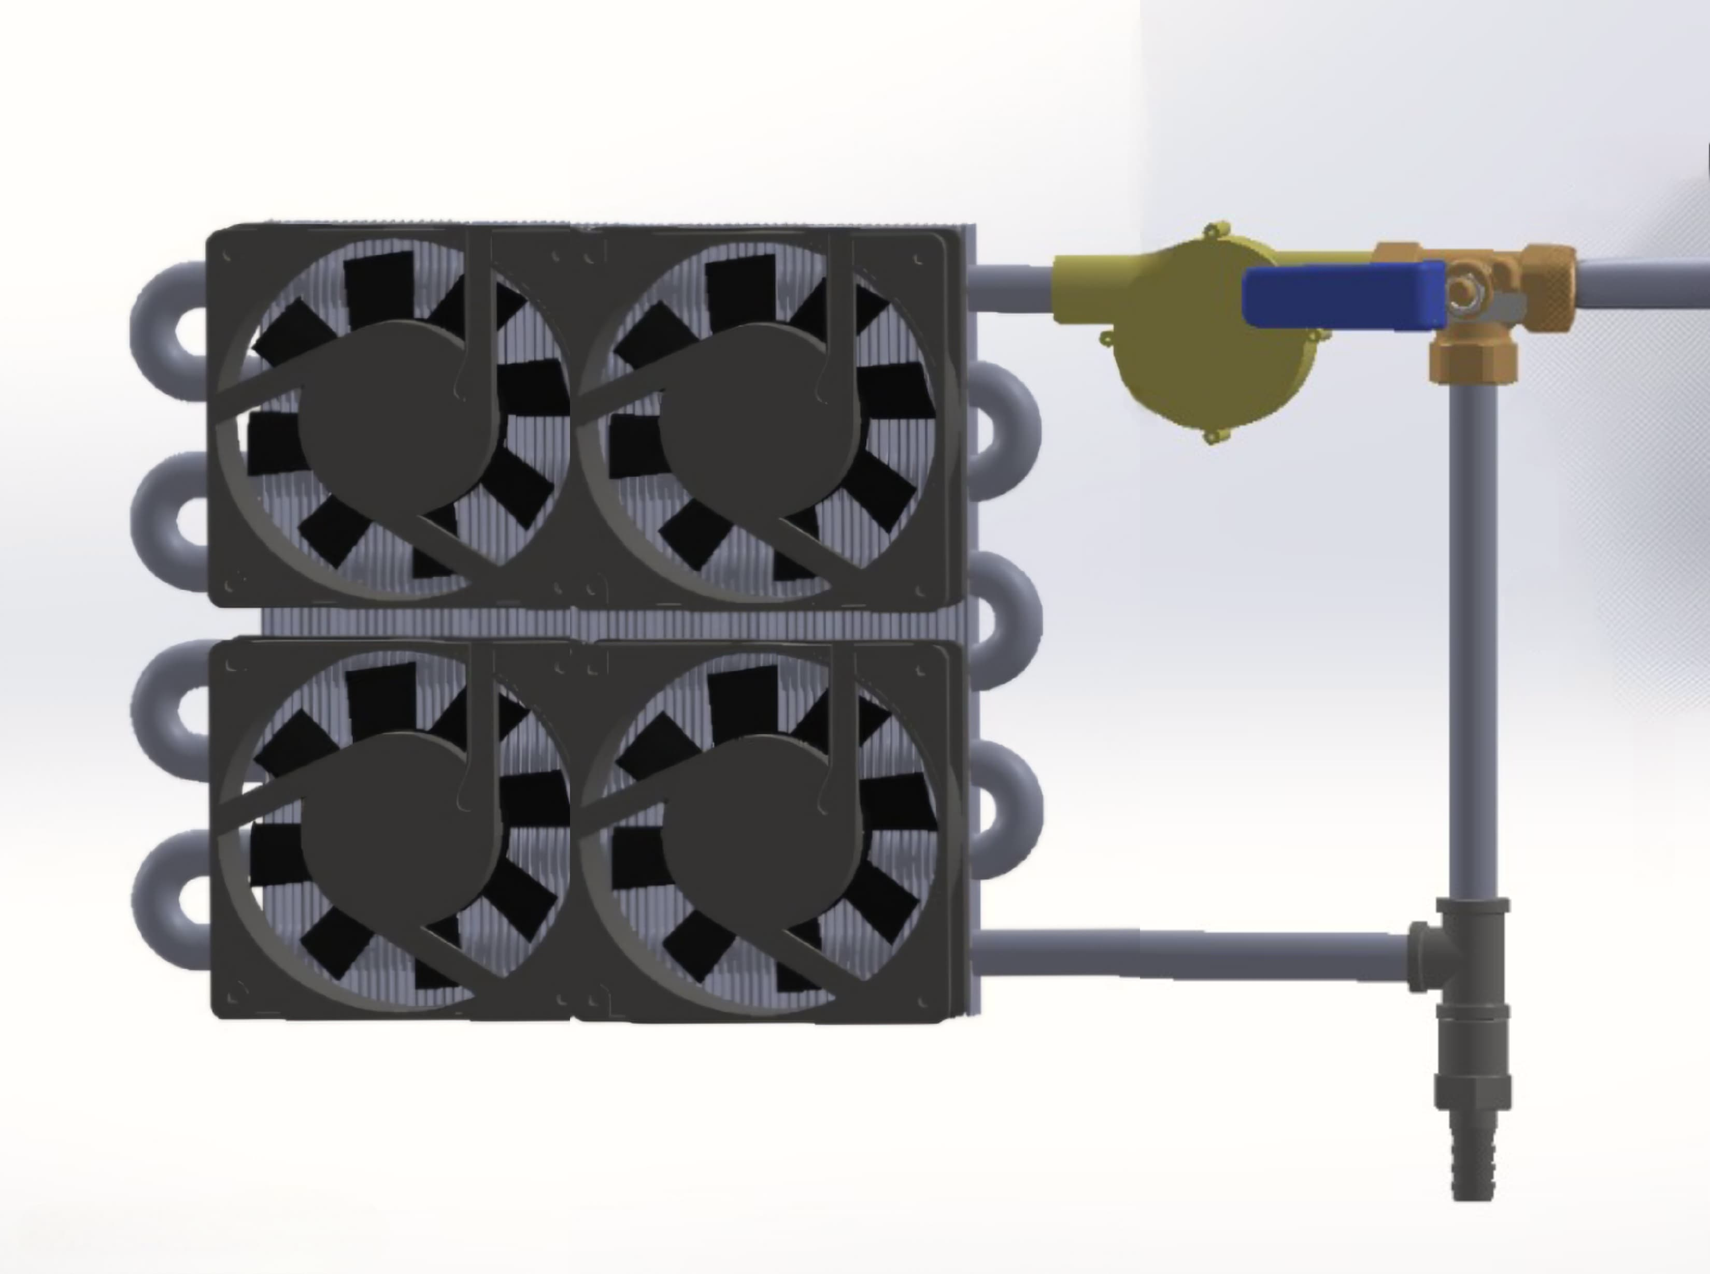


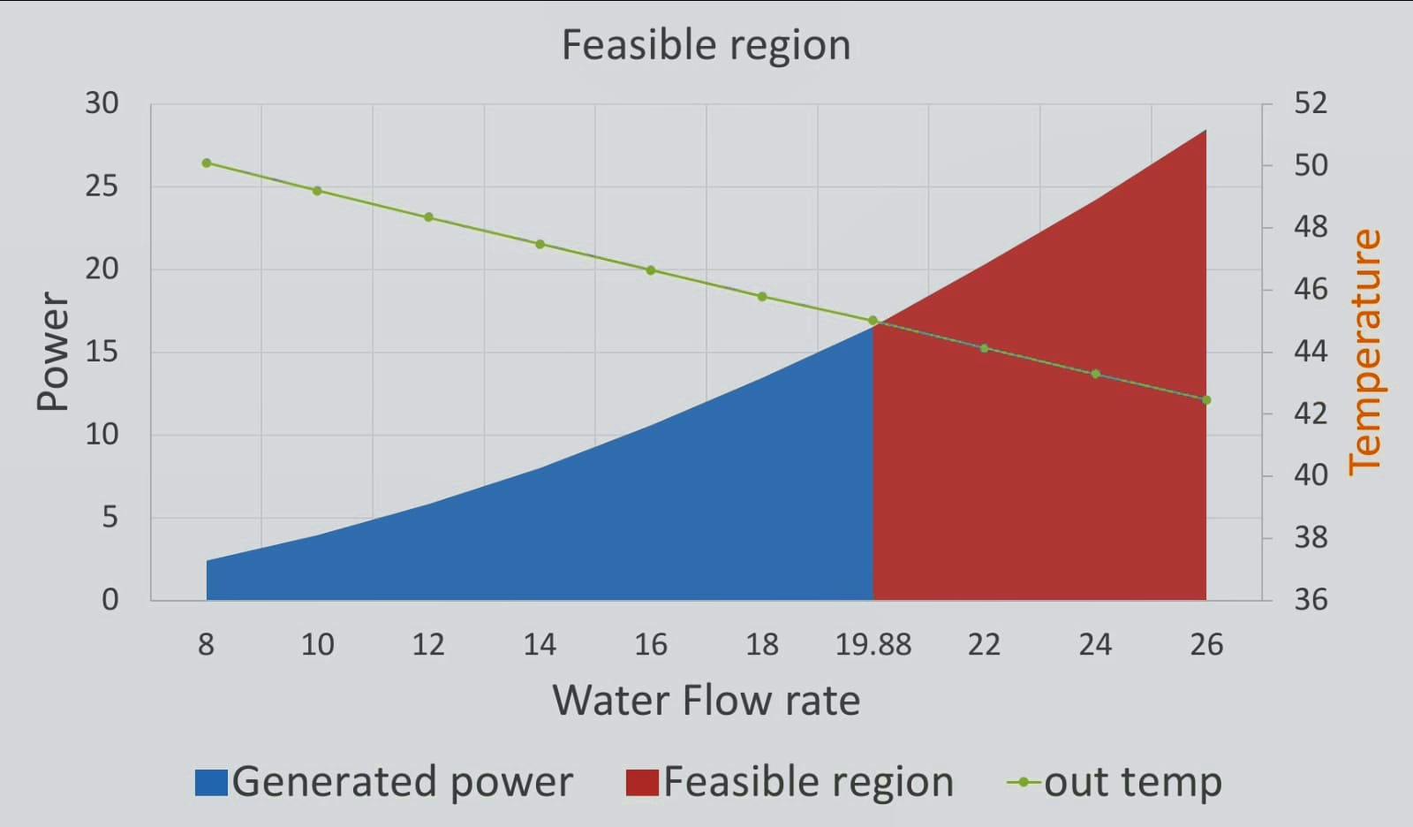




Self-Operated Water-Cooling System
Hassan Alhelal ISE Abdulwahab Alshemmari ISE
Alaa Busaleh ME Mohammed Alassaf CHE
Ali Almusailem ME
TEAM: 47
PROBLEM STATMENT
TESTING PROTOTYPE
In Saudi Arabia's hot climate, water stored in household tanks becomes excessively heated during the summer, making it unsuitable for daily use and increasing reliance on electrically powered water-cooling systems. The *SOWCS* project offers an innovative solution by utilizing the kinetic energy of water flow to achieve this goal without electricity.
The test was conducted on the prototype of the Self-Operated Water-Cooling System (SOWCS), where the functions are:
  Utilizes kinetic energy from water flow to power the cooling system.
  Automatically activates the cooling mechanism when water flow is detected.
  Cools water upon opening the tap, achieving a temperature reduction of 2–3°C, though the target was 8°C.
  Achieved a stable water flow rate of 7 liters per minute, meeting the specification for household use.
  Integrated radiator and fan combination ensure effective heat dissipation, but the turbine's low efficiency led to reduced fan speed, affecting overall performance.
CONSTRAINTS
Tank height: The tank should be positioned at least 6 meters above the usage point.
Pipes: The tank pipe diameter should be at least 1/2 inch.
Easy On-Off: The system should be easy to turn off when not needed.
CONCLUSION
SPECIFICATIONS
The prototype achieved a 2-3°C temperature reduction, short of the 8°C target, and maintained a stable flow rate of 6.4 liters per minute.
The estimated cost for the full design is X SR, while the prototype cost around Y SR.
Challenges and Recommendations:
  Cooling Performance: Achieving the 8°C target requires enhancing radiator efficiency, improving fan airflow, and using better thermal materials.
  Turbine Efficiency: The turbine's low efficiency reduced fan speed, affecting cooling. Redesigning the turbine can improve energy conversion and fan performance.
Performance: it should reduce the water temperature 8 degrees Celsius at least.
Flow Rate: The system operates with flow rate of 7–10 (L/min), suitable for domestic water use.
Cooling Speed: The system cools the water instantly.

