Slide 1

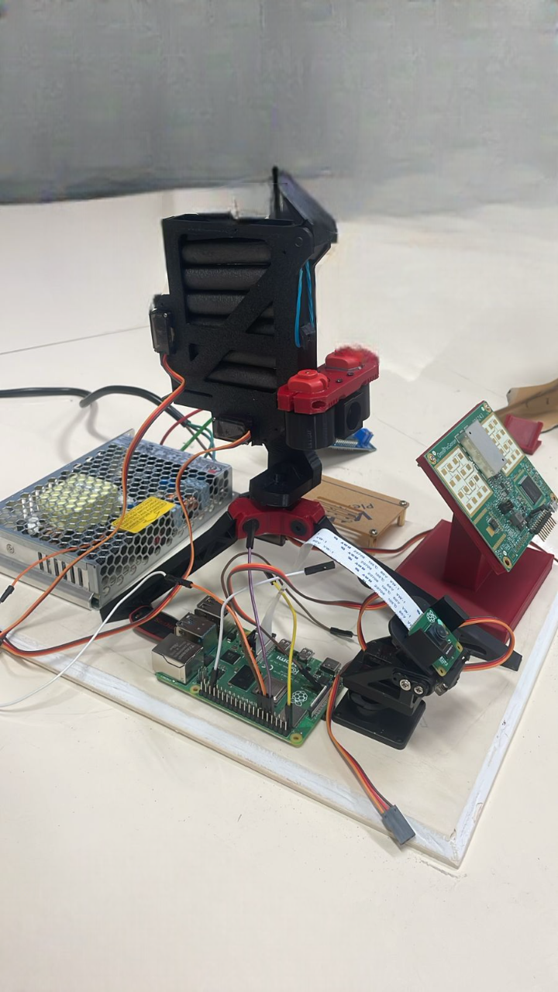
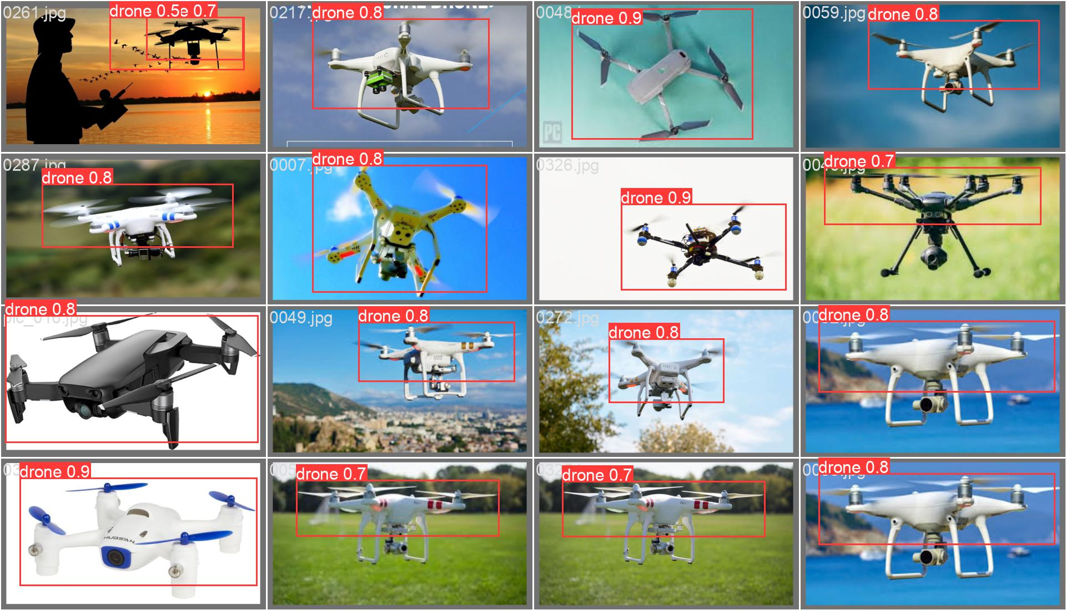
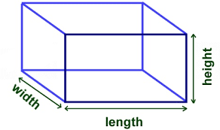
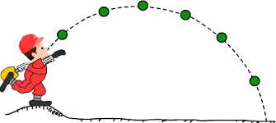


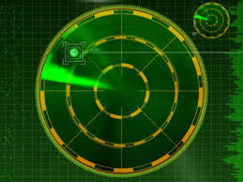
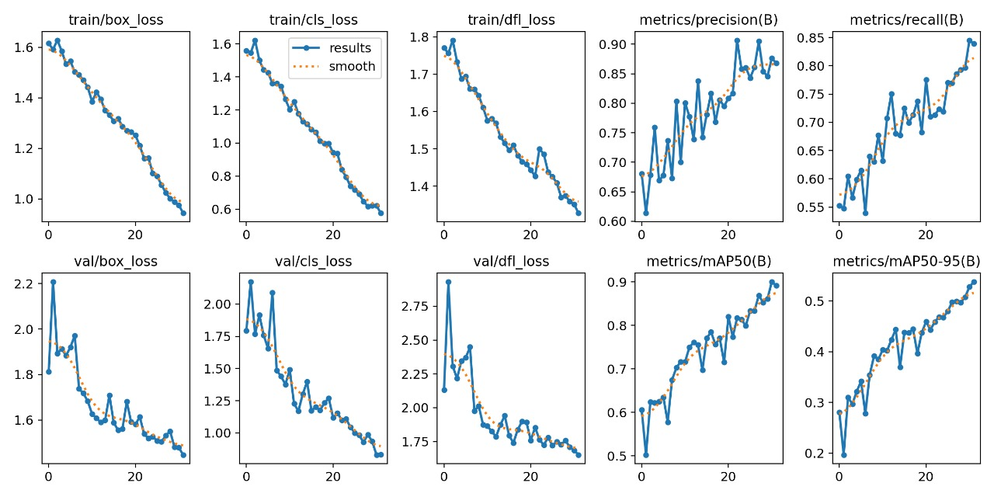
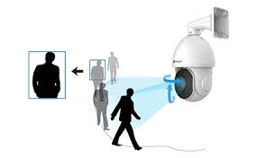



Anti Drone Defense System
Omar Almuqbil & Abdulaziz Aljohani: EE | Faisal Alharthi: CS | Saad Alshuaibi & Khaled Alghamdi: ME
KFUPM Design Expo
ELEVATOR PITCH
PROTOTYPE DESIGN
Our system is designed to detect and neutralize unauthorized drones in real-time using radar and YOLOv8 for accurate and fast object detection.
Our system is designed to detect and neutralize unauthorized drones in real-time using radar and YOLOv7 for accurate and fast object detection.
PROBLEM STATEMENT
As the use of drones increases, so does the threat of unauthorized drones invading restricted airspaces, posing risks to security, privacy, and public safety. Current methods of detecting and neutralizing such drones are often slow, inaccurate, or unable to handle high volumes of drone activity in real-time. There is a critical need for a robust, fast, and precise system capable of identifying unauthorized drones instantly and neutralizing them before they can cause harm or breach secure areas.
TESTING/ VALIDATION
CONSTRAINTS
Portability | Range
Efficiency | Durability
TARGET SPECIFICATION
• Detection Range: 15-20 meters
• Tracking Speed: Real-time updates
• Response Time: 2-3 seconds
• Accuracy: 85% within 10-20 meters
CONCLUSIONS
System Performance: Strong under controlled conditions, with potential for long-term durability enhancements.
Durability Testing: Exposure to environmental stresses highlighted areas for structural improvement.
User Experience: Easy to use, with opportunities to make tracking adjustments more intuitive.
Future Focus: Insights will drive improvements for enhanced robustness and user-friendliness.

