Slide 1


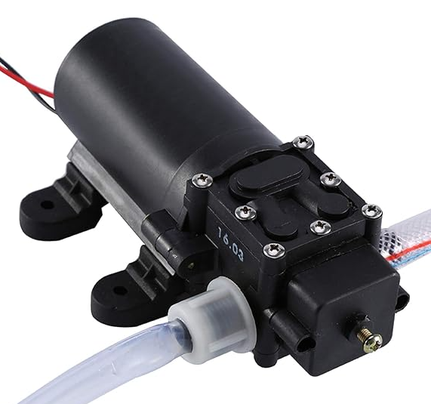
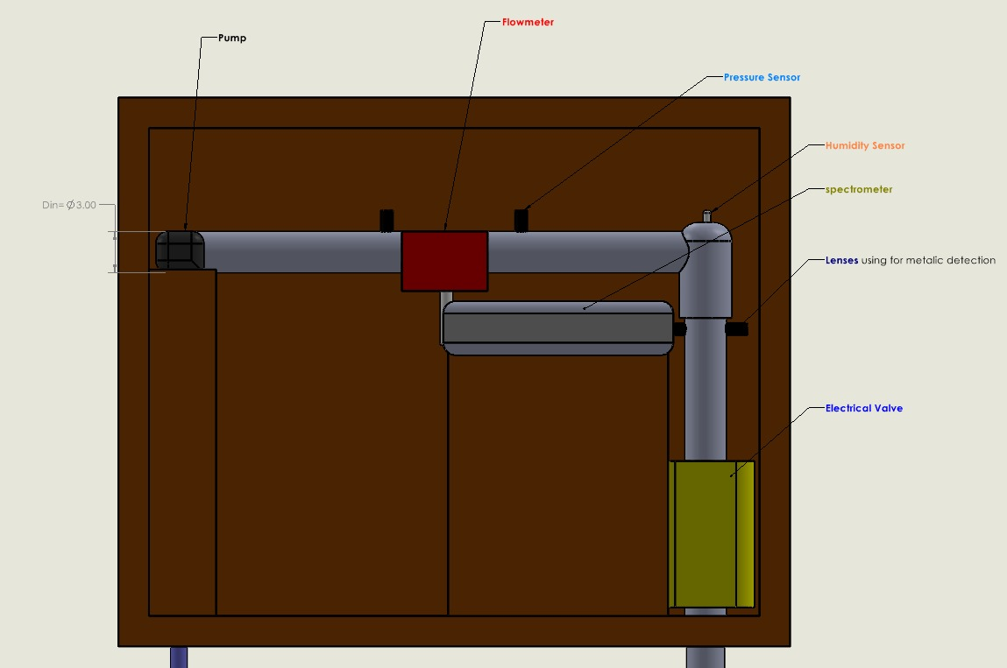
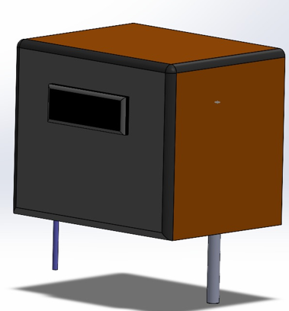
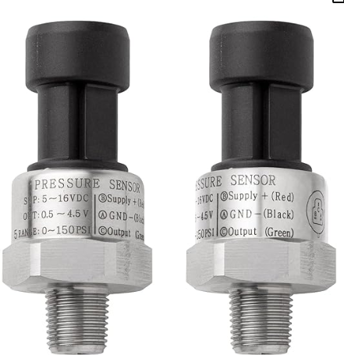
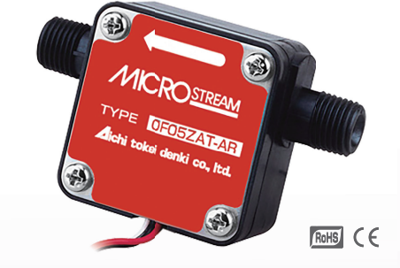
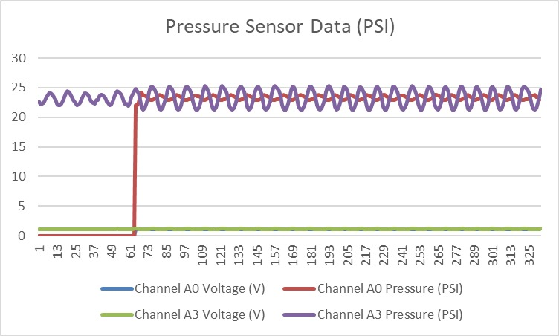
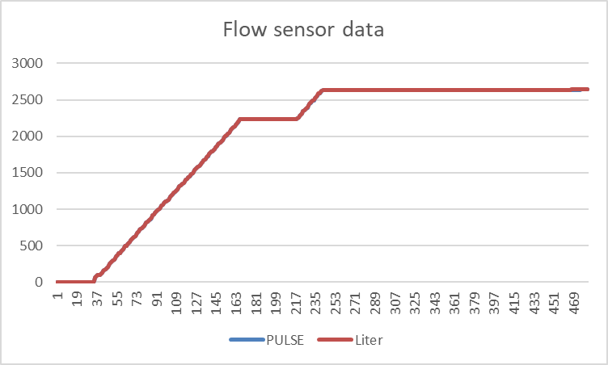
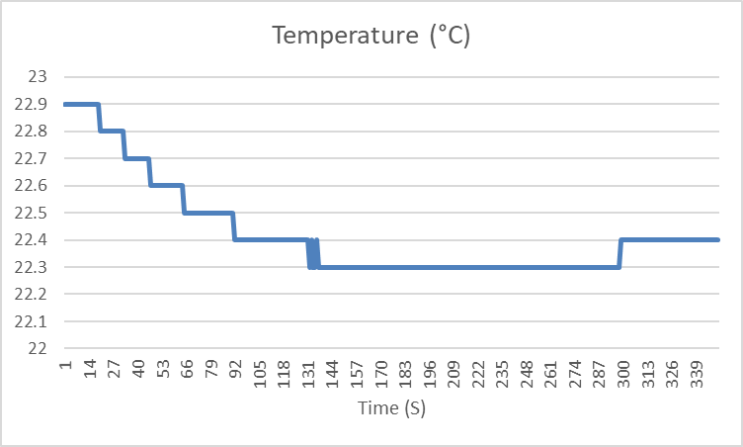
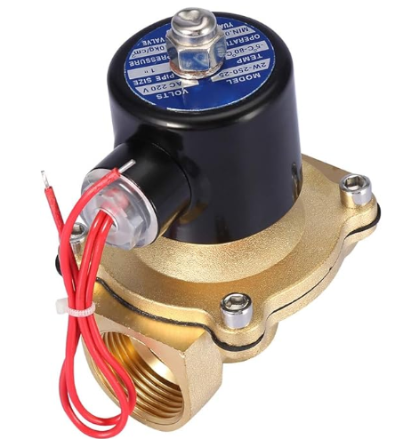
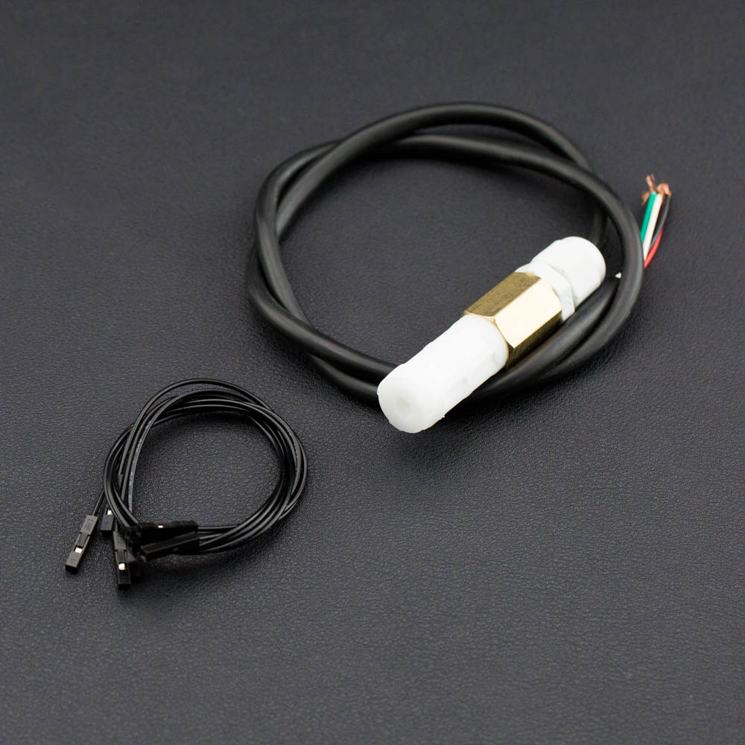
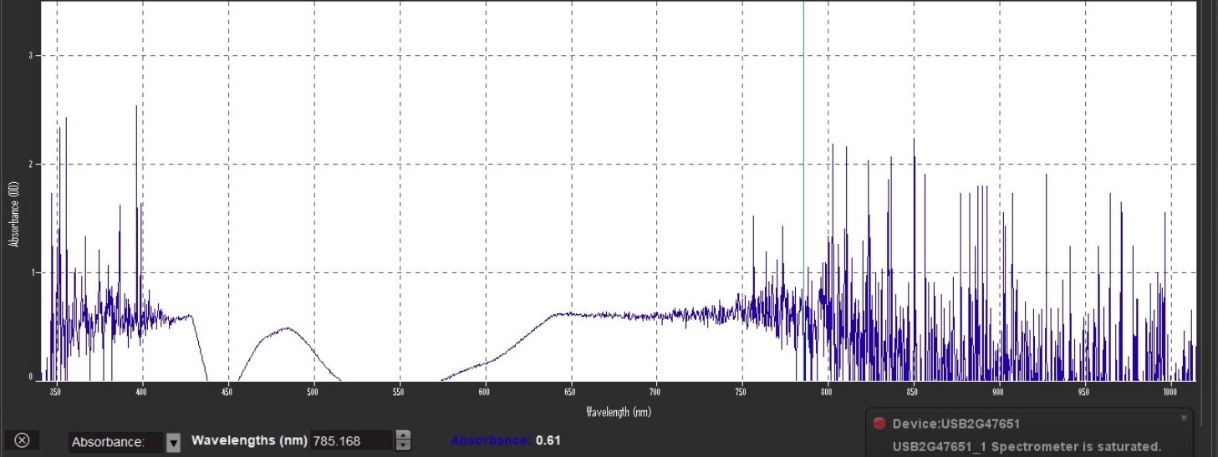
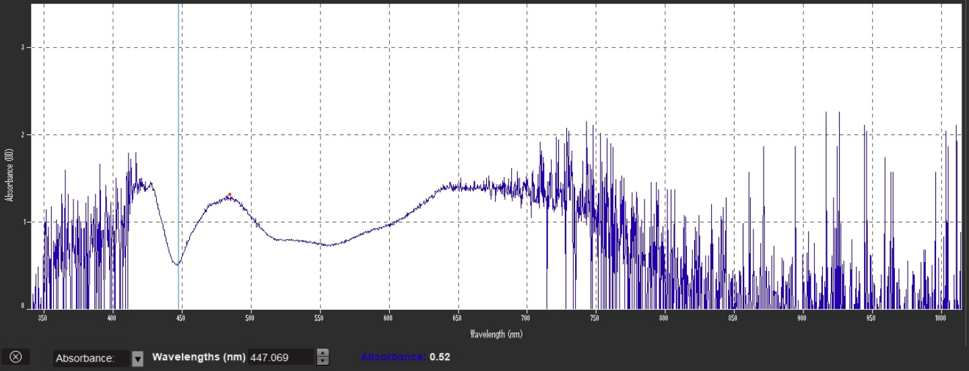
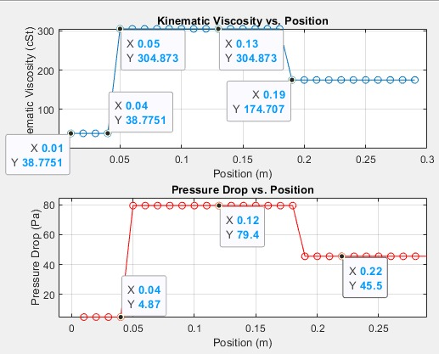
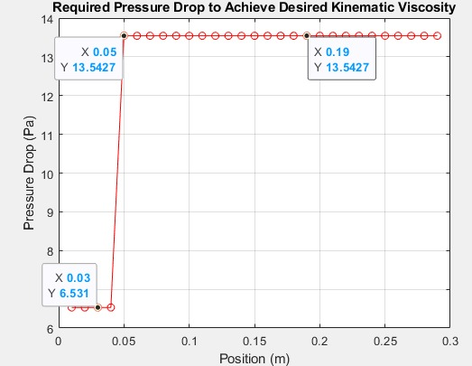
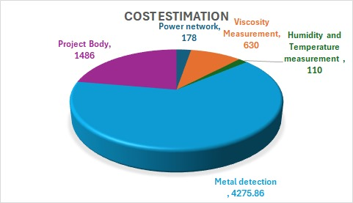
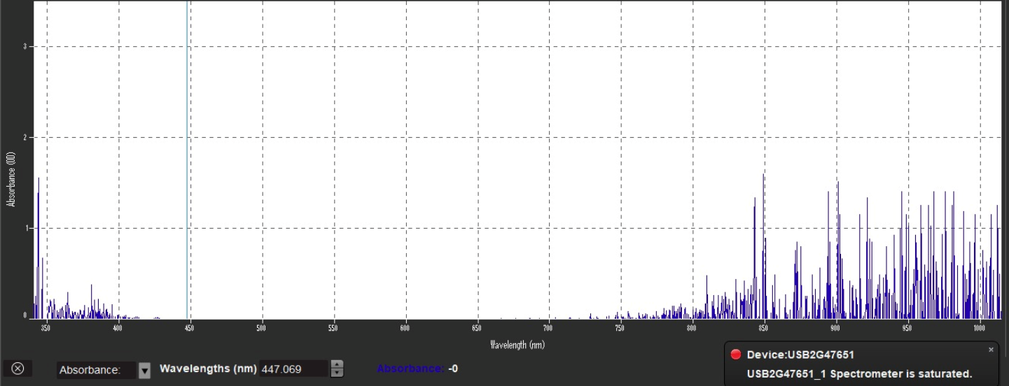
Continuous Loop Lubrication Oil Inspection & Monitoring Machine For Rotating Equipment
Ali Al-Asiri ME Khalid Al-Mutairi ME
Khaled Dwaikat EE Abdulaziz Al-Juhani ME Ahmed Ali Al-Awazim COE
TEAM: 44
Problem Statement
Pump
Assembly
The quality of lubricating oil in rotating equipment deteriorates over time, affecting performance and leading to a potential 25% rise in maintenance costs and unexpected failures. To address this, a continuous monitoring system is essential for detecting oil quality issues before they result in costly repairs and downtime.
Manufacturer | DIYIER
Output power | 60W
Flow Rate | Up to 5L/min
Voltage | 12V
Max pressure | 0.8MPA
Constrains
Feature | Description
High Temperature Operation | Operates effectively up to 50°C for the Saudi climate.
Rapid Responsiveness | Adjusts sampling rate within 5-30 seconds based on user input.
Customizable Thresholds | Allows users to set thresholds within ±20% of nominal values.
Budget-Friendly | Total budget capped at 10,000 SAR.
Regulatory Compliance | Complies with Saudi Standards Organization (SASO) regulations.
Maintenance Accessibility | Accessible maintenance within 50 km of remote locations.
Cost-effective Operations | Operational costs increase limited to 5% of current expenses.
Pressure Senor
Manufacturer | Ronybuy
Measuring Range | 0-150 PSI
Operating Temperature | -40-150 C
Material | 316 SS
Response Time | <0.3ms
Target Specifications
Flow Sensor
Feature | Description
Adjustable Sampling Rate | Configurable from 1 minute to 1 hour.
Threshold-based Alerts | Alerts generated for parameters exceeding set limits ±10%
Offline Data Storage | Stores at least 1 month of data on an SSD card.
Water in Oil Measurement | Accuracy of ±10% for measuring water content in oil via capacitive sensor.
Viscosity Measurement | Accuracy of ±10% for measuring oil viscosity using flow rate and pressure sensors.
Oil Temperature Measurement | Accuracy of ±10% in measuring oil temperature.
Oil Pressure Measurement | Accuracy of ±10% in measuring oil pressure.
Manufacturer | Jetec Electroncs
Flow Rate Range | 0.085 – 5 L/min
Accuracy | ±2% RS
Temperature Range | -10 to +70°C
Measurable Liquids | heating, light, heavy oil
Sensor Readings
Electrical Valve
Type | Solenoid Valve
Pressure Resistance | 1 MPa (0-10 kg)
Voltage | AC 220V
Control Form | Opens when powered
Concept Evaluation
Temperature & Humidity sensor
Metallic Detection
​ | Criteria Wight​ | First Design​ ​ | Second Design​ | Third Design​
Safety ​ | 0.353​ | 0.23​ | 0.3​ | 0.47​
Cost​ | 0.0686​ | 0.50​ | 0.27​ | 0.23​
Automation ​ | 0.0370​ | 0.15​ | 0.33​ | 0.52​
Measurement Precision ​ | 0.150​ | 0.36​ | 0.32​ | 0.32​
In Site Measurement​ | 0.114​ | 0​ | 0.35​ | 0.65​
Wireless data transfer​ | 0.0367​ | 0​ | 0​ | 1​
Proactive Maintenance​ | 0.240​ | 0.18​ | 0.27​ | 0.45​
Save the Data Offline​ | 5.85e-4​ | 0.28​ | 0.36​ | 0.36​
Score​ |  | 0.218​ | 0.302​ | 0.480​
Manufacturer | DFRobot SHT20
Type | Temperature & Humidity
Accuracy | 1550 rpm
Water Resistance | Waterproof
Compatibility | Compatible with Arduino
Oil with iron
Oil with Copper
Mechanical Insights in the Lubrication Systems
Cost Estimations
Pure oil

