Slide 1
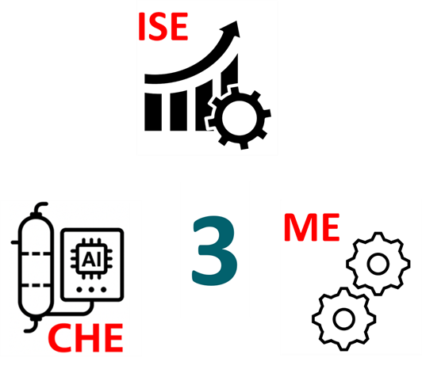




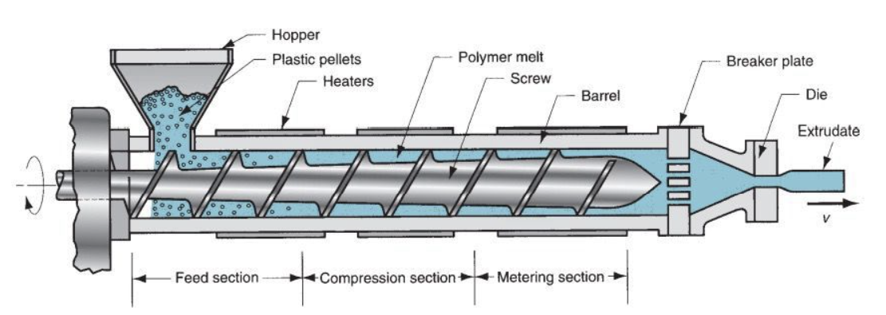
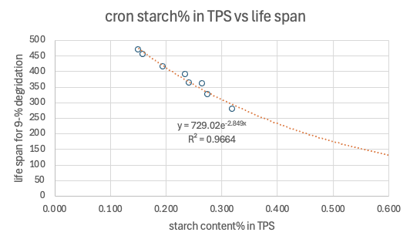
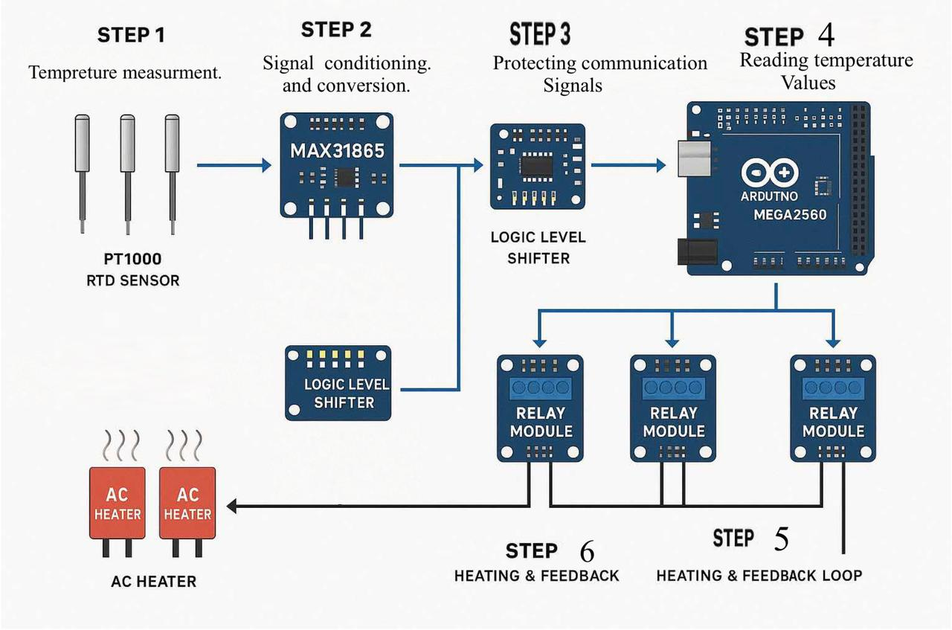
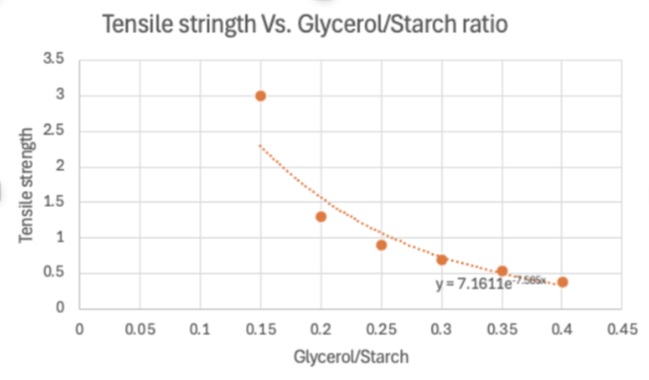
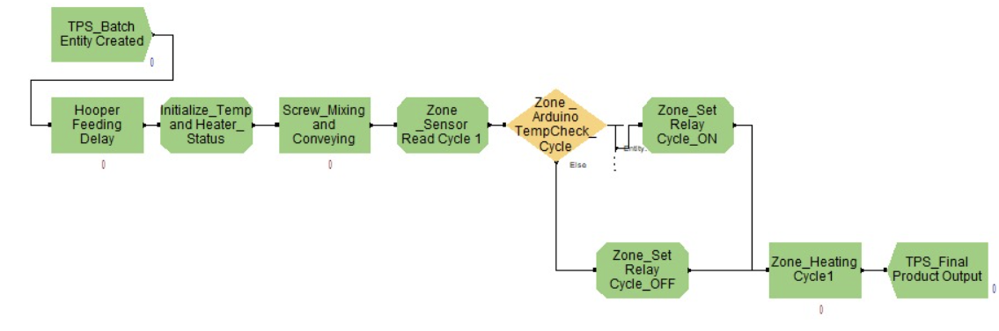



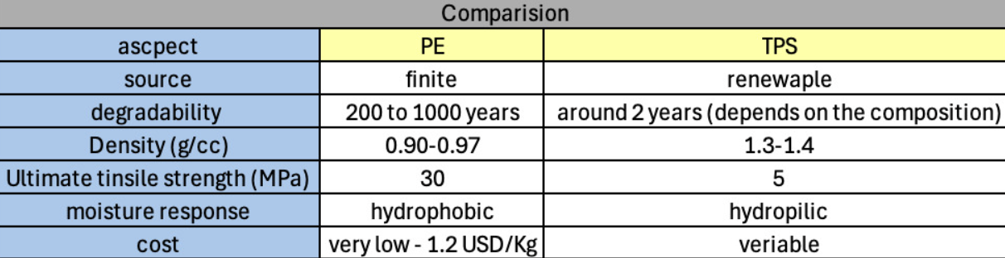

Production of Biodegradable Plastic Using an Extrusion Process
TEAM
044
Coach: Dr. Muhammad Nurunnabi Siddiquee
Hussain Alzayer (ISE) Abdullah Mohammed (ISE) Abdulaziz Aljedani (CHE) Bader Albuainain (CHE) Ali Alyaseen (ME) Tariq Alsahaf (MECoach: Coach Name(Font size : 48)
1.Introduction
3b. Specification
5. Experiment
7. Conclusion
•The use of traditional plastics has created serious environmental challenges.
•Biodegradable plastic offers an eco-friendly solution for disposable plastic needs.
•Unlike petroleum-based plastics, bio-plastics degrade quickly and help protect the environment.
Temperature Range
Starch content
Mixed starch, glycerol, and water.
Fed the mixture into the extruder hopper.
Heated, mixed, and extruded to form the final product.
Our project aims to design an integrated industrial produce biodegradable plastic using abundant organic materials like starch and vinegar. A single screw extruder will handle heating, mixing, and extrusion, enabling continues, high-quality, and efficient production. This integrated approach reduces energy use and operational costs while offering an eco-friendly alternative to petroleum-based plastic.
Tensile Strength
Defect Rate
4. Prototype
6. Testing / Validation
2.Problem Statement
Petroleum-based plastics persist in the environment for centuries, rely on non-renewable resources, harm wildlife, and are difficult to recycle. In contrast, biodegradable plastics offer a sustainable alternative by breaking down naturally, reducing pollution, and supporting eco-friendly waste management.
What is next?
Promoting the use of bioplastic throughout Saudi Arabia.
Supporting the Kingdom’s Vision 2030 by advancing environmental sustainability.
Reducing toxic emissions.
Minimizing plastic waste in landfills and oceans.
3a. Constraints
Limited Budget
Bio-Degradability
Power Consumption

