Slide 1
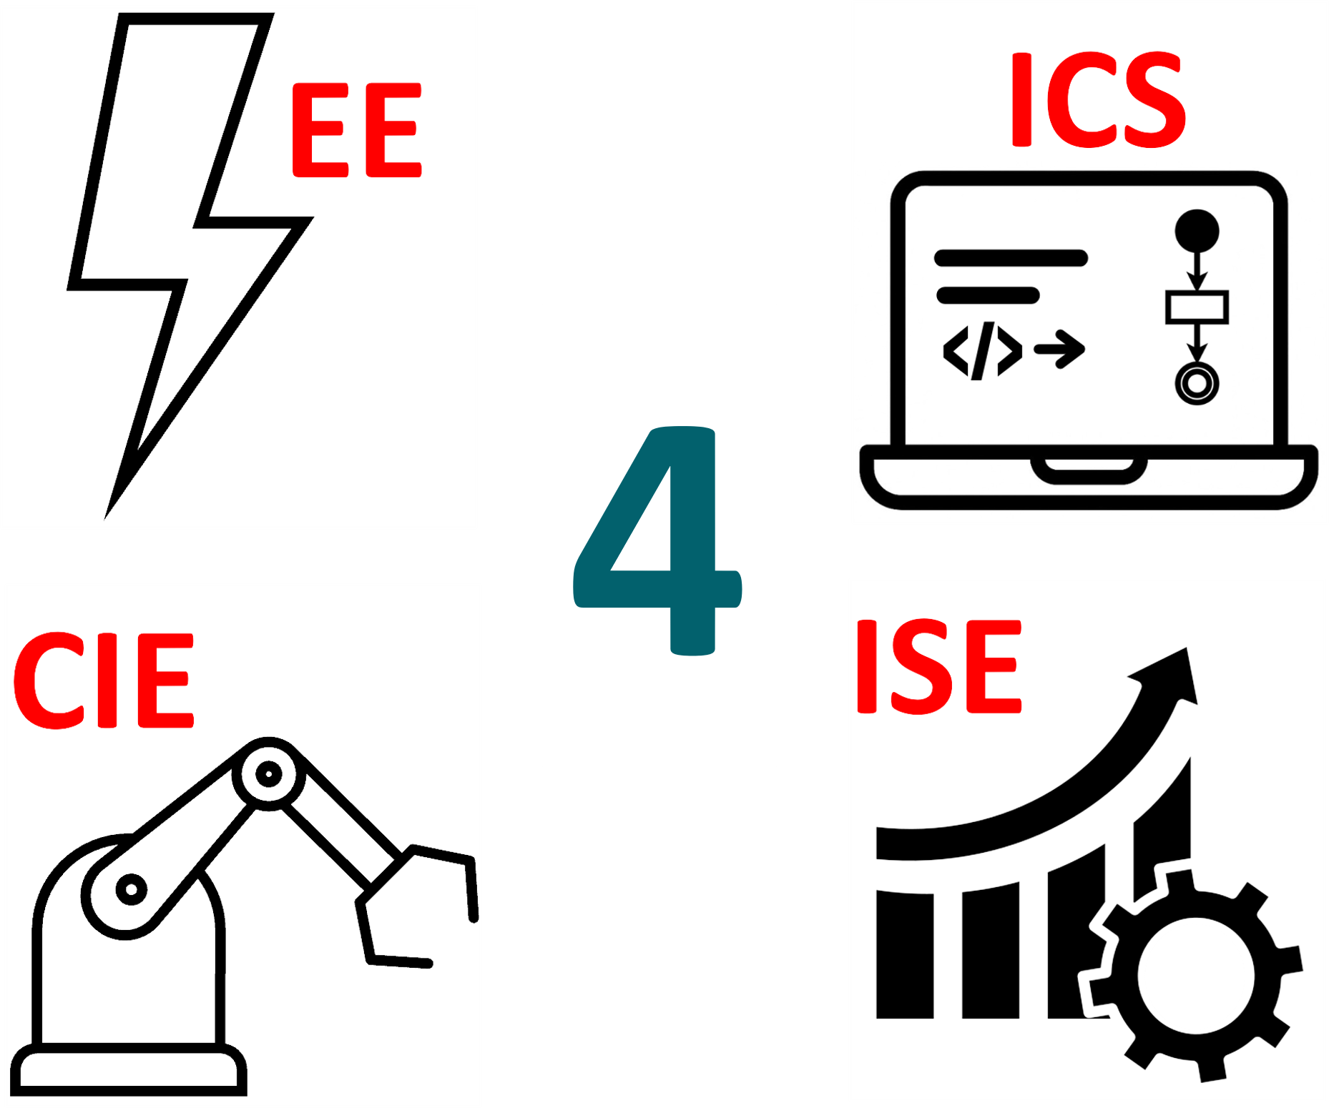
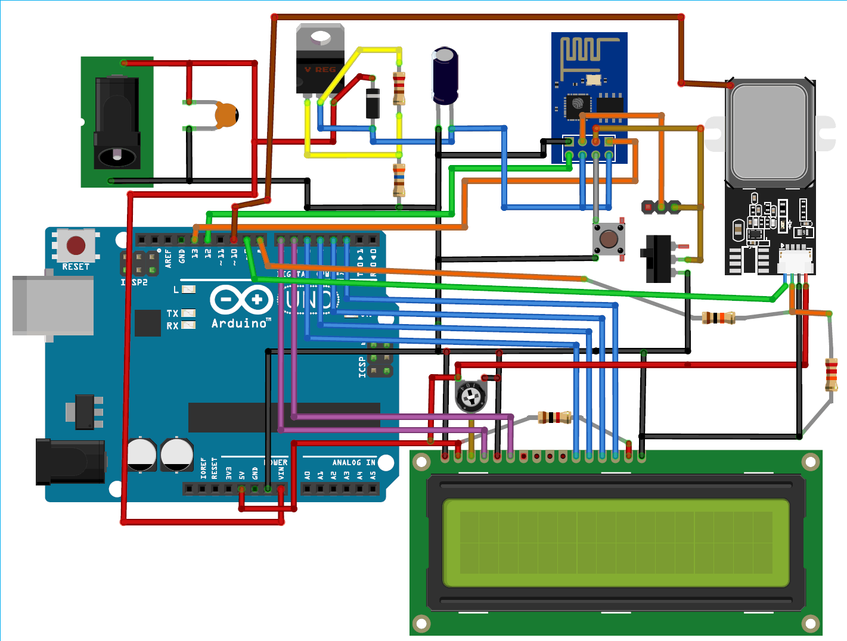
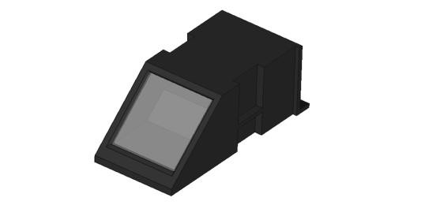
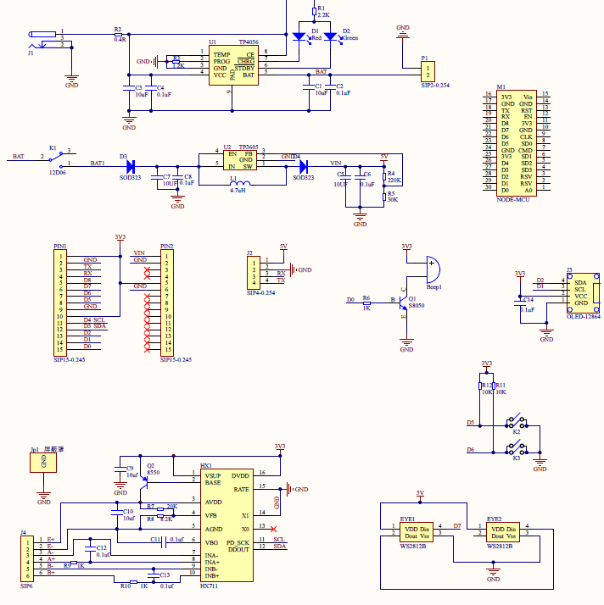
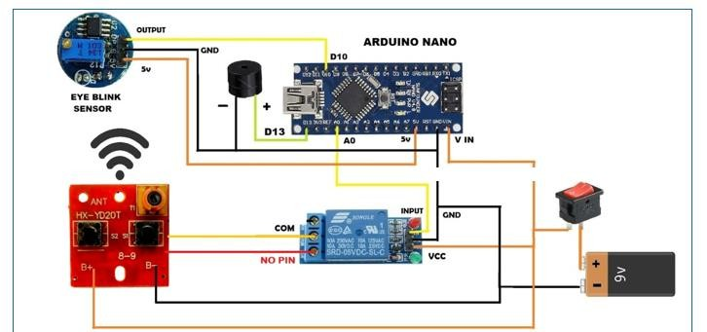
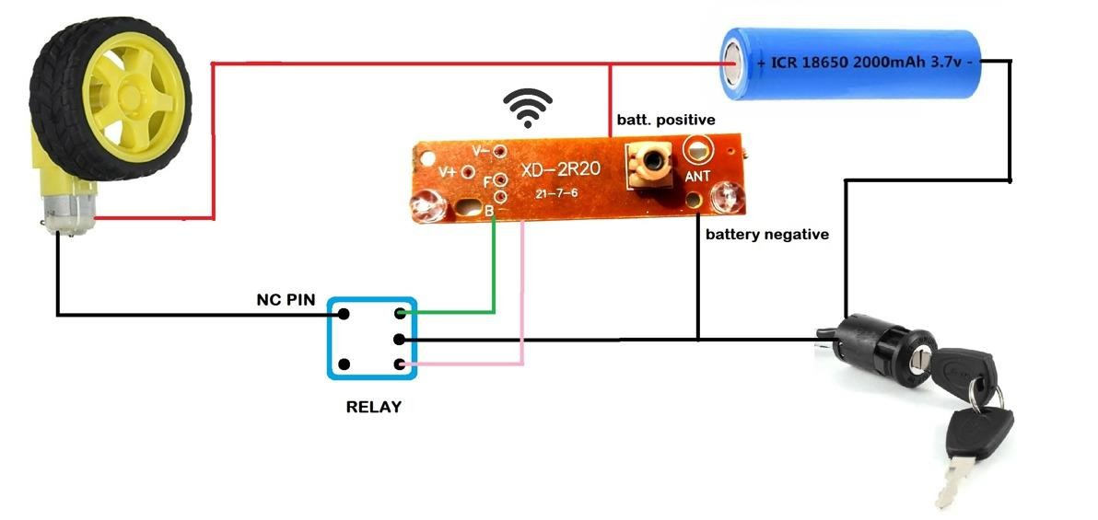
Nova Logistics
TEAM
042
Osama Bukhari, Rasheed Alqahs, Faisal Mazeed, Faris Alobaisey, Majed Albaqami, Abdulrahman Bajaber
Coach: Emad Ramadan
Introduction
Problem Statement
Prototype Design
Validation & Testing
As global trade continues to expand, the logistics industry faces mounting pressure to become faster, safer, and more reliable. Companies must balance delivery speed with cost, ensure driver safety, and protect shipments—all while keeping up with growing customer expectations. This project emerges as a response to these challenges, offering a smart, unified system that reimagines how logistics can operate in a more secure, efficient, and sustainable way
Logistics operations still face delays, security risks, and high fuel costs due to outdated systems and lack of integration. A smarter, unified solution is needed to secure shipments, monitor driver safety, automate compliance, and optimize delivery routes
1- The Fingerprint Authentication Device. The system is built on a breadboard, with the core components visible: the NodeMCU ESP8266 microcontroller, OLED display module, and the optical fingerprint sensor.
Smart Security Glasses: We validated that the eye-tracking sensor detects signs of driver fatigue with over 95% accuracy in real-time conditions. This ensures immediate alerts for drowsiness, significantly enhancing driver safety and reducing fatigue-related incidents by 30%
Optimal Route Application: Our AI-powered route optimization successfully achieved the target of processing and updating delivery routes within 2 second
2- This schematic diagram represents the final circuit design for the Truck Weight Measuring Station.
Constraints
Final Target Specifications
Conclusion
Fast processing: Route optimization and live updates must complete within 2 seconds
System responsiveness: Web/app must respond in ≤500ms for up to 10,000 users
Security: Fingerprint system must have a FAR ≤ 0.01% and use end-to-end encryption
Sustainability: System must reduce fuel use by 15% and emissions by 10%.All Specifications
AI Route Optimization: Generates efficient delivery routes using real-time data
Real-Time Tracking: Website and mobile app provide shipment and driver status
Eye-Tracking Safety Glasses: Detects drowsiness and alerts drivers instantly
Biometric Fingerprint Authentication: Restricts shipment access to authorized personnel.
We developed and tested an integrated logistics system that improves security, safety, and efficiency. The results show real gains in fuel savings, delivery time, and driver monitoring, proving the solution’s readiness for real-world use
3- This close-up image highlights the circuit board used in the Smart Security Glasses, showcasing the integration of key components like the battery, sensor, and relay module.

