Slide 1

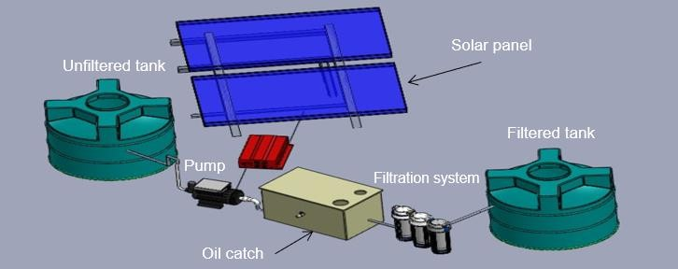
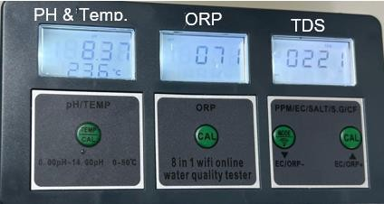
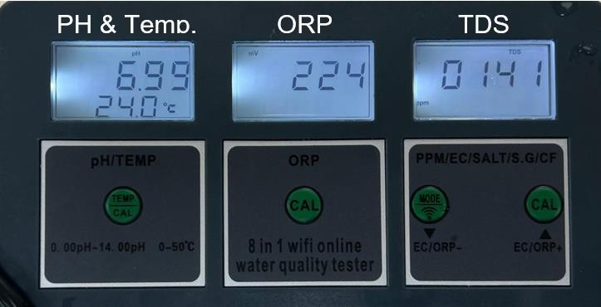
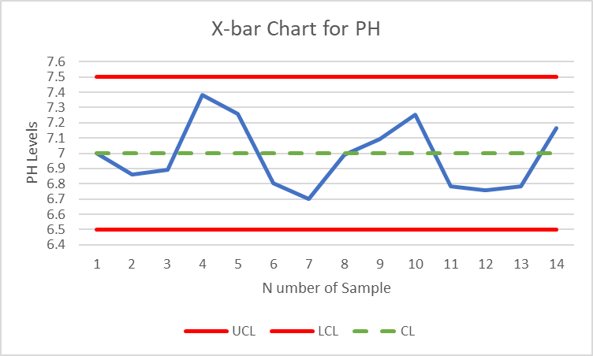





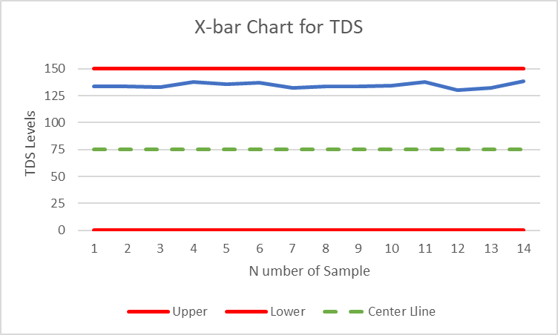
Sustainable Water Management: Filtration and Reuse of Wastewater from Car-Washing Stations
Advisor: Dr. Ismail Ibrahim Al Maraj
Yasser Alzahrani(ISE), Hamad Alduayj(CHE), Mohammed Alfarhan(ISE), Abdullah Alridy(CHE), Osamh Fnais(ME)
Problem Statement
Prototype Design
Testing/Validation
Car washes waste vast amounts of water, raising costs and harming the environment. Existing
Parameters before filtration
systems are expensive, inefficient, and unsustainable, making water recycling a challenge for businesses aiming to cut expenses and reduce environmental impact.
Constraints
User Training: The system should not require training for employees in maintenance and operation..
Parameters after filtration
Energy Efficiency: The filtration system must incorporate solar panels to supply at least 35% of its energy needs.
Area: The target range for system size should not exceed 2*1.5 m².
Oils: must remove the oil from the water before introducing water to the filtering material.
Water Temperature: should be between 20-45
ºC to prevent paint damage.
Equations
Quality Control Chart
Pump Power:
𝑃 = ρ ∗ g ∗ Q ∗ H
ρ = Density of water (1000 kg/m³ ).
g = Gravitational constant (9.81 m/s²). Q = Flow rate (m³/s ).
H = Total head loss (m).
Specification
Solar panel power:
Conclusion
pH: must be between 6.5 - 7.5 to ensure neutralized water.
Total Dissolved Solids (TDS): less than 150 ppm to avoid scaling and deposits.
This project developed an optimized water filtration system for car wash wastewater, featuring a multi-stage process including oil catch, screen filter, sand filter, resin filter, and activated carbon. The system ensures water quality suitable for reuse, with a focus on efficiency, minimal maintenance, and sustainability for car wash operations.
P = Power required by the solar panel
solar
(W).
1.25= Safety margin (dimensionless).
0.35= Fraction of the energy provided by the solar panel (dimensionless).
P_{pump}= Power consumed by the pump (W).
T_{pump}= Operating hours of the pump per day (h).
T_{sun peak} = Peak sun hours per day (h).
Hardness level: should be between 75-150 mg/L to prevent both scaling and corrosion.
Flow rates: the flow rate is 6.67 L/m where we have 100 L and 15 minutes.
Acknowledgements
We sincerely thank Dr. Zyad Lesman and Dr. Ismail Ibrahim Al Maraj for their invaluable guidance and support. Our gratitude also goes to KFUPM for providing financial support and resources for the prototype development. Lastly, we thank our design team for their hard work and dedication.
ORP between 200 to 300 mV to provide enough oxidizing potential to clean effectively.

