Slide 1

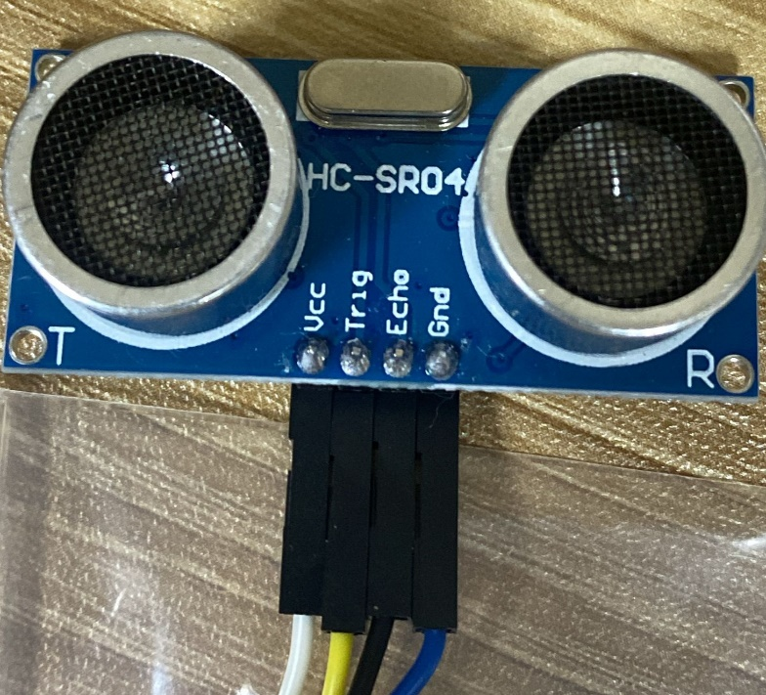
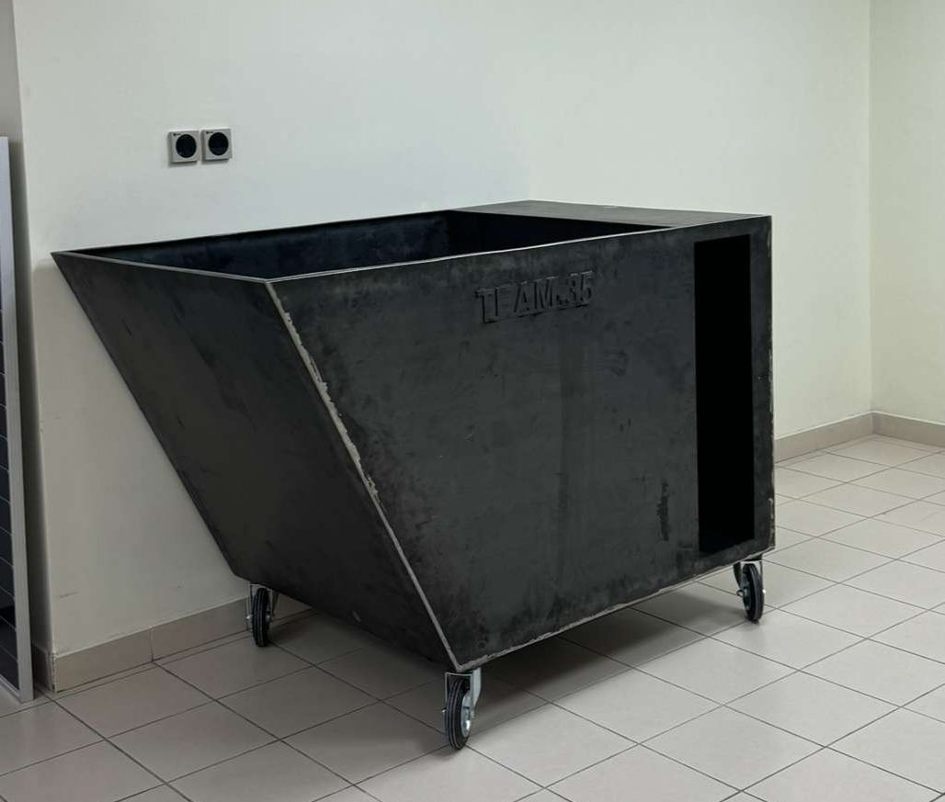
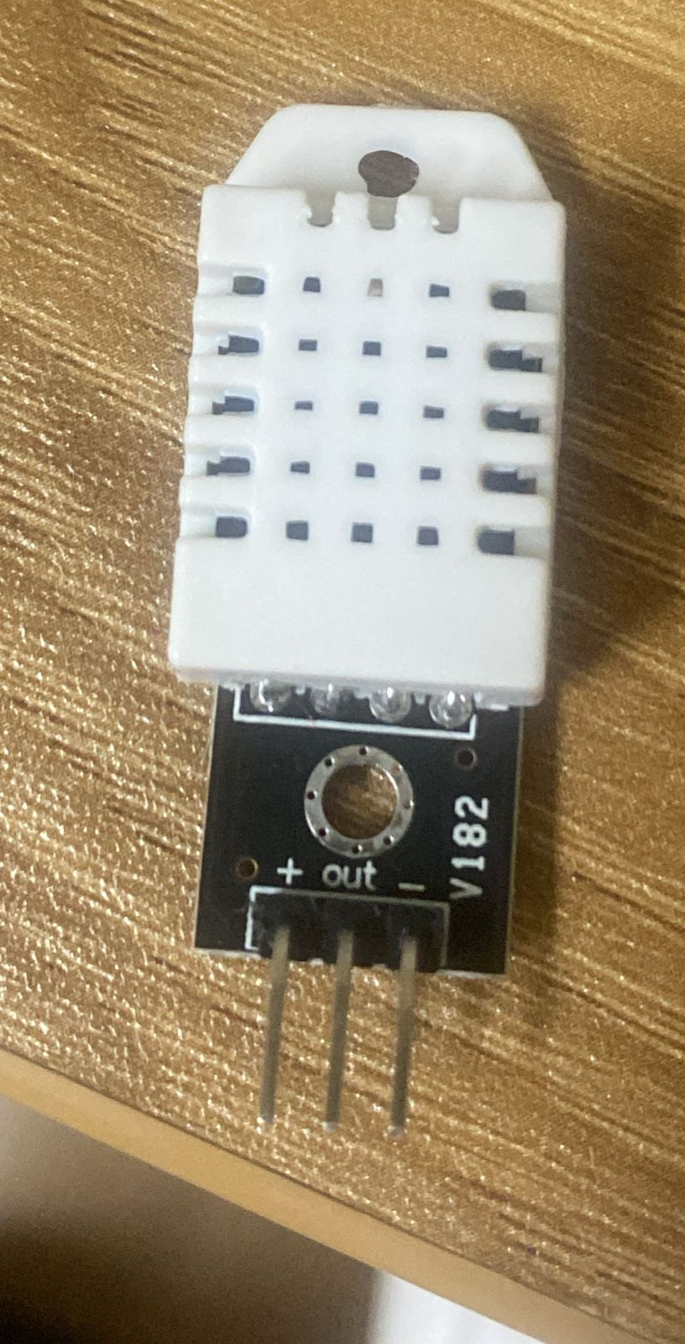
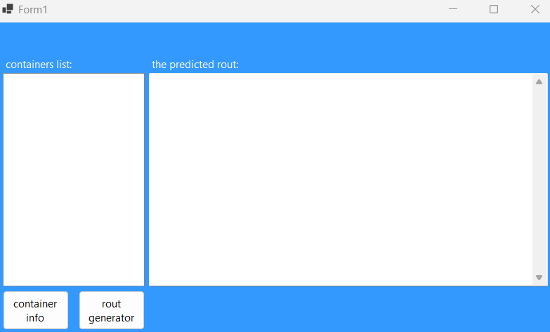
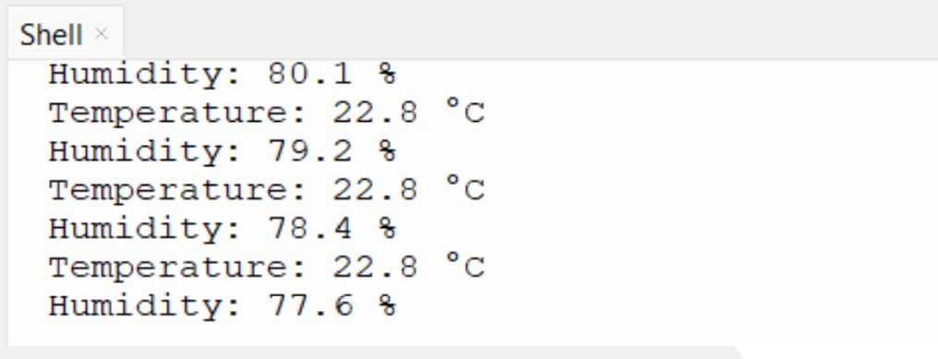
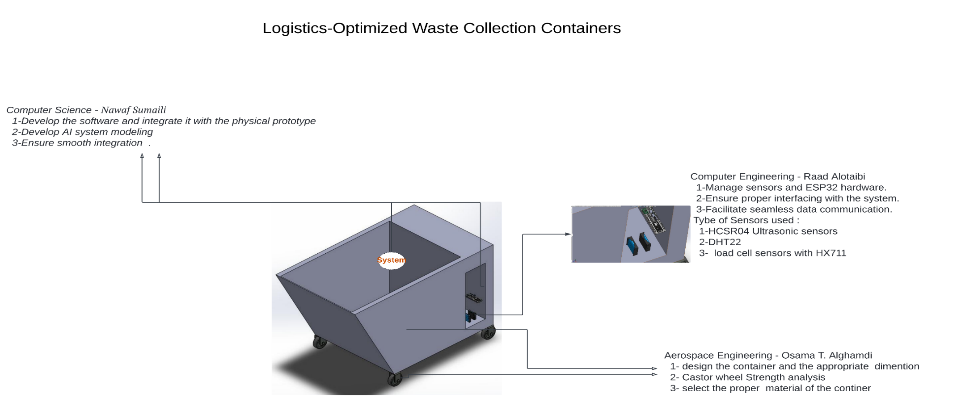
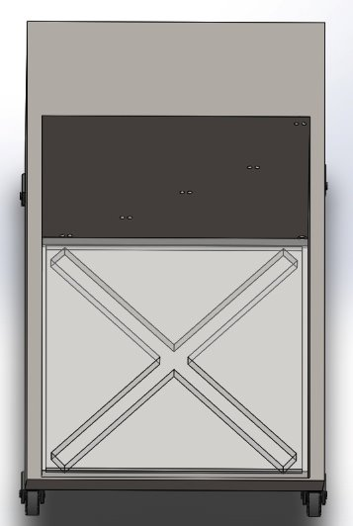
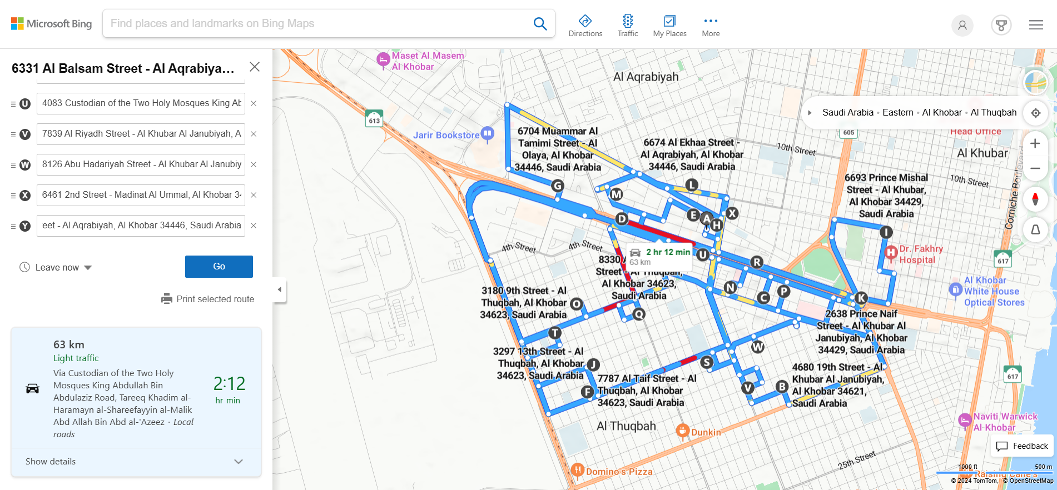
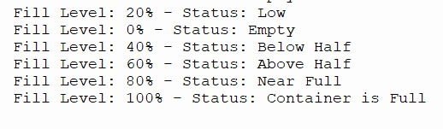
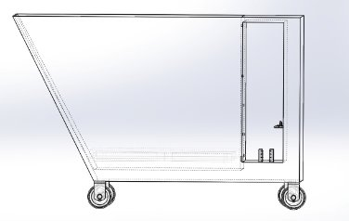
Logistics-Optimized Waste Collection Containers with Real-Time Monitoring
TEAM 35
Ibrahim Bagazi ISE Raad Alotaibi COE
Ibrahim Alomran ISE Osama Alghamdi AE
Nawaf Sumaili CS
INTRODUCTION​
Prototype Development
Problem Statement:
The current municipal waste collection system in Saudi Arabia could be improved using the logistics optimized waste collection system. This is because the current system utilizes an exhaustive routing methods which consumes fuel on unnecessary trips.
Constraint:
1- Number of Containers in a neighborhood < 150
2- The Waste Collection Weight < 400 Kg 3- At most two Trucks assign to one neighborhood
Specifications:
1- Ultrasonic sensor for fill rate
2- Hx711 sensor for weight
3- Heat sensor for heat detection
4- 4mm thick iron container
Testing
User Interface:
Sensor Reading
Design
Future Work
Data Integration: Seamlessly integrate comprehensive data into the system for enhanced functionality.
Algorithm Development: Advance the route optimization algorithm for improved efficiency and adaptability.
AI Model Deployment: Finalize, validate, and implement the AI model to deliver accurate, intelligent, and scalable solutions.
Conclusion
In this study, the AE student was responsible for the design and the material choices for the container, the COE student was responsible for extracting the needed information from the container using sensors, and both the ISE and ICS students were responsible for making useful predictions using the gathered information using A.I. models and algorithms. Combining their effort to create a system to optimize the logistics of waste collecting.

