Slide 1

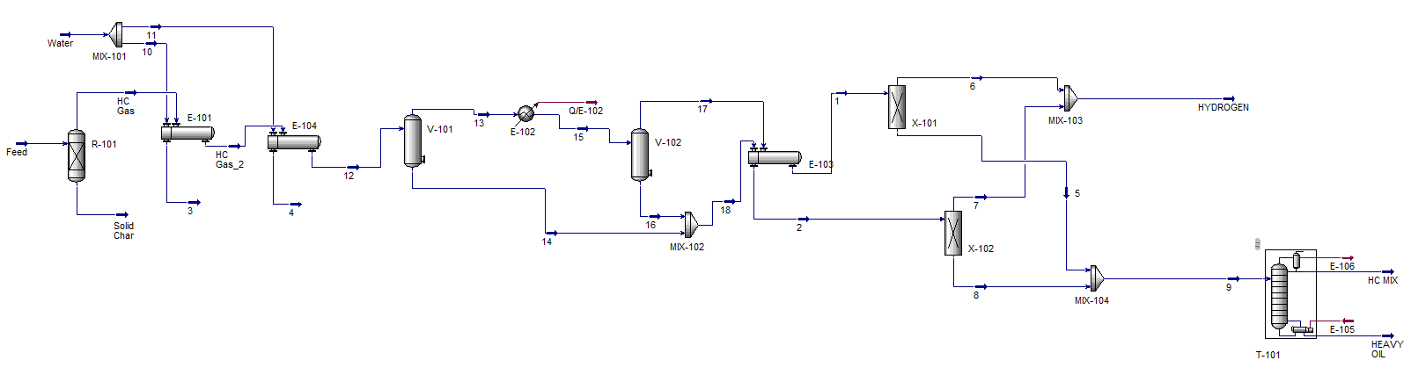
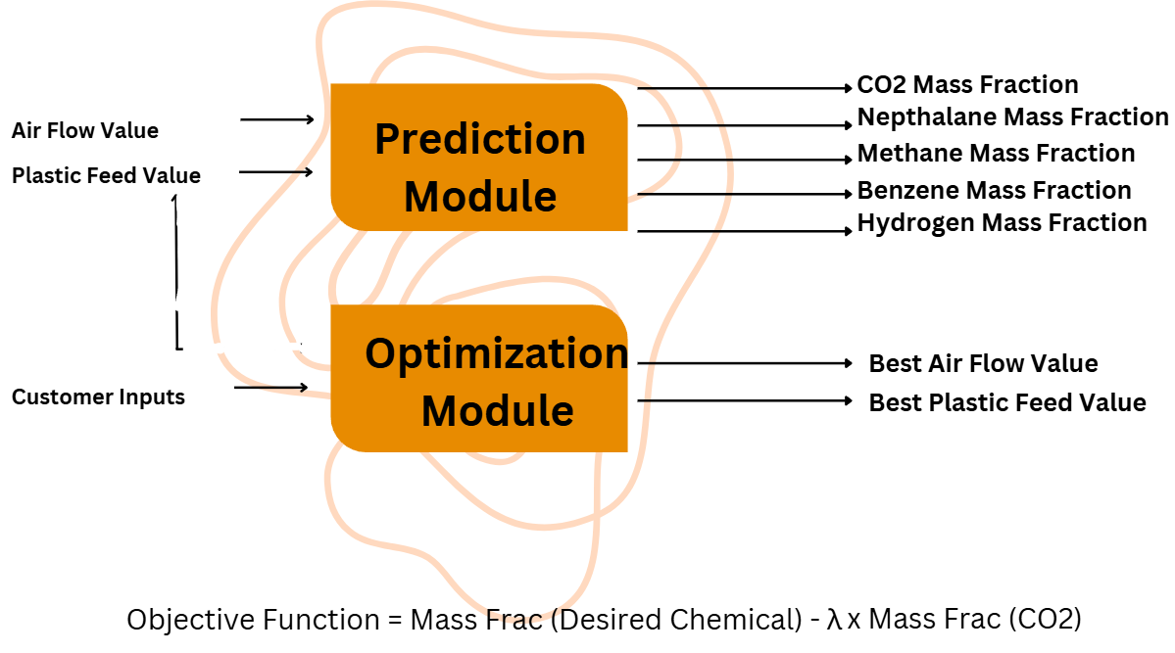

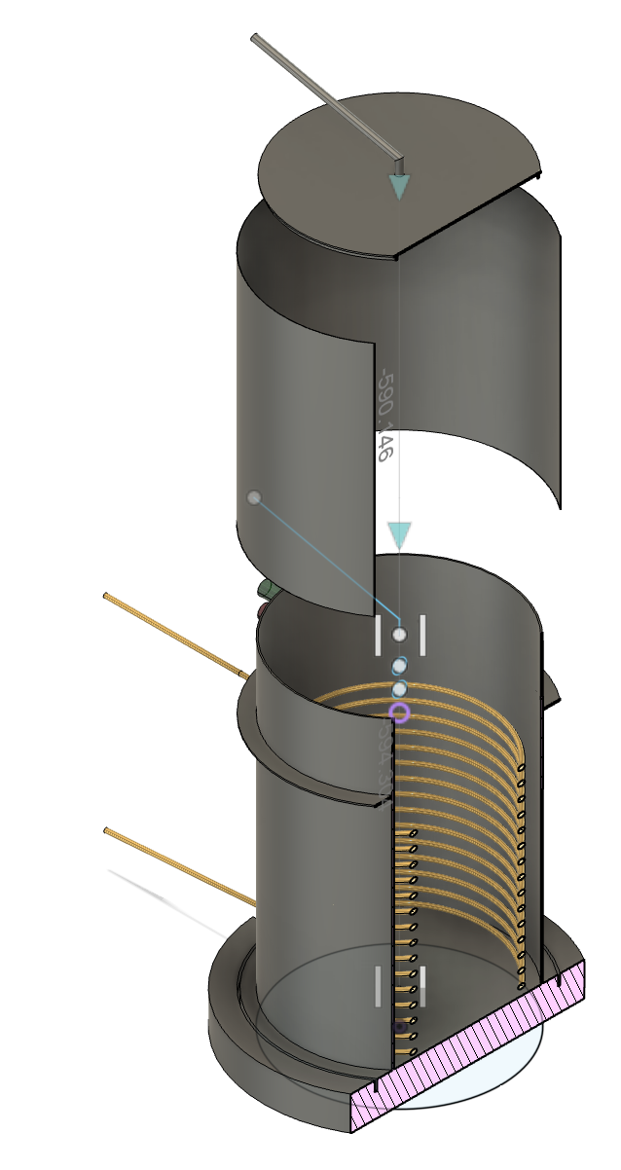
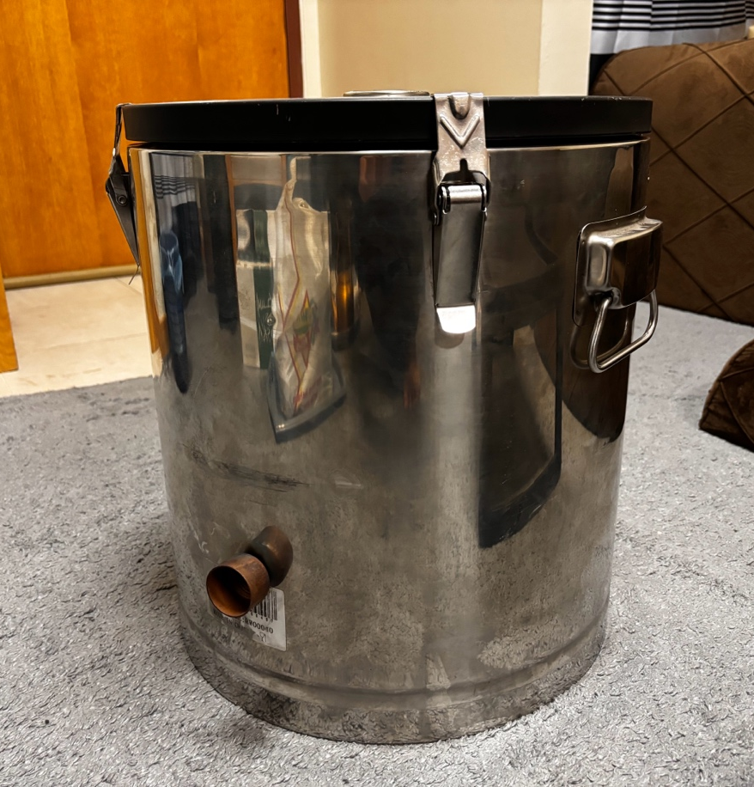

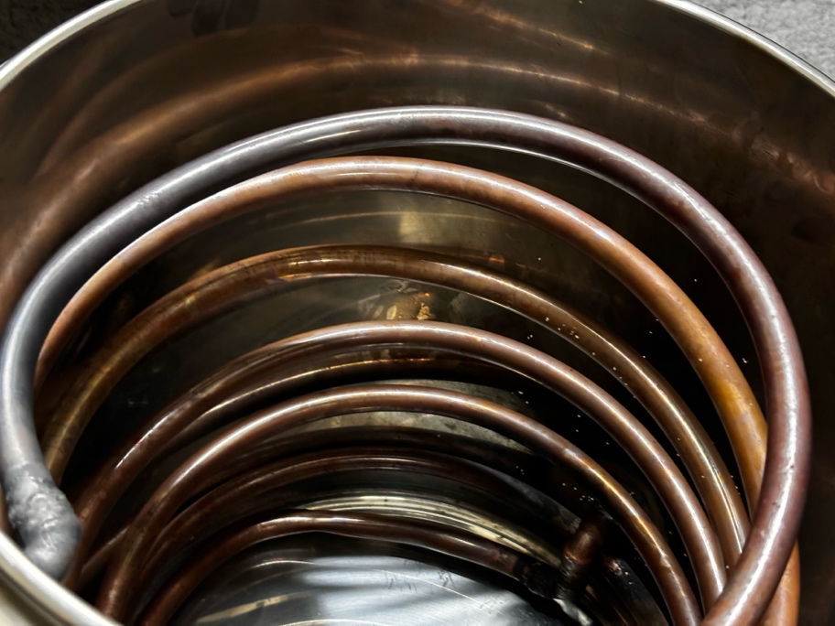

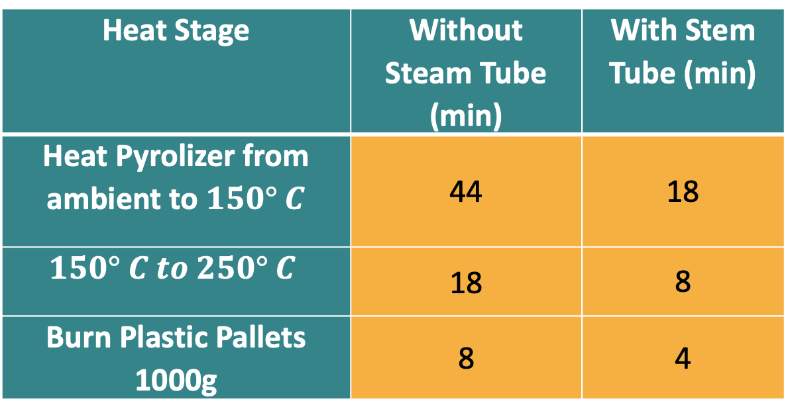
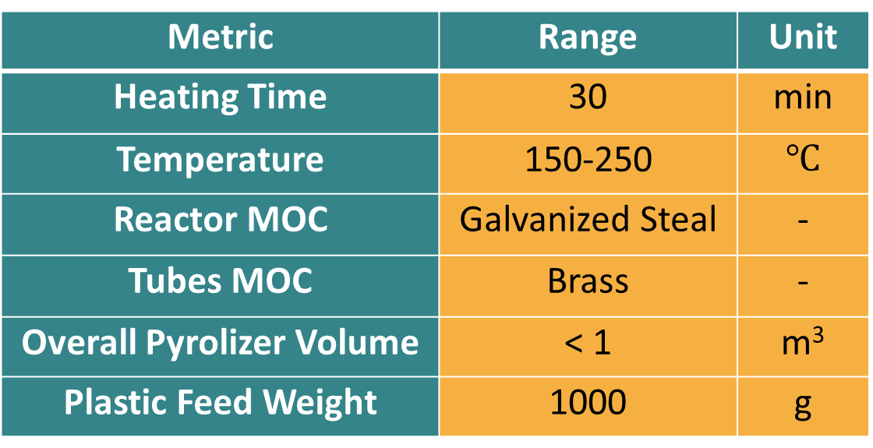
Transformative Pyrolysis: AI-Enhanced Process
TEAM: 34
Abdulrahman Alanazi (ISE) Salman Alharbi (CHE)
Awadh Alrashdi (CHE) Mohammed Ashy (ME)
Salem Balharith (CS)
PROBLEM STATEMENT
Aspen HYSIS Simulation
AI Model
The accumulation of off-grade plastics poses significant environmental and economic challenges due to inadequate recycling methods. Pyrolysis offers a promising solution for converting these plastics into high-value chemicals. Integrating artificial intelligence (AI) into this process could improve operational efficiency, safety, and environmental performance.
CONSTRAINTS
PROTOTYPE DESIGN
PROJECT VALIDATION
CO₂ emissions< 0.2 Kg CO₂ / Kg Feed .
Hot Steam Tube will act as convection heater to pyrolizer wall.
Heat Stage | Without Steam Tube (min) | With Stem Tube (min)
Heat Pyrolizer from ambient to $150° C$ | 44 | 18
$$150° C to 250° C$$ | 18 | 8
Burn Plastic Pallets 1000g | 8 | 4
Handling Different plastics without substantial change on the process
AI model must read the data from the reactor
TARGET SPECIFICATIONS
CONCLUSION
Metric | Range | Unit
Heating Time | 30 | min
Temperature | 150-250 | $$℃$$
Reactor MOC | Galvanized Steal | -
Tubes MOC | Brass | -
Overall Pyrolizer Volume | < 1 | m³
Plastic Feed Weight | 1000 | g
In order to dramatically shift the waste management of the petrochemical industry, the AI-enhanced pyrolysis project uses Aspen HYSYS simulation. Through turning plastic waste into useful products such as oil and syngas, the environment is protected, green-house gases emissions are reduced, and the cycle economy encouraged. From the economical aspect, the project reduces operating expenses, increases revenues, and corresponds to requirements of green financing. On the social aspect, it calls for enhanced public health, creation of jobs and mainly embraces the environment. This innovative way leads to cleaner, more efficient and ultimately sustainable future for industries and societies.
Reach maximum initial temperature (150 Celsius) without the use of combustion
Reduce CO2 emission sense no burning in the beginning

