Slide 1
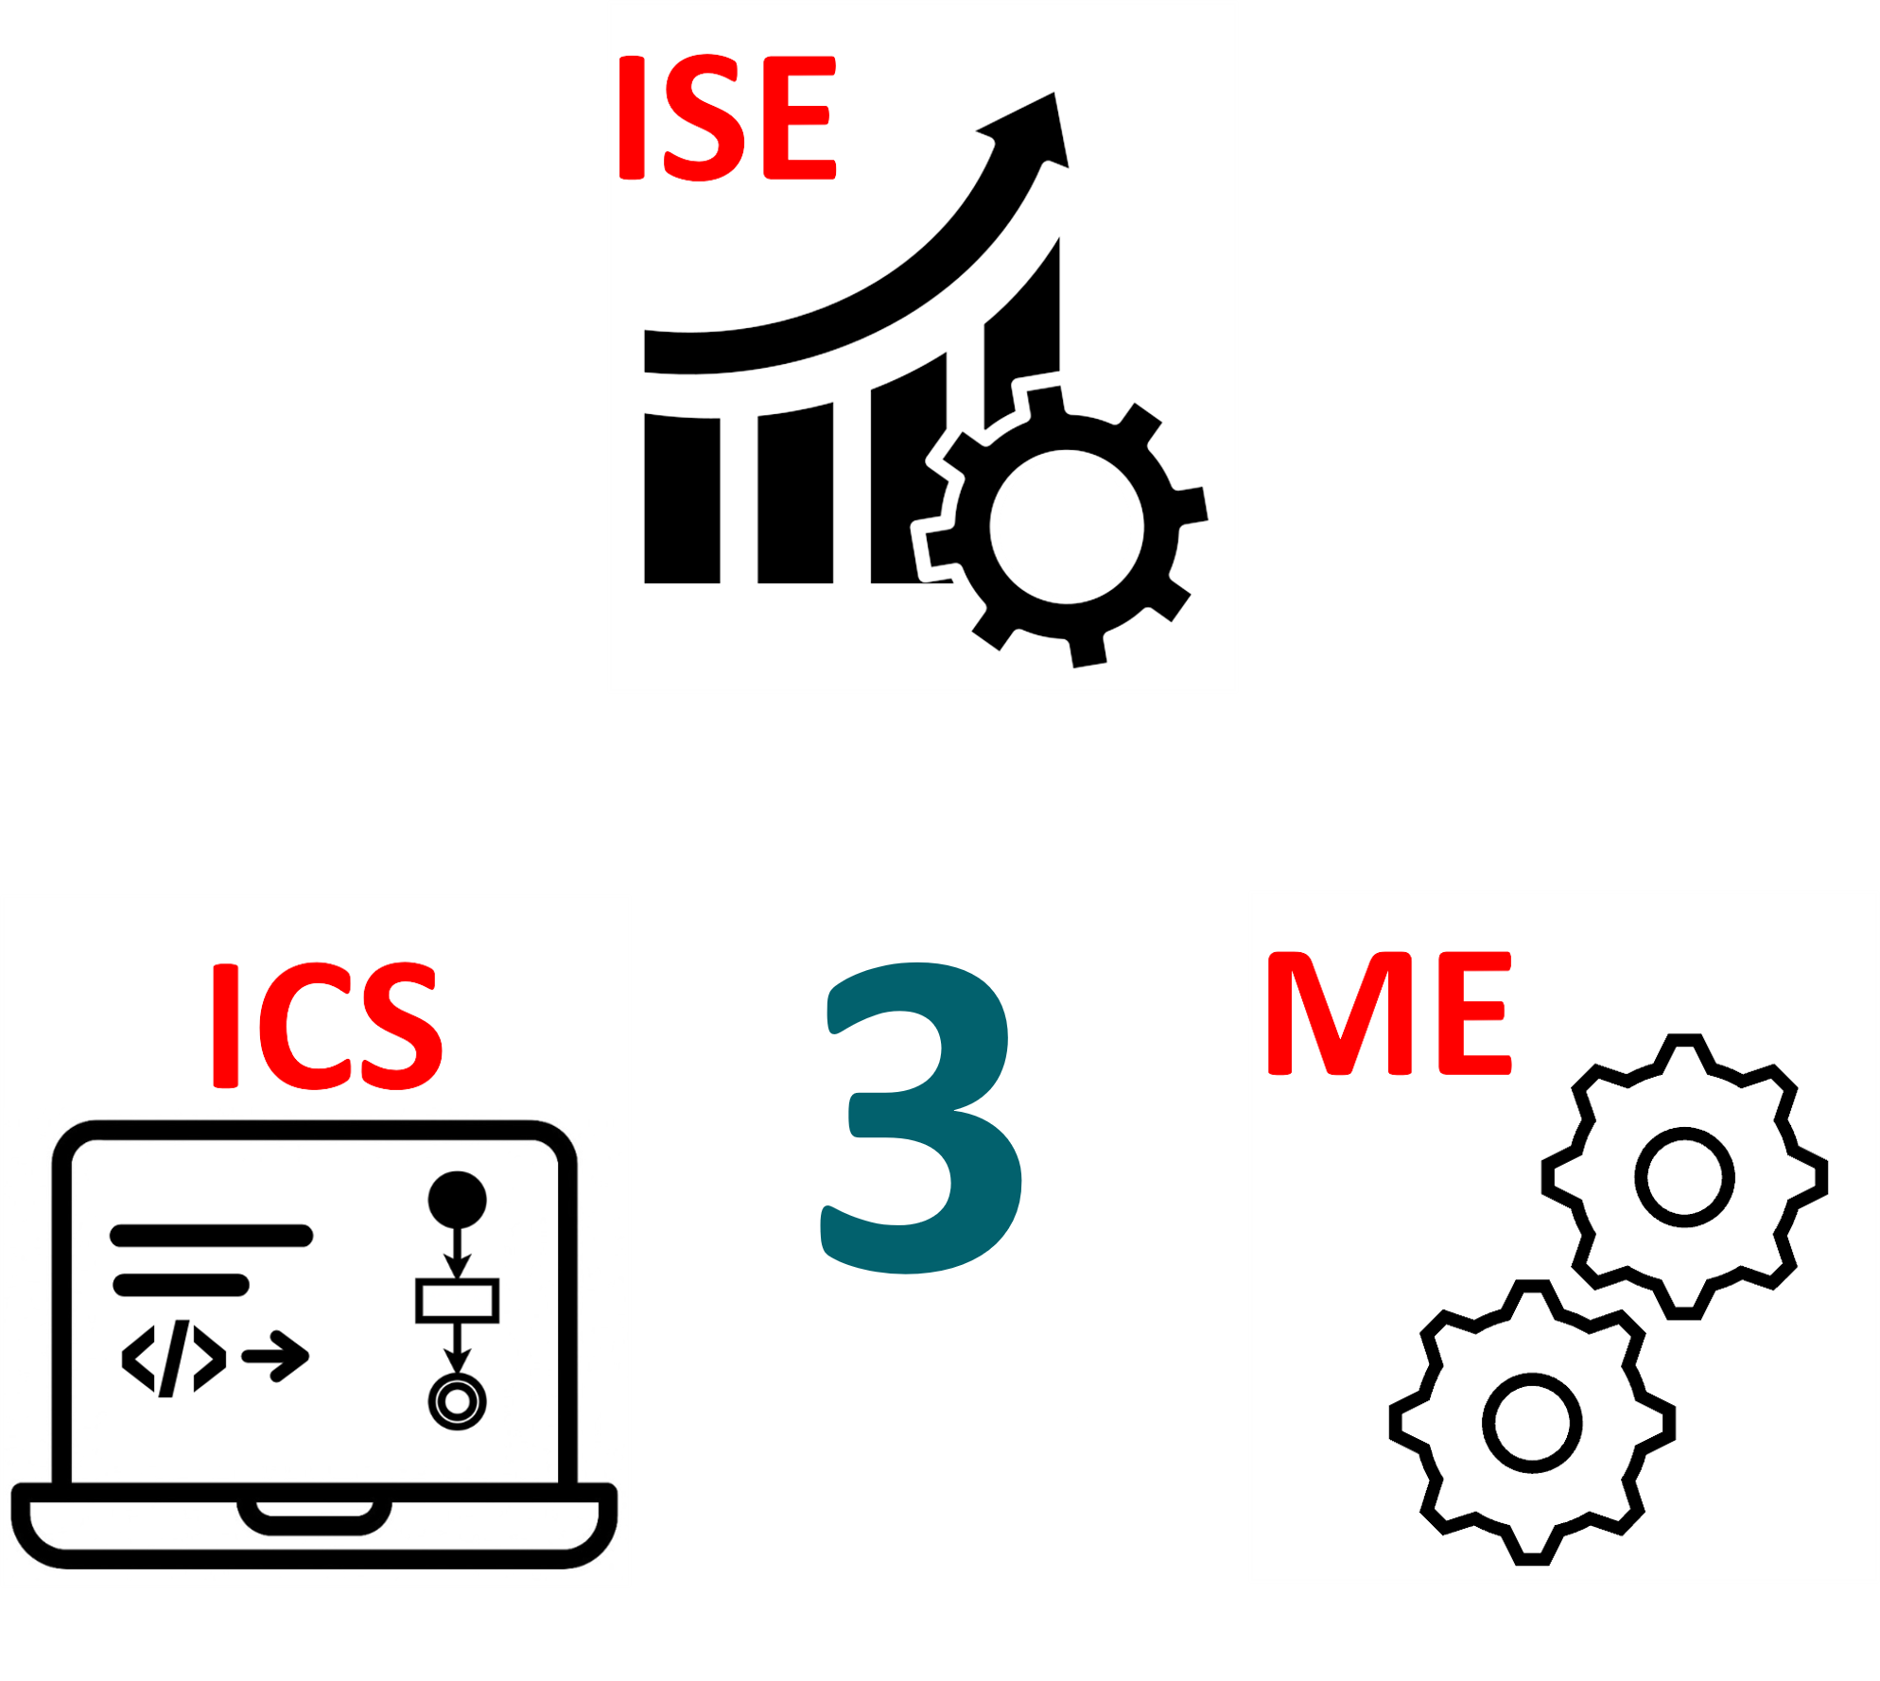
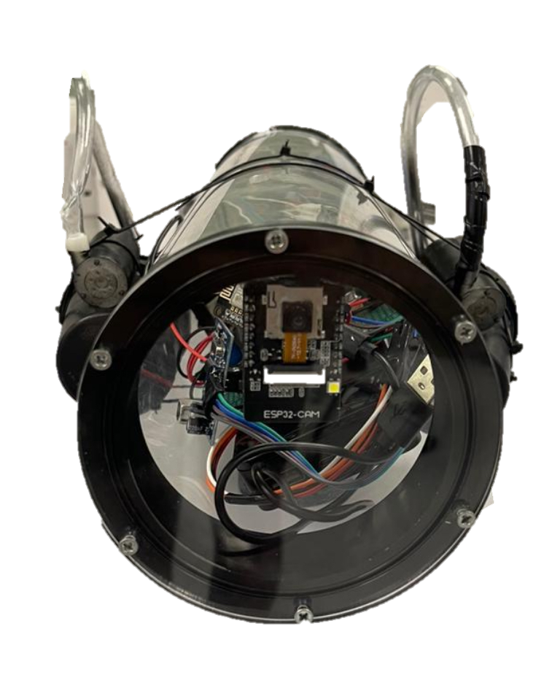
TEAM
003
Corrosion Monitoring Device
Hussain Alshabrami, Abdulaziz Altamimi, Mohammed Alzahrani, Abdullah Alqahtani, Abdulrahman Almuhanna, Nawaf Alzamil
Coach: Ismail Almaraj
Introduction & background
Specifications:
Testing - validation
Cost Analysis
Introduction:
This project introduces a remotely operated underwater device designed to inspect water tanks and detect corrosion and wear. It uses sensors and a camera with AI analysis to provide real-time monitoring, reducing cost and improving safety.
Maximum pressure: maintain at least 250 Kpa underwater pressure
System Dashboard: real-time dashboard should update environmental signals every 4 seconds
Dimensions: The device should not exceed 0.7m in length and 0.4m in diameter
Inspection: device cannot have more than 2 samples with a 1m diameter
Propulsion system: optimized fans for minimal drag force and high thrust and max speed of 3 m/s
Prototype Validation: Withstood high kPa at 10 m depth.
Propulsion: Delivered 50N thrust, 1 m/s speed.
AI Detection: 91% accuracy, 130 ms/image on 50 images.
Sensors: 1800+ packets in 1 hr,
0% loss.
Buoyancy: Pumps adjusted depth in 10 s.
System: 150 ms API latency, 4 s dashboard refresh.
Safety: Passed leak, pressure, retrieval tests.
Specs Met: ~90% achieved, minor cost overrun.
Problem statement:
  Inspecting underwater structures is challenging, risky, and costly using traditional methods. These manual approaches lack real-time feedback, require high manpower, and often miss early signs of corrosion. A safer, faster, and smarter solution is needed to improve inspection accuracy and reduce operational costs.
Constraints:
Conclusion
The Corrosion Monitoring Submarine Device (CMD) is an innovative solution
for underwater tank inspections,
integrating advanced sensors, AI-based corrosion detection, and a robust
propulsion system. Designed for deep-
water operation, it ensures precise navigation and real-time environmental monitoring while withstanding high pressures. By reducing manpower and inspection costs, the CMD enhances safety and efficiency for
industries like oil and gas. Future enhancements will focus on deeper water capabilities, improved AI accuracy, and enhanced autonomy, making it a versatile tool for underwater exploration and maintenance.
Prototype design
Data logging: The system must log data for analysis while maintaining secure storage to prevent data loss.
Weight: The weight of the submarine will be around 4.5 kg.
Samples: Number of samples do not exceed 2 samples in each area.
"Frame Design : Frame that is resistant to wear and corrosion and waterproofed

