Slide 1

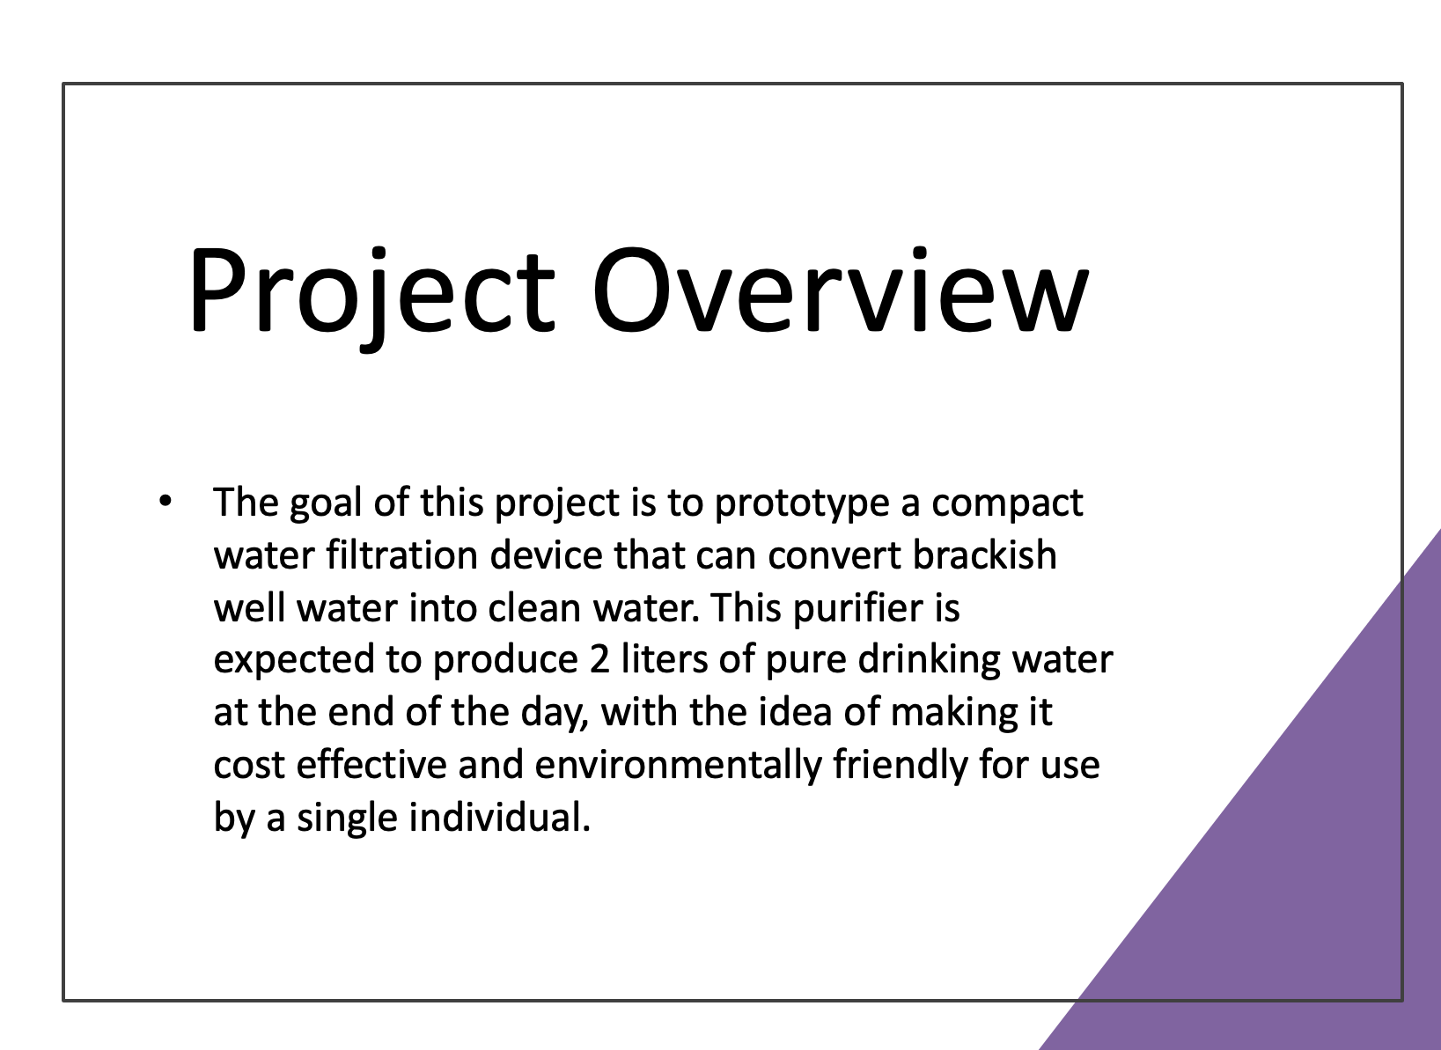
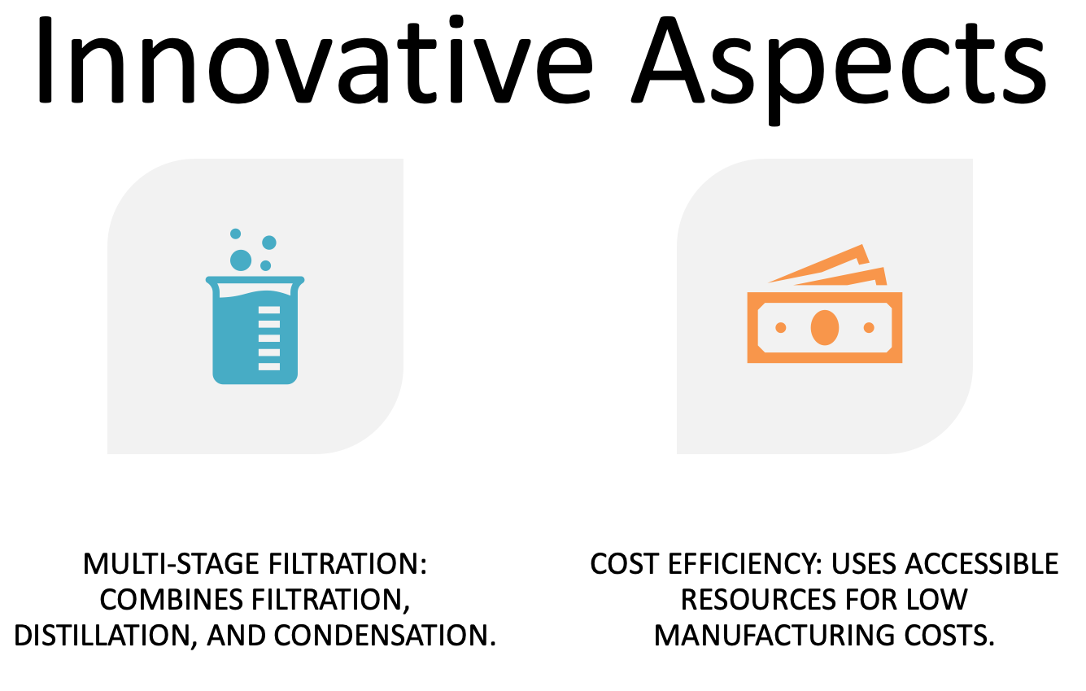
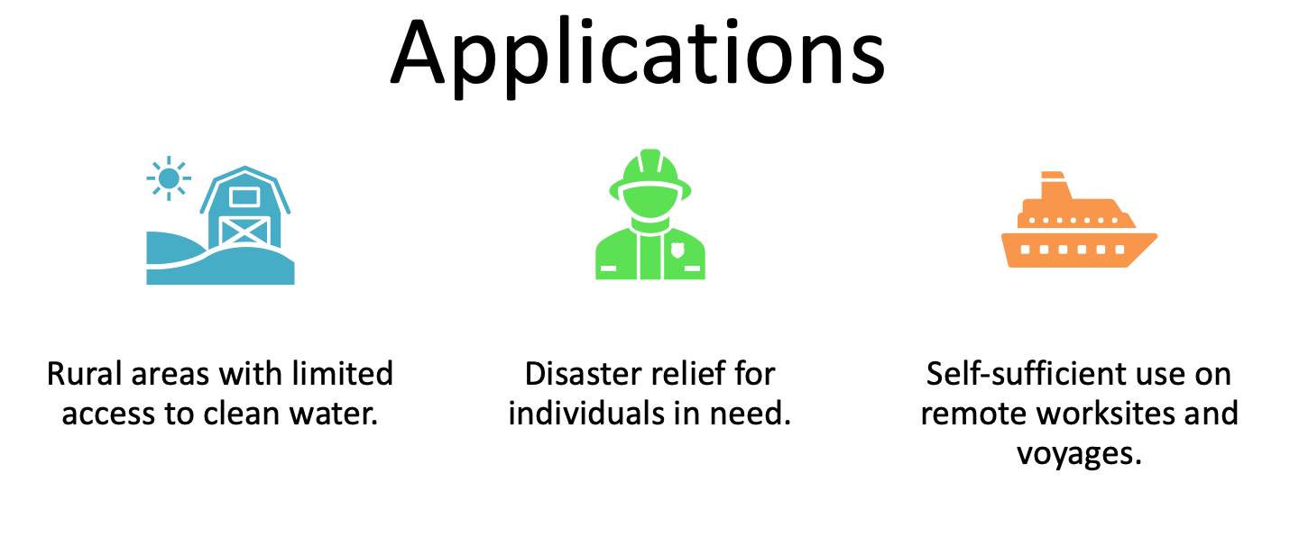
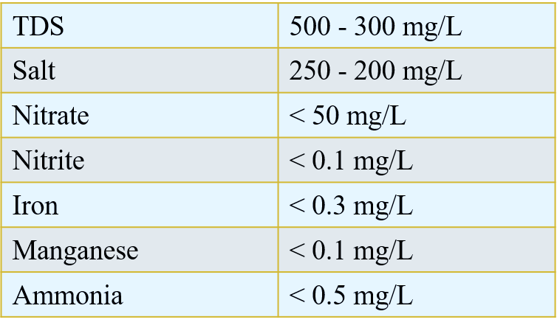
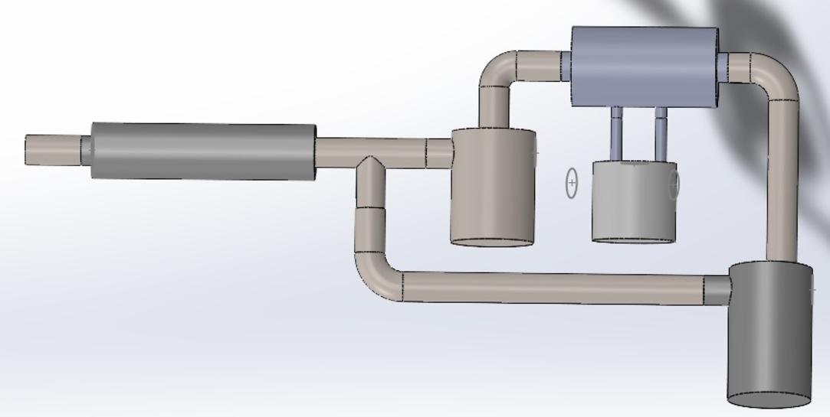
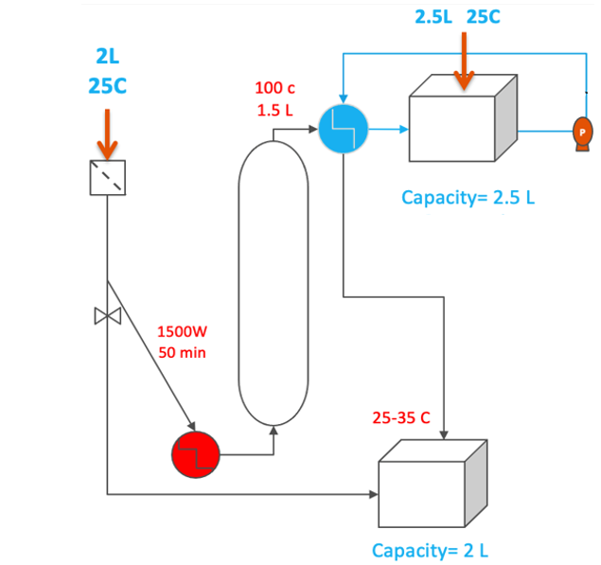
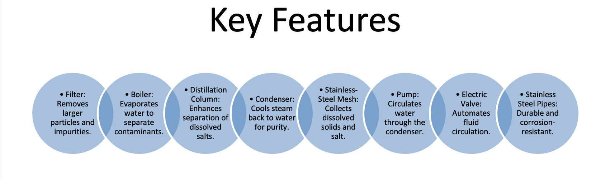
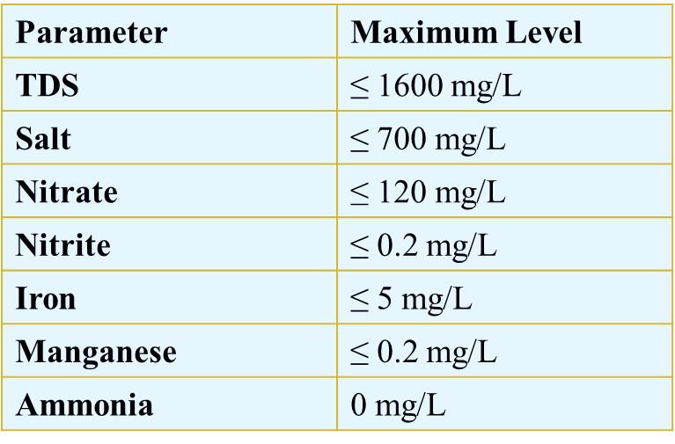
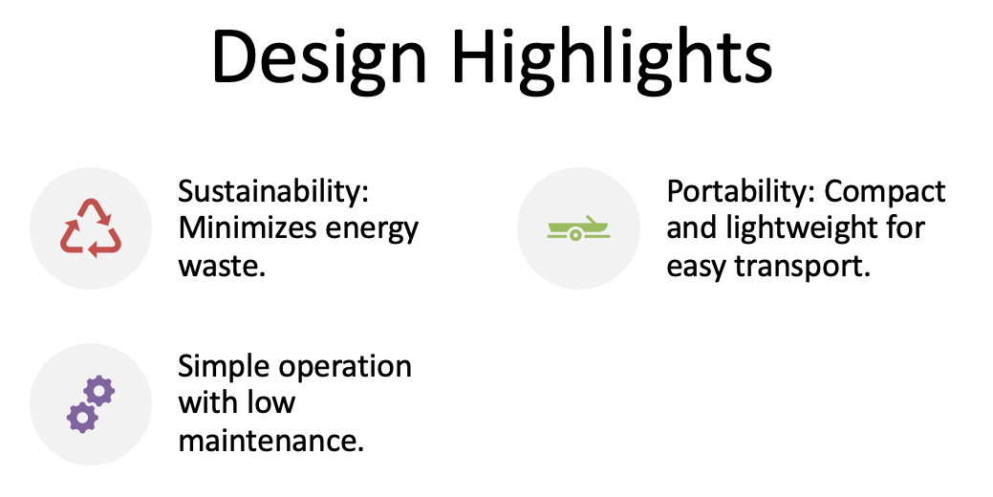
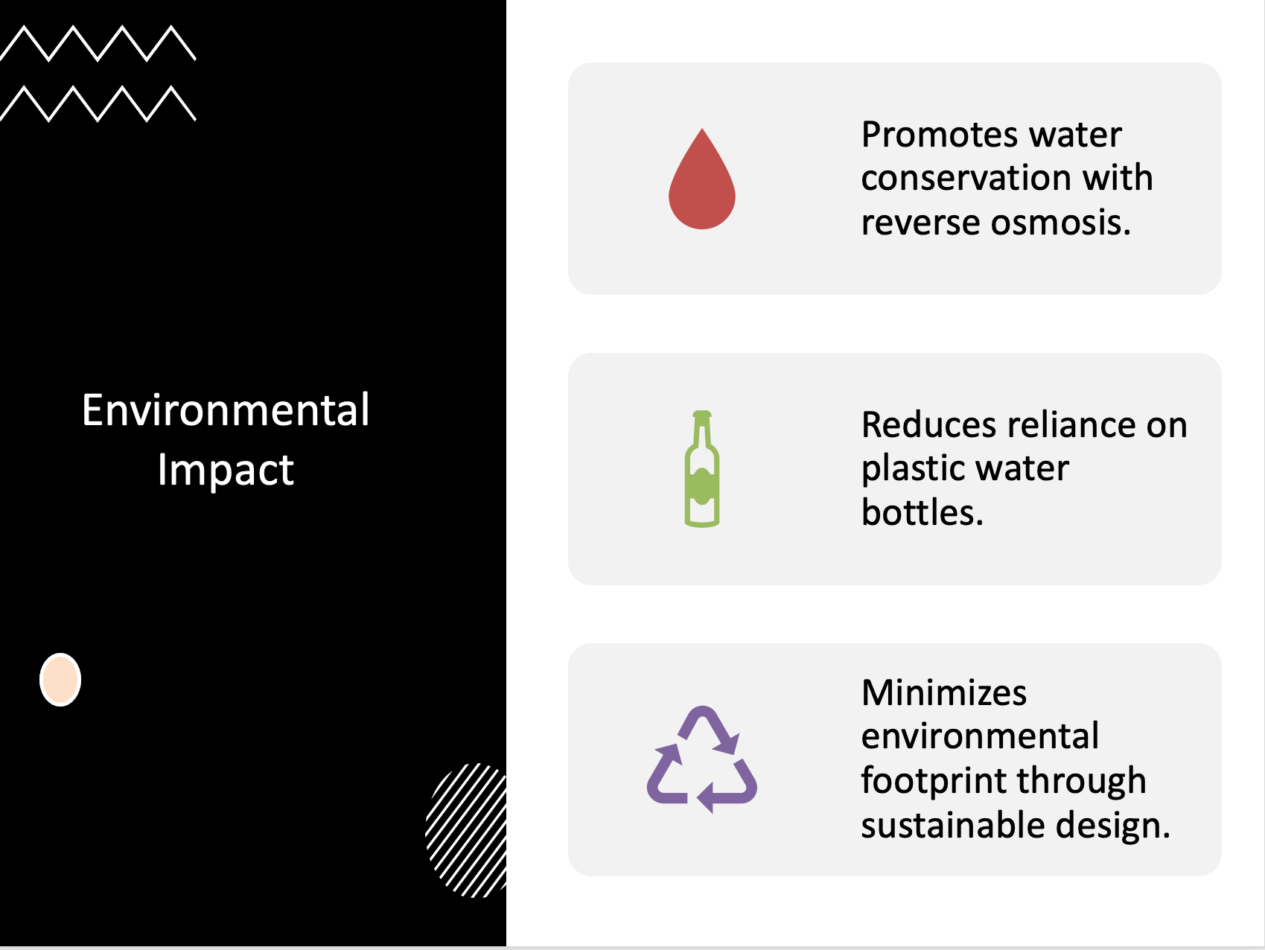
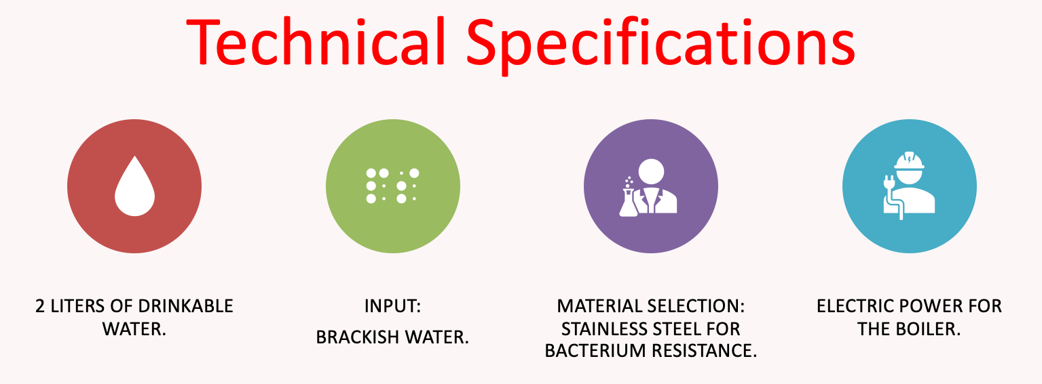
Team : 27
Abdullah Hassan
Abdullah Alzahrani
Ibrahim alobaid
Saud alotaibi
Portable Water Filtration Device
Multidisciplinary and Individual Responsibilities
Mechanical Engineering
The specifications of the pipes that include diameter and depth
The Sizes of the containers
Chemical Engineering
Sampling water from different sites
Industrial Engineering
Control the quality and the flow of the water
The filtration processing
The overall design of the portable water filtration
Choosing the best power supply
Test it before we process it and after it
Select the best type of heat exchanger
Generating the design of the experiment
Arranging the plan of the process
Validation and Verification

