Slide 1


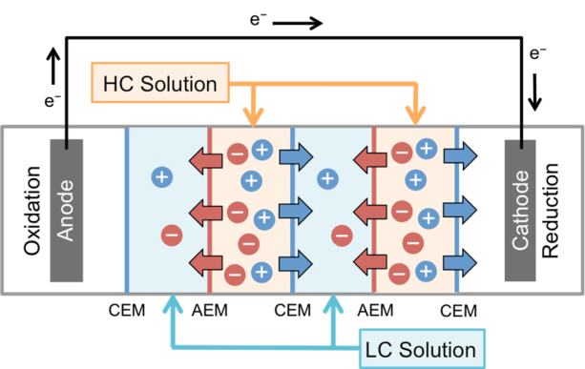
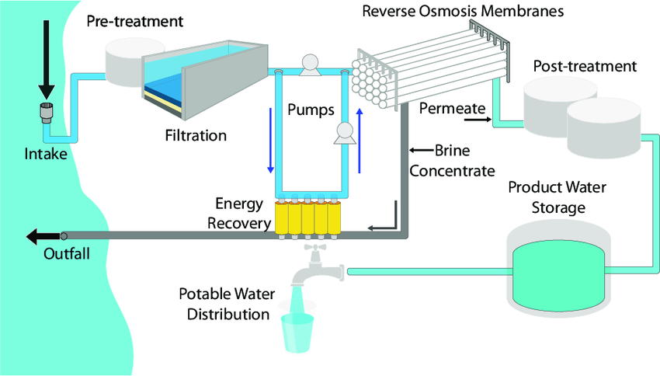
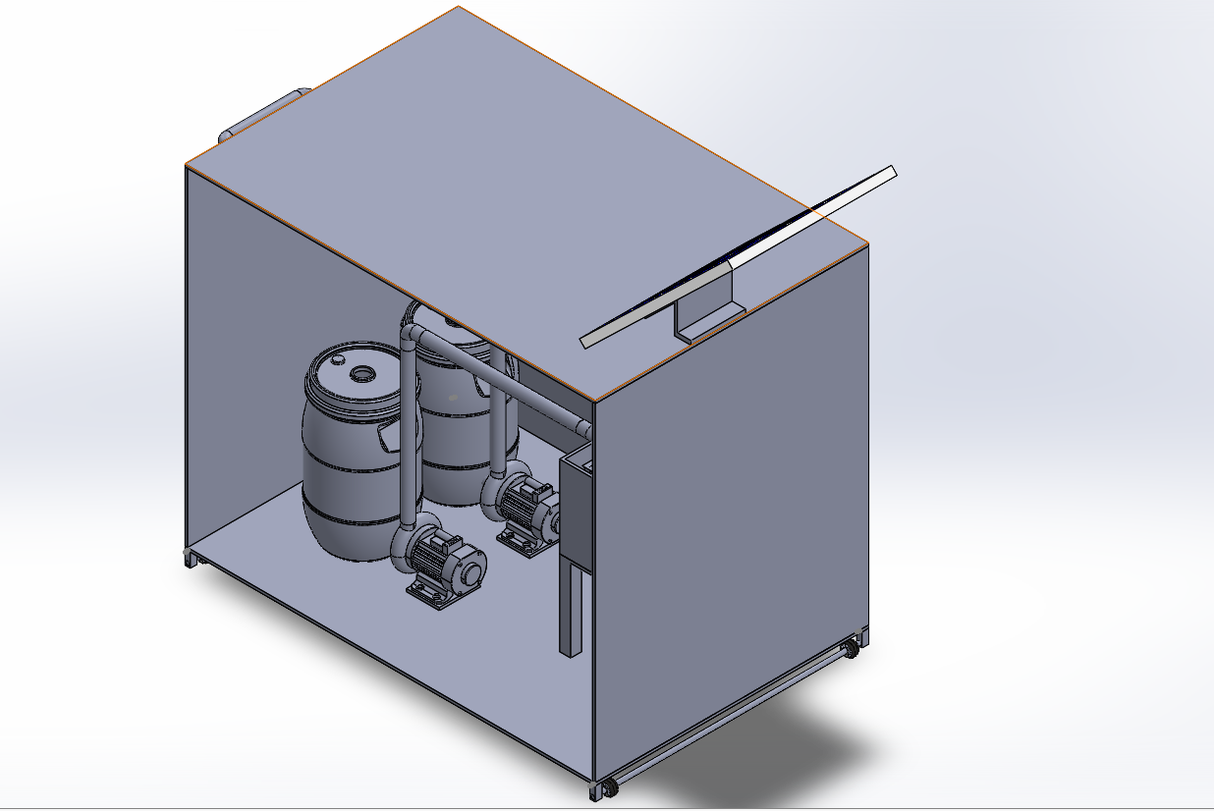
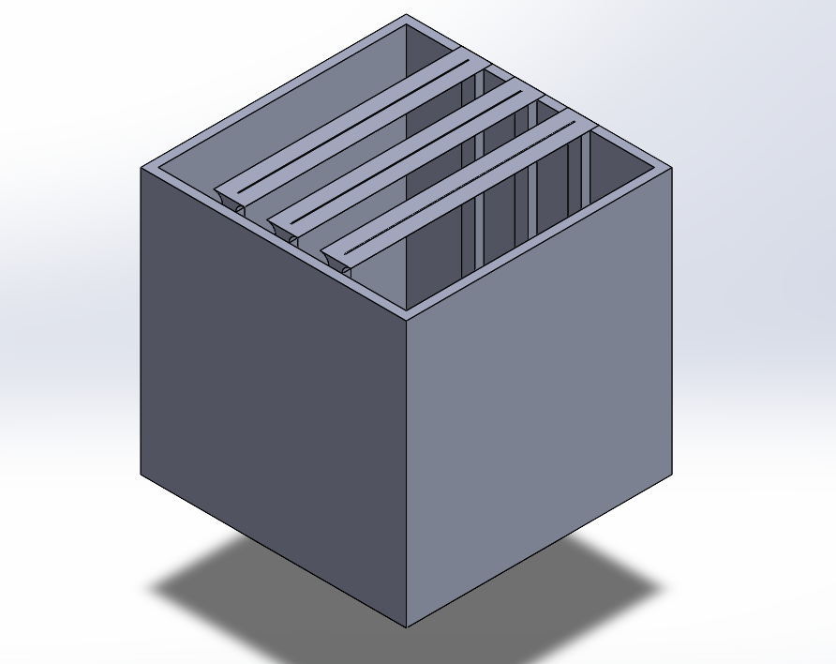
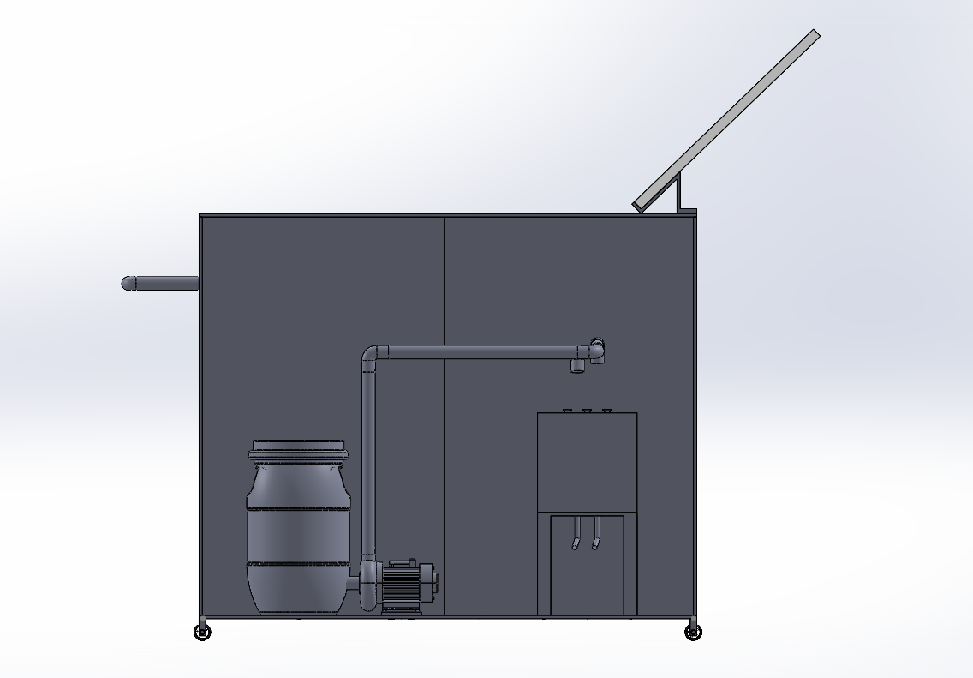
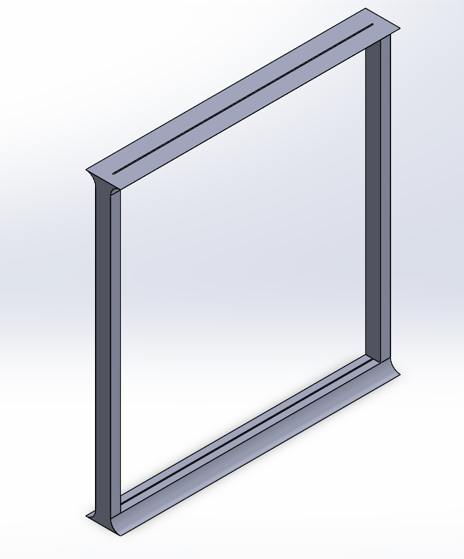
Generate electricity through water desalination fuel cells
TEAM 25
Osama Alghamdi (CHE) - Abdulrazag Alanazi (CHE) - Hamoud Almutairi (ME) - Mohammed Aldayl (AE) - Ahmed Bugshan (EE)
King Fahd University of Petroleum & Minerals - KFUPM
Introduction
Prototype Design
Conclusions
Saudi Arabia's Vision 2030 aims to enhancing energy sustainability and reducing carbon emissions for a greener future. Aligning with this vision, this project harnesses saline wastewater from desalination plants to generate electricity through Reverse Electrodialysis (RED) technology. By transforming waste into a clean and renewable energy resource, offering an innovative step toward sustainable energy solutions.
In conclusion, the project has achieved its objectives through an innovative solution that utilizes Reverse Electrodialysis (RED) technology to generate electricity from saline wastewater produced by desalination plants. By transforming a by-product into a valuable energy resource, this project demonstrates a sustainable and energy-efficient approach, aligning with global goals for renewable energy and environmental preservation.
Problem Statement
Testing and Validation
Desalination plants require significant energy and produce saline wastewater as by-product. This project leverages the salinity gradient in wastewater to generate electricity using RED technology, providing a cleaner and more energy-efficient solution for environmentally friendly and sustainable desalination.
3D printing of the membrane's holders were exactly designed at 400 cm².
Corrosion resistance materials were used to resist corrosion due to salt.
Flow rate manipulation techniques used to adjust flowrate.
Standard sizing and materials used to meet budget limitation.
Constraints
Material corrosion resistance ≥ 18 mm/year.
Salinity gradient ≥ 30 ppt.
Budget limitation ≤ 6000 SAR.
Electricity production fluctuation, dC ≠ 0
Run | Output, W | Deviation
1 | 0.89 | 11%
2 | 0.92 | 8%
3 | 0.9 | 10%
Target Specifications
Surface area of interaction of 400 cm².
0.5 L/min flow rate.
Power generated 1 W.
Process tank capacity 10L.

