Slide 1


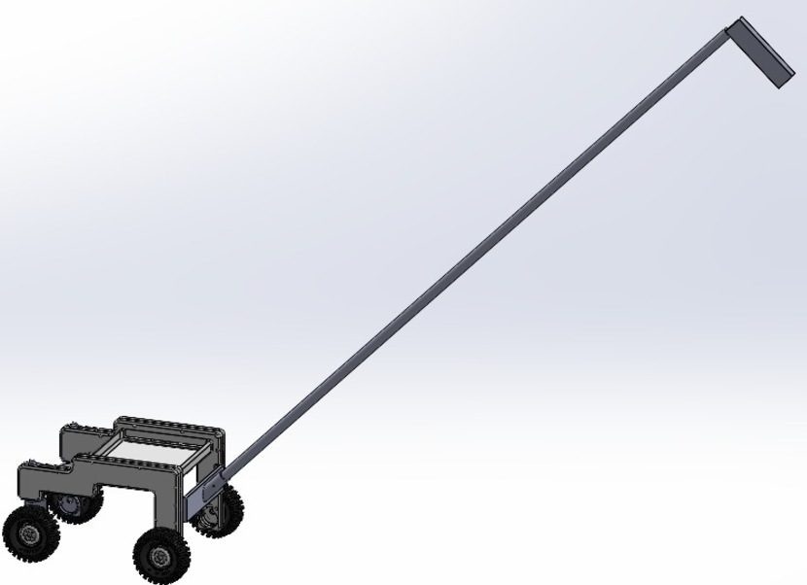
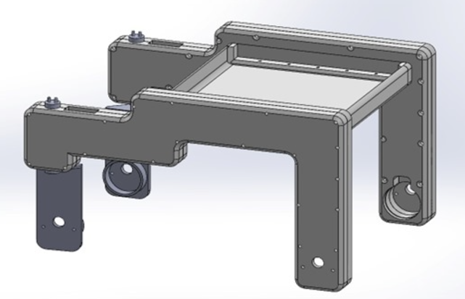
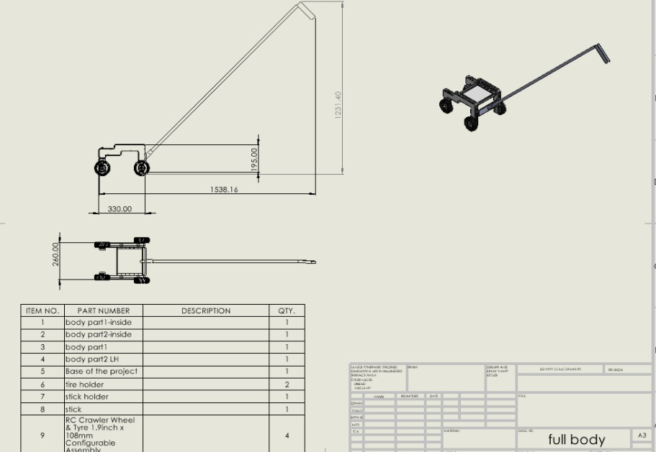
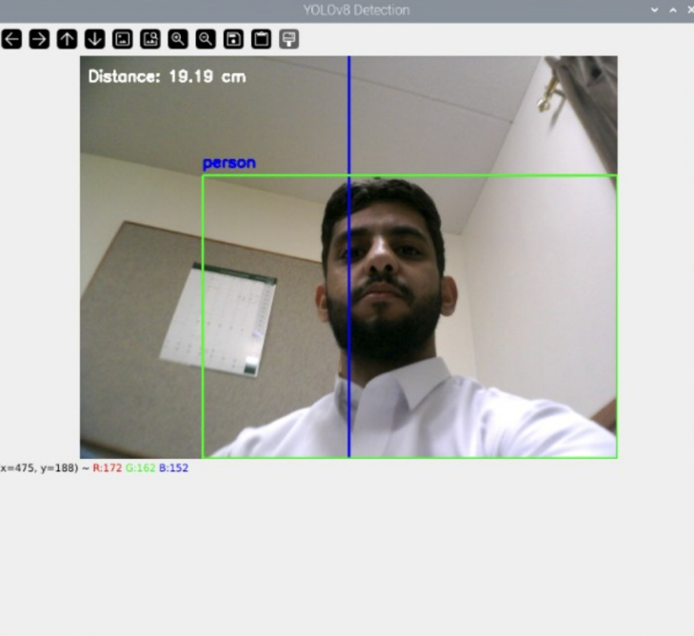
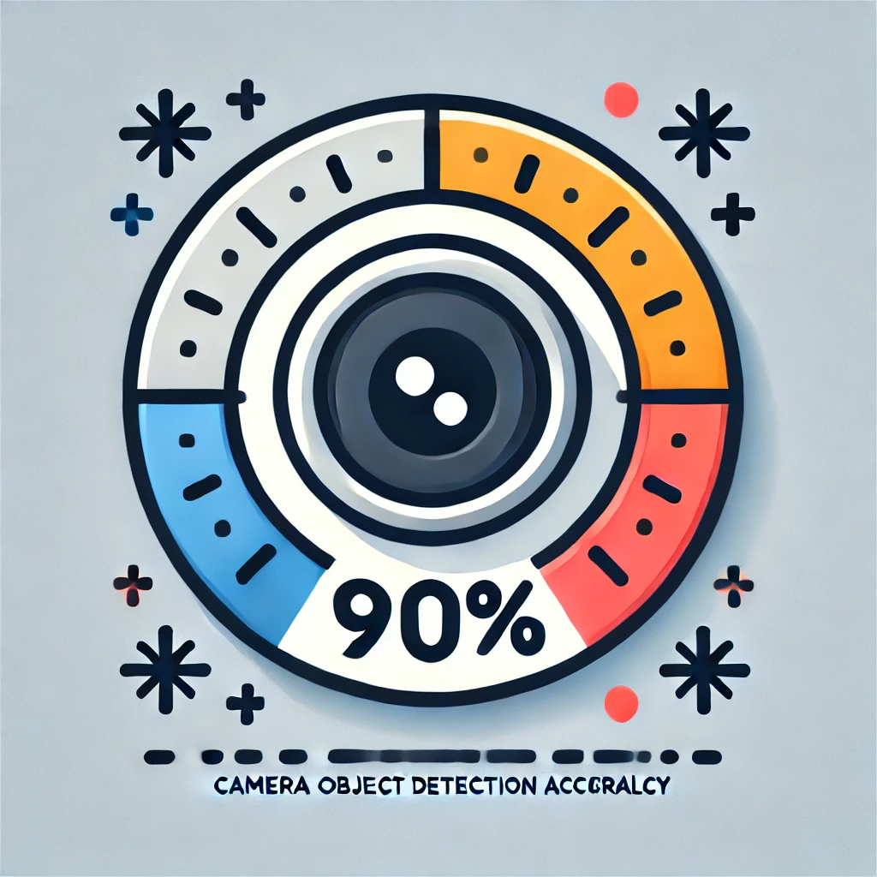
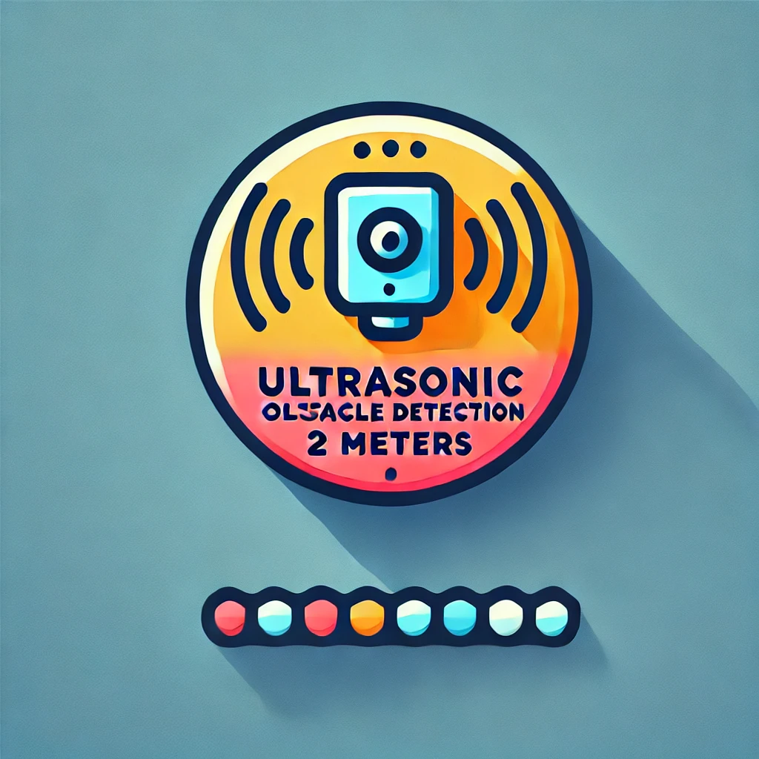
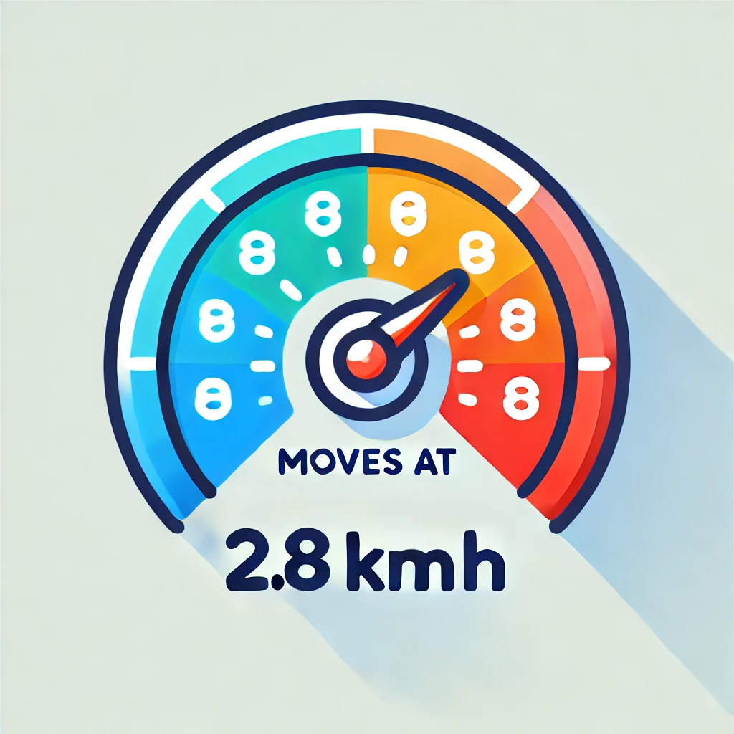



Smart Blind Guider
Omar Alraies Abdulrahman Al Qahtani Osamah Alhamdan Malik Alharbi Abdulkarim Alhussaini
ME ME CS EE ISE
201955790 201955230 201971070 201930430 201949190
Introduction
Prototype
Validation
The Smart Blind Guider enhances mobility for visually impaired individuals by integrating AI, sensors, GPS, and audio feedback. It detects obstacles in real-time, providing safe and ergonomic navigation.
accuracy of the camera object detection >90% .
Ultrasonic for obstacle detection, range up to 2 meters.
battery with 3.5-hour runtime.
Moves at speed of 2.8 km/h.
Problem Statement
Visually impaired individuals face challenges in navigating independently due to limited effective assistive tools. A smarter, safer, and more user-friendly solution is essential.
Project Impact
Economic.
Social
Global.
Environmental.
Constrains
Camera Detection
Cost <=4000​​
Camera should detect objects in both various lighting conditions.
operate effectively in various weather conditions.
Conclusion
The Smart Blind Guider represents a transformative approach to assistive technology for the visually impaired. By leveraging advanced AI, sensor integration, and ergonomic design, the device empowers users to navigate independently and safely. This innovation not only improves the quality of life for individuals but also contributes to a more inclusive society, where mobility and autonomy are accessible to all.
Target Specifications

