Slide 1
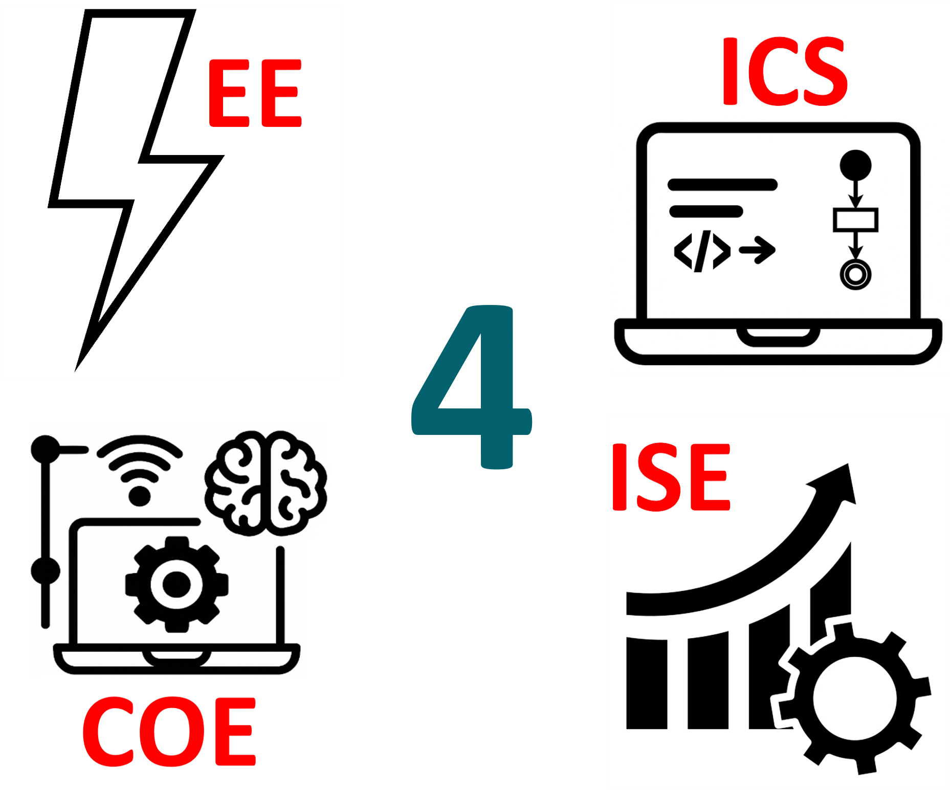
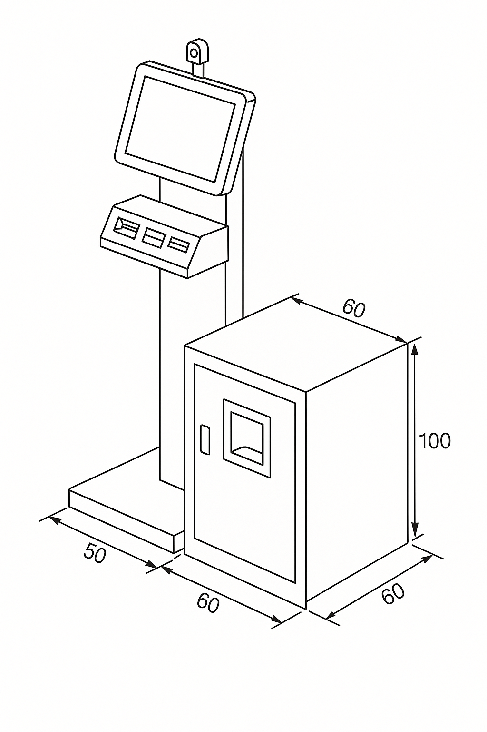
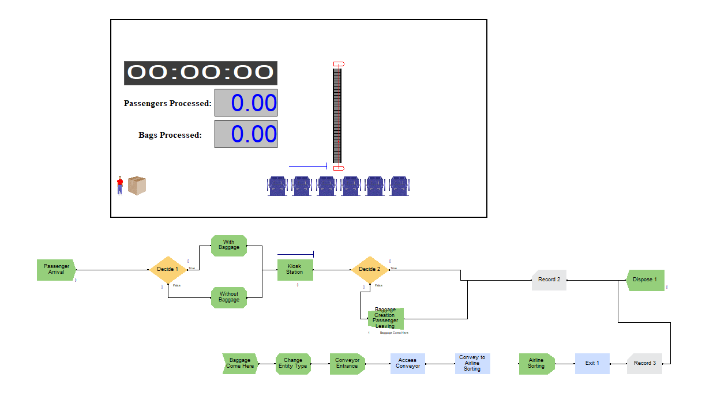

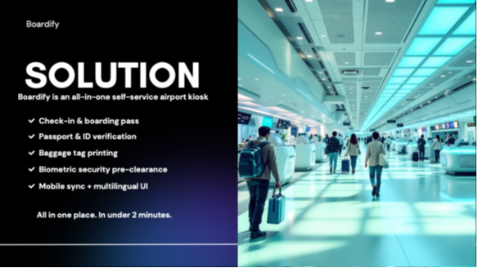
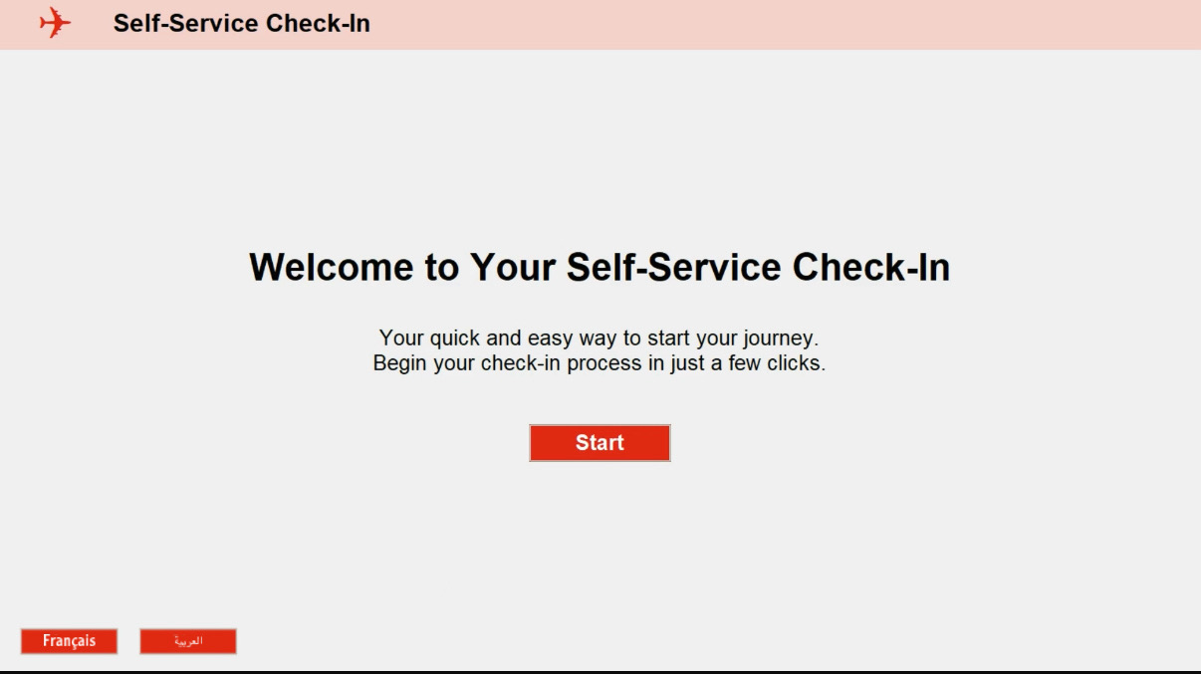
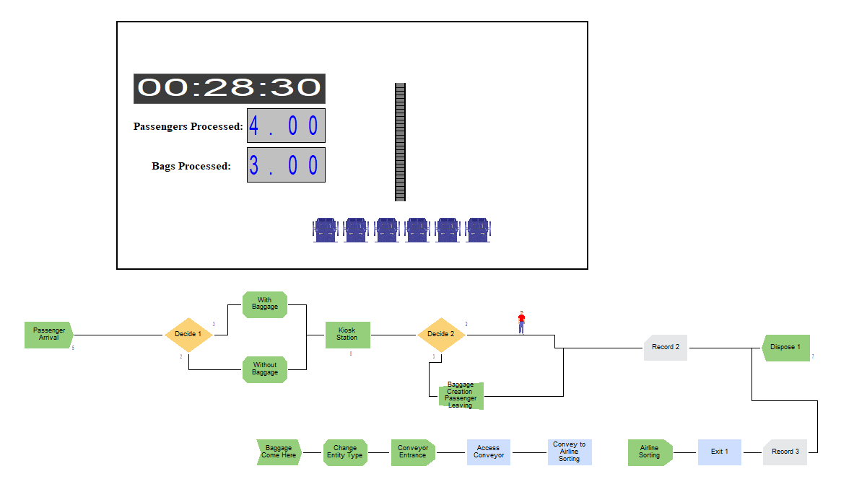
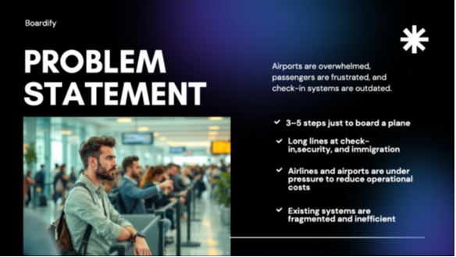
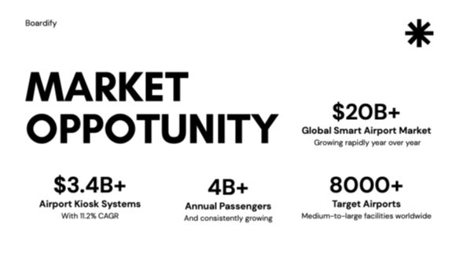
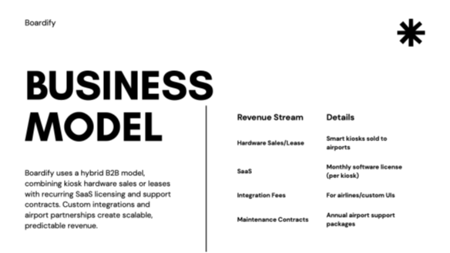

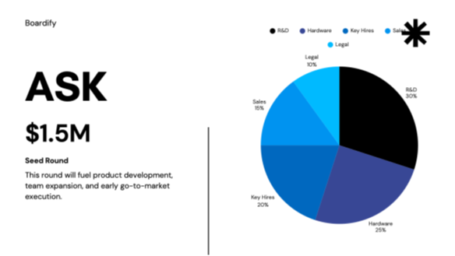

Team
02
Smart Airport Self-Check-In with Biometric Verification and Automated Baggage Handling
Bander Moafa | Yousef Alsayed | Mohammed Alshaye | Jehad Albulayhid | Dhafer Alzaher | Abdullah Aldeheman
Coach: Mr. Abdulmajeed Alothman
Overview
Validation & Verification
Prototype Development
Commercialization
This project presents a smart self-check-in kiosk designed to automate the passenger and baggage check-in process at airports. The system integrates facial recognition, passport scanning, ticket printing, baggage weighing, and tag generation—all within a compact, user-friendly unit. Through embedded control, sensor integration, and backend validation, the kiosk enhances both operational efficiency and passenger experience. A simulation and optimization model was developed to evaluate its impact on queue time and system throughput, ensuring the design is scalable and validated under real-world conditions.
The system was validated using ARENA simulation to model real passenger flow, kiosk usage, and baggage processing. Key metrics like wait time and utilization were optimized. A linear programming model was also used to determine the optimal number of kiosks under realistic constraints.
Boardify lets you check in for any airline in under four minutes—bags tagged, seat chosen, boarding pass printed—with no lines. Our all-in-one smart kiosk fuses AI queueing, real-time airline links, ±100 g baggage weighing, and a multilingual (Arabic/English/French), ADA-compliant interface. Airports save up to 30 % in staffing, airlines cut processing time 60 %, and our modular design makes future add-ons like biometrics plug-and-play.
Snapshots of Simulation
Pitch
Problem Statement
Traditional airport check-in counters are prone to long queues, manual bottlenecks, and operational inefficiencies—particularly during peak hours. Airlines like SAUDIA at King Khalid International Airport experience high passenger volume, where slow processing at check-in points leads to crowding and delays. There is a clear need for a self-service solution that automates passenger identification and baggage handling while reducing wait times and improving service throughput.
Objective
The objective of this project is to design and prototype a self-check-in kiosk that automates the check-in process—covering ID verification, ticket printing, baggage weighing, and tagging. The system is built to reduce check-in time, improve passenger flow during peak hours, and minimize manual intervention. It is supported by embedded control, biometric verification, and simulation-based validation to ensure efficiency and scalability in real-world airport environments.
Simulation Results
Prototype Result
Scenarios
# of Kiosks (c)
Arrival Rate
Avg. Wait Time
Max. Queue
Utilization
Existing systems lack seamless integration of biometric verification, baggage handling, and real-time validation.
Our prototype addresses this through a compact kiosk design and an intuitive app interface with multilingual, accessible features that enhance user experience and system efficiency.
Scenario A
4
200/hr
8.2
9
91%
Scenario B
5
200/hr
5.7
6
83%
Scenario C
6
200/hr
3.9
4
68%

