Slide 1
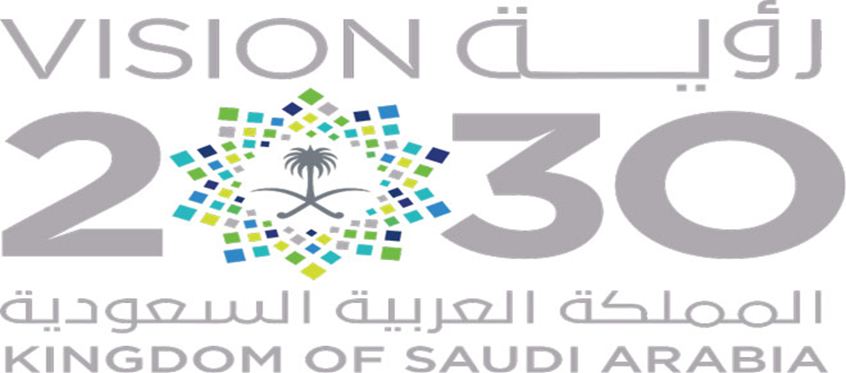


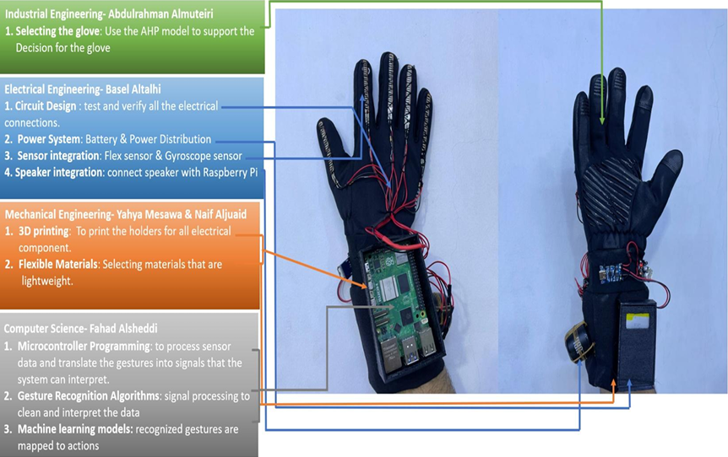
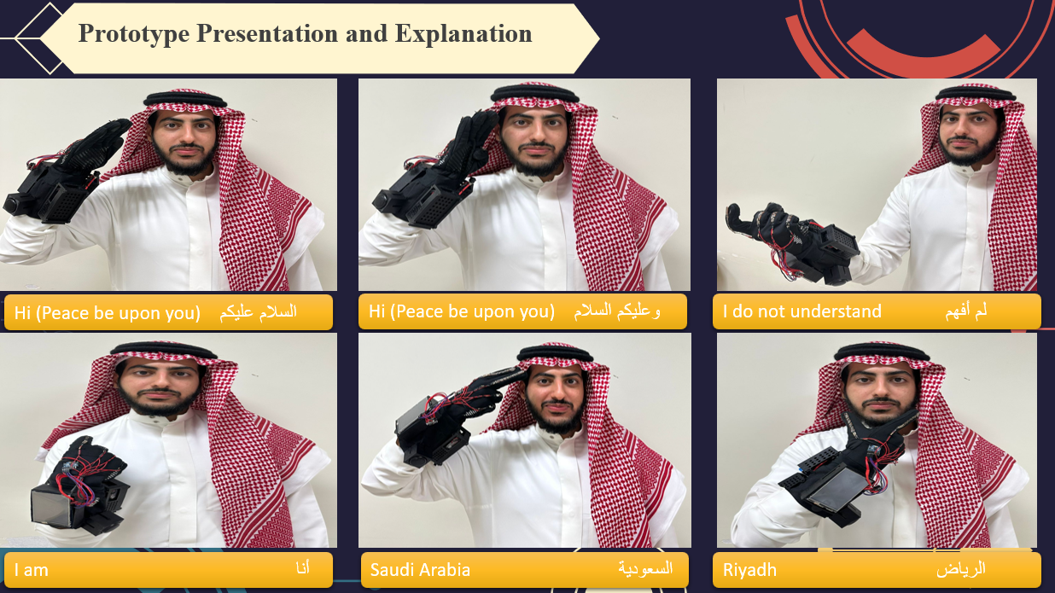
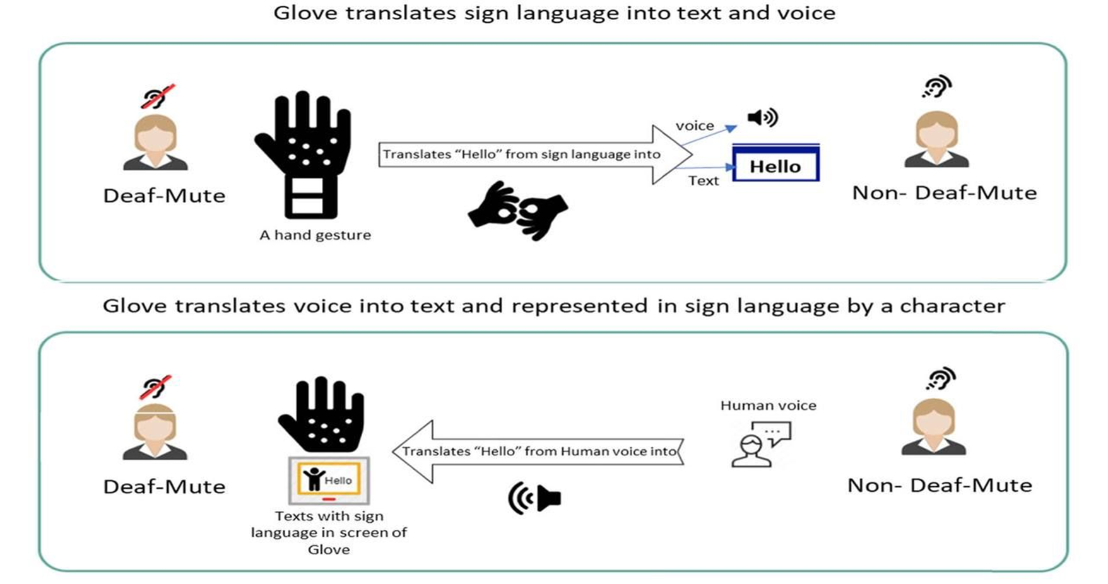
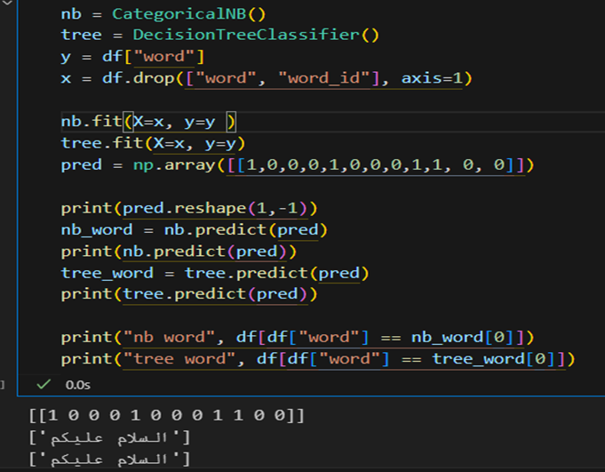
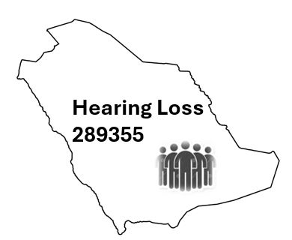
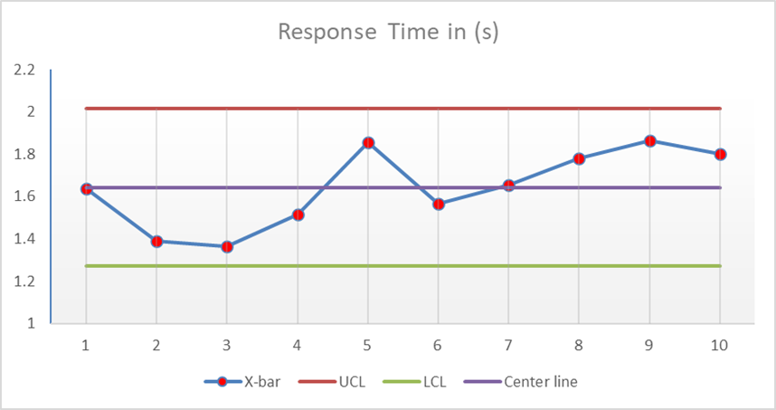
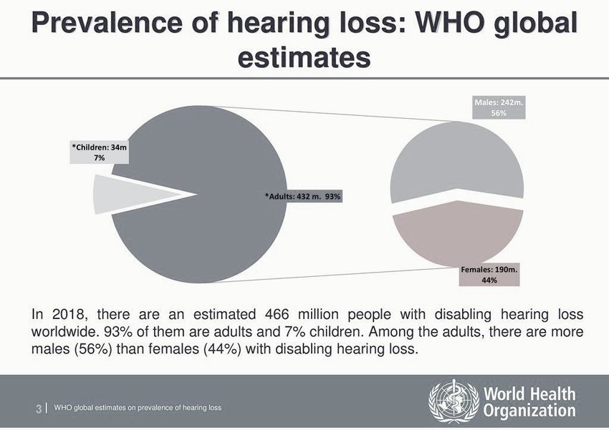
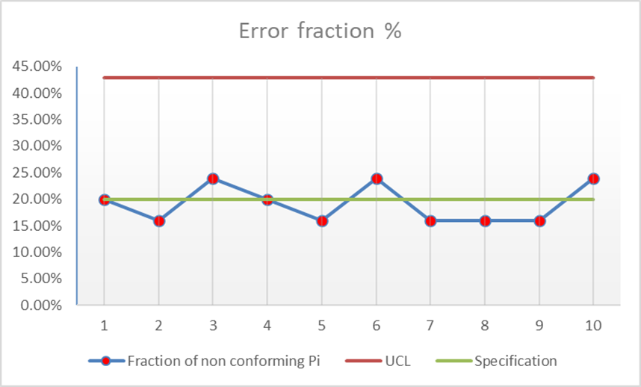
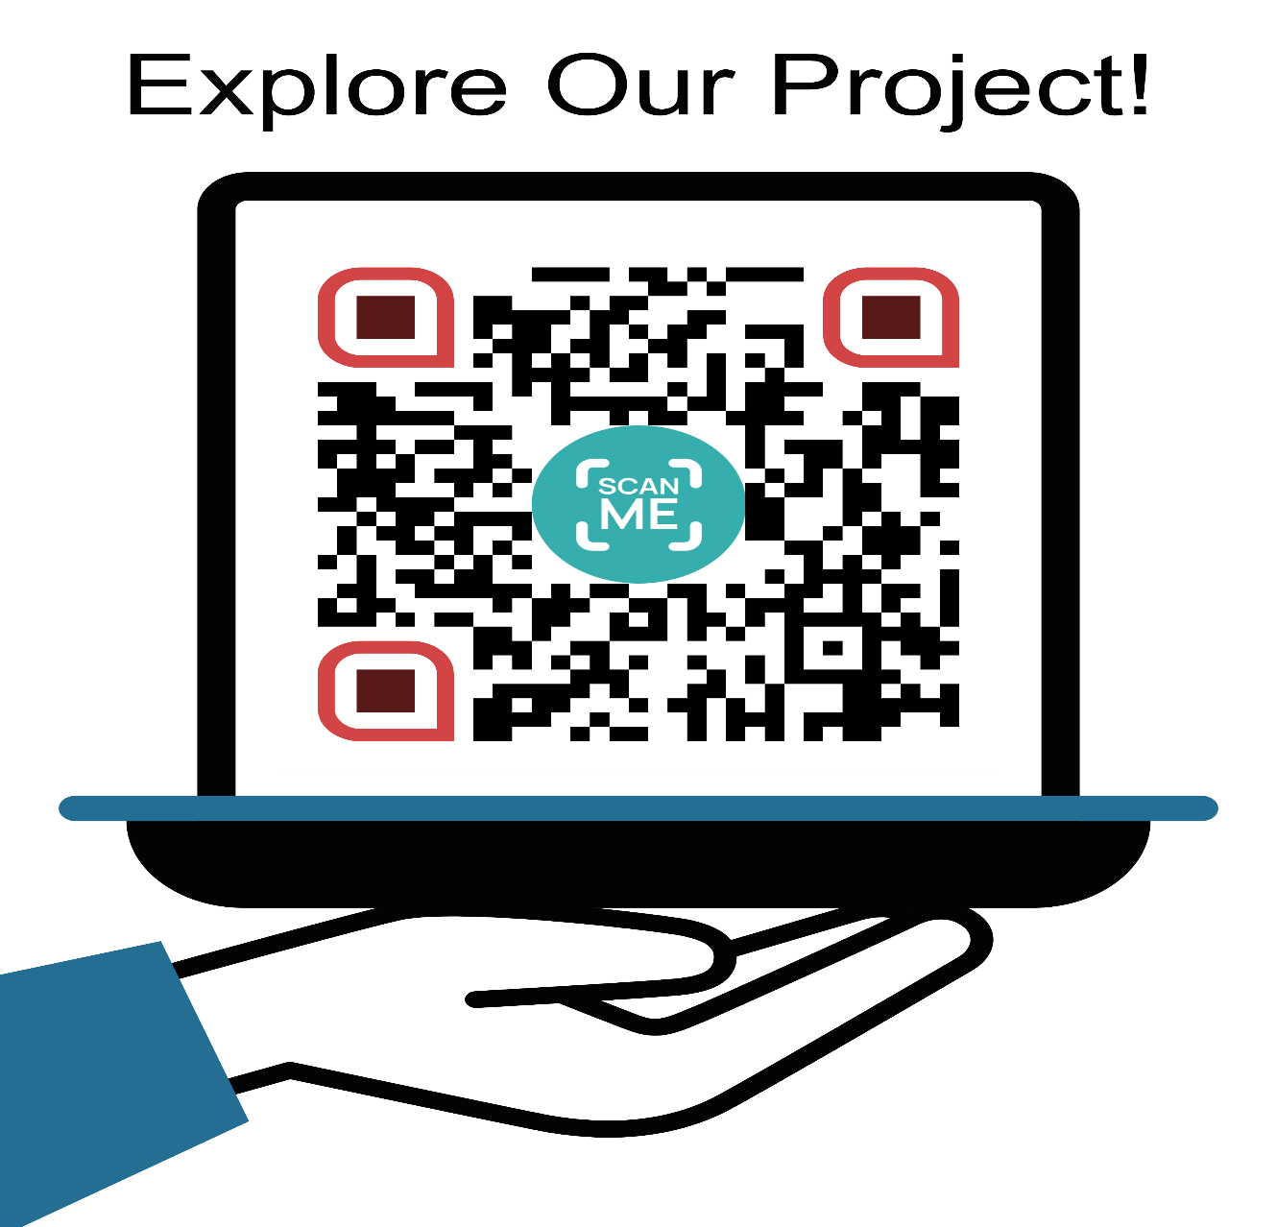
Glove for the deaf to understand and convert it to audible speech
Team Members:
Yahya Mesawa (ME), Naif Aljuaid (ME), Basel Altalhi (EE), Fahad Alsheddi (CS), Abdulrahman Almuteiri (ISE)
Instructor : Dr. Emad Ramadan| TEAM Design department | King Fahd university of Petroleum and Minerals
Elevator Pitch
PROTOTYPE DESIGN
Prototype Explanation
There are 20 million people in the world born deaf. So, for hospitals and non-profit organizations who need to improve their communication with hearing impaired people, the smart glove is a communication enabler that will translate sign language into speech. In contrast to currently developed solutions, the smart glove will allow for two-way communication
Objective of Project
Translate Arabic Sign Language into speech. In contrast, convert audible speech into text.
Engage deaf with the society through using two-way communication
Lightweight, user-friendly, and compatible with devices.
Safe, comfortable, and eco-friendly design.
AI Modeling
Introduction
Deaf individuals often face significant challenges in communicating with those who do not understand sign language. Existing technologies, such as apps and translation devices, often fall short due to limitations in accuracy, comfort, or real-time functionality. This project introduces a smart glove designed to translate Arabic Sign Language into speech, fostering effective two-way communication.
The General Authority for Statistics reported that 1.4% of the Saudi population experiences disabling hearing loss, equating to approximately 289,355 individuals.
In 2018, there are an estimated 466 million people with disabling hearing loss worldwide. 93% of them are adults and 7% children. Among the adults, there are more males (56%) than females (44%) with disabling hearing loss.
Results (Constraints / Specifications )
Constraints:
Durability: Must withstand wear and tear - Yes.
Compatibility: Must work with a range of platforms - No (Prototype only).
Safety: Must ensure user safety - Yes.
Social: Should address societal impact - Yes.
Environmental: Use eco-friendly materials - Yes.
Economic: Be cost-efficient - Yes.
Specifications:
Response Time: Less than 1 second - No (Prototype only).
Accuracy: At least 90% - Yes.
Battery Life: More than 5 hours - Yes.
Power Consumption: Less than 2 W - Yes.
Weight: Less than 450 grams - No (Prototype only).
Dimensions: Specific length, width, thickness - Yes.
Harmonic Distortion: Less than 1% - Yes.
Sound Output: Greater than 60 dB - Yes.
Categories Served
Educational Institutions: Enhances learning for deaf students and supports educators.
Non-Profit Organizations: Empowers outreach programs for the deaf community.
Healthcare: Improves patient-doctor communication in medical settings.
Public Services: Bridges communication gaps in government and service sectors.
Corporate Environments: Fosters inclusivity in workplaces and professional interactions.
Social Events: Promotes accessibility in cultural and community gatherings.
Testing And Validation
COST ESTMITION
The total cost of the project
is 2594.07 SAR
Conclusions
This smart glove is a transformative step in assistive technology, designed to empower the deaf community by enabling effective and independent communication. With its real-time capabilities, ergonomic design, and high accuracy, it represents a significant leap in addressing the needs of Arabic-speaking individuals with hearing impairments. The project underscores the value of multidisciplinary collaboration and innovation in creating impactful solutions.
TEAM 15

